Slide 1
Source Code
#!/usr/bin/perl
# file: serial-monitor-to-binary.pl
# Purpose: Convert serial monitor from arduino into a binary file of 32 bit
# unsigned ints.
use warnings;
no warnings "portable";
use strict;
use File::Slurp;
my $inputFile = read_file('rng-output');
open(my $outputFile, '>:raw', 'rand-stream.bin') or die "Can't open: $!";
#get rid of the newlines
$inputFile =~ s/\n//g;
my @array = ();
push @array, $1 while ($inputFile =~ /(.{1,32})/msxog);
foreach my $elem(@array) {
print $outputFile pack('L',$elem);
}
close($outputFile);
#file: arduino_code.ino
#Purpose: Monitor digital pin and output over serial
#to host.
void setup() {
Serial.begin(9600);
pinMode(2, INPUT);
}
void loop() {
int count = 0;
while(1) {
unsigned int val = digitalRead(2);
Serial.print(val);
count++;
if (count == 80) {
Serial.print("\n");
count = 0;
}
delay(10);
}
}

Slide 2
Preliminary Results
preston@neo:~/ee4390-senior-design-i/src/dieharder-3.31.1/dieharder$
./dieharder -g 201 -a -f ../../rand-stream.bin
#=============================================================================#
# dieharder version 3.31.1 Copyright 2003 Robert G. Brown #
#=============================================================================#
rng_name | filename |rands/second|
file_input_raw| ../../rand-stream.bin| 3.55e+07 |
#=============================================================================#
test_name |ntup| tsamples |psamples| p-value |Assessment
#=============================================================================#
# The file file_input_raw was rewound 288 times
diehard_birthdays| 0| 100| 100|0.00000000| FAILED
# The file file_input_raw was rewound 2373 times
diehard_operm5| 0| 1000000| 100|0.00000000| FAILED
# The file file_input_raw was rewound 5042 times
diehard_rank_32x32| 0| 40000| 100|0.00000000| FAILED
# The file file_input_raw was rewound 6293 times
diehard_rank_6x8| 0| 100000| 100|0.00000000| FAILED
# The file file_input_raw was rewound 6840 times
diehard_bitstream| 0| 2097152| 100|0.00000000| FAILED
# The file file_input_raw was rewound 11213 times
diehard_opso| 0| 2097152| 100|0.00000000| FAILED
AND SO ON. Every test failed because the captured sequence was not long enough.

Slide 3
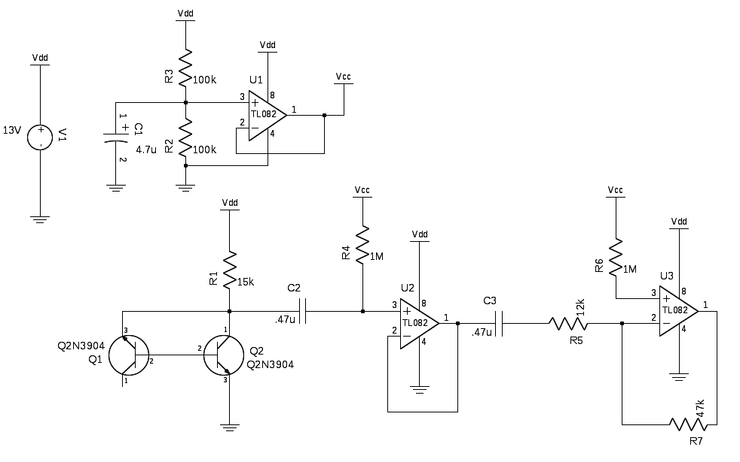
Analog Portion Schematic

