Slide 1


CASE STUDY-4
Air Quality Prediction in Urban Areas

Slide 2
Team
Sr. | Team ID | Name | Role
1 | S4F_CP_Team_12182 | ISWARYA. S | Team Leader
2 | S4F_CP_Team_12182 | VASUKI. V | Team Member 1
3 | S4F_CP_Team_12182 | KARTHIKA. S | Team Member 2
4 | S4F_CP_Team_12182 | KAMALIKA. B | Team Member 3
5 | S4F_CP_Team_12182 | KIRUTHIKA.K | Team Member 4

Slide 3
Content
Abstract
Problem Statement
Objective
Data Collection and Preparation
Proposed Solution (Methodology)
Model Performance Evaluation
Screenshots / Demonstration (video)
Future Scope
Conclusion
Notes:
Abstract
Problem Statement (Clearly define the challenge)
Objective (State your project's goal)
Background and Research (Discuss existing solutions, trends, and gaps)
Data Collection and Preparation (Focus on data sources, cleaning, and augmentation)
Proposed Solution (Methodology)
Model Architecture (e.g., CNN, U-Net, YOLOv5)
Key Techniques (e.g., Transfer Learning, Image Augmentation)
Model Performance Evaluation
Metrics (Accuracy, Precision, Recall, IoU, etc.)
Graphs (Confusion Matrix, ROC Curve, etc.)
Screenshots / Demonstration (Visual proof of system functionality)
Future Scope (Improvements, scalability, and integration ideas)
Conclusion (Summarize results and impact)
Q&A Session

Slide 4
Abstract
Urban air pollution significantly affects human health and environmental conditions.
Traditional air monitoring is limited in coverage and real-time response.
Machine Learning (ML) models can leverage real-time sensor, weather, and traffic data to predict Air Quality Index (AQI).
This study explores AI-based AQI prediction models for a 24-hour lead time, enabling early warnings and informed decision-making.

Slide 5
Problem Statement
Growing Urban Air Pollution:
Increased vehicle emissions, industrial pollutants, and construction dust contribute to high pollution levels.
Challenges in Current Monitoring Systems:
Limited sensor coverage and delayed reports make real-time action difficult.
Manual data collection and weather dependence reduce accuracy.
Need for AI-Based Solutions:
Real-time, scalable, and accurate AI models can help predict air quality trends and issue timely alerts.

Slide 6
Objective
Primary Goal:
Develop a machine learning model to predict AQI 24 hours in advance.
Key Objectives:
Analyze critical pollution factors such as PM2.5, PM10, NO₂, and CO.
Integrate weather and traffic data to improve prediction accuracy.
Provide real-time alerts to public and city officials.
Assist in urban planning by identifying pollution hotspots.

Slide 7
Data Collection and Preparation
Dataset Composition:
Air Quality Data: PM2.5, PM10, NO₂, CO levels (collected over 3 years).
Traffic Data: Vehicle congestion, road density, peak hours.
Weather Data: Temperature, humidity, wind speed, precipitation.
Data Preprocessing Steps:
Handling missing values using interpolation techniques.
Removing outliers (extreme pollution spikes).
Feature scaling to normalize different data types.
Time-series analysis to extract seasonal pollution patterns.

Slide 8
Proposed Solution (Methodology)
Overall Approach:
Collect and clean sensor, traffic, and weather data.
Perform feature selection to identify key variables affecting AQI.
Train ML models (Regression, LSTM, XGBoost) on historical data.
Validate performance using test datasets.
Deploy a real-time AQI prediction system.
Machine Learning Techniques Used:
Regression Models: Simple, interpretable but less effective for time-series.
LSTM (Long Short-Term Memory): Best for time-series AQI forecasting.
XGBoost: Effective for tabular data with complex relationships.

Slide 9
Model Architecture
Best Model Selected:
LSTM (for handling time-series pollution data).
Workflow of Model:
Input Layer: Receives past AQI, weather, and traffic data.
Hidden Layers (LSTM Cells): Captures long-term dependencies.
Output Layer: Predicts AQI for the next 24 hours.
Reason for Choosing LSTM:
Learns long-term patterns in time-series data.
Outperforms traditional models in forecasting accuracy.

Slide 10
Model Performance Evaluation
Evaluation Metrics Used:
Mean Squared Error (MSE): Measures prediction errors.
Root Mean Squared Error (RMSE): Evaluates model performance in actual AQI units.
R² Score: Measures how well the model explains variability in AQI.
Results:
LSTM model showed 15-20% lower prediction errors compared to standard regression models.
High correlation with actual AQI values, making it reliable for real-world deployment.

Slide 11
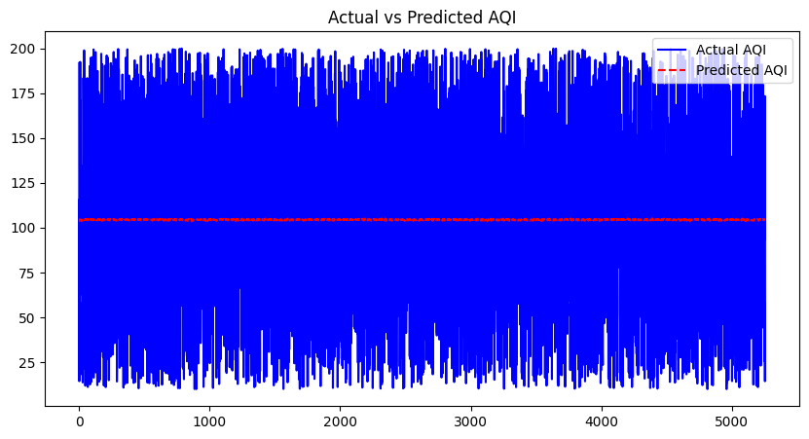
Screenshots / Demonstration (video)
GITHUB LINK : https://github.com/asper131c22ug131csc074/AI-and-GREEN-SKILLS-CASE-STUDY-4

Slide 12
Future Scope
Improving Model Accuracy: Incorporating satellite and IoT-based real-time data.
Expanding to More Cities: Customizing for different geographic and climatic conditions.
Integration with Smart Cities:
Traffic Management: Redirecting vehicles to reduce emissions.
Public Awareness: Recommending travel routes with lower pollution exposure.
Policy Support: Providing insights for city planning and environmental policies.

Slide 13
Conclusion
Key Takeaways:
AI-driven AQI prediction is more accurate, scalable, and real-time than traditional methods.
LSTM-based forecasting models effectively capture pollution trends.
The system can assist policymakers, health agencies, and urban planners in proactive pollution control.
Final Thoughts:
Implementing AI-based air quality prediction can lead to healthier urban environments.

Slide 14
CASE STUDY- 4
QUESTIONS & ANSWER

Slide 15
Questions:
How can machine learning models be used to predict air quality levels?
ML analyzes pollution, weather, and traffic data using models like LSTM and XGBoost to forecast AQI.
ML models analyze historical pollution, weather, and traffic data to find patterns and predict future AQI.
They help forecast pollution 24 hours in advance for early warnings.
2. Which features in the dataset are likely to have the most significant impact on air quality?
~ Main Pollutants: PM2.5, PM10, NO₂, CO.
~ Weather factors: Temperature, humidity, wind speed.
~ Traffic volume & congestion: More vehicles increase emissions.

Slide 16
3. Build a model to predict AQI for the next 24 hours.
~ Clean and prepare the data
~ Train and test an LSTM model using past 24-hour data.
~ Evaluate with RMSE or R²
~ Deploy for real-time predictions.
4. How can this model be integrated with a city's traffic management system to reduce pollution?
~ Smart signals to ease congestion.
~ Vehicle restrictions on high-pollution days.
~ Public alerts via apps.
~ Adjust traffic lights and routes during high AQI
~ Promote public transport

Slide 17
5. Discuss the role of AI in mitigating air pollution in developing countries?
~ Real-time monitoring & alerts.
~ Smart urban planning & low-cost solutions.
~ Predicts pollution spikes early.
~ Helps enforce smart traffic and emission rules.
~ Enables low-cost air quality monitoring.
~ Raises public awareness through apps and alerts.

