Slide 1

Storage Devices: HDD vs SSD, Errors
CompTIA A+ Domain 3.0 – Hardware: Storage Devices & Troubleshooting

Slide 2


Agenda
Activation: Show HDD & SSD examples (10 min)
Demo: Watch video (15 min)
Application: Troubleshoot case studies (20 min)
Brain Break: Quick Draw (5 min)
Integration: Group share (20 min)
Formative: Worksheet (15 min)
Exit Ticket (5 min)

Slide 3


Activation (10 min)
Hands-On Exploration:
Pass around HDD and SSD examples
Discussion Prompt: 'What differences do you notice physically?

Slide 4

Demo (15 min)
Video: HDD vs SSD
WatcH Video and complete Guided Notes provided

Slide 5

Application (20 min)
Case Study: Storage Failures
Work in groups of 3
Case Studies:
SMART error on boot
Boot device not found
Clicking HDD noise
RAID array degraded
Slow SSD performance
Use the Troubleshooting Flow Worksheet

Slide 6
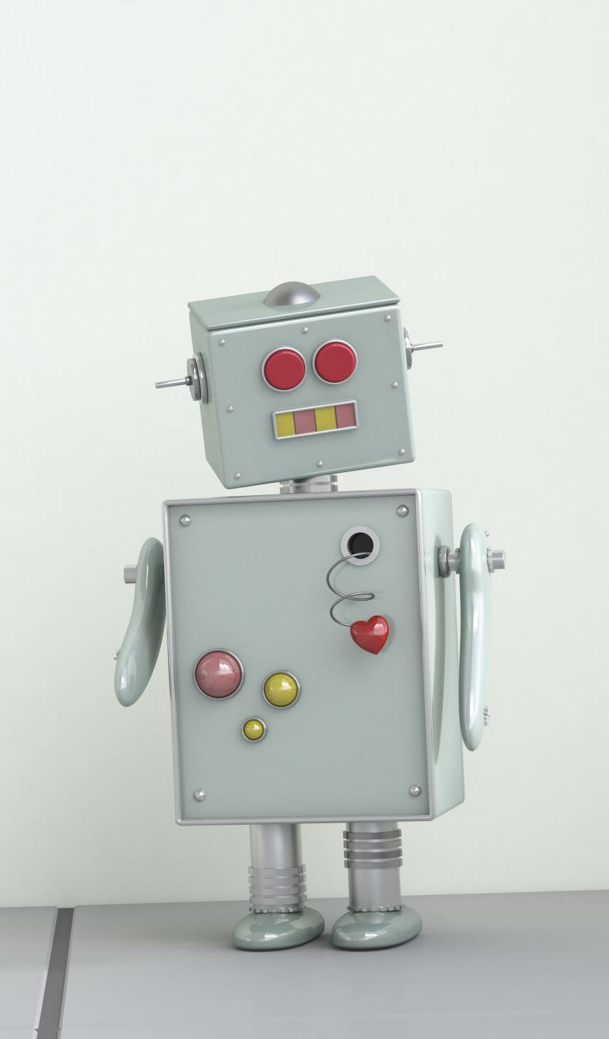

Brain Break (5 min)
Quick Draw Challenge:
Draw a robot trying to carry a hard drive (2 minutes).
Share a few drawings.

Slide 7

Integration (20 min)
Group Sharing:
Each group explains their troubleshooting path

Slide 8
Exit Ticket (5 min)
Complete in Google classroom

