Slide 1
Networking Hardware
Routers, Switches, and Cabling

Slide 2
Agenda
Activation: Show device photos (10 min)
Demonstration: Video & guided notes (20 min)
Brain Break: Pictionary (10 min)
Application: Hardware worksheet & VM activity (25 min)
Integration: Discussion (15 min)
Summative: Quiz (10 min)

Slide 3

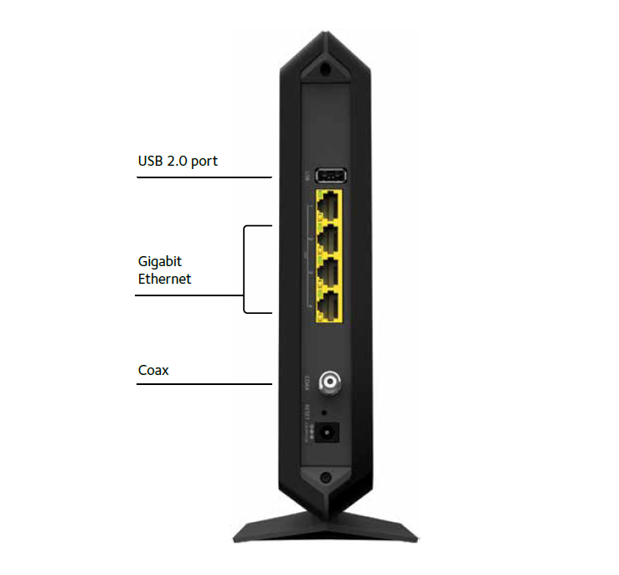
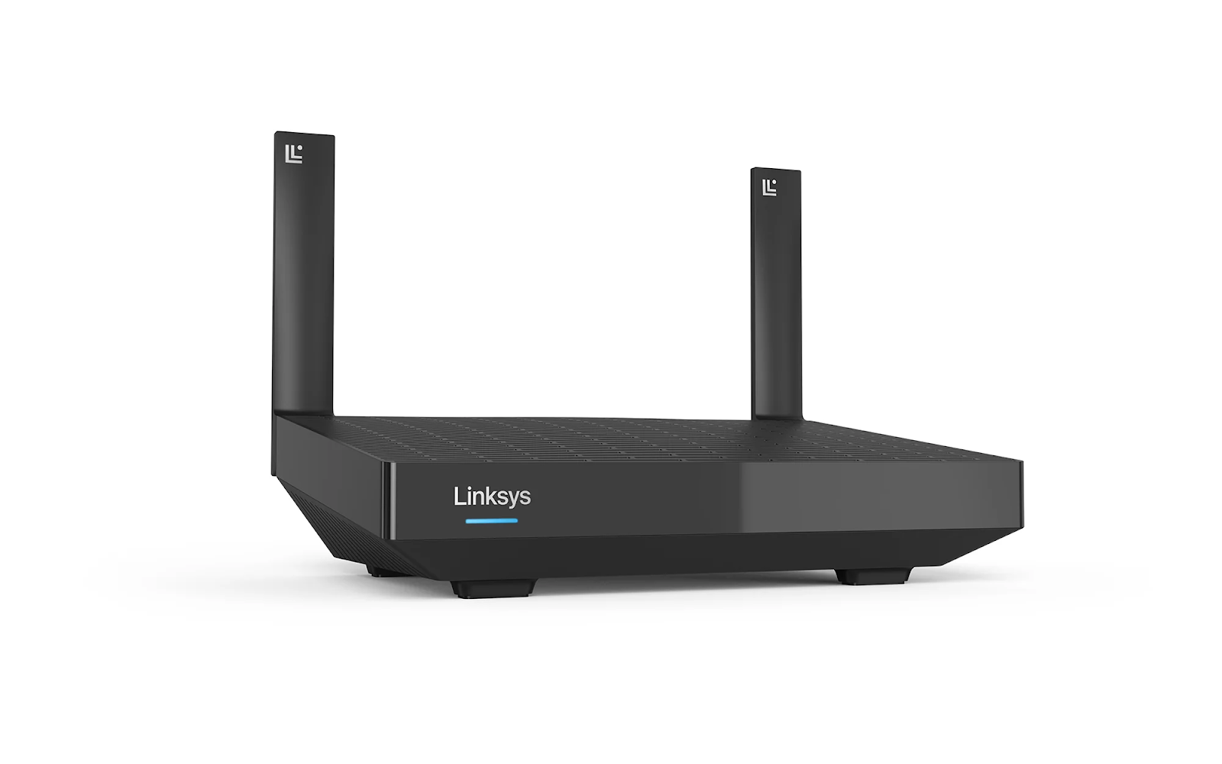
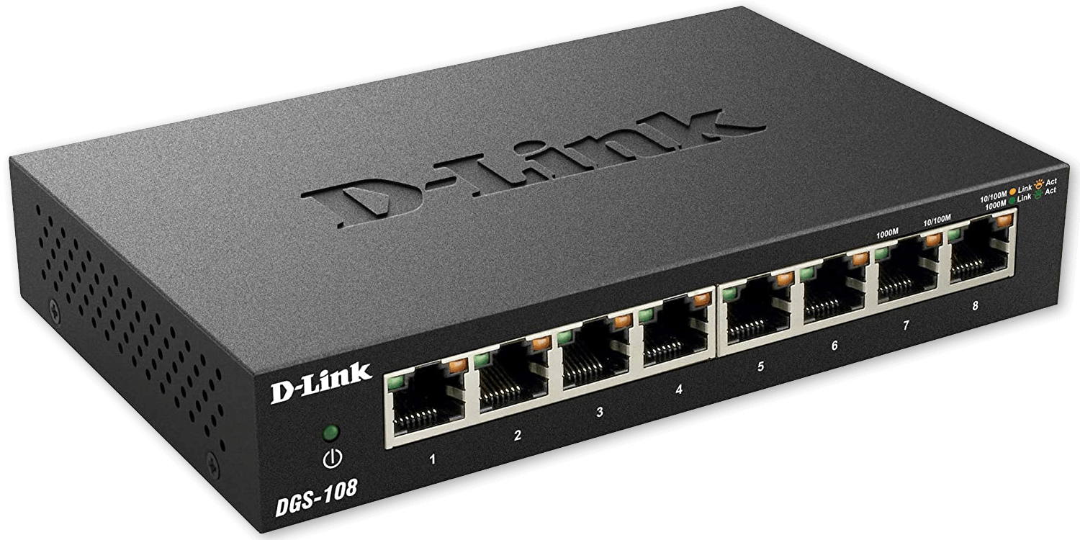
Activation: Device Photos
Quick discussion: Which of these have you seen at home or school?

Slide 4
Device: Router
Identify its function in the network

Slide 5
Device: Switch
Identify its function in the network

Slide 6
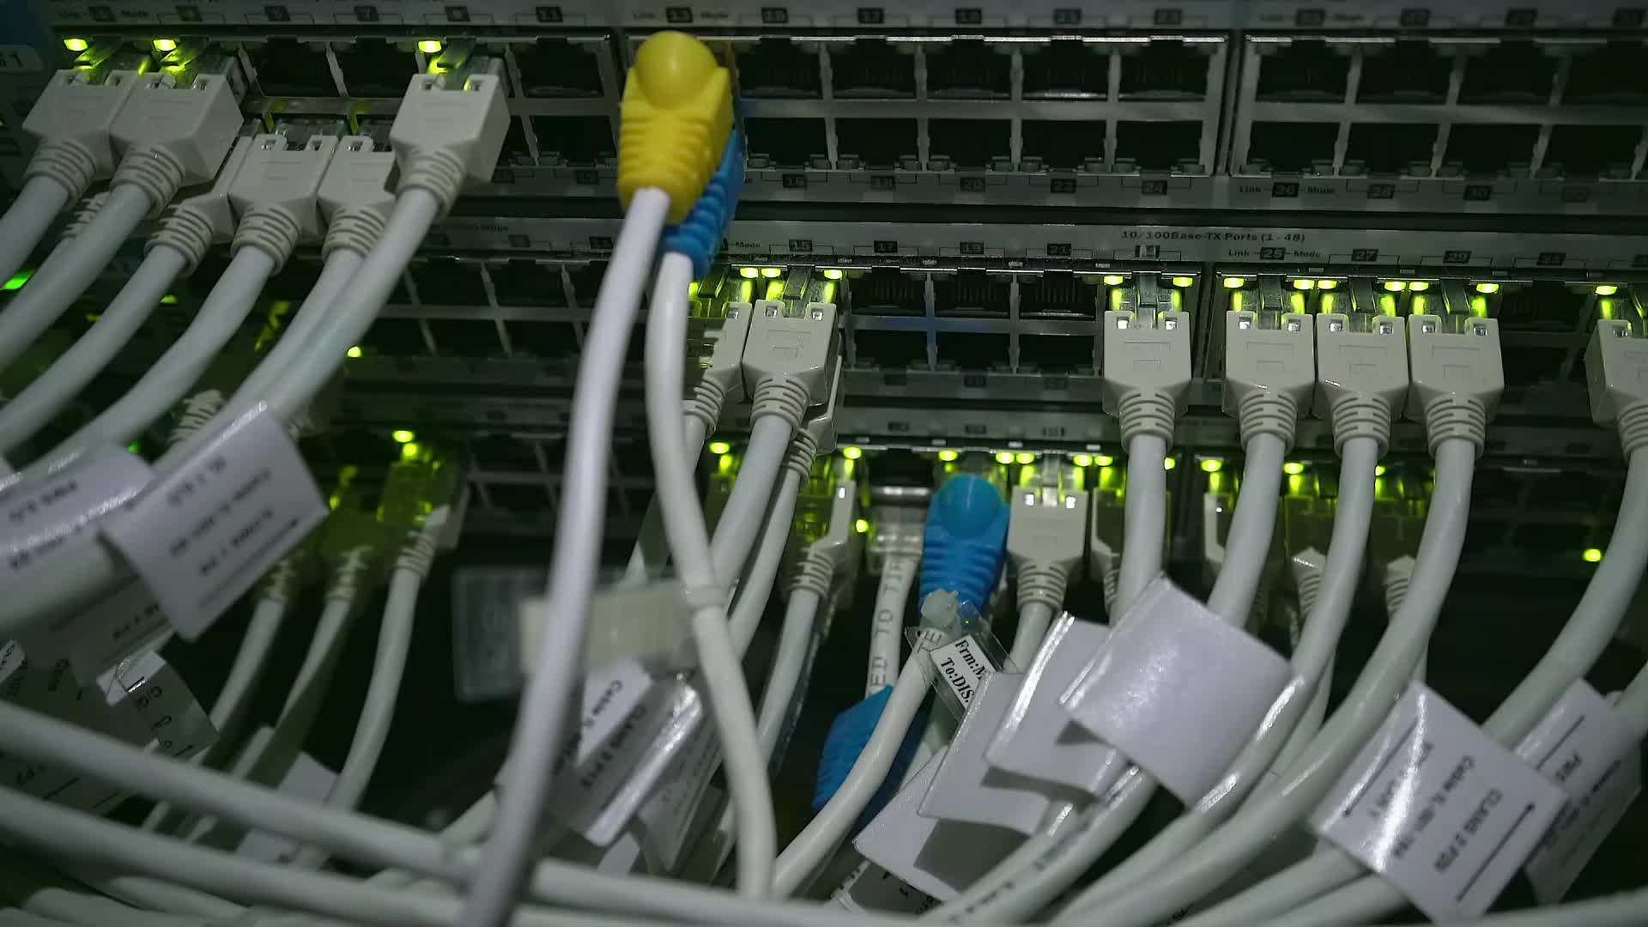
Device: Ethernet Cable
Identify its function in the network

Slide 7

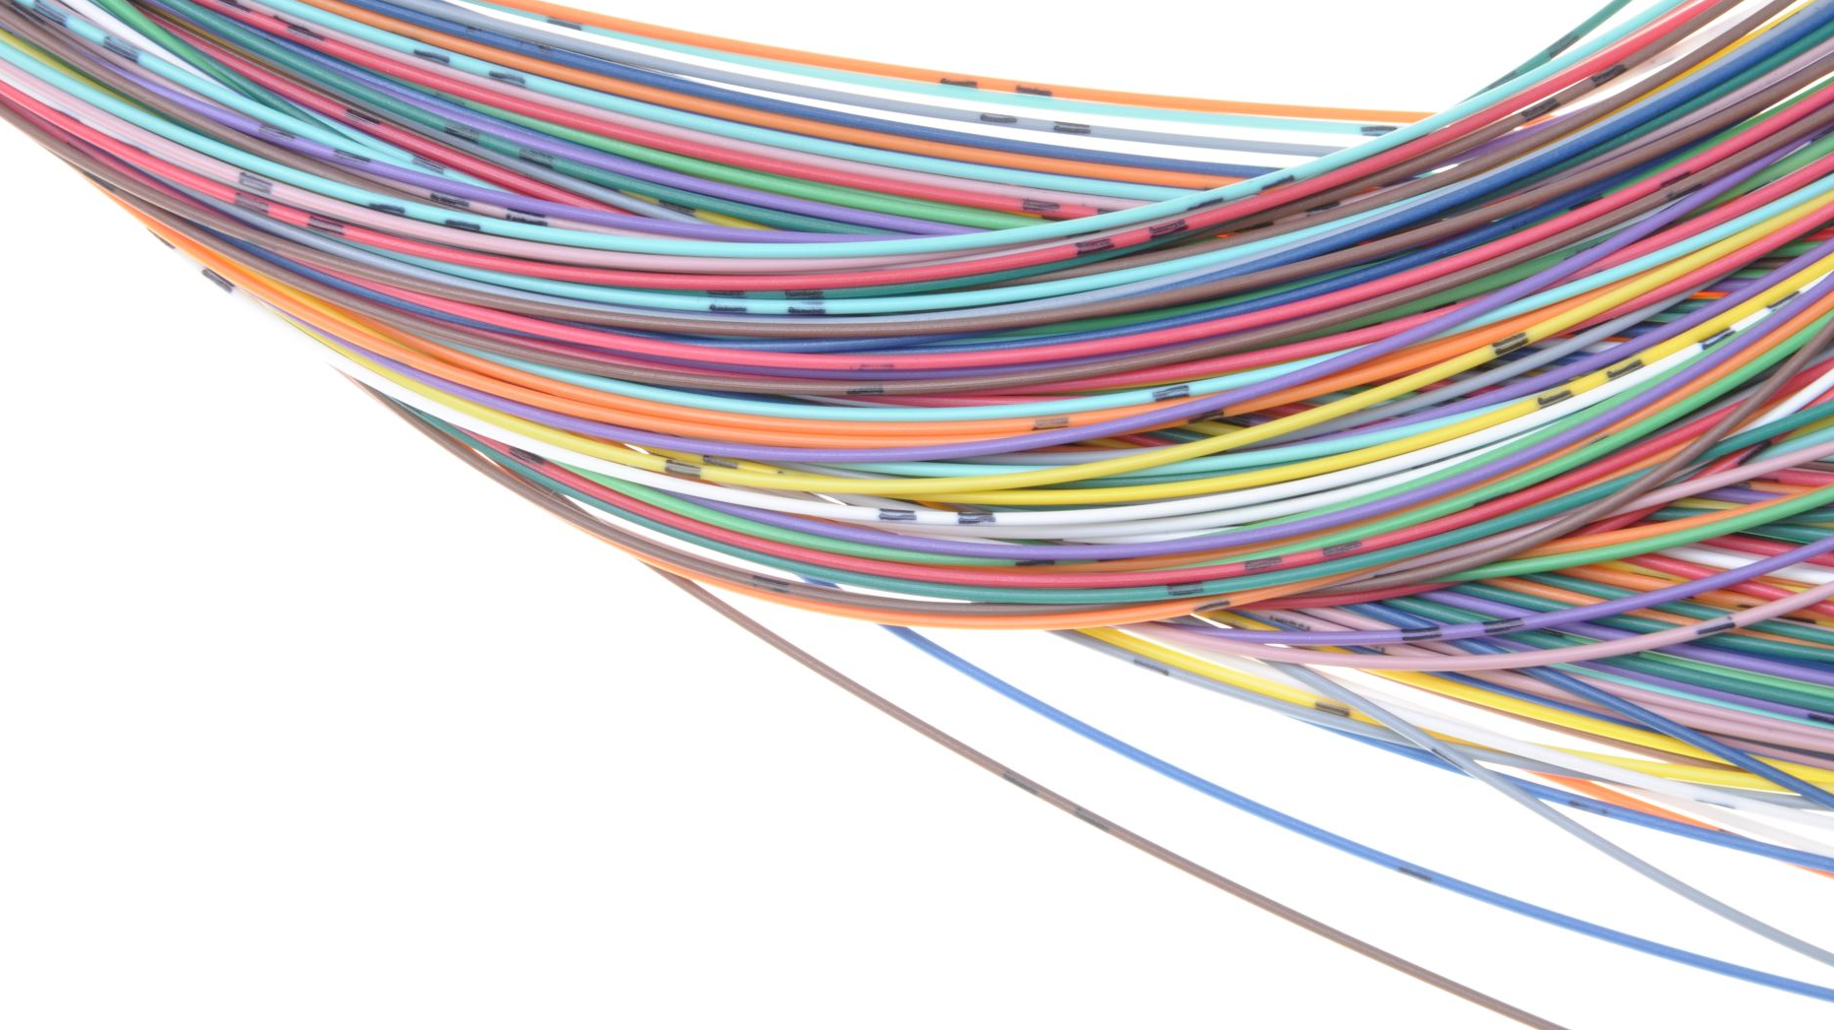
Device: Fiber Cable
Identify its function in the network

Slide 8
Device: Patch Panel
Identify its function in the network

Slide 9

Demonstration: Video
Watch video on networking hardware (20 min)
Complete guided notes during the video

Slide 10

Brain Break: Pictionary
Groups of Three
Students rotate as drawers
Instructor will tell the drawers the device to draw
10 minutes

Slide 11
Round 1: Router

Slide 12
Round 2: Switch

Slide 13
Round 3: Ethernet Cable

Slide 14
Round 4: Fiber Cable

Slide 15
Round 5: Patch Panel

Slide 16
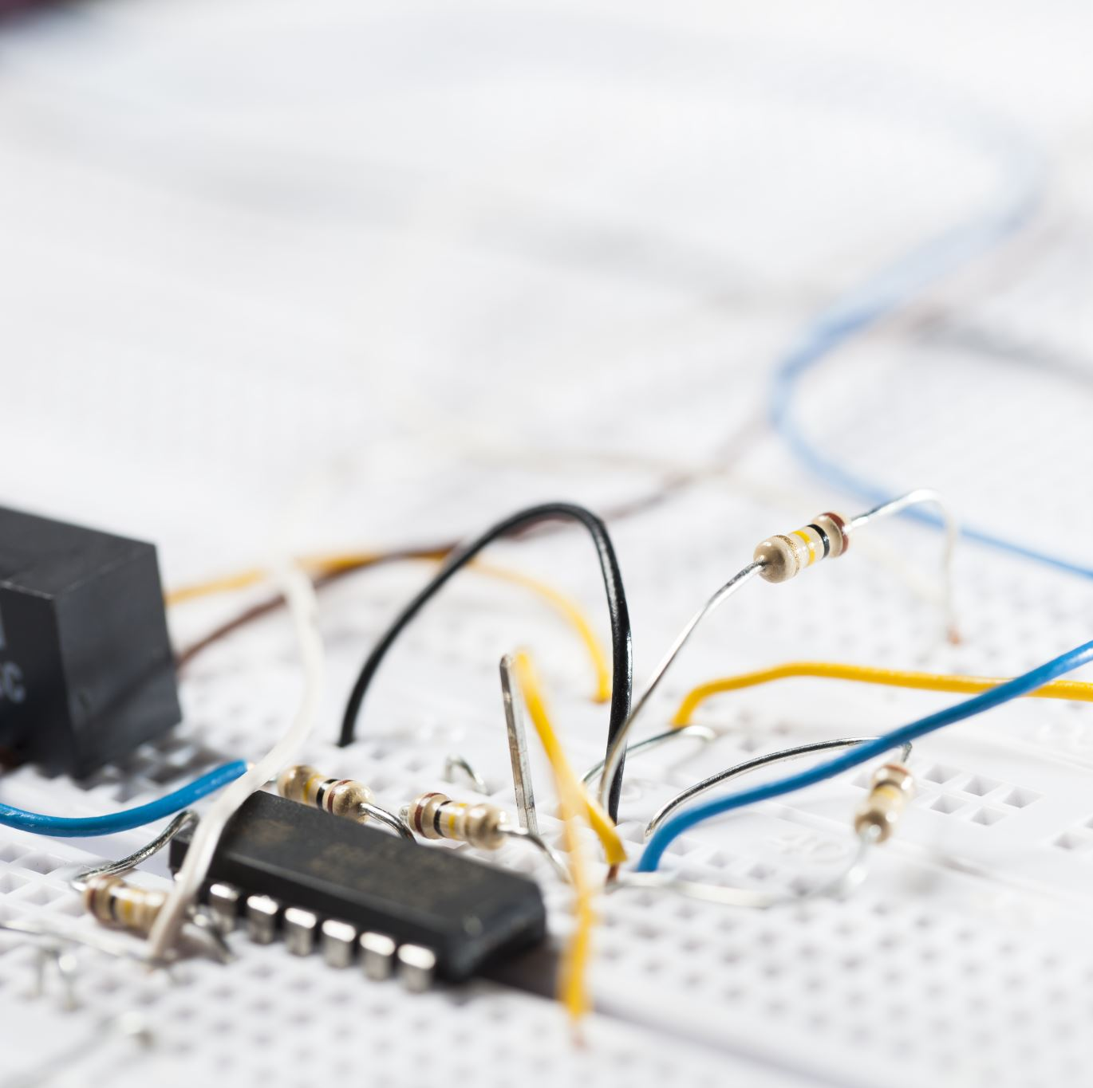
Lab
Identify functions of routers and switches
Match ports and cables to diagrams
VM Task: Use ipconfig/ping to test connectivity
Hands-on (if available): Cable tester demonstration

Slide 17
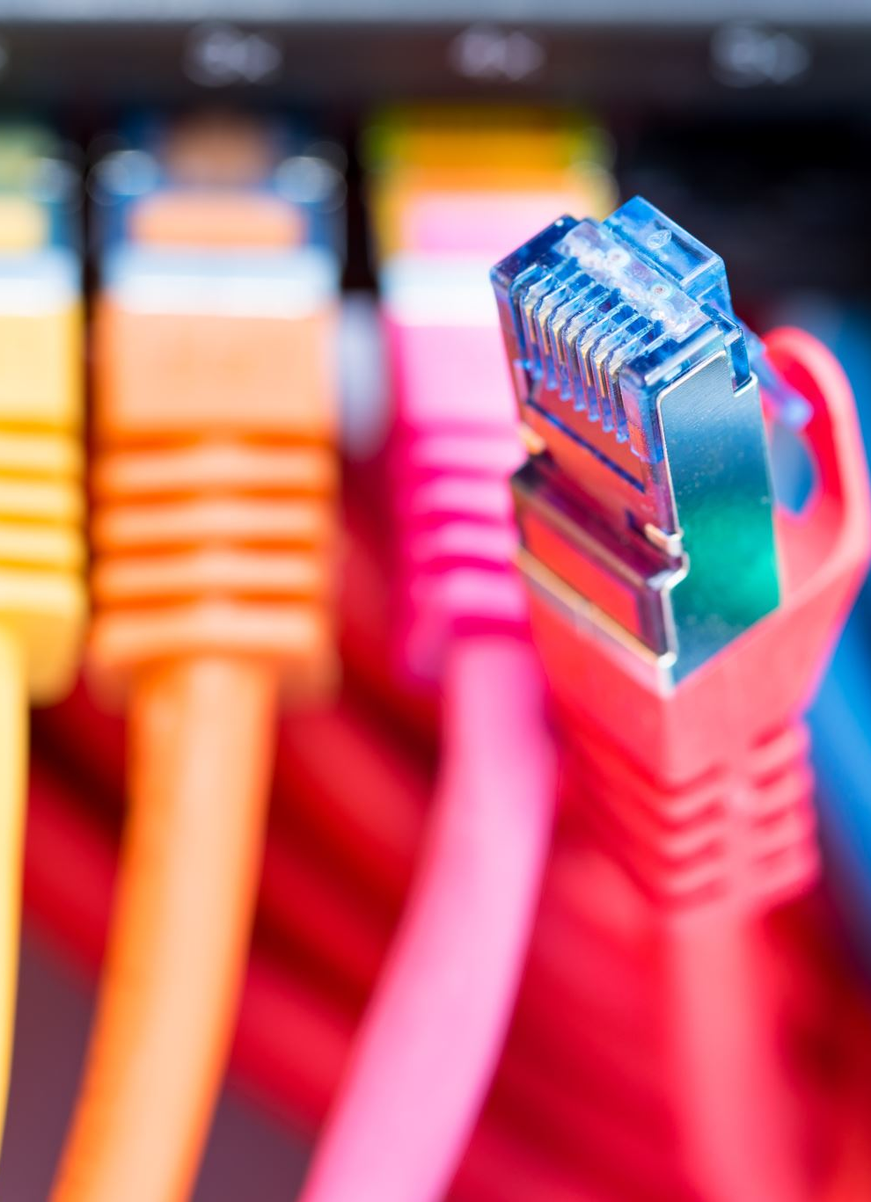
Integration: Discussion
What issues arise from wrong cable types?
How do routers and switches complement each other?

Slide 18

Summative: Quiz
10 min quiz (A+ style questions)
Multiple-choice, multiple-select, one-word short answers

