Slide 1


Frozen Systems & BSODs
App freezes & Blue Screens
100-Minute Lesson Plan

Slide 2

Agenda with Timings
1. Activation (Engage) – 10 min
2. Demo (Video + Discussion) – 15 min
3. Application (Practice on VM) – 25 min
4. Brain Break (Riddles + Phones/Snacks) – 10 min
5. Integration (Group Discussion) – 15 min
6. Formative (Mini-Quiz) – 10 min
7. Wrap-Up & Review – 15 min

Slide 3

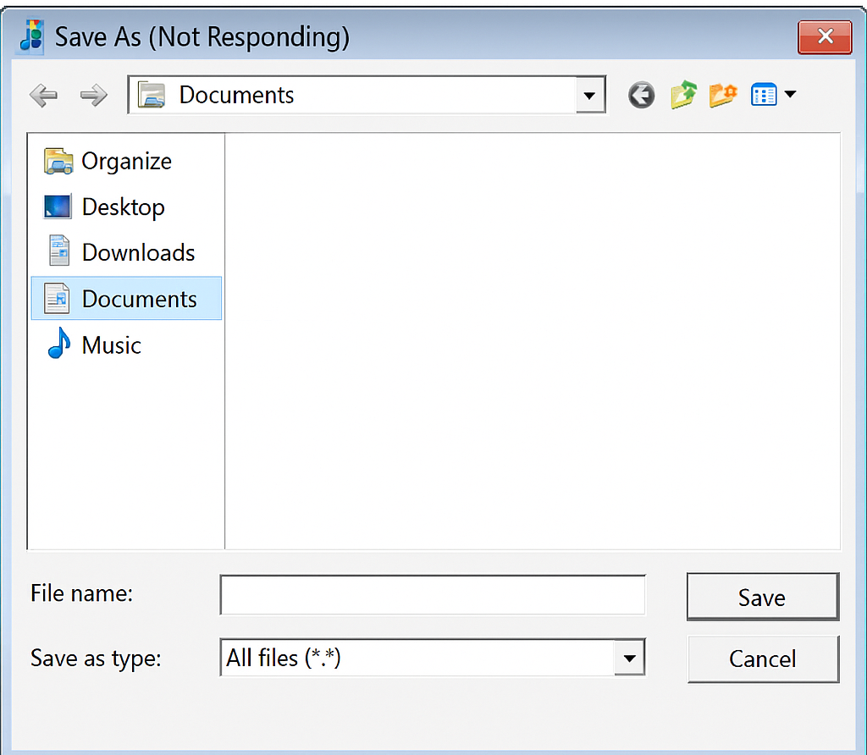

Activation (10 min)
What would you try first?

Slide 4

Demonstration (20 min)
Watch demonstration video in Google Classroom
Complete Guided Notes

Slide 5

Application (15 min)
Diagnose BSOD on Windows 7 VM
Identify error code & research meaning

Slide 6
Brain Break (10 min)
Riddle 1: You have a dozen eggs. You break two, you cook two, and you eat two. How many eggs do you have left?
Riddle 2: I’m tall when I’m young, and I’m short when I’m old. What am I?
Answer: 10 (you still have the rest—you only used 2 eggs).
Answer: A candle.

Slide 7
Integration (15 min)
• How do freezes and BSODs affect workplaces?
• Encourage sharing real experiences
• Timer: 15 minutes
YouTube Timer: https://www.youtube.com/watch?v=u_BcMXgws6Y

Slide 8
Formative Assessment (10 min)
• Students complete quiz in Google Classroom
• 5 Questions: BSOD causes, freezes, Task Manager, tools
• Timer: 10 minutes
YouTube Timer: https://www.youtube.com/watch?v=geyBSrgLazE

Slide 9
Wrap-Up (15 min)
• Go over quiz answers
• Reinforce key takeaways:
– Freezes → Task Manager first
– BSOD = hardware/software critical error
– Tools: Event Viewer, WinDbg
• Timer: 15 minutes
YouTube Timer: https://www.youtube.com/watch?v=u_BcMXgws6Y

