Slide 1
Boot Failures & Hardware
Focus: Power, POST, beep codes, and Windows Recovery tools

Slide 2
Agenda Overview
Activation: Scenario prompt
Demonstration: Power/POST, Beep Codes, WinRE tools
Application: Group triage flowchart activity
Integration: Share findings & discussion
Exit Ticket

Slide 3


Engage (10 minutes)
Scenario: 'A computer powers on, fans spin, but no display appears.'
Turn & Talk: What could cause this?
List 2 possible first steps.
Share out

Slide 4

Demonstration: Power & POST
Watch Video and complete Guided notes
Check PSU cord/switch
POST = Power-On Self-Test, verifies CPU, RAM, GPU
Failures produce beep/error codes

Slide 5

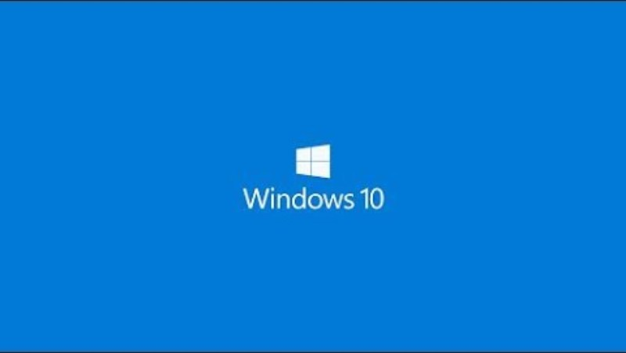



Brain Break
🧍 Stand, stretch, and reset!
Mini challenge: 'Name that beep’
Start the time
Play each sound
First to raise hand answers
Notes:
Start the timer, play the beeps
If this goes quickly, have them search youtube for more codes

Slide 6
Demonstration: Windows Recovery (WinRE)
Startup Repair → automatic fix
Safe Mode → minimal driver boot
Command Prompt → bootrec, SFC, CHKDSK
Video: https://www.youtube.com/watch?v=CK8pT64mFj0&t=420s

Slide 7
Practice
Groups: Diagnose 3 symptom cards
No POST
Beep pattern
Automatic Repair Loop
Map First Safe Step → Tool → Next Decision

Slide 8
Integration (Share)
Stand-Up Debrief:
One mistake to avoid
One best practice to start with

Slide 9
Exit Ticket
Quick 3 Questions: Complete in Google Classroom

