Slide 1

Networking Basics
LAN/WAN, IP addressing, Subnetting, Protocols
Engagement: How many devices are connected at home?

Slide 2

Agenda
LAN vs. WAN concepts
IP addressing & subnetting basics
Common networking protocols
Lab: Assign & test IP configs
Brain Break

Slide 3
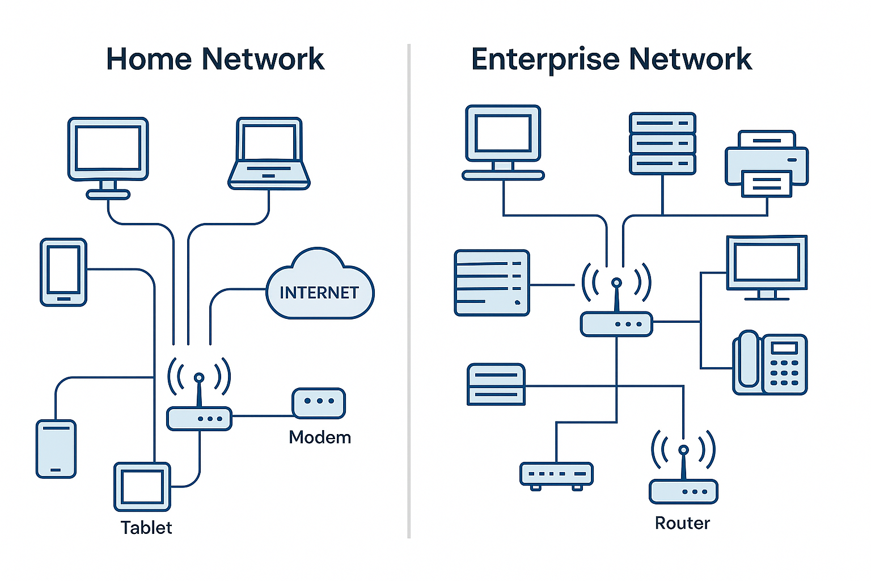
Activation (10 min)
Prompt: How does your home connect to the Internet?
Compare wired vs wireless
Visual: Home vs Enterprise Network

Slide 4

Video Demonstration (15 min)
Guided Notes:
Define LAN/WAN
What is an IP address?
Why subnetting?
Common protocols

Slide 5

Brain Break (10 min)
Game: Guess the Song
Play 10-second clips of popular songs
Students guess title/artist

Slide 6

Application Lab (30 min)
Work in pairs:
Part 1: Identify scenarios as LAN or WAN
Part 2: Assign IP addresses to 3 VMs
Part 3: Use 'ping' to test connectivity
Deliverable: Worksheet + Screenshots

Slide 7
Integration & Share (10 min)
Groups share LAN/WAN scenario answers
Debrief: What did you notice about how devices communicate?

Slide 8
Exit Ticket (10 min)
Difference between LAN & WAN?
Protocol for sending emails?
Command to test connectivity?

