Slide 1

Pseudo Code & Troubleshooting Challenge
Team Logic Challenge

Slide 2
What We’re Doing

Slide 3
Overview
Work in teams to break real-world problems into clear steps
Programming students write pseudo code
Hardware students write troubleshooting steps
Fast paced logical thinking challenge

Slide 4
Team Expectations

Slide 5
Expectations
Teams of 3 to 4
Everyone participates
Listen before writing answers
One records, one presents, all contribute
Respect teammates

Slide 6
How It Works

Slide 7
Process
Each round gives a new scenario
Programming teams write pseudo code
Hardware teams write troubleshooting steps
You may stand or use whiteboards
Call out DONE when finished

Slide 8
How You Earn Points

Slide 9
Scoring
Speed: First team done earns a point
Clear Thinking: Logical steps earn 2 points
Teamwork: Everyone contributes earns 1 point
Fast is good. Clear thinking is better.

Slide 10
Examples

Slide 11
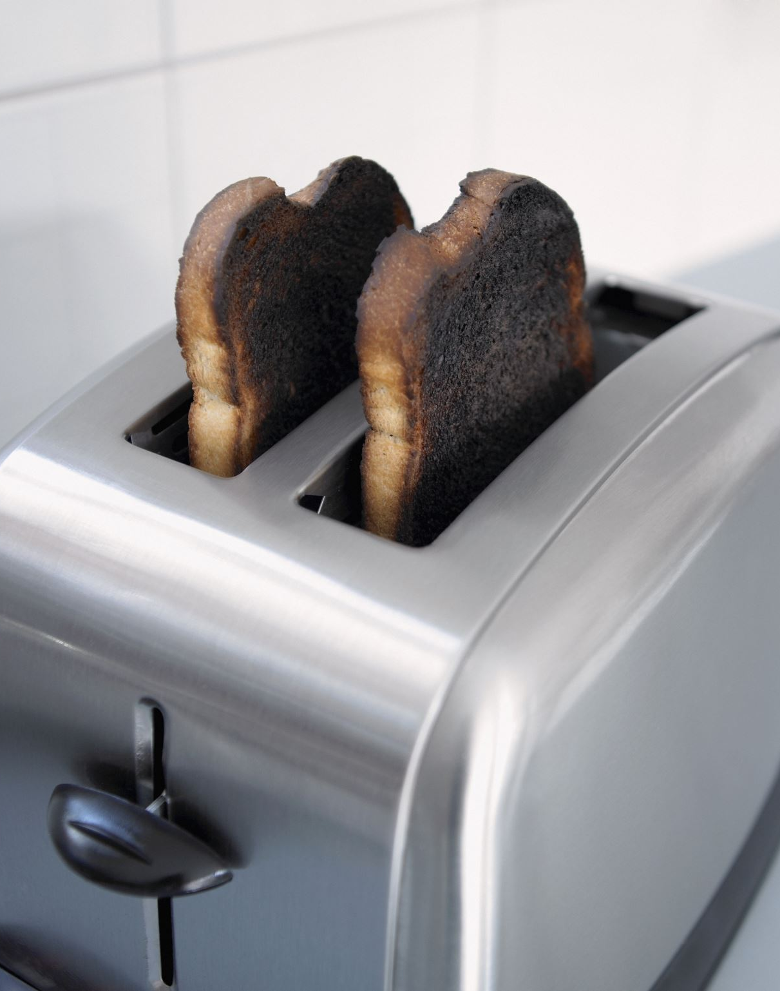
Programming Example – Making Toast
Get bread
Put bread in toaster
Press toast button
Remove toast when finished

Slide 12
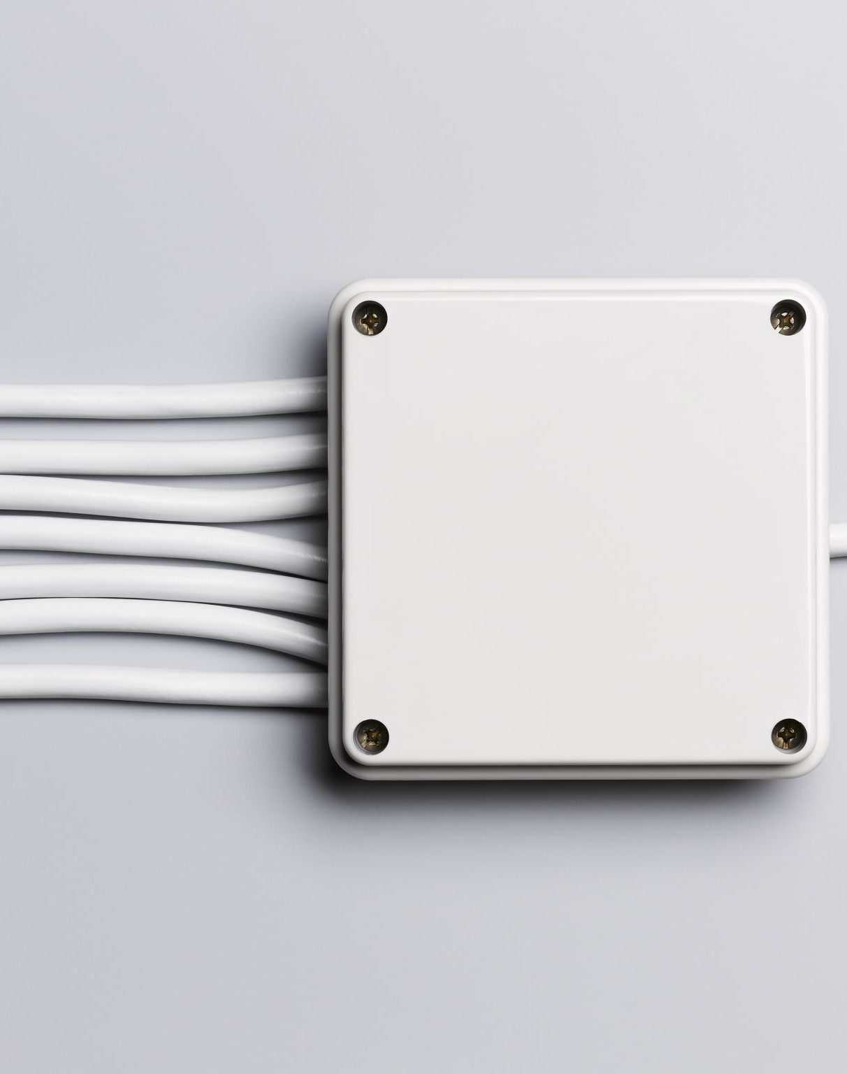
Hardware Example – PC Will Not Power On
Check power cable
Test wall outlet
Inspect power supply
Check motherboard connections

Slide 13
Work Together

Slide 14
Collaboration
Different experiences create stronger teams
Make space for every voice
Use clear language
Ask questions

Slide 15
After Each Round

Slide 16
Reflection
Share team solutions
01
Discuss what worked
02
Compare approaches
03

Slide 17

Goal

Slide 18
By the End
Break problems into logical steps
Think like a programmer or technician
Work as a team
Explain reasoning clearly

Slide 19
Rounds

Slide 20


Round 1
Programming Task: Prepare a fruit salad
Hardware Task: Phone will not charge

Slide 21

Round 2
Programming Task: Send an email message
Hardware Task: Wi-Fi issue

Slide 22
Round 3
Programming Task: Morning routine steps
Hardware Task: Printer not working

Slide 23

Round 4
Programming Task: Find a library resource
Hardware Task: Laptop won’t connect to projector

Slide 24
Round 5
Programming Task: Create a social media profile
Hardware Task: Keyboard not responding

