Slide 1

Your phone plan
for finals
One study block. Then the next.
Swing
The fun way to scroll less.
Notes:
First-party student planning resource by Aspire, makers of Swing. Suggestions are optional, not evidence of improved grades or health. Product identity: https://swing.so/ . Icon: https://swing.so/apple-touch-icon.png?v=4 . Observed October 26, 2026.

Slide 2
Your first study block
One task
“Finish question 3” beats
“fix my entire life.”
Choose your break time. Put the phone
out of reach if you can.
Notes:
Editorial planning suggestions, not measured product efficacy or medical advice. No claim that this method causes better grades, focus or reduced screen time.

Slide 3
Swing setup
iPhone. iOS 18 or later.
1. Allow Apple’s Screen Time permission.
2. Pick your distracting apps in Rotblock.
3. Finish setup.
swing.so/how-it-works/
Notes:
Product setup verified from live https://swing.so/how-it-works/ and https://swing.so/block-instagram-on-iphone/ on October 26, 2026. iOS minimum checked against https://itunes.apple.com/lookup?id=6741825562&country=us . Swing supports whole-app protection, not selective Instagram Reels-only blocking.

Slide 4
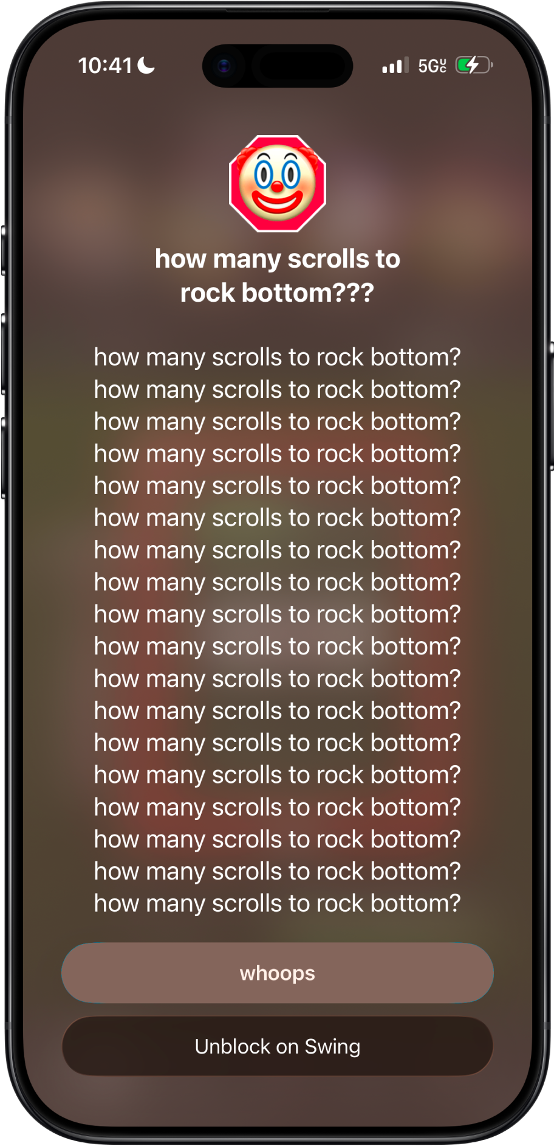
The interruption
Blocking active?
Try opening a selected app
outside an unblock window.
Get trolled when you scroll.
Notes:
Actual existing product screenshot, not a newly produced demo. Source: https://swing.so/assets/swing-rock-bottom-block.png . Setup/test behavior: https://swing.so/block-instagram-on-iphone/ . Example copy varies. No claim that the screenshot is a recorded impression for a specific user or the current installed build.

Slide 5
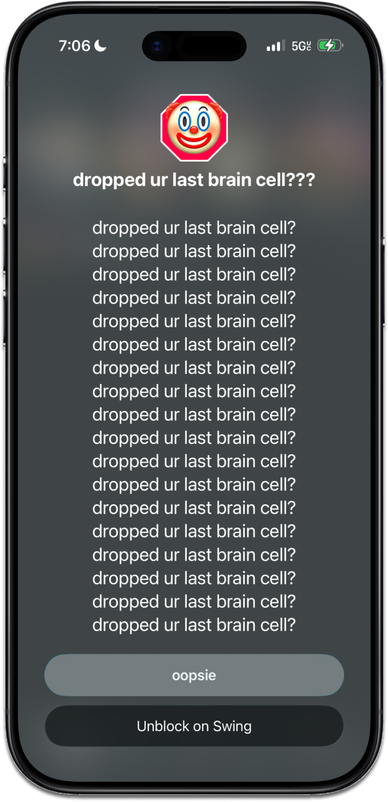
A quick reply
Open Swing. Choose an
unblock window. Send the reply.
Your group chat does not need
a 47-Reel sequel.
Swing blocks the whole app. You can unblock.
It cannot keep DMs open while blocking Reels.
Notes:
Actual existing screenshot: https://swing.so/assets/swing-ios-block-screen.png . Whole-app limitation, user-controlled unblock windows and setup verified from https://swing.so/block-instagram-on-iphone/ on October 26, 2026. Do not call this an unbreakable lock. Instagram, account and messages remain installed/intact according to the first-party guide.

Slide 6
Your seven-day check
Same apps. Same device.
Record each completed day in the tracker.
Compare with the previous full week.
Keep what actually helps you.
A personal comparison cannot prove what caused a change.
By Aspire, makers of Swing. swing.so
Notes:
Companion workbook: 7-day-scroll-reset.xlsx. Users manually enter their own same-scope screen time and previous seven-day average. Missing data is not zero. No grades, health or causal-effect claim. Apple report guide: https://support.apple.com/guide/iphone/iphbfa595995/ios . Public status: private draft, not published to Gamma or any distribution platform.

