Slide 1
Spring & Security
2021년 2월 15일

Slide 2
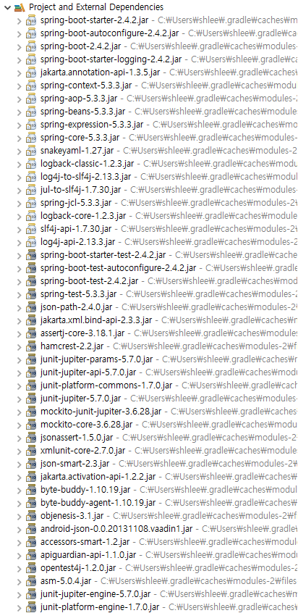
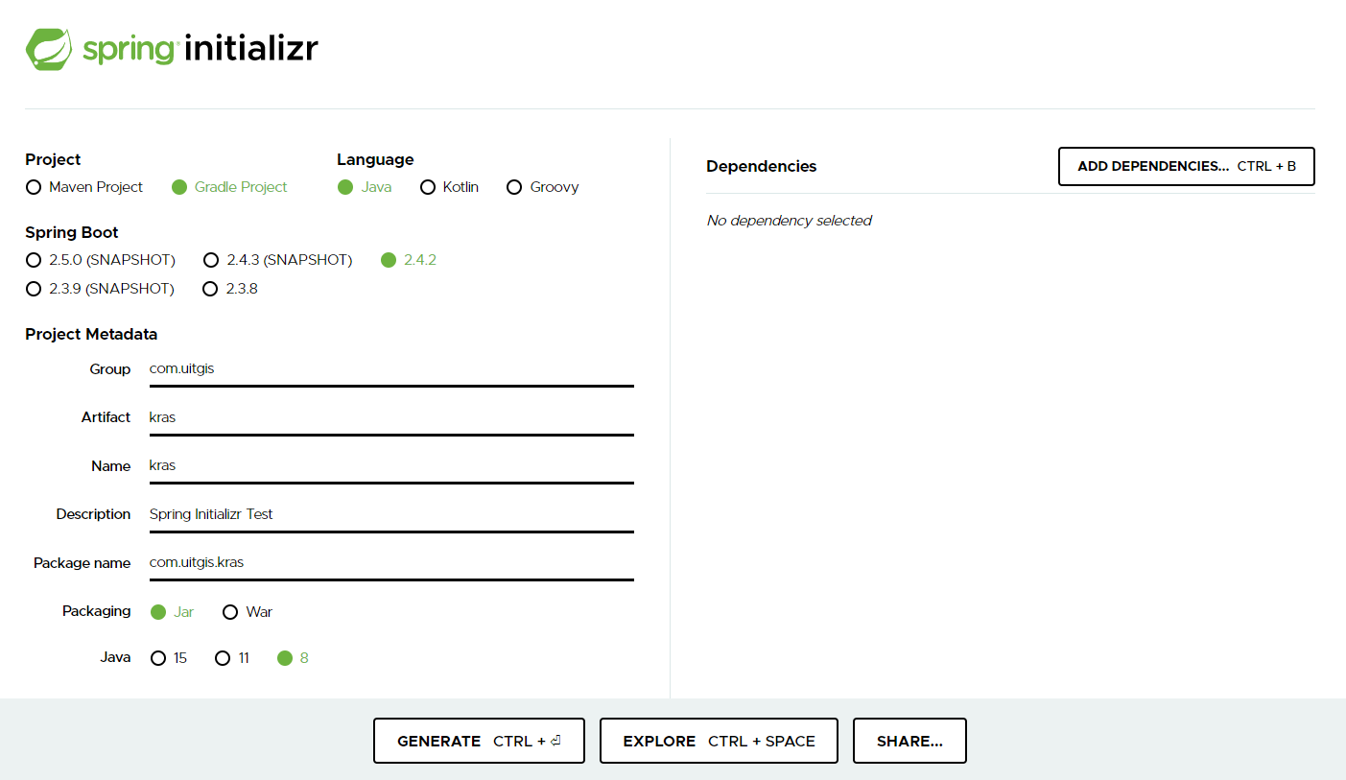
Spring Project Init
Spring Initialize

Slide 3
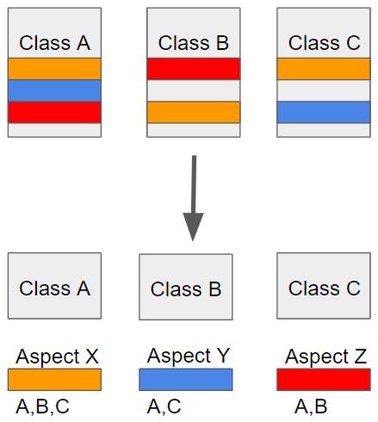
2. AOP
Aspect Oriented Programming
Aspect
Jointpoint
- before
- after
- after return
- after throwing
- around
Execution
- execution
* com.uitgis.kras..*Controller.*(..)
- @annotation

Slide 4
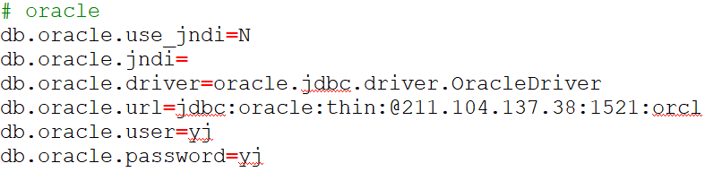
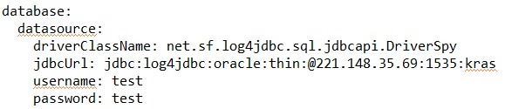
3. Why application.yml?
가독성 & Validate

Slide 5
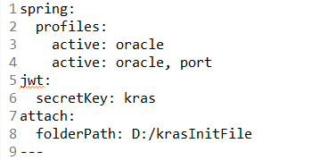
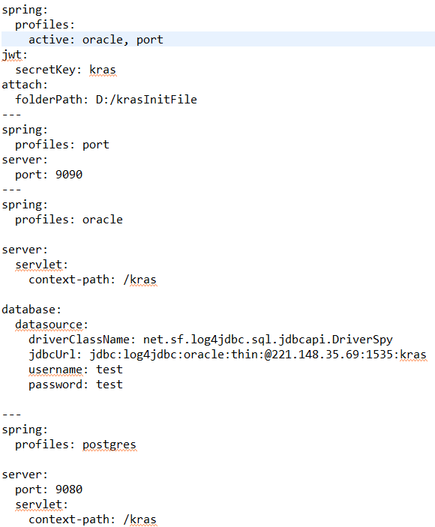
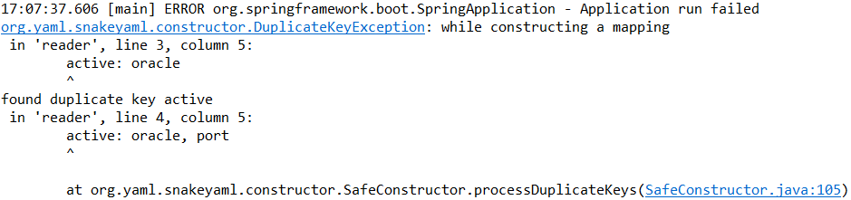
3. Why application.yml?
Profile

Slide 6
4. REST API
Representational State Transfer
Request
Response
URI Naming
- kras/users/{kras2}/device/photo
HTTP Method
- GET, POST, PUT, DELETE
HttpStatus
- OK(200), BAD_REQUEST(400) 등
- less INTERNAL_SERVER_ERROR(500)
ResponseEntity

Slide 7
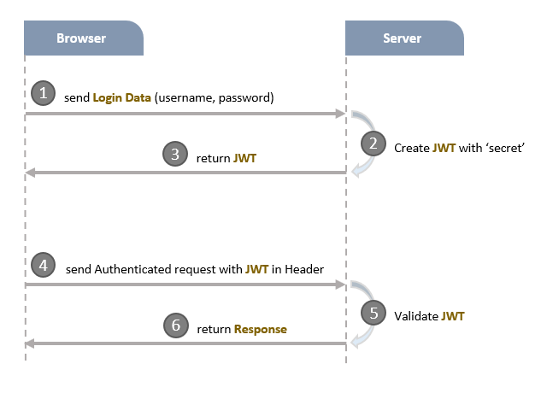
5. JWT
Request & Response
Create Token
Validate Token
Get Authentication By Token

Slide 8
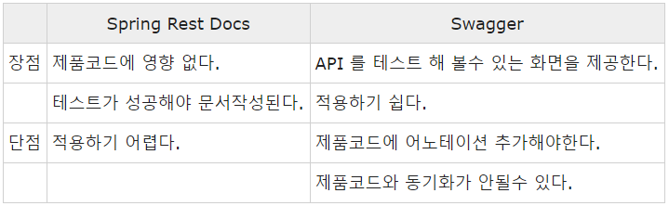
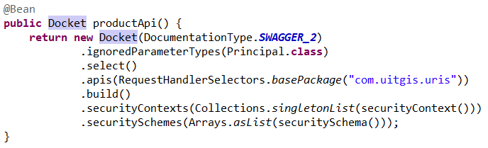
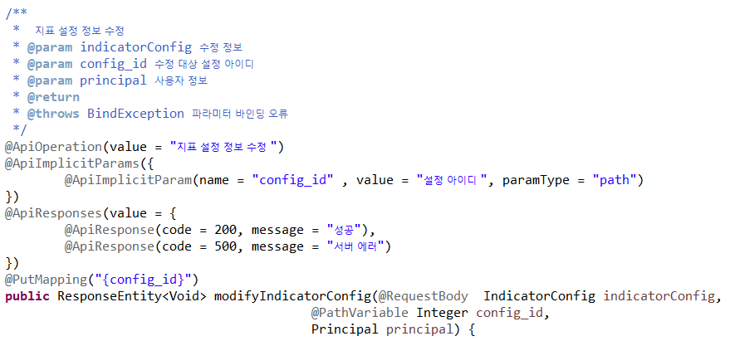
6. REST Docs
REST Docs VS Swagger

Slide 9
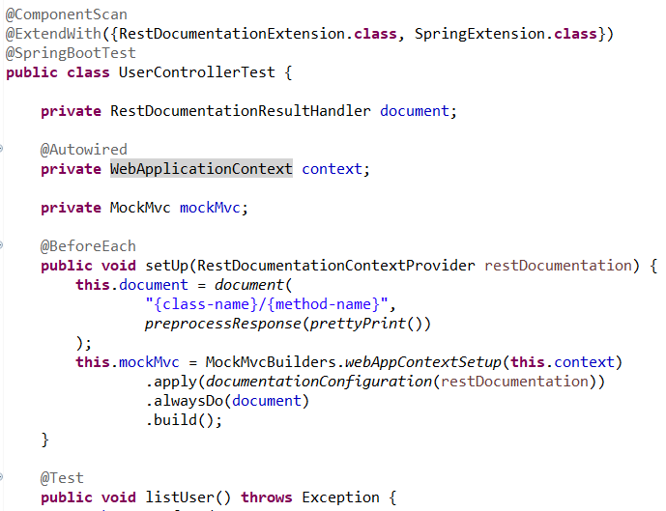
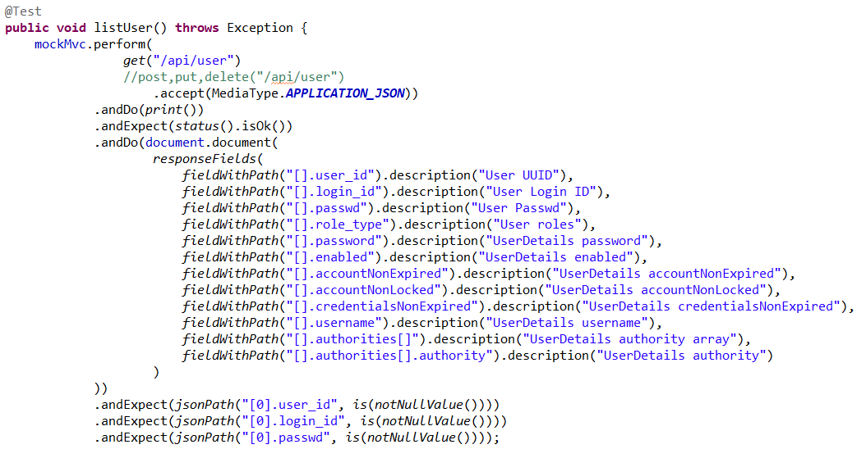
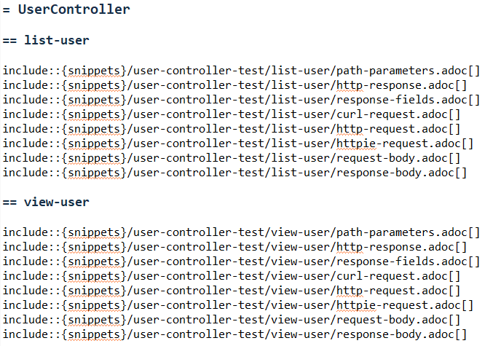
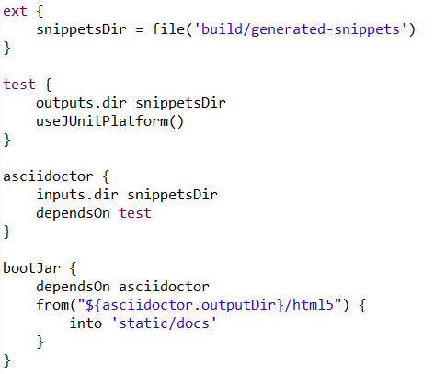
6. REST Docs
REST Docs dependency
Junit4 VS Spock
MockMvc VS Rest Assured
AsciiDoc VS MarkDown

