Slide 1
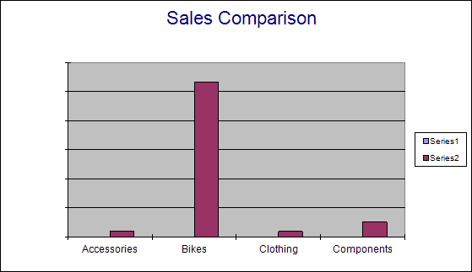
 | 2003 |  |  |  |  | - |  | 12 | Sales Report
 | Syed Abbas
 | 2023 |  |  |  |  |  |  | 12 | Order Summary
 | Order Number |  |  |  | Product Category |  |  |  |  |  | Sales
 | SO58915 |  |  |  | Clothing |  |  |  |  |  | ￥944.20
 |  |  |  |  | Accessories |  |  |  |  |  | ￥954.75
 |  |  |  |  | Components |  |  |  |  |  | ￥2,564.08
 |  |  |  |  | Bikes |  |  |  |  |  | ￥23,105.47
 | Subtotal |  |  |  |  |  |  |  |  |  | ￥27,568.49
 | SO59045 |  |  |  | Bikes |  |  |  |  |  | ￥3,589.79
 | Subtotal |  |  |  |  |  |  |  |  |  | ￥3,589.79
 | Total |  |  |  |  |  |  |  |  |  | ￥31,158.29

Slide 2
 |  | Product Category | Sales
 |  | Accessories | ￥954.75
 |  | Bikes | ￥26,695.26
 |  | Clothing | ￥944.20
 |  | Components | ￥2,564.08

