Slide 1
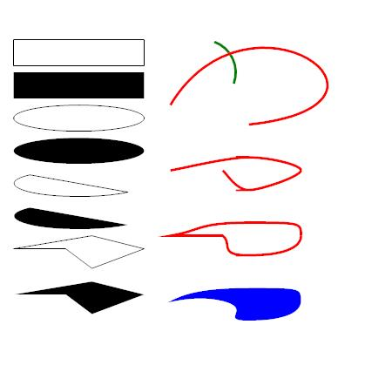
Aspose EMF+ Figures

