Slide 1
1
subtitle
text
Text
Notes:
Test notes

Slide 2
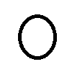

Image hyperlink
$$x=\frac{−b±\sqrt{b^{2}−4ac}}{2a}$$

Slide 4
text

