Slide 1
Text Box
Hi There
Third!!
Fourth___
Aspose.Slides for .NET

Slide 2
Aspose.Slides for .NET
Welcome
Hello World

Slide 3
Merged Cells
New

Slide 4


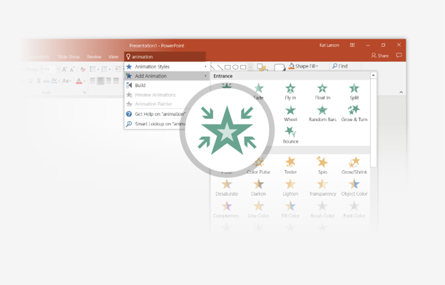
You’re an expert with Tell Me
The Tell Me box finds the right command when you need it, so you can save time and focus on your work. Try it:
SELECT ME
1
Select the Robot picture on the right.
2
Type animation in the Tell Me box, and then choose Add Animation.
3
Choose an animation effect, like Zoom, and watch what happens.

