Slide 1
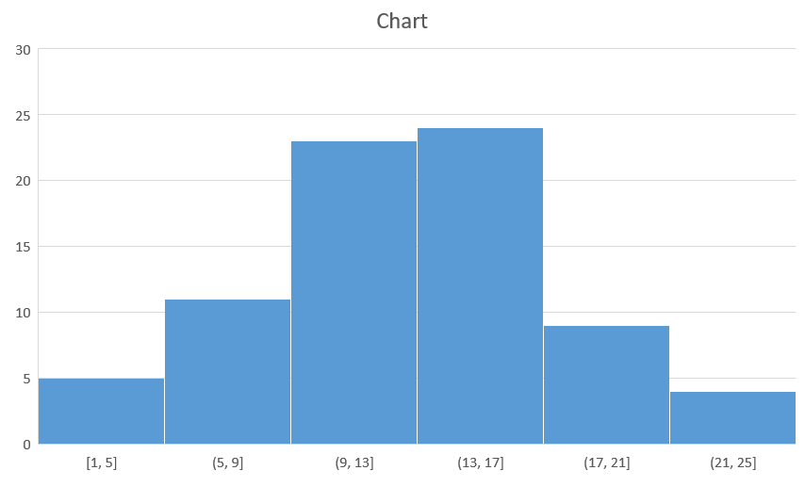

Slide 2
rectangle

Slide 3
Slide 3
Model | Engine | Year
Audi | 2.0 | 2007
Renault | 1.4 | 2010
Ford | 1.8 | 2010
Opel | 1.9 | 2005

Slide 4
Smart Art
Start
Middle
end

Slide 5

Picture

