Slide 1
NextSlide
Test PPT
Notes:
This is slide 1

Slide 2

This is slide 1 – Testing Video Playback
Notes:
This slide is #2 and has a video

Slide 3
Slide 2 – Testing Builds
Build 1
Build 2
Build 3
Notes:
This is slide 3

Slide 4
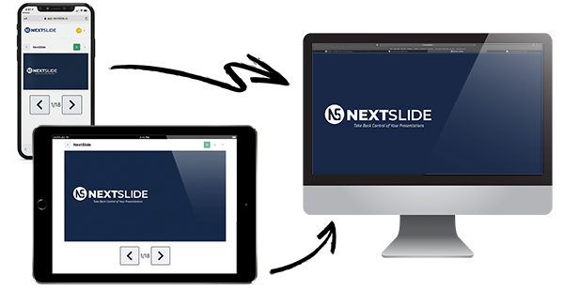
Image Animation Test
Notes:
This is slide 4

Slide 5
Transition Test
We will test a crossfade from this slide to the next slide
Notes:
This is slide 5

Slide 6
Transition Test
There should have been a crossfade between these two slides
Notes:
This is slide 6

