Slide 1
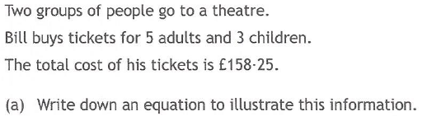
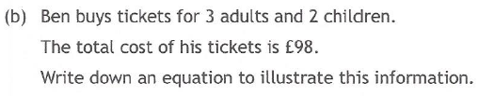
Past Paper Questions – National 5 Mathematics
Topic: Simultaneous Equations
06.01

Slide 2
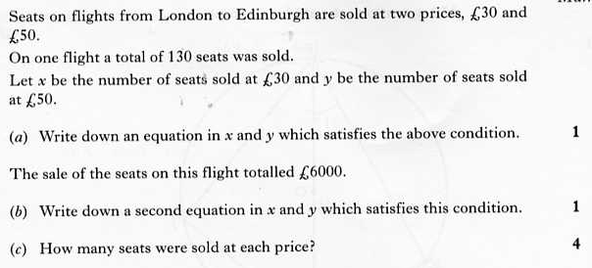
Past Paper Questions – National 5 Mathematics
Topic: Simultaneous Equations
06.02

Slide 3
Past Paper Questions – National 5 Mathematics
Topic: Simultaneous Equations
06.03

Slide 4
Past Paper Questions – National 5 Mathematics
Topic: Simultaneous Equations
06.04

Slide 5
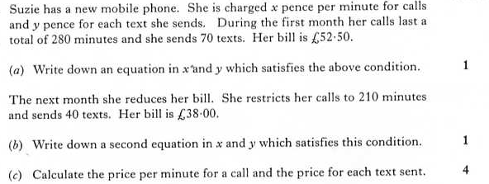
Past Paper Questions – National 5 Mathematics
Topic: Simultaneous Equations
06.05

Slide 6
Past Paper Questions – National 5 Mathematics
Topic: Simultaneous Equations
06.06
Notes:
6

Slide 7
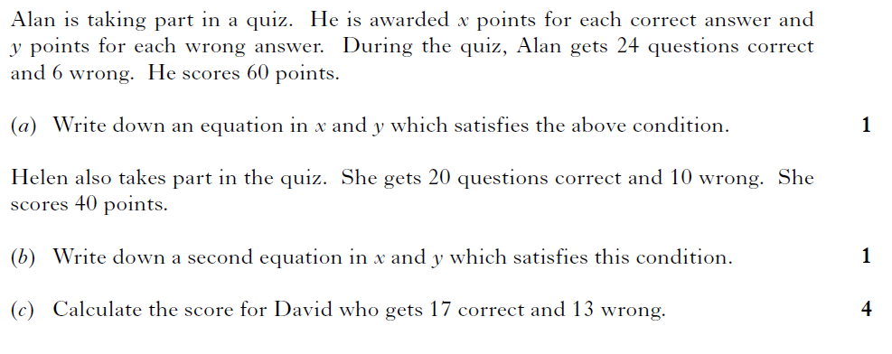
Past Paper Questions – National 5 Mathematics
Topic: Simultaneous Equations
06.07
Notes:
7

Slide 8
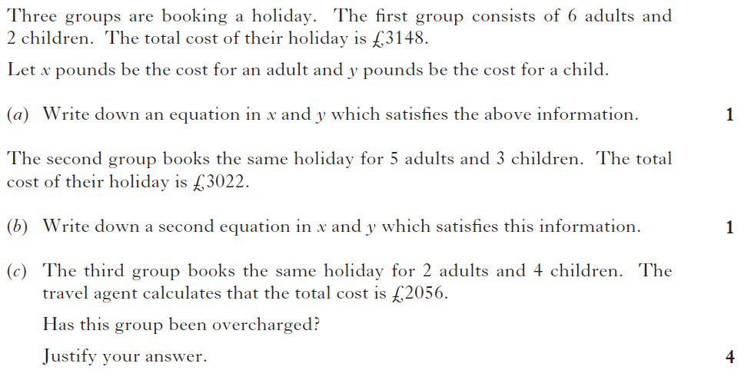
Past Paper Questions – National 5 Mathematics
Topic: Simultaneous Equations
06.08
Notes:
8

Slide 9
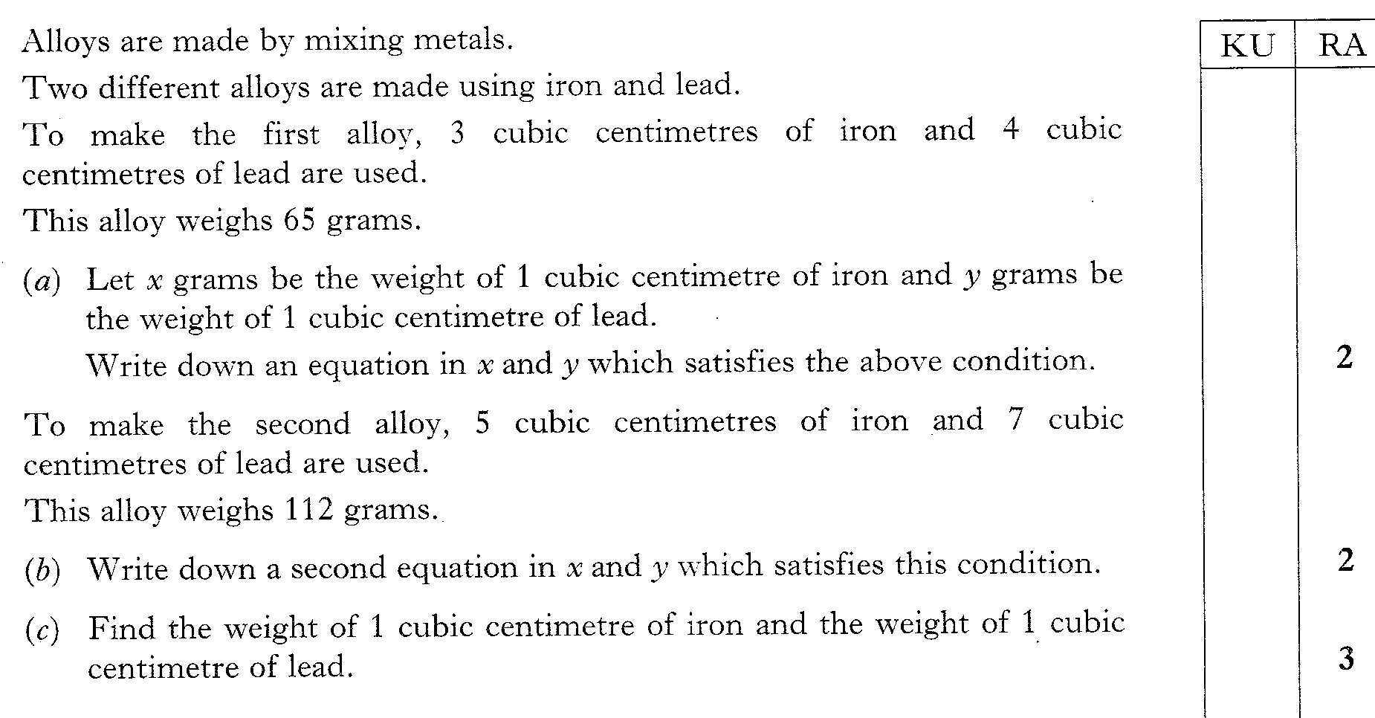
Past Paper Questions – National 5 Mathematics
Topic: Simultaneous Equations
06.09

Slide 10
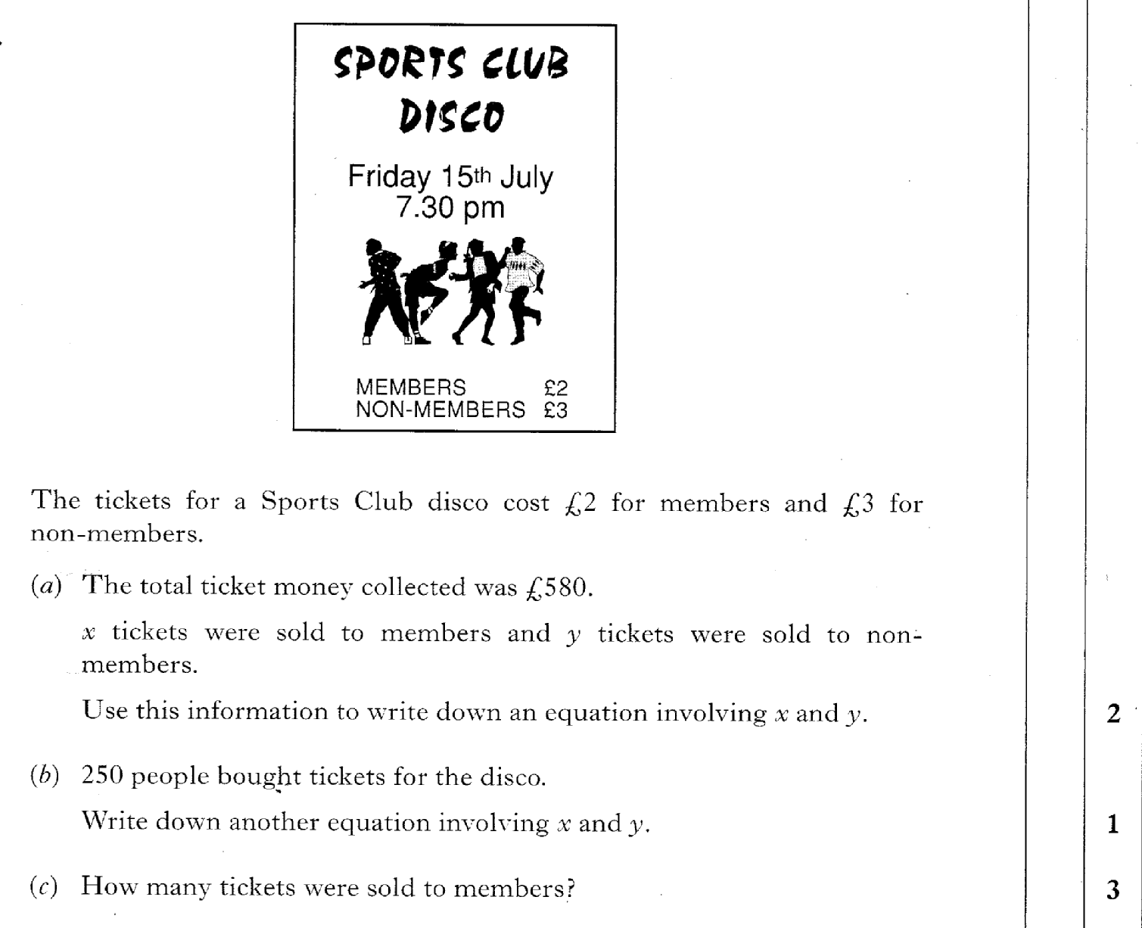
Past Paper Questions – National 5 Mathematics
Topic: Simultaneous Equations
06.10

Slide 11
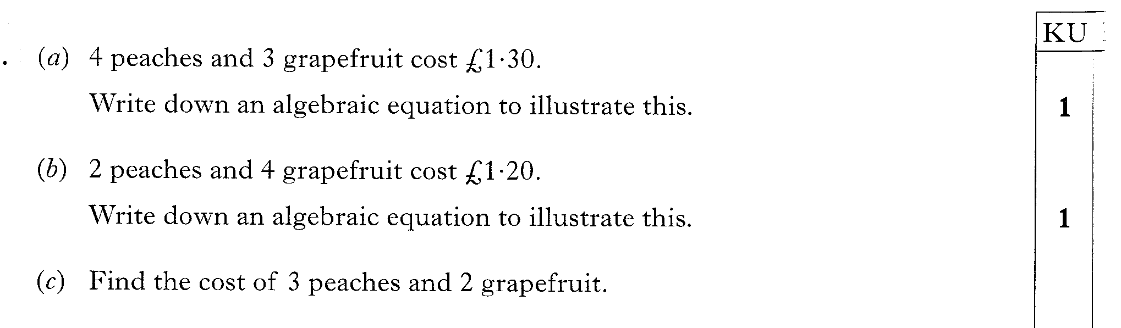
Past Paper Questions – National 5 Mathematics
Topic: Simultaneous Equations
06.11

Slide 12
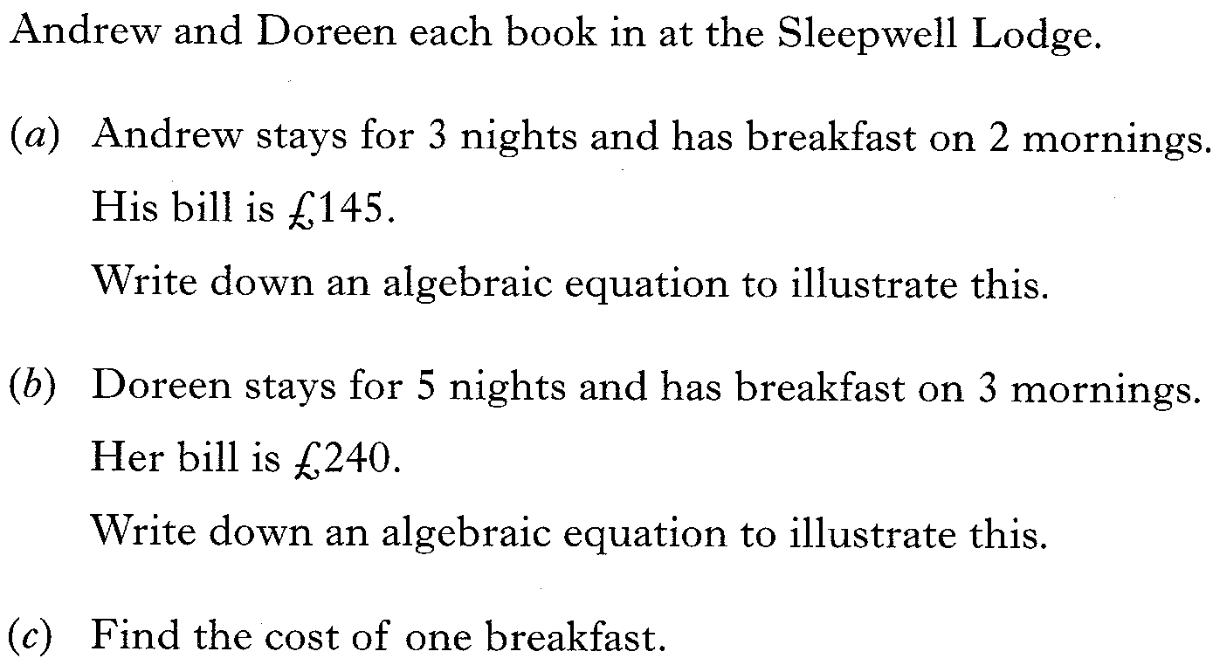
Past Paper Questions – National 5 Mathematics
Topic: Simultaneous Equations
06.12

Slide 13
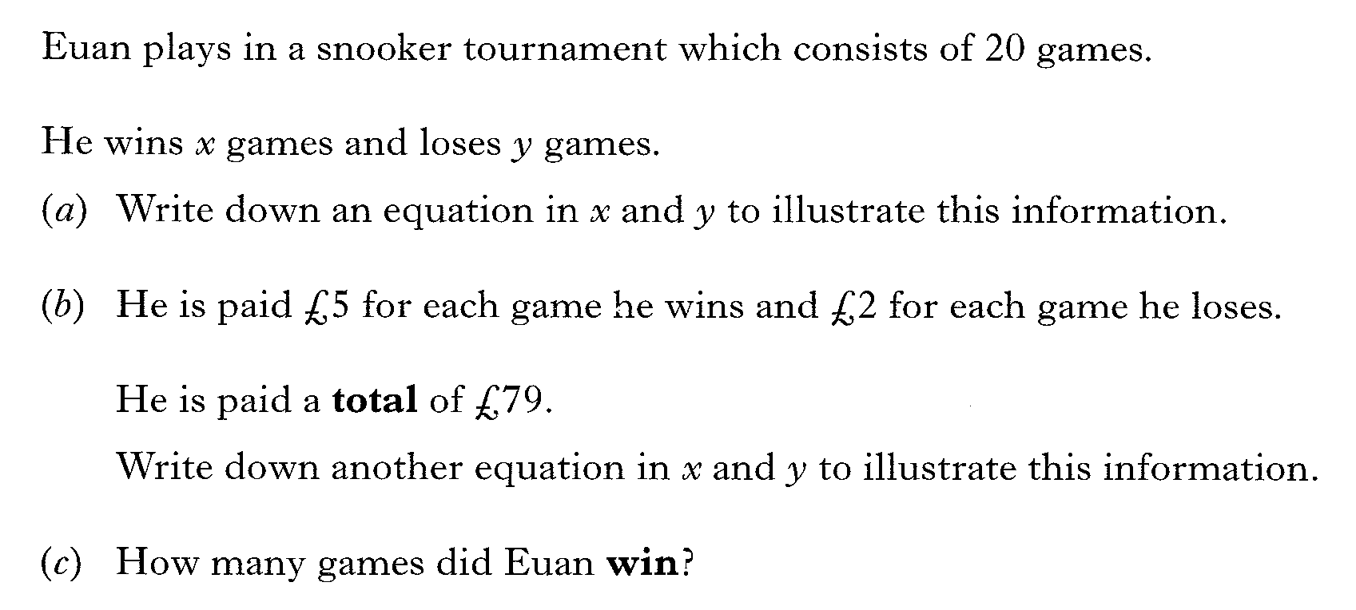
Past Paper Questions – National 5 Mathematics
Topic: Simultaneous Equations
06.13

Slide 14
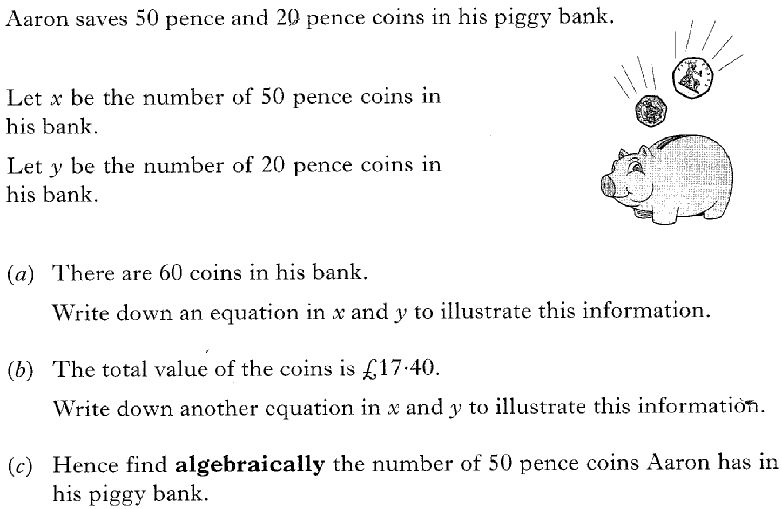
Past Paper Questions – National 5 Mathematics
Topic: Simultaneous Equations
06.14

Slide 15
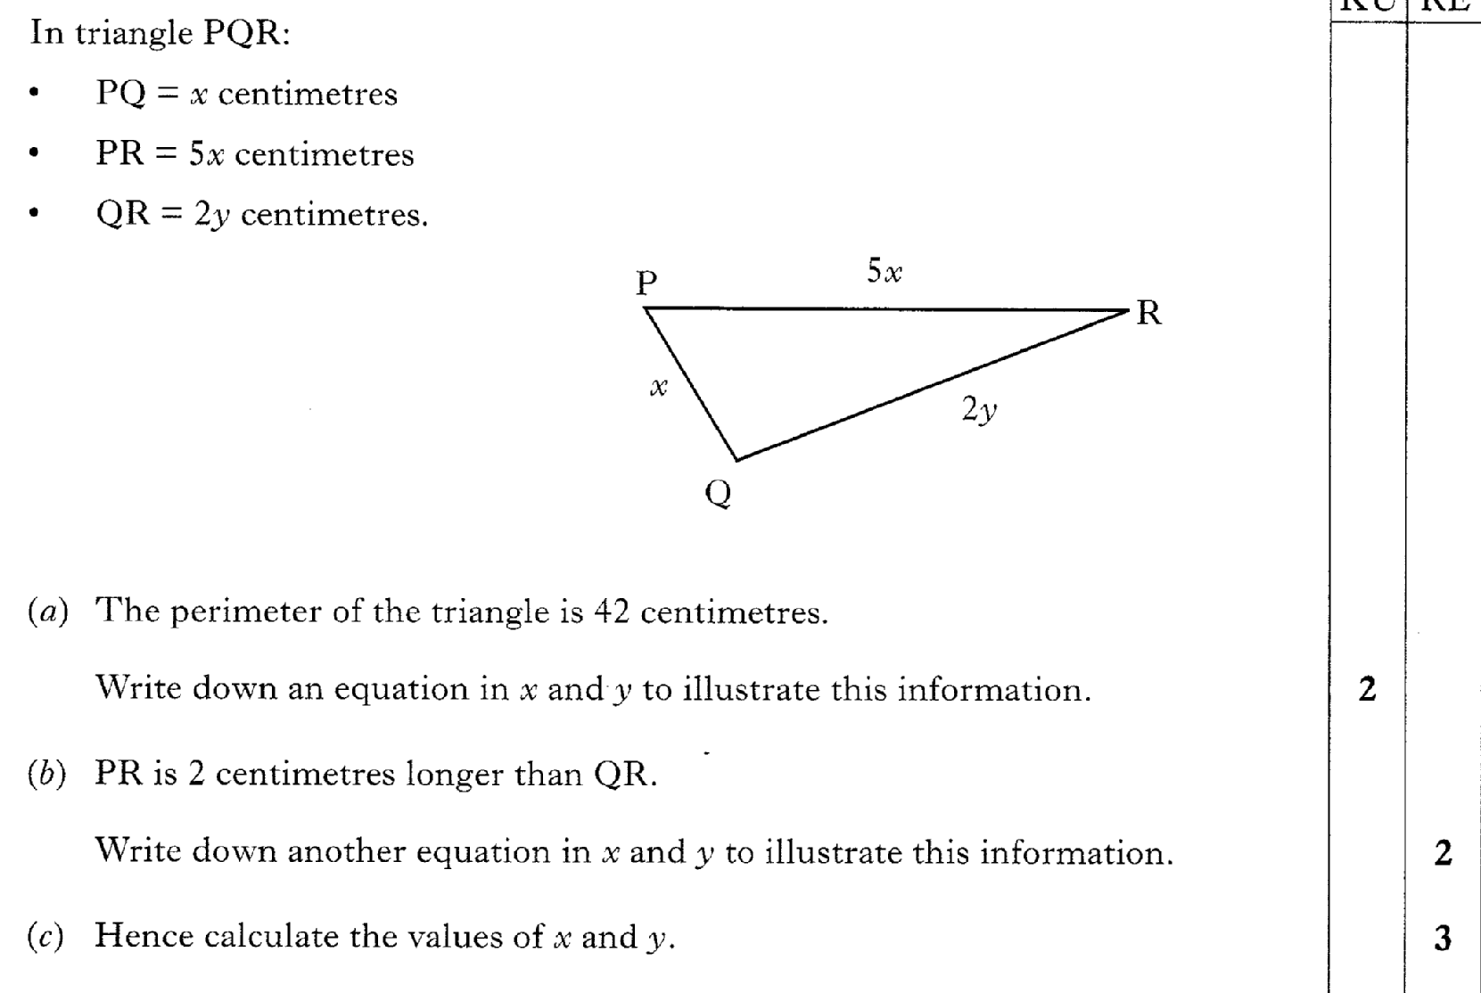
Past Paper Questions – National 5 Mathematics
Topic: Simultaneous Equations
06.15

