Slide 1
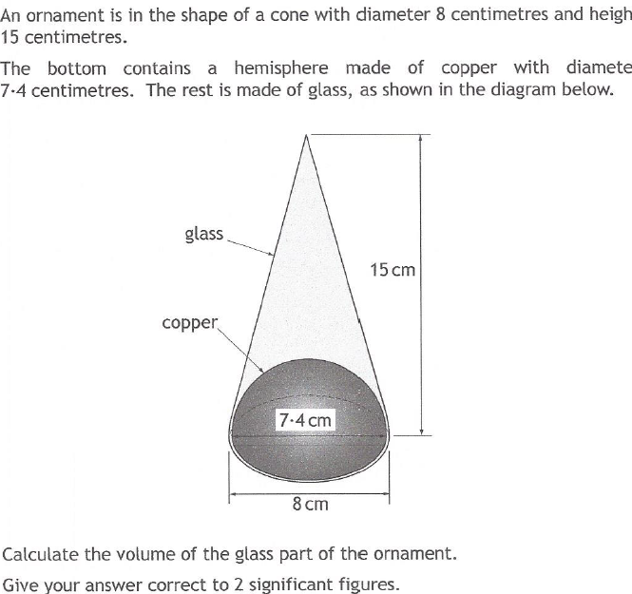
Past Paper Questions – National 5 Mathematics
Topic: Volume
25.01

Slide 2
Past Paper Questions – National 5 Mathematics
Topic: Volume
25.02

Slide 3
Past Paper Questions – National 5 Mathematics
Topic: Volume
25.03

Slide 4
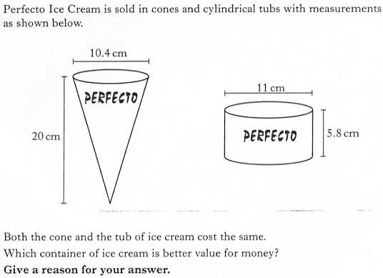
Past Paper Questions – National 5 Mathematics
Topic: Volume
25.04

Slide 5
Past Paper Questions – National 5 Mathematics
Topic: Volume
25.05

Slide 6
Past Paper Questions – National 5 Mathematics
Topic: Volume
25.06

Slide 7
Past Paper Questions – National 5 Mathematics
Topic: Volume
25.07

Slide 8
Past Paper Questions – National 5 Mathematics
Topic: Volume
25.08
Notes:
8

Slide 9
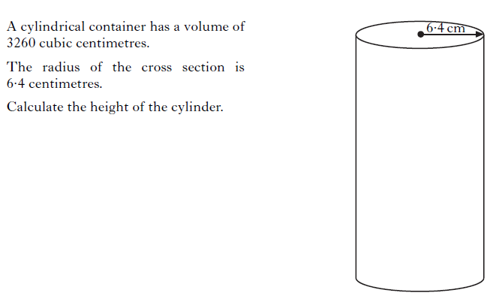
Past Paper Questions – National 5 Mathematics
Topic: Volume
25.09
Notes:
9

Slide 10
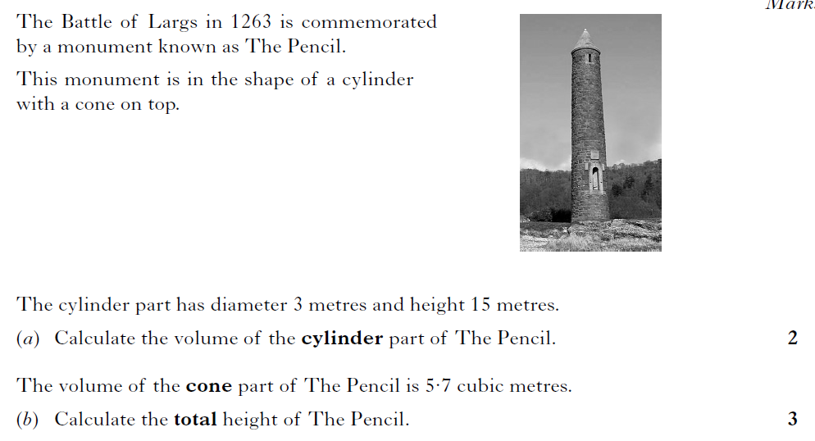
Past Paper Questions – National 5 Mathematics
Topic: Volume
25.10
Notes:
10

Slide 11
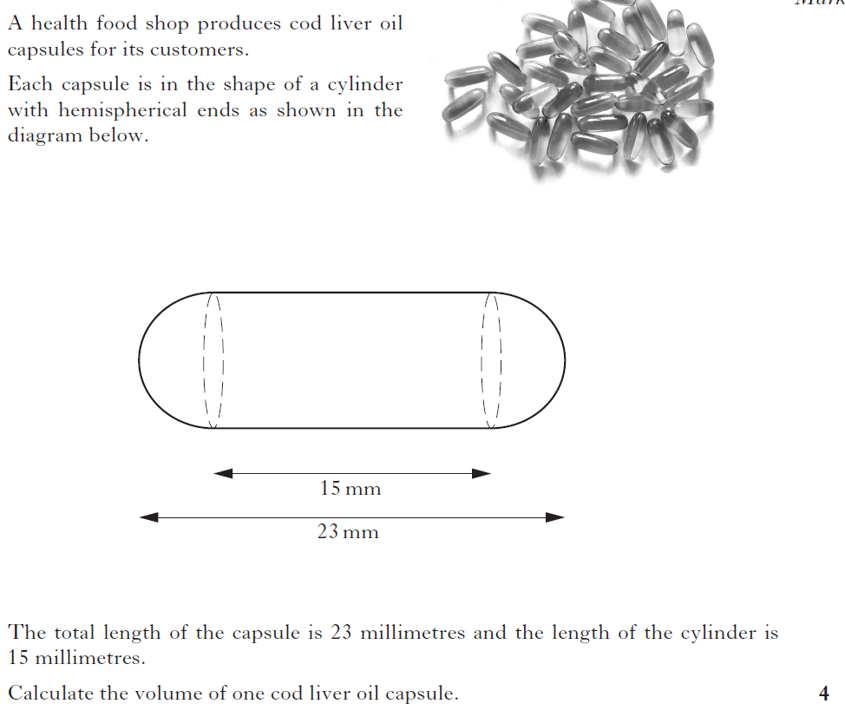
Past Paper Questions – National 5 Mathematics
Topic: Volume
25.11
Notes:
11

Slide 12
Past Paper Questions – National 5 Mathematics
Topic: Volume
25.12

Slide 13
Past Paper Questions – National 5 Mathematics
Topic: Volume
25.13

Slide 14
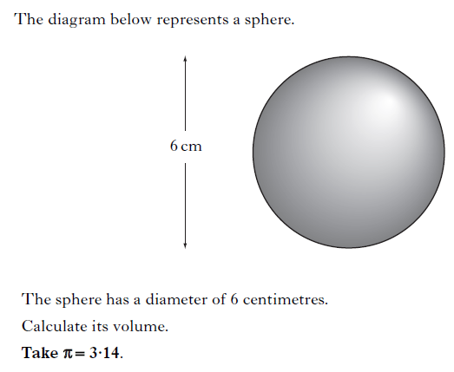
Past Paper Questions – National 5 Mathematics
Topic: Volume
25.14
Notes:
14

Slide 15
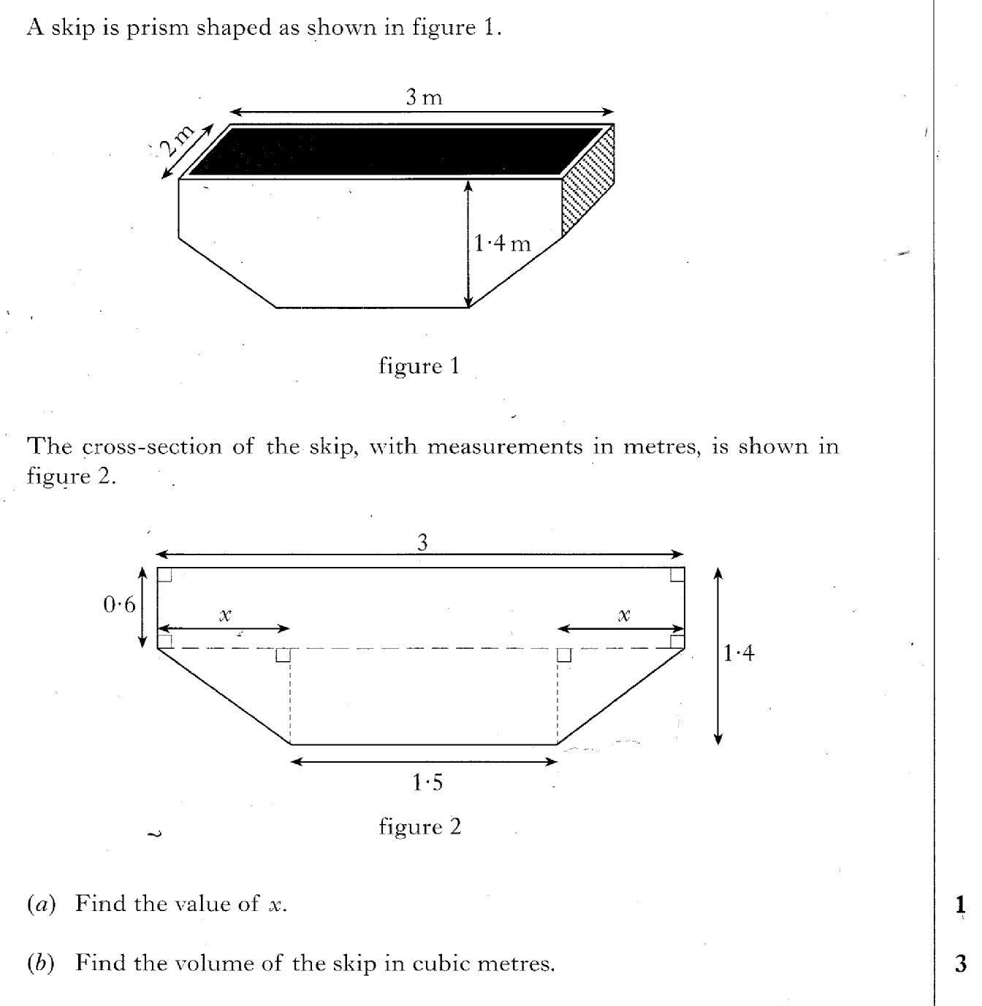
Past Paper Questions – National 5 Mathematics
Topic: Volume
25.15

Slide 16
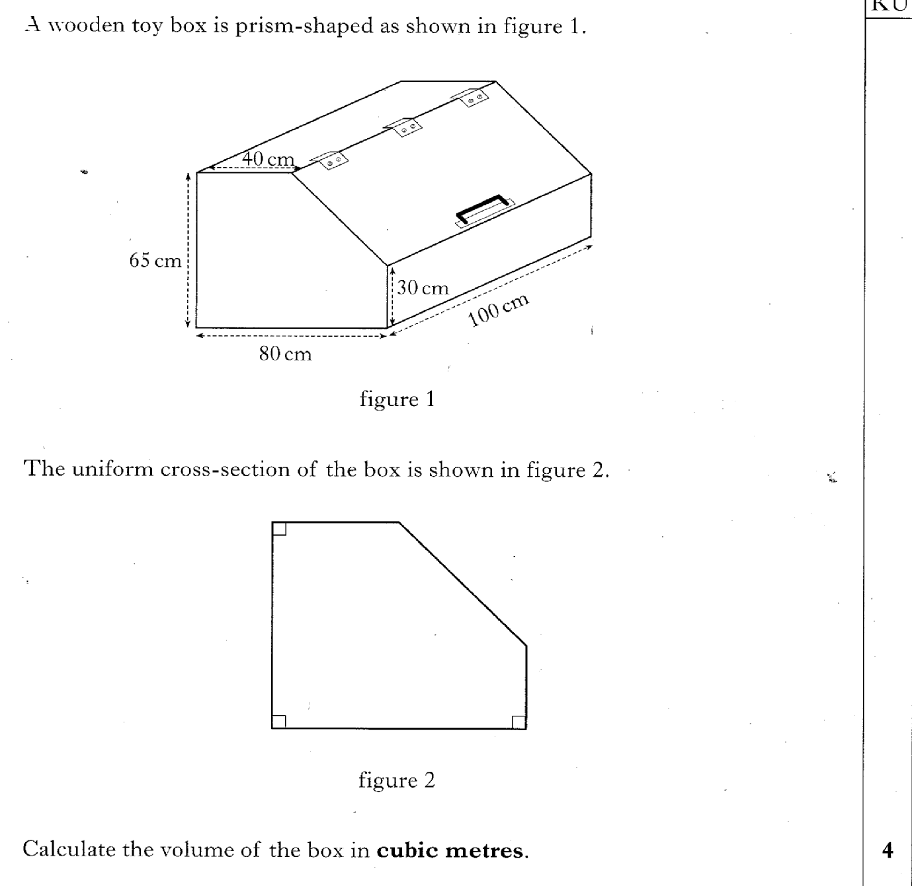
Past Paper Questions – National 5 Mathematics
Topic: Volume
25.16

Slide 17
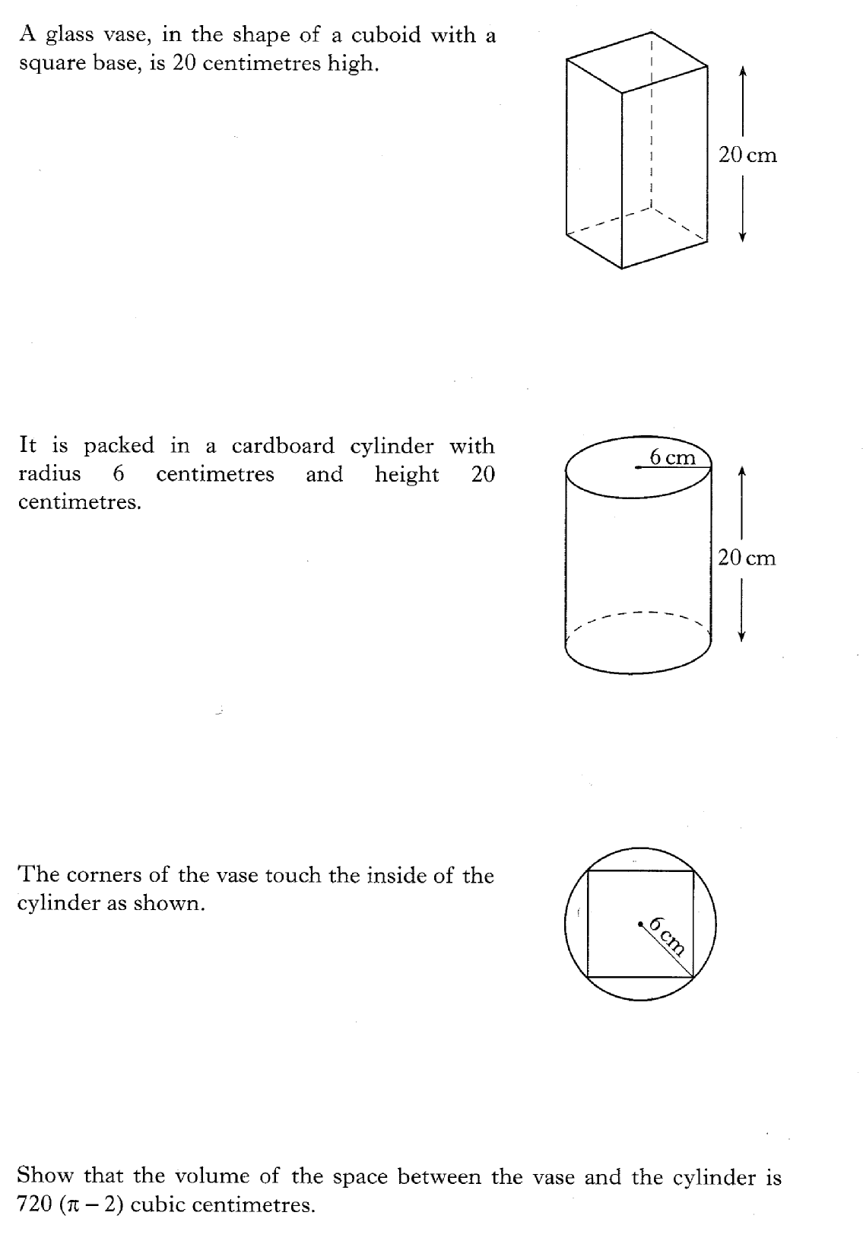
Past Paper Questions – National 5 Mathematics
Topic: Volume
25.17

Slide 18
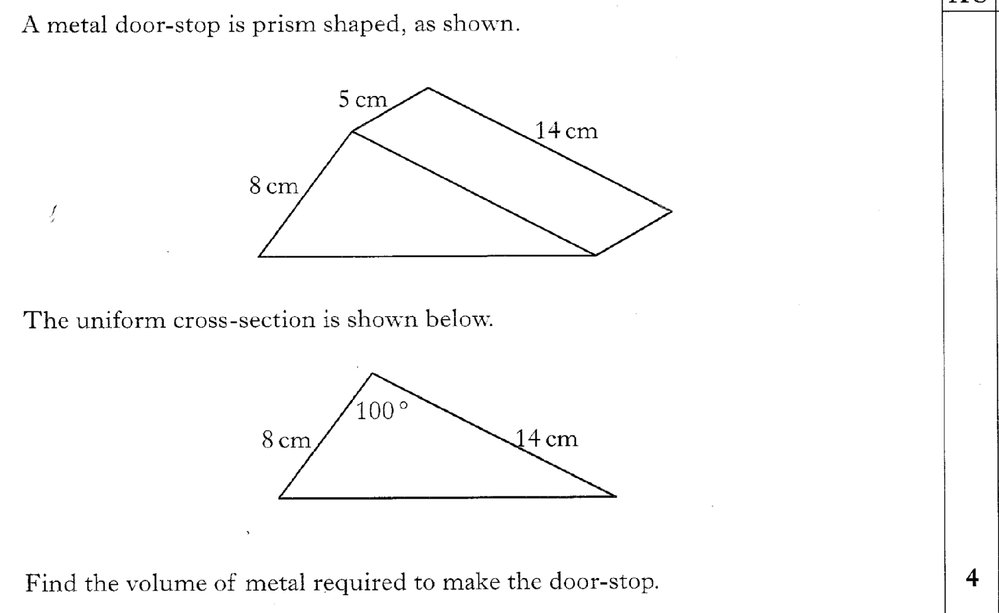
Past Paper Questions – National 5 Mathematics
Topic: Volume
25.18

Slide 19
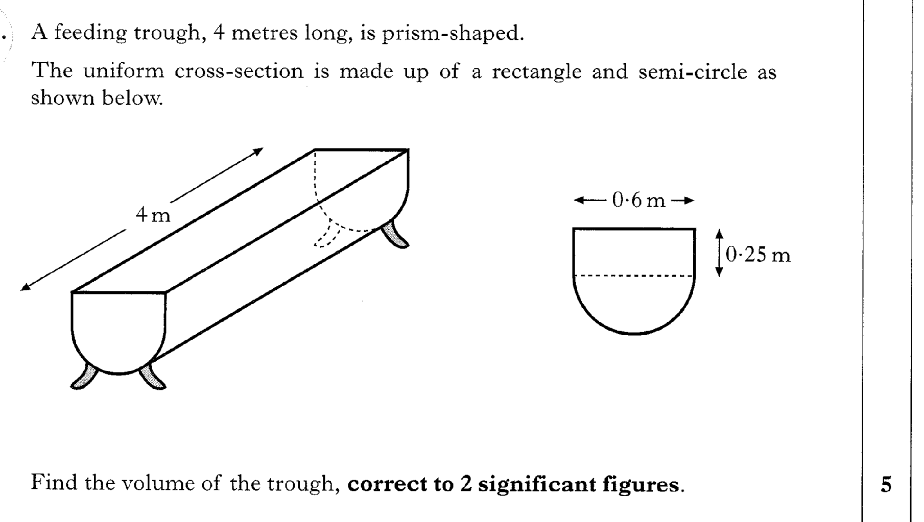
Past Paper Questions – National 5 Mathematics
Topic: Volume
25.19

Slide 20
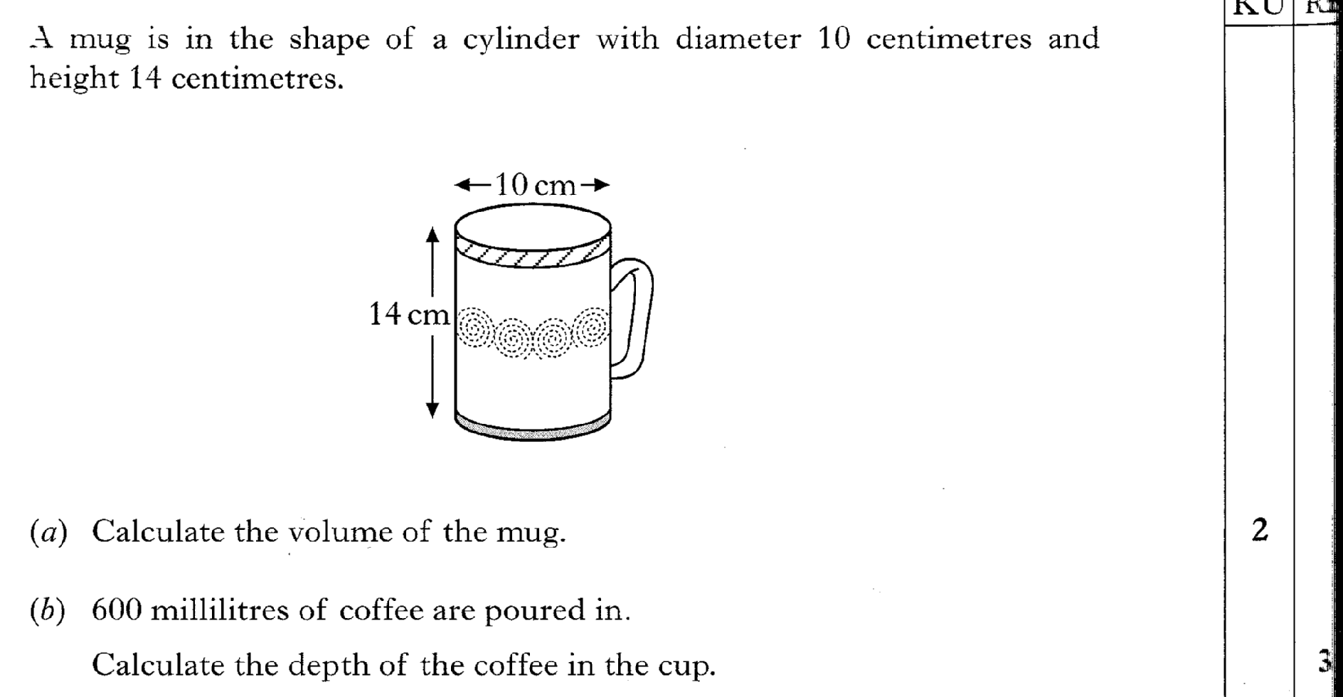
Past Paper Questions – National 5 Mathematics
Topic: Volume
25.20

Slide 21
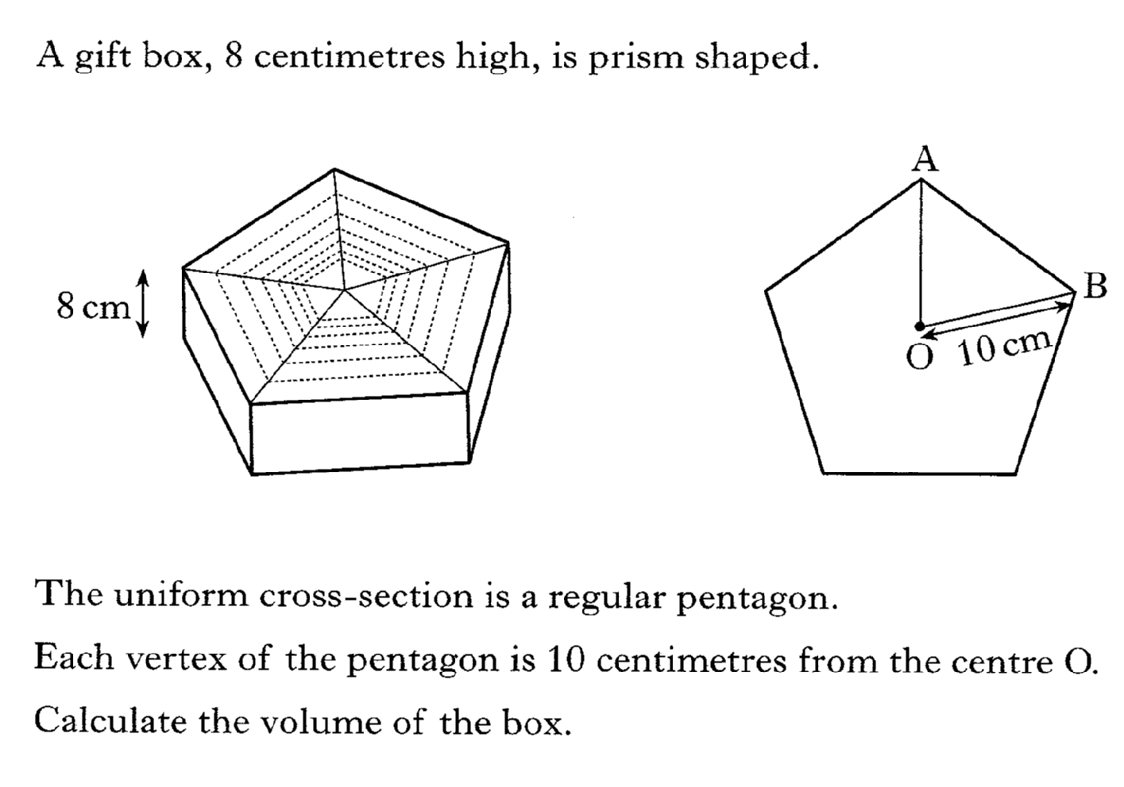
Past Paper Questions – National 5 Mathematics
Topic: Volume
25.21

Slide 22
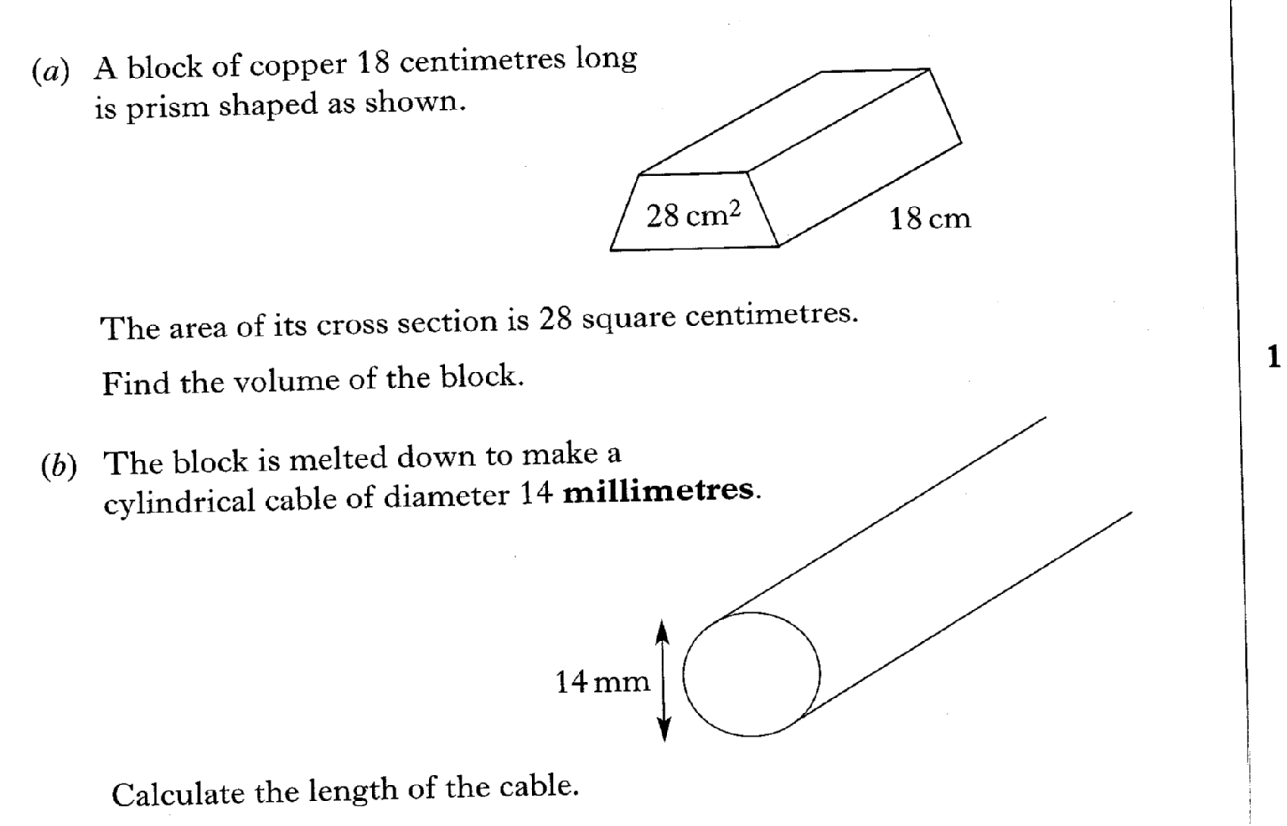
Past Paper Questions – National 5 Mathematics
Topic: Volume
25.22

Slide 23
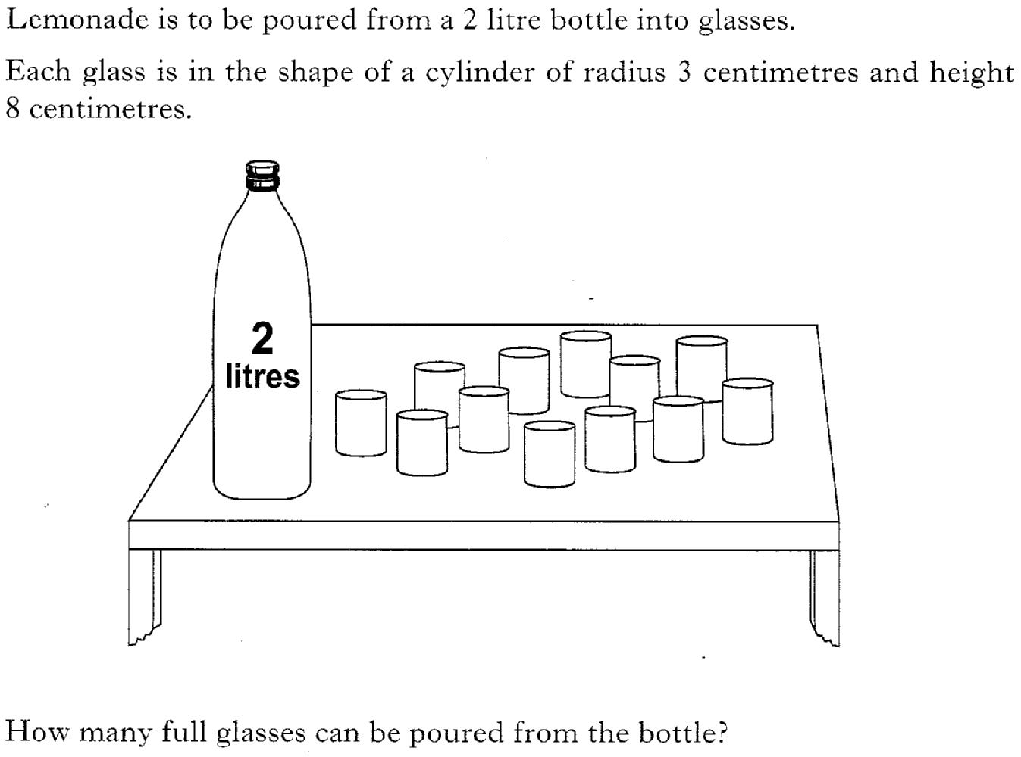
Past Paper Questions – National 5 Mathematics
Topic: Volume
25.23

Slide 24
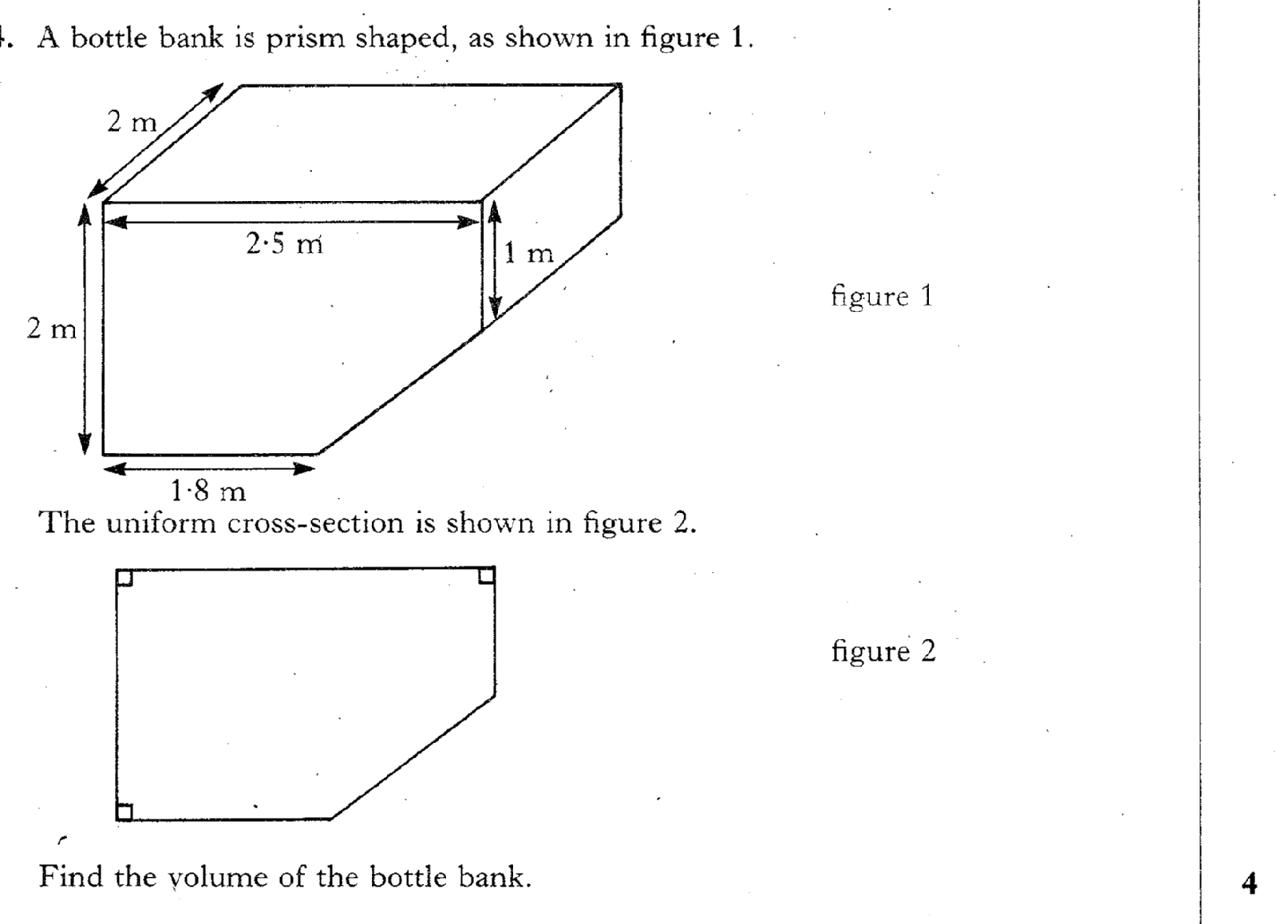
Past Paper Questions – National 5 Mathematics
Topic: Volume
25.24

Slide 25
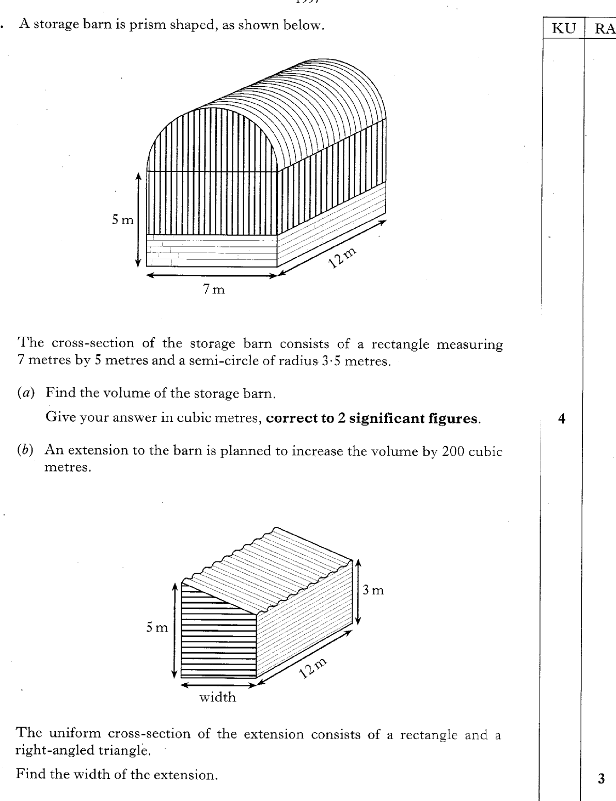
Past Paper Questions – National 5 Mathematics
Topic: Volume
25.25

Slide 26
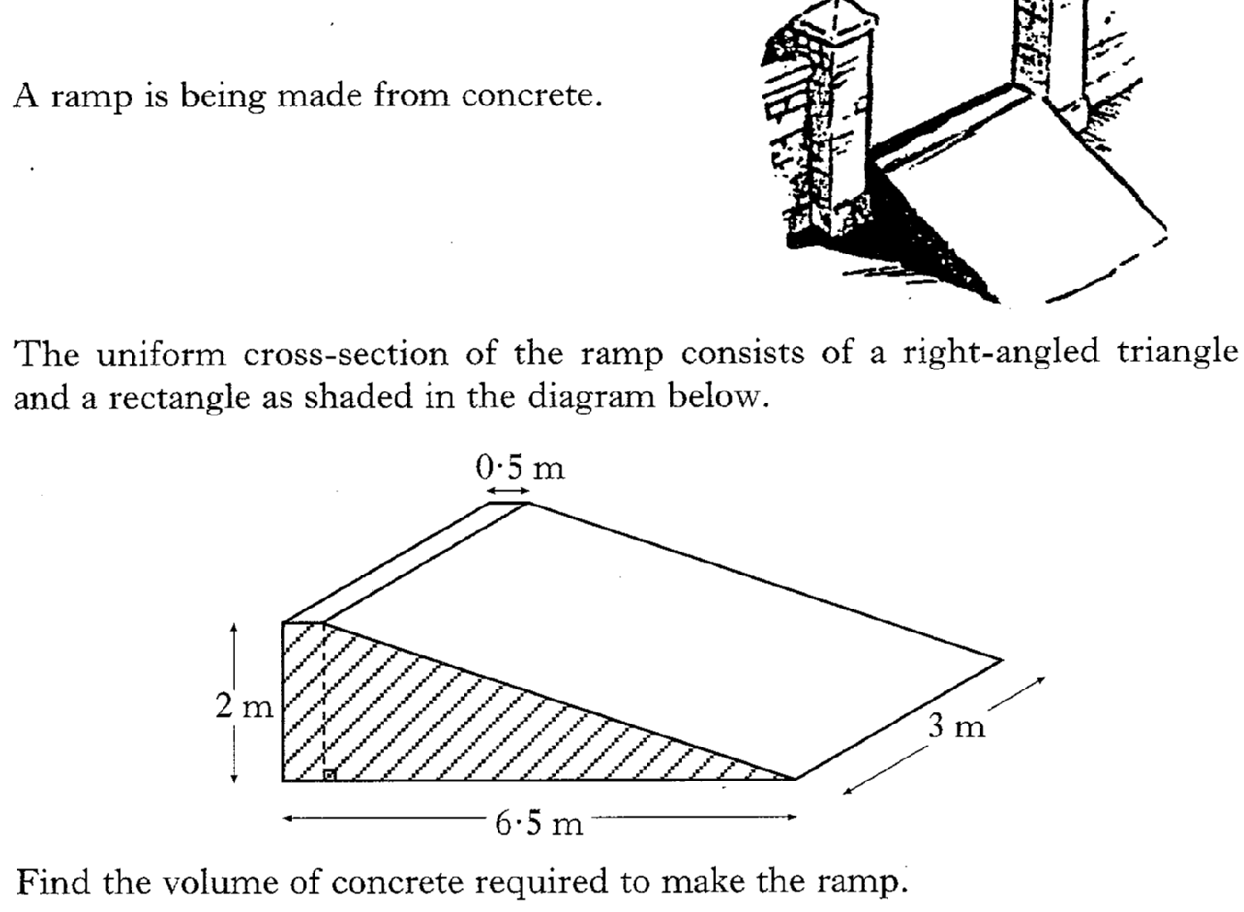
Past Paper Questions – National 5 Mathematics
Topic: Volume
25.26

