Slide 1
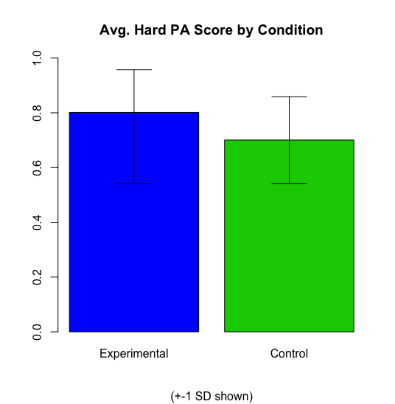
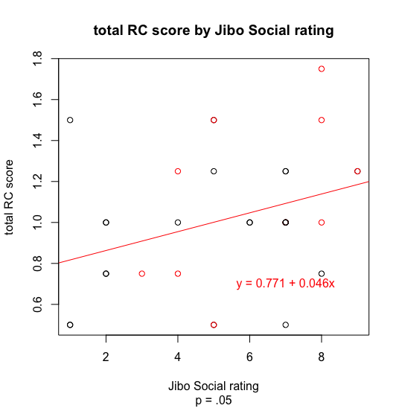

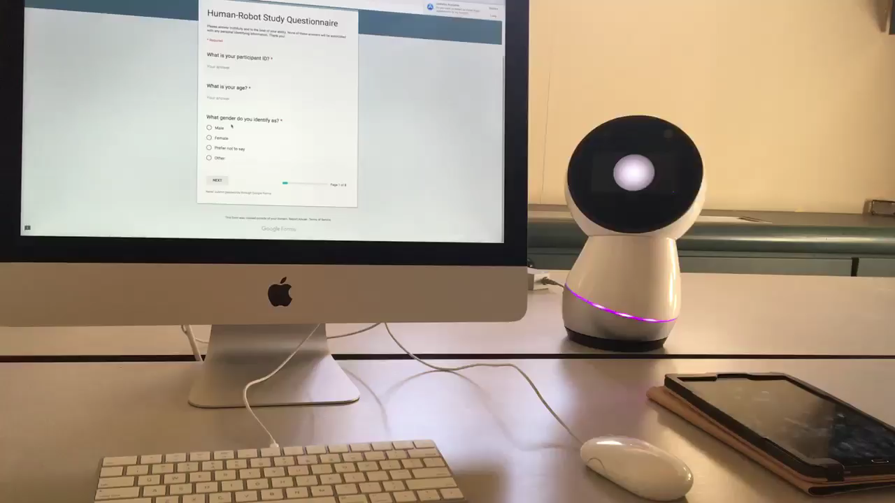
Social Robots & the Social Facilitation Effect To what extent does the social nature of a robot elicit the social facilitation and social inhibition effects in humans?
Results
- Participants in the experimental (vs. control) condition were able to learn and perform significantly better in both the easy and difficult versions of a paired-association task
- Perceptions of robot sociality were generally positively correlated with various performance measures
Experimental Condition: Social Robot
Intro: Experimenter greeted robot
Robot learned participant name, voice, and face
passive ESML movement behavior
glancing behavior
Control Condition: Non-Social Robot
Intro: Users controlled robot with app
Same movements, but robot faced side of user
Glancing Behavior
ESML Behavior

