Slide 1
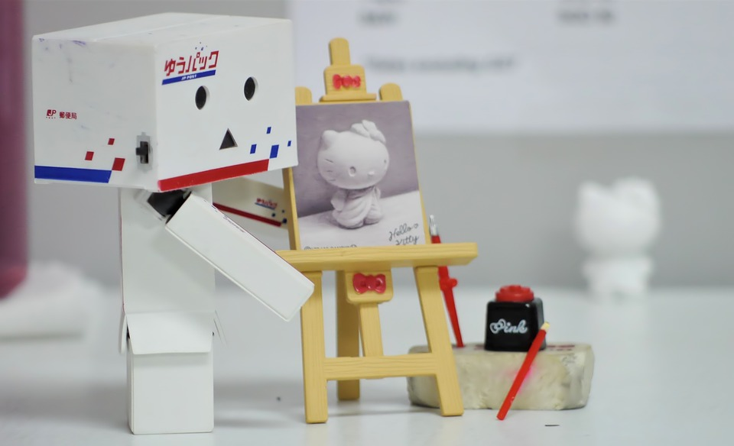
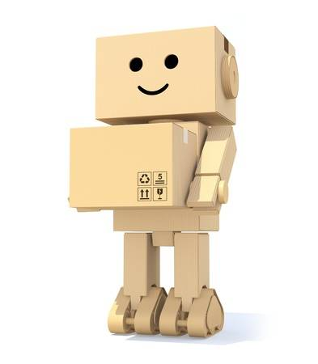
Social Facilitation with a Social Robot
Ling, Nathan
(Team Boxhead)

Slide 2
Problem Statement:
To what extent does the social nature of a robot elicit the social facilitation and social inhibition effects in humans?
Motivation: To explore whether the presence of social robots can promote task performance and learning in humans, substituting in for the role of human tutors/supervisors/co-workers/companions
Contributions to existing literature:
THEORY: Providing evidence for/against the Evaluation Apprehension theory (Cottrell, 1972)
By comparing social vs. non-social robots
APPLICATIONS: Using real world, learning-based tasks
APPLICATIONS: Using a robot likely to be found in daily life in the near future

Slide 3
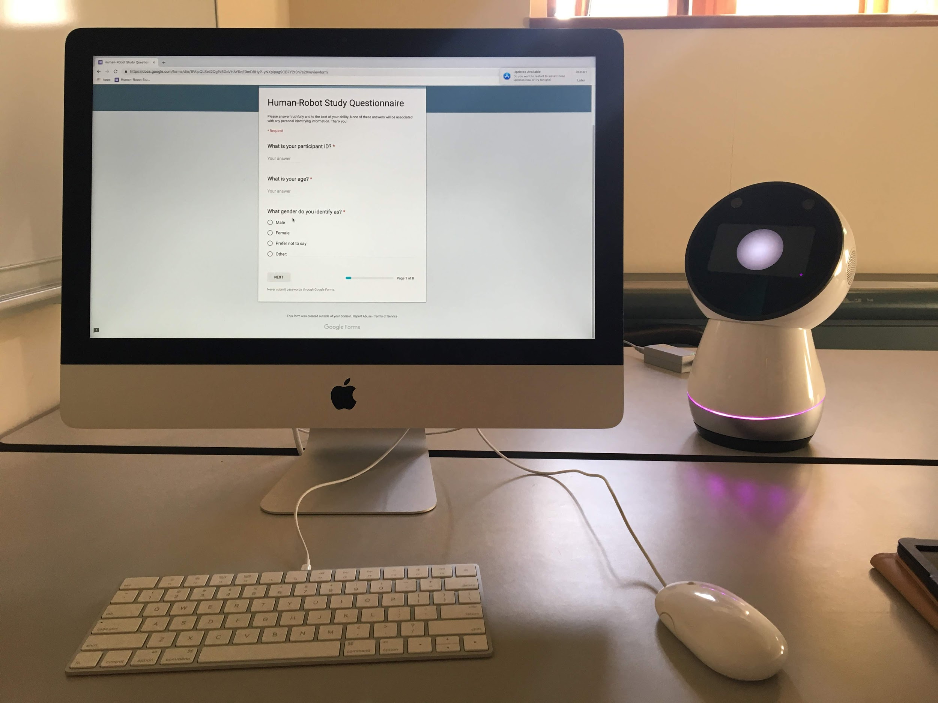
Methodology
Participants
Procedure
Robot Interaction
Performance Tasks

Slide 4
Methodology
Participants
33 participants from the Yale University area
Gender: 22 females, 11 males
Age: M = 20.72, SD = 3.53

Slide 5
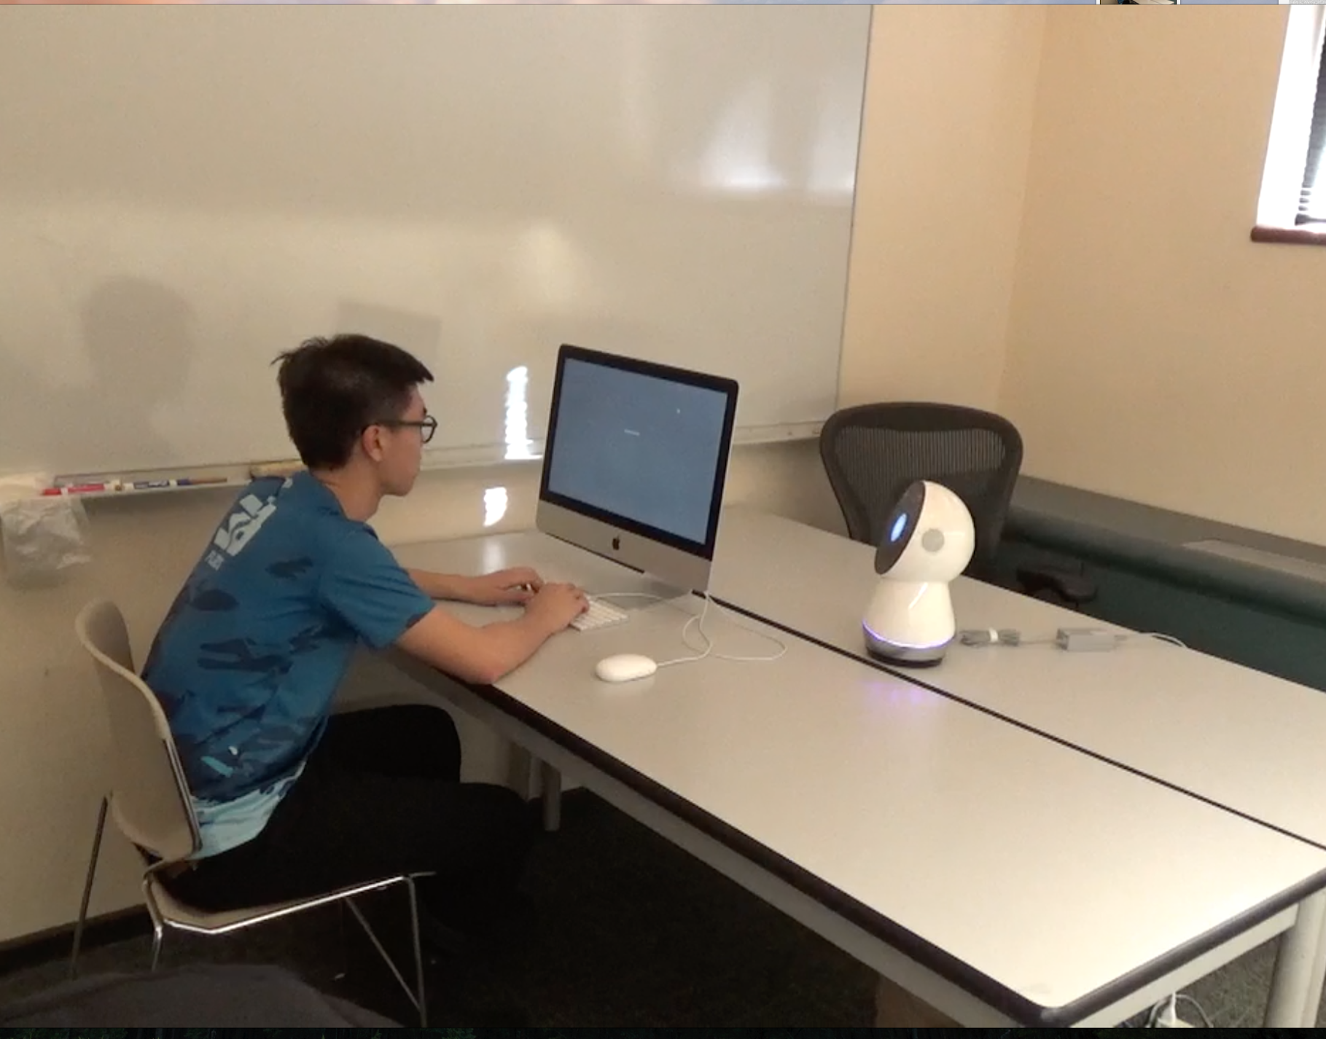
Methodology
Participants
33 participants from the Yale University area
Gender: 22 females, 11 males
Age: M = 20.72, SD = 3.53
Procedure
Participants introduced to robot
Participants carried out tasks on computer

Slide 6
Robot Interaction
Focused on two main kinds of interaction between robot and participant
How robot was introduced
How robot behaved during tasks
Interested in making Jibo more social during the experimental condition
Maintain consistent amount of speech and movement between two conditions

Slide 7
Robot Interaction
Introduction
Control: users used tablet to control Jibo
Experimental:
Experimenter walked in and greeted Jibo with “Hey Jibo! How are you?”
Users were added to Jibo’s loop
During-task behaviors
Passive movement and ESML behaviors
Glancing behaviors
Control: Faces to the right of the participant (towards the wall)
Experimental:
Faces in the direction of the participant
Glances between participant and computer

Slide 8

Notes:
Con Intro

Slide 9
Robot Interaction
Introduction
Control: users used tablet to control Jibo
Experimental:
Experimenter walked in and greeted Jibo with “Hey Jibo! How are you?”
Users were added to Jibo’s loop
During-task behaviors
Passive movement and ESML behaviors
Glancing behaviors
Control: Faces to the right of the participant (towards the wall)
Experimental:
Faces in the direction of the participant
Glances between participant and computer

Slide 10
Notes:
Exp Intro

Slide 11
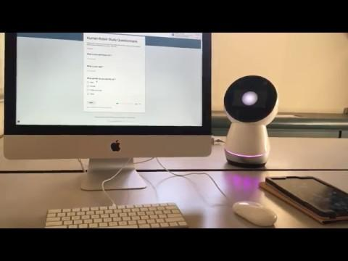
Robot Interaction
Introduction
Control: users used tablet to control Jibo
Experimental:
Experimenter walked in and greeted Jibo with “Hey Jibo! How are you?”
Users were added to Jibo’s loop
During-task behaviors
Passive movement and ESML behaviors
Glancing behaviors
Control: Faces to the right of the participant (towards the wall)
Experimental:
Faces in the direction of the participant
Glances between participant and computer

Slide 12
Robot Interaction
Introduction
Control: users used tablet to control Jibo
Experimental:
Experimenter walked in and greeted Jibo with “Hey Jibo! How are you?”
Users were added to Jibo’s loop
During-task behaviors
Passive movement and ESML behaviors
Glancing behaviors
Control: Faces to the right of the participant (towards the wall)
Experimental:
Faces in the direction of the participant
Glances between participant and computer

Slide 13
Notes:
Control glancing behavior

Slide 14
Robot Interaction
Introduction
Control: users used tablet to control Jibo
Experimental:
Experimenter walked in and greeted Jibo with “Hey Jibo! How are you?”
Users were added to Jibo’s loop
During-task behaviors
Passive movement and ESML behaviors
Glancing behaviors
Control: Faces to the right of the participant (towards the wall)
Experimental:
Faces in the direction of the participant
Glances between participant and computer

Slide 15
Notes:
Experimental glance

Slide 16
Performance Tasks
Paired association
Participants are tested on memory of cue-response pairs
EASY: Japanese hiragana - English meaning pairs
HARD: Japanese hiragana - Romanization pairs
Word association
Given a stimulus word, participants were asked to write as many related verbs as possible
EASY: ball, rope, wheel
HARD: kite, scissors, projector
Reading comprehension
Participants answered multiple-choice questions based on an article
EASY: Excerpt from Science website article, 4 choices per question
HARD: Excerpt from Science journal, 5 choices per question

Slide 17
Paired Association
した
shita
Difficult task

Slide 18
Paired Association
した
shita
した
down
Difficult task
Easy task

Slide 19
Paired Association
した
up
Right or wrong response?

Slide 20
Performance Tasks
Paired association
Participants are tested on memory of cue-response pairs
EASY: Japanese hiragana - English meaning pairs
HARD: Japanese hiragana - Romanization pairs
Word association
Given a stimulus word, participants were asked to write as many related verbs as possible
EASY: ball, rope, wheel
HARD: kite, scissors, projector
Reading comprehension
Participants answered multiple-choice questions based on an article
EASY: Excerpt from Science website article, 4 choices per question
HARD: Excerpt from Science journal, 5 choices per question

Slide 21
Word Association
projector
project
present
teach
...
Difficult task

Slide 22
Word Association
projector
project
present
teach
...
ball
bounce
kick
dribble
shoot
roll
hit
...
Difficult task
Easy task

Slide 23
Performance Tasks
Paired association
Participants are tested on memory of cue-response pairs
EASY: Japanese hiragana - English meaning pairs
HARD: Japanese hiragana - Romanization pairs
Word association
Given a stimulus word, participants were asked to write as many related verbs as possible
EASY: ball, rope, wheel
HARD: kite, scissors, projector
Reading comprehension
Participants answered multiple-choice questions based on an article
EASY: Excerpt from Science website article, 4 choices per question
HARD: Excerpt from Science journal, 5 choices per question

Slide 24
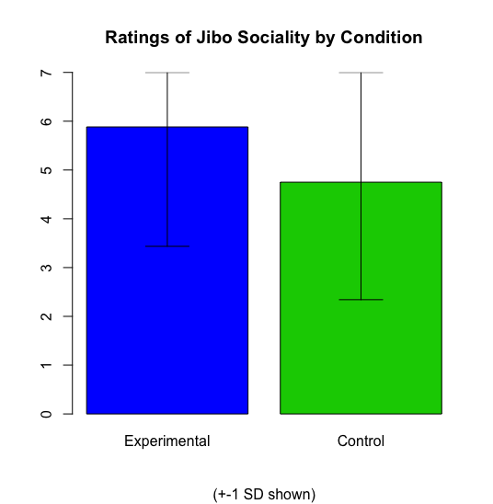
Results
Manipulation check
Experimental condition rated Jibo more social compared to control group
Experimental: M = 5.88, SD = 2.45
Control: M = 4.75, SD = 2.41
Not statistically significant
t(31) = 1.34, p = .19
Why?
Weakness of the manipulation
Our participant pool…!
Technical issues during the experiment
Jibo always responds when called
Connectivity issues

Slide 25
Results: Task Performance by Manipulation
Covariates:
Age
Gender
Exposure to CS and robotics
Extraversion
Self-Efficacy
Empathy
Knowledge of Japanese (for the Paired Association task)

Slide 26
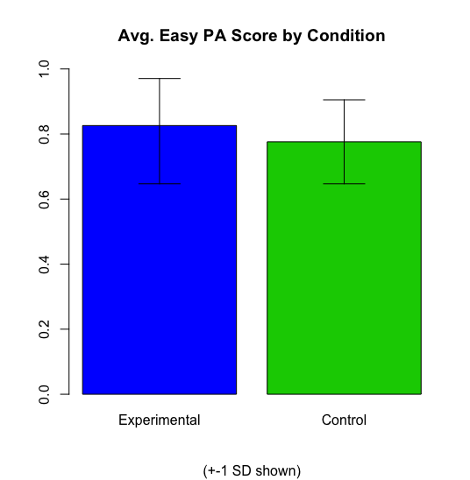
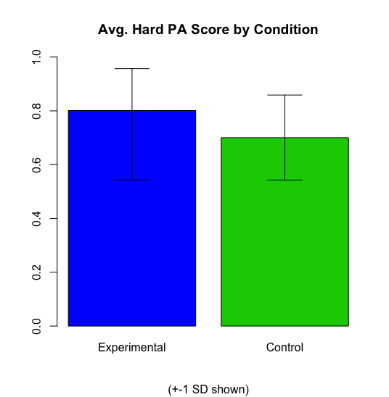
Results: the Paired Association Task
Hard: p = .02, Easy: p = .20; difficulty difference t(32) = -1.99, p = .05

Slide 27
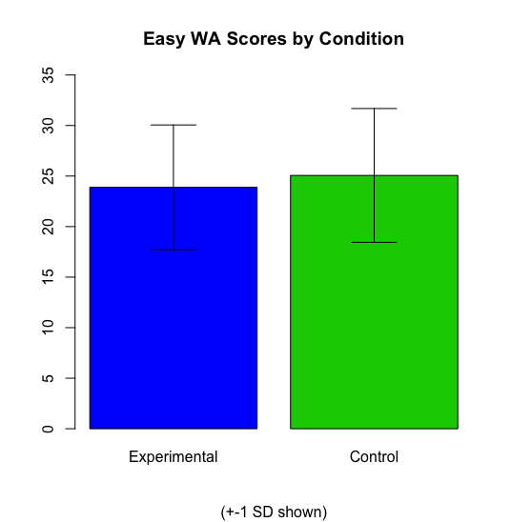
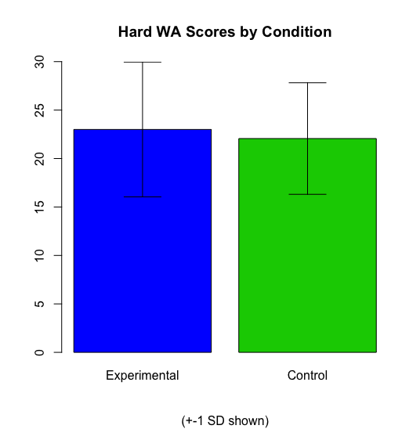
Results: the Word Association Task
Hard: p = .67, Easy: p = .54, ifficulty difference t(32) = -1.79, p = .08

Slide 28
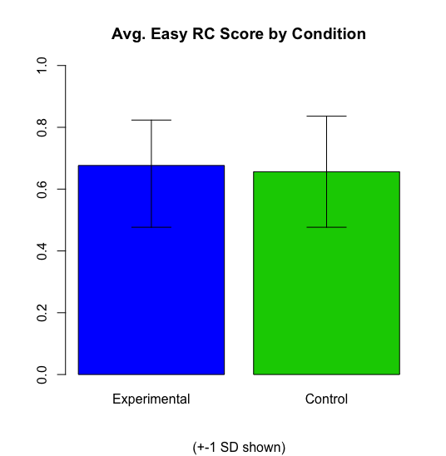
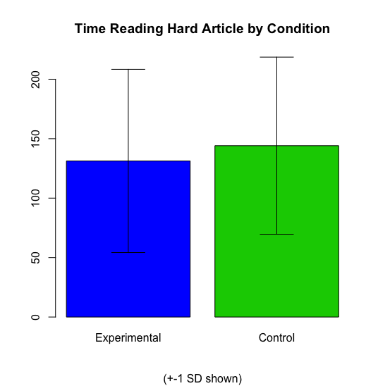
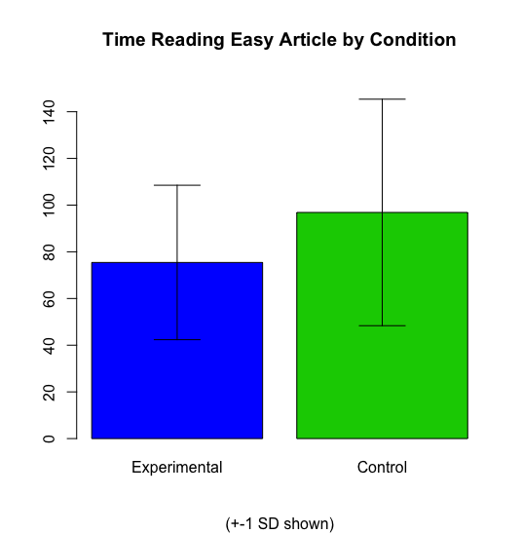
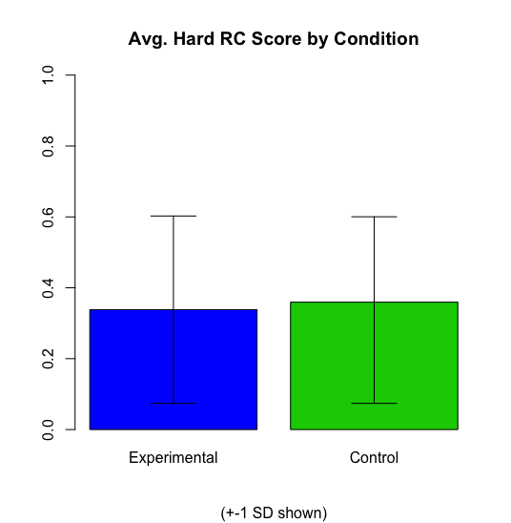
Results: the Reading Comprehension Task
Hard: p = .80, Easy: p = .75, difficulty difference t(32) = -7.04, p < .001, and t(32) = 4.95, p < .001 for time reading

Slide 29
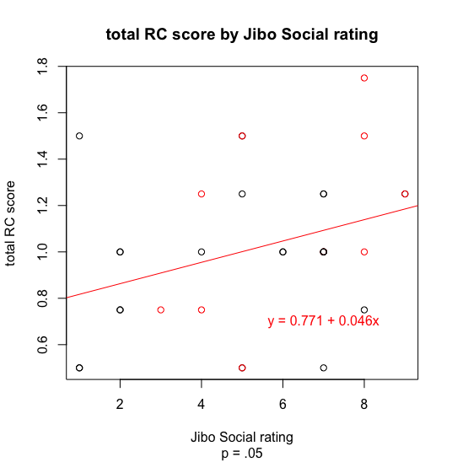
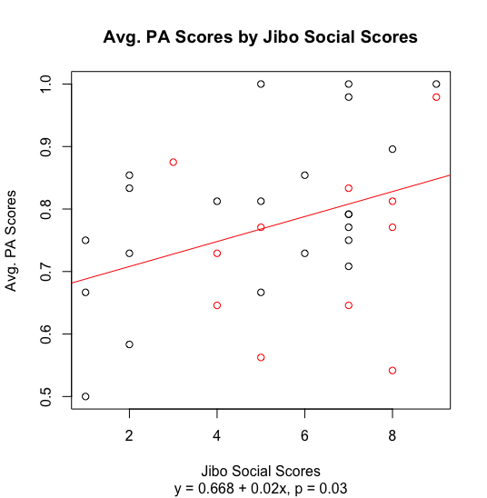
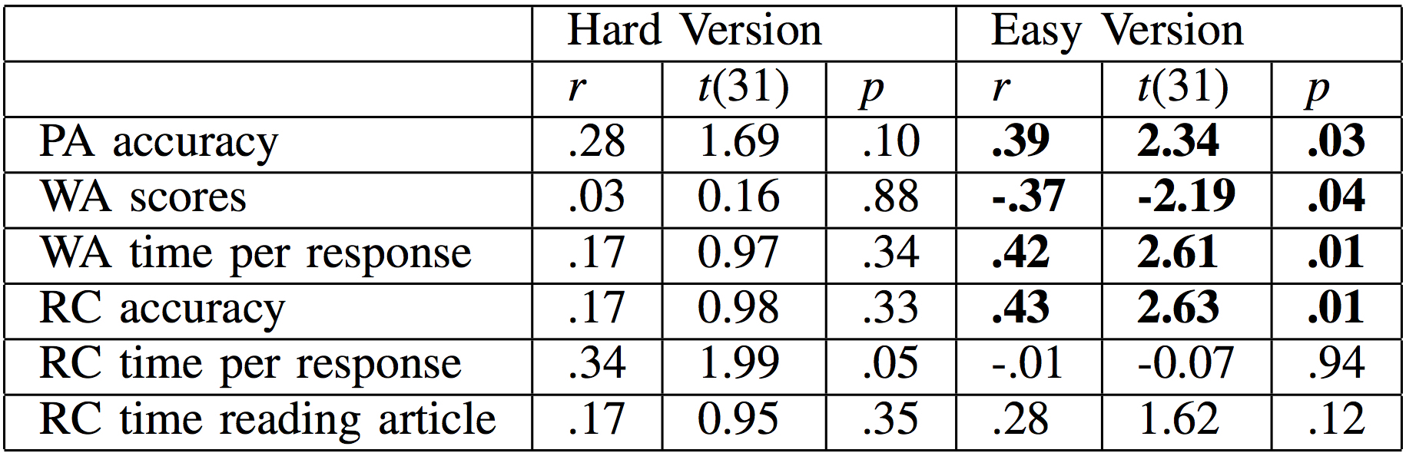
Results:
Correlations
Correlation with Jibo Sociality | Hard Version | Easy Version
PA Accuracy | r = .28, t(31) = 1.69, p = .10 | r = .39, t(31) = 2.34, p = .03
WA Scores | r = .03, t(31) = 0.16, p = .88 | r = -.37, t(31) = -2.19, p = .04
WA time spent per response | r = .17, t(31) = 0.97, p = .34 | r = .42, t(31) = 2.61, p = .01
RC Accuracy | r = .17, t(31) = 0.98, p = .33 | r = .43, t(31) = 2.63, p = .01
RC time spent per response | r = .34, t(31) = 1.99, p = .05 | r = -.01, t(31) = -0.07, p = .94
RC time spent reading article | r = .17, t(31) = 0.95, p = .35 | r = .28, t(31) = 1.62, p = .12
Notes:
I think this version of the table is nicer, but if you like the old one, I left it on the slide underneath the new table

Slide 30
Other sources of error
Self-efficacy score differences across conditions? (p = .10)
The diminishing manipulation effect
Effects in PA but not WA, RC tasks?
Poor task + task evaluation design
Ceiling and floor effects in the RC task
Boredom? (especially by the time they reach the easy tasks)
Arbitrary evaluations in the WA task

Slide 31
Implications
Robots do elicit the social facilitation effect
Including in the context of learning tasks
Social robots can increase motivation
Alleviating accessibility problems in education
The social facilitation effect is mediated by the perceived sociality of the observer
Noticeable effects despite a weak manipulation
Supports the evaluation apprehension theory of social facilitation
Robots elicit a diminished social inhibition effect
This may be due to an unique social identity attributed to robots

Slide 32
Future Directions
Do robots elicit the social inhibition effect further along the arousal spectrum compared to humans?
How would participants have performed without the presence of a human?
The co-action social facilitation effect

Slide 33
End
We’d like to thank Scaz, Sarah, and the rest of CPSC473 for a great semester!

