Slide 1
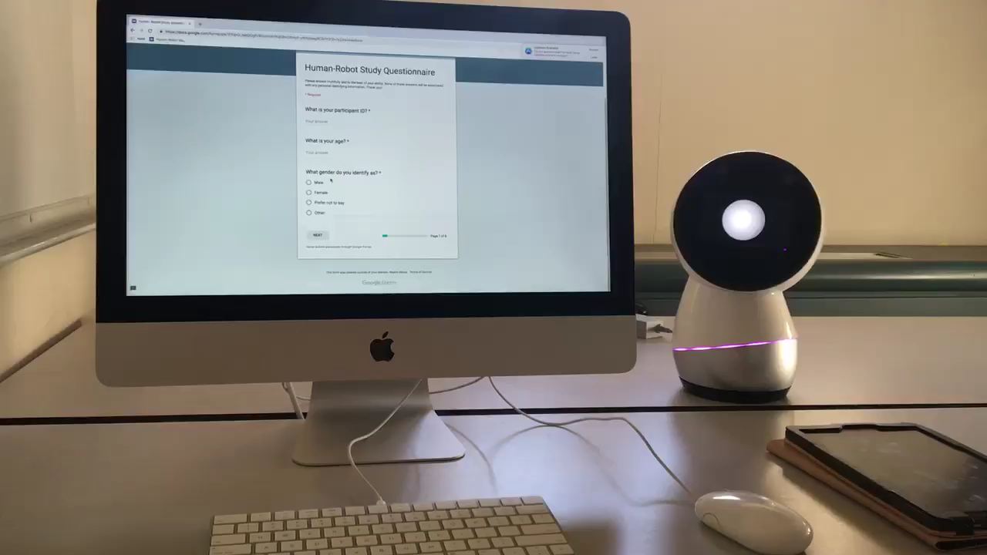
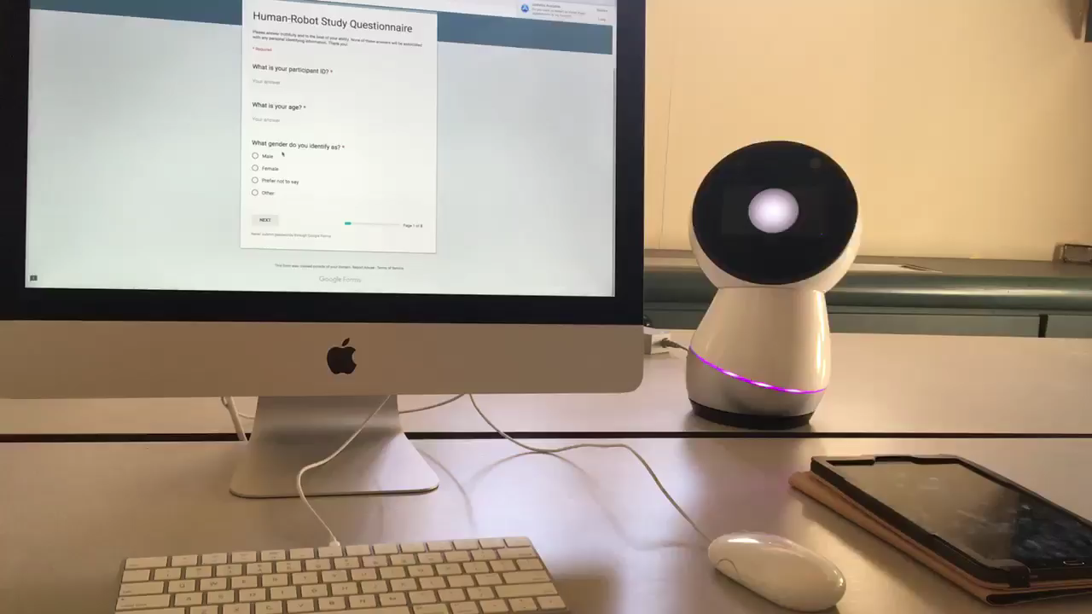
Social Robots & the Social Facilitation Effect Problem Statement: To what extent does the social nature of a robot elicit the social facilitation and social inhibition effects in humans?
Experimental Condition:
Experimenter greeted robot
Robot learned participant voice and face
Robot had idle ESML behavior
Robot glanced at user
Control Condition:
Users controlled robot with app
Robot glanced to side of user
ESML Behavior
Glancing Behavior

