Slide 1
Real-time Streaming Analytics & Alerting
Team - Anonymous
Srinivas
Surya
Amitav
April 2015

Slide 2
Agenda
Problem and Solution Overview
System Demo
Summary

Slide 3
What is the problem statement?
Create a real-time log stream monitoring and alerting system which can process continuous stream of log data, monitor it for user defined keywords and generate alerts when you detect the key words.
What are the Use Cases?
Development of a scalable system for the below 4 use cases -
Real-time streaming log monitoring and collection from multiple applications
Real-time streaming log processing in online mode and generation of events/incidents based on rules/keywords
Querying on the real-time data for finding events/incidents, reporting and visualization
Real-time log alerting/notification through different modes (Email/SMS)
Software and Hardware Details
Splunk Enterprise 6.2.x
Splunk Development Platform – SDK/APIs
Bootstrap 3.0
Jboss 7.1.1
JDK 7
Perl
Linux OS
What is our Solution?
Developed a scalable platform using the above softwares. we have used three different streaming log sources from accesslog,syslog,emaillog. Logs are being generated with the help of log simulators. Each of the streaming log source is being accessed/monitored by a forwarder or a monitor which reads the streaming logs using pull mechanism. Forwarders are created in Perl. The streaming data is ingested by respective indexers and stored in MongoDB. Here we have enabled a custom Dashboard for the users.
We have created a custom portal in Bootstrap which provides visualization and reporting capabilities for users. The custom Portal displays the total events, critical incidents with real-time graphs. Custom Portal is integrated using SDK/APIs and hosted on Jboss app server. The solution is integrated with an Alert Engine which sends the alerts based on the configured keywords in the Portal.

Slide 4
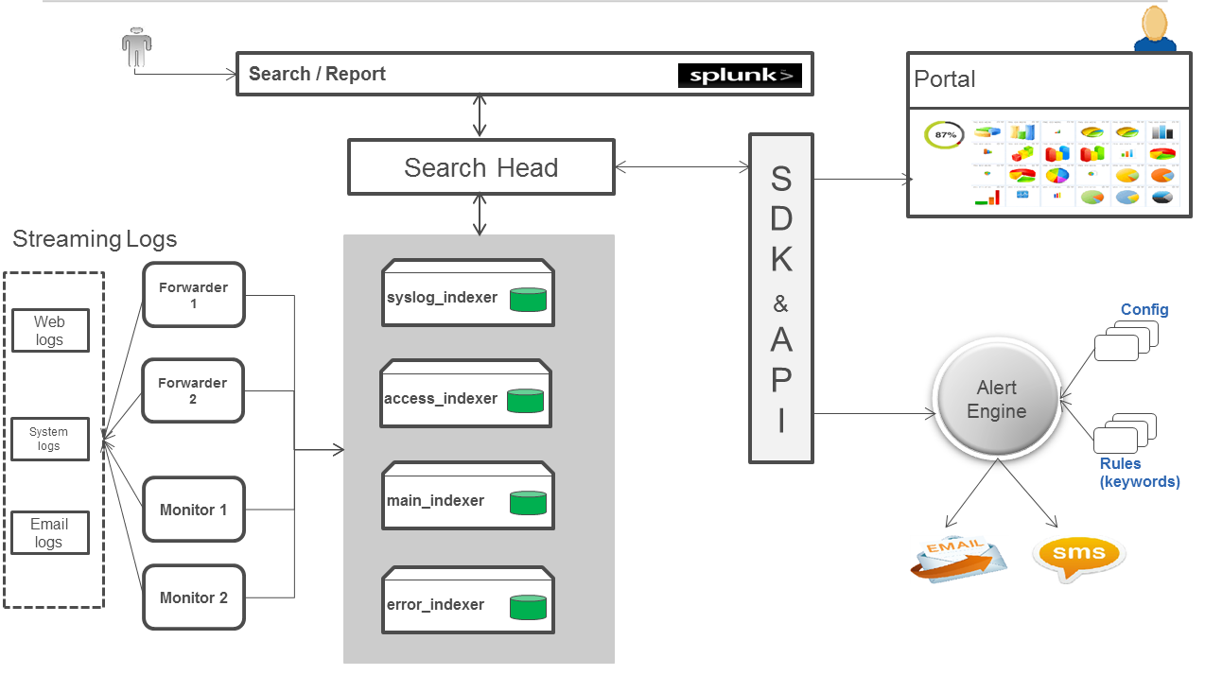
Design and Implementation Architecture

Slide 5
How our solution meets the problem statement?
A. Scalability
Scalability if streaming dataflow increases : By using Forwarders/Monitors – If Data volume increases we can increase the instances of forwarders and monitors
Scalability if data volume increases : Increasing the capacity of the commodity hardware of Splunk platform– CPU,RAM, Disk
Scalability if the users increases – By using Load balancers and multiple Splunk core engines
Scalability if the Downstream systems increases – By using more scalable APIs
B. Realtime query on the streaming data
By using Splunk Search and Reporting App and SPL
C. Realtime Alerting
Using Splunk APIs
Using Splunk Alerting which is part of the licensed version
D. User Experience and visualization
Using custom Dashboard based on the user requirements
Providing savedQueries, report Acceleration
Realtime visualization with various types of graphs

Slide 6
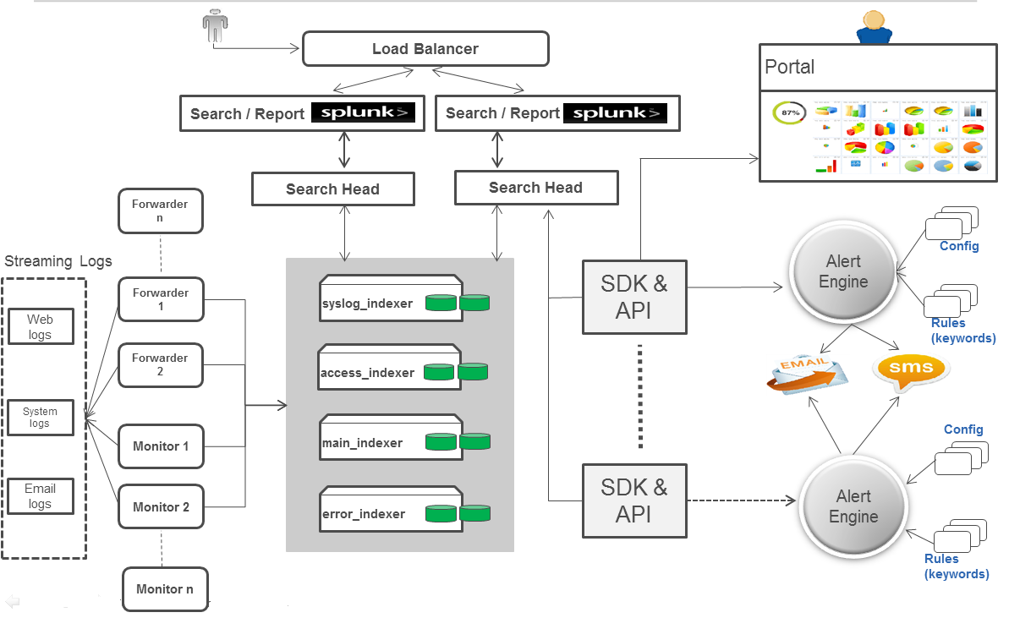
Scalable Architecture

Slide 7
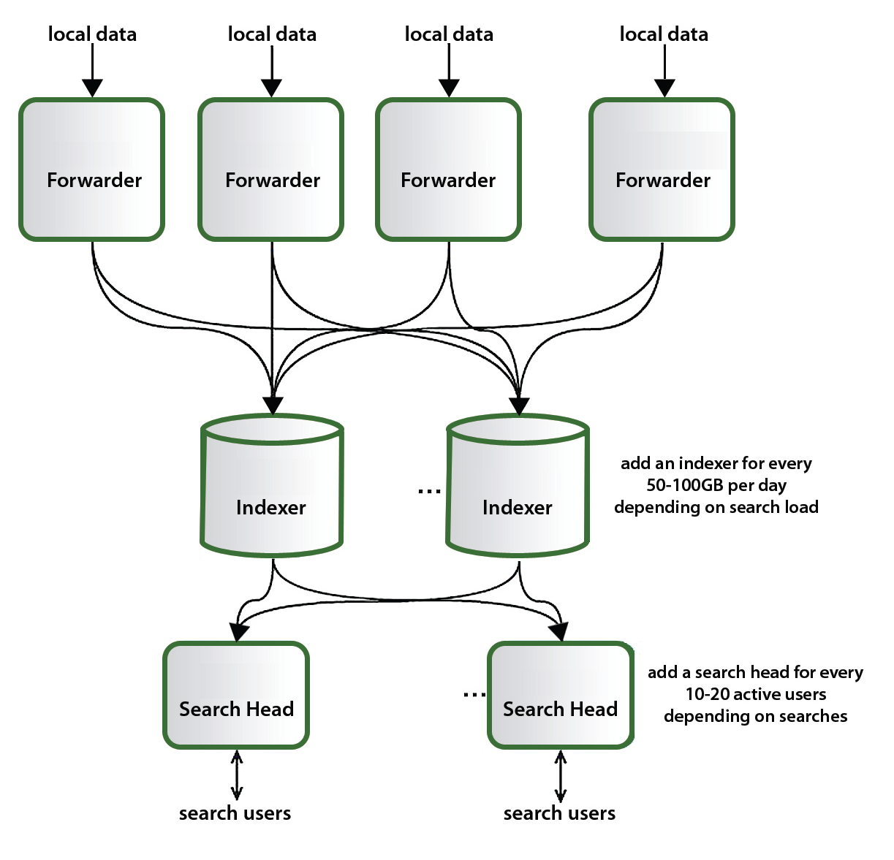
Scalability Benchmark

Slide 8



