Slide 1

Smart Waste Management System
Dr. B.R.Ambedkar National Institute Of Technology, Jalandhar
Department Of Instrumentation And Control Engineering
Major Project
Supervisor : Professor Dr. A.K. Jain
Team Members
Aditi Singh (19106006)
Amit Anand (19106009)
Ashish Kumar (19106013)
Aswini Kumar (19106015)

Slide 2
Project Overview
The project aims to develop a system for real-time monitoring of the filling level of dustbins using ultrasonic sensors, ESP8266, and a GSM module. The collected data is transmitted to a central server and displayed on an mobile application.

Slide 3
Problem Statement
Challenges in traditional garbage collection method
Traditional methods rely on manual observation or predetermined schedules for garbage collection.
Lack of real-time data can lead to inefficient waste management practices, such as emptying partially filled dustbins or missing overfilled bins.
Garbage collection trucks may be deployed inefficiently, resulting in wasted time and resources.

Slide 4
Problem Statement
Need for real time monitoring
Inefficient resource allocation
Lack of real-time data on the filling levels of dustbins can lead to inefficient routing and collection schedules.
Limited Adaptability to Changing Conditions

Slide 5
Objectives
Develop a Real-Time Monitoring System
Establish Data Transmission Mechanism
Create a mobile application

Slide 6
Project Proposal
Real time levels of dustbins levels are measured by ultrasonic sensor.
For transmission of sensor data we are using GSM module and node MCU.
We are showing real time level of dustbins on mobile application.

Slide 7
Main Hardware Components
Ultrasonic sensor (HC-SR04)
GSM/GPRS SIM module (SIM 800L)
Node MCU (ESP8266)

Slide 8
Software Technologies
Arduino IDE
Firebase
Google Map Api
App Development

Slide 9
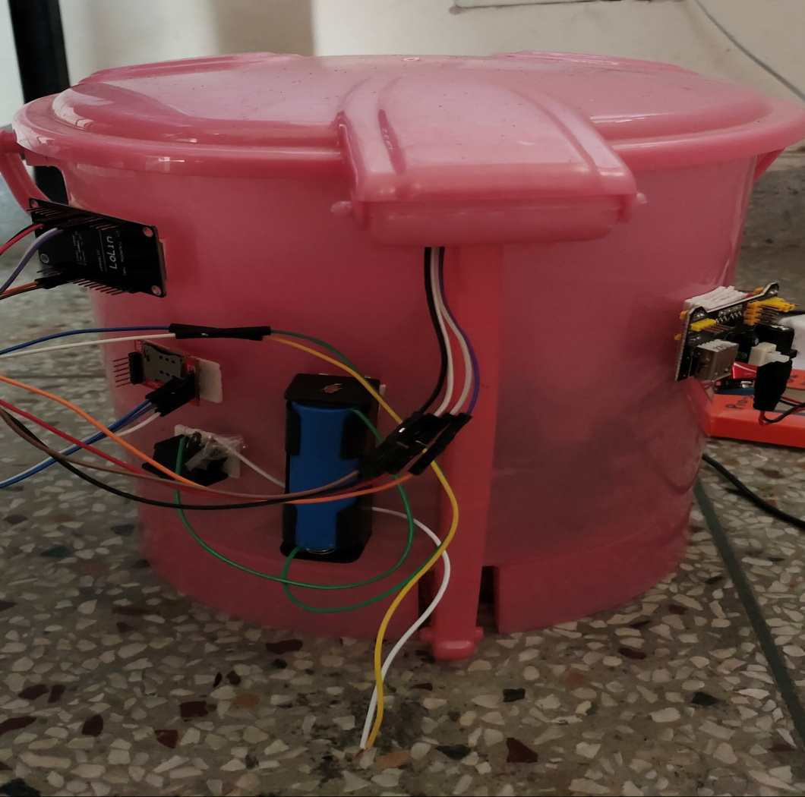
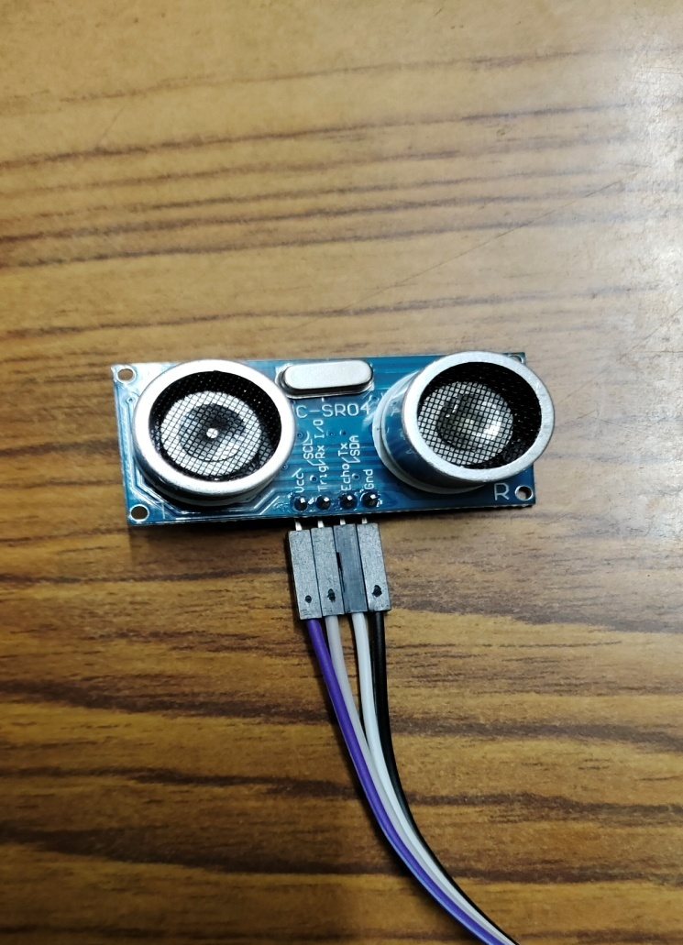
Sensor Node Prototype

Slide 10
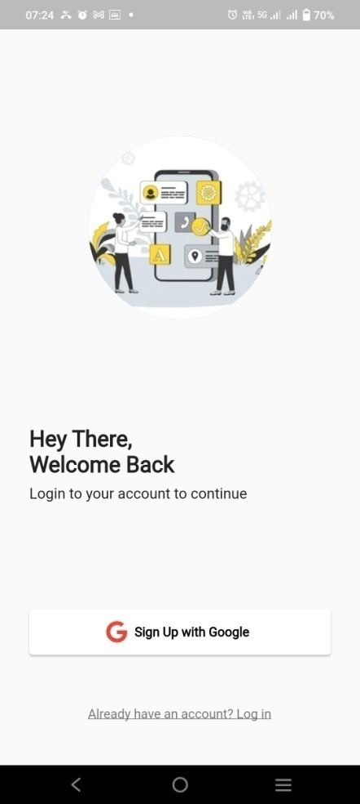
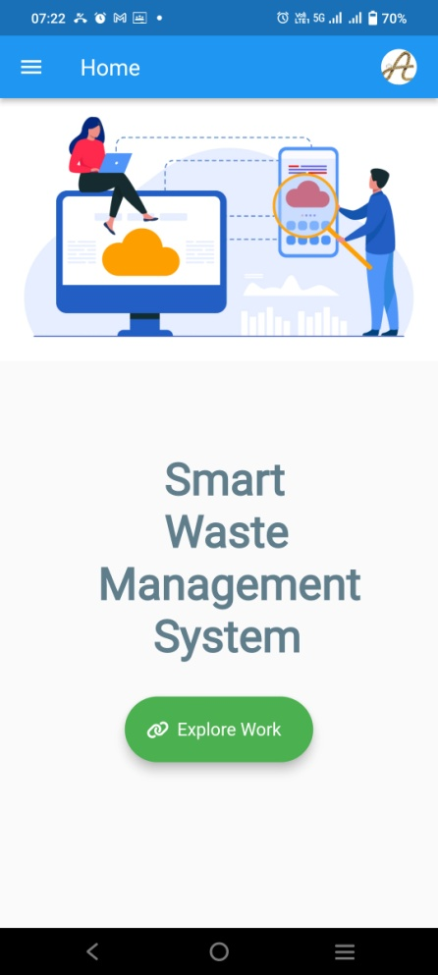
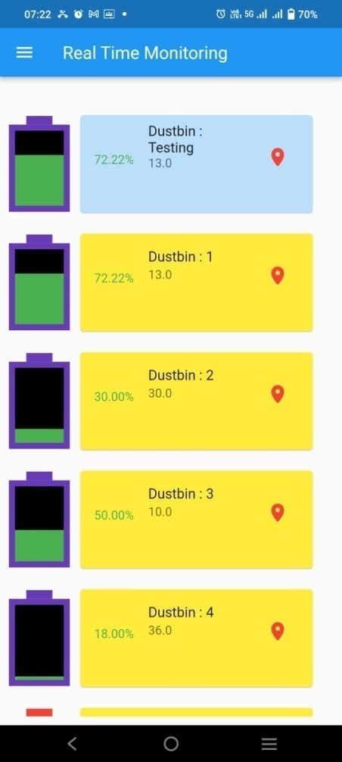
Real Time Monitoring Interface

Slide 11
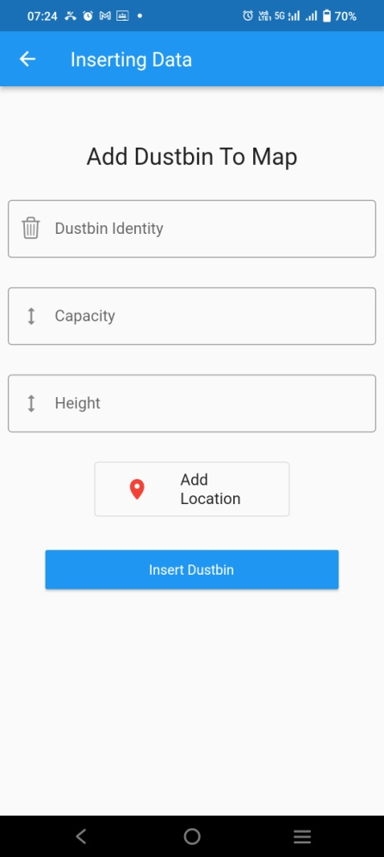
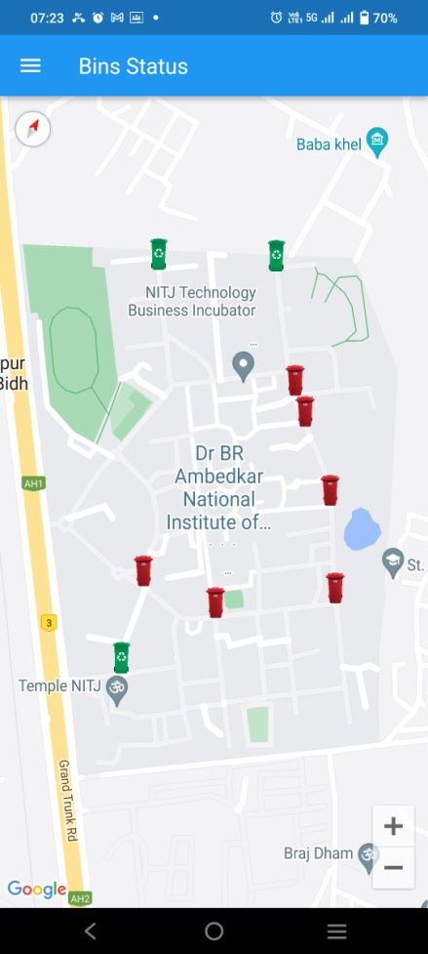
Status of Bins Interface

Slide 12
Conclusion
All the given objectives of the project is completed
Develop a Real-Time Monitoring System
Establish Data Transmission Mechanism
Create a Website Interface

Slide 13
Key Takeaways of Project
Efficient Waste Management
Optimal Resource Allocation
Time saving
User friendly interface

Slide 14
Future Scope
Integration of Machine Learning and AI
Predictive Maintenance
Integration with Smart City Infrastructure
Sensor Network Expansion

Slide 15
Thank You

