Slide 1
The Lemonade Stand – DBMS Project
Group 1 – K007, K035, K047, K070
Notes:
Good evening. We’re group 1, constituted of K007 Yash Burshe, K035 Ridhima Mishra, K047 Arushi Rai, and K070 Charitra Arora.

Slide 2
Business Scenario Overview
Small lemonade stand run by two children - started this business to earn some extra money over the summer, in June, July, and August.
Agreement with the golf course to provide electricity and water in exchange for a rental fee of 5% of the sales.
Both children working as employees being paid a daily wage of $75.
Notes:
This business scenario covered the requirements of a small lemonade stand run by two children, who started this business to earn some extra money over the summer, in June, July, and August.
After an agreement with the golf course to provide the children's stand with electricity and water in exchange for a rental fee of 5% of the sales, the children started their business, both working as employees being paid a daily wage of 75 dollars.

Slide 3
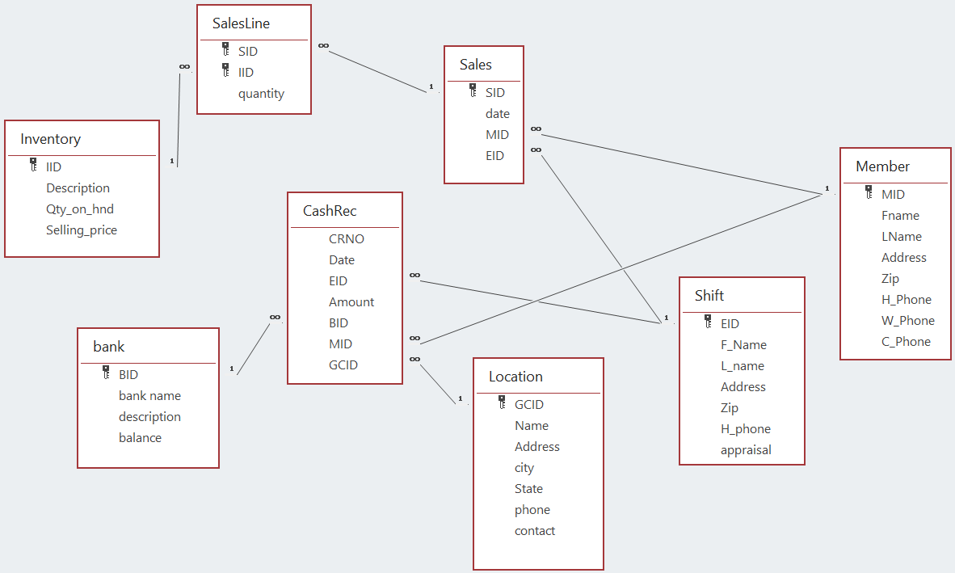
Business Scenario Overview (contd.)
Notes:
We’ll try to explain the entire sales process in brief, employing the database design.
The golf course they're working on has been recorded in the location table along with the employees' details in the shift table. This might not seem so tremendous or even a necessity at the moment when there are just 2 employees and one lemonade stand only, but allows the business to expand later on without warranting any changes in the database design.

Slide 4
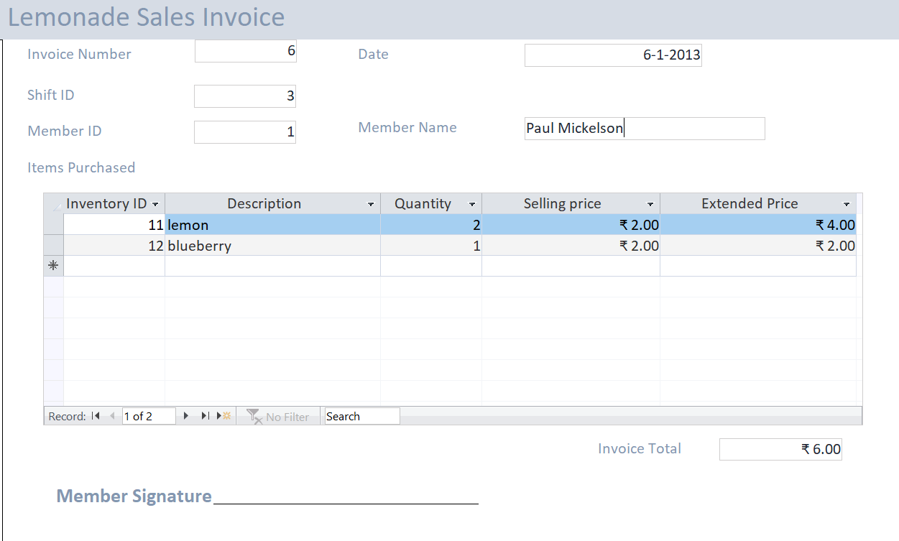
Business Scenario Overview (contd.)
Notes:
Now, the sales are intended to be tracked employee-wise. Therefore, we add the sales details to the database through this form, the usage of which we shall now demonstrate.

Slide 5
Business Scenario Overview (contd.)
Notes:
35 –
This form adds the new sales data to the tables Sales and SalesLine, respectively.
The member ID here refers to the member table, (click) which stores all of the club's members' details, including their names, that was hence, displayed on the invoice we just made.
Going back to the sales data, once the necessary details are added to the sales table, a subsequent addition is made to the SalesLine table, which, storing the sales ID and inventory ID as a composite key, also keeps the quantity purchased, bearing in mind that a customer can buy more than one items from the inventory.
Click
The inventory ID is just a unique identifier of all the 19 flavours that the lemonade stand offers, along with the specific details of each flavour stored in the Inventory table.

Slide 6
Business Scenario Overview (contd.)
Notes:
35 –
The last step of the business process is collecting the cash receipts for all of the members' monthly purchases, of which a detailed invoice is sent to the club after all of the sales are recorded on each of the members' personal club cards.

Slide 7

Performance Analysis
How good are sales and cash receipts for 2013?
Is the lemonade stand doing a good job collecting cash on their sales? Why is this an issue the lemonade stand needs to think about?
Which lemonade flavors should the lemonade stand focus on in the future? Are there some flavors that maybe they shouldn’t sell anymore?
Which employees appear to generate the most sales? What about the least sales?
What is the effect of weather on sales? How does understanding the effect of weather on sales improve our understanding of the business?
Who are the lemonade stand’s best customers? Who are the worst customers? How should the lemonade stand use this knowledge?
Can you think of any IT security or control risks that exist in the database or the sales process? Would there be ways for employees to steal inventory using the database for example?
Notes:
35 –
These are the questions we’ll now be going over to analyse the performance of this business.

Slide 8
¹ ⁻ Sales and cash receipts for 2013
Total Sales in 2013
Quantity – 5265 units
Amount – $ 13,283.00
Units sold
Total Cash Receipts for 2013
$ 13,123.00
Month-wise Analysis
Notes:
As the graph on the right clearly elucidates, sales peaked in June 2013 when the business first opened in terms of the quantity sold, followed by a slowing down in July, which again saw a rise in August.
The total sales in 2013, in terms of units sold, is 5265 units, which generated sales of 13,283 dollars.
The cash receipts for 2013 were for 13,123 dollars, which when subtracted from the sales amount, shows a payment default of 160 dollars.

Slide 9
² ⁻ Cash Collection
Problem?
Payment defaulters
Computation of profits and losses
Rent payment
Total Sales in 2013
$ 13,283.00
Profits and losses could be computed
on the basis of cash receipts
Defaulter reports could be another
report sent to the management
Defaulters could be fined (new table
needed)
Total Cash Receipts for 2013
$ 13,123.00
Solutions
Notes:
For Qs 2 –
Like we’ve already seen, the difference of 160 dollars in the cash receipts of 2013 and the sales amount indicates some members’ default in payment, which is obviously, not a good thing for the business for the following reasons:
It causes a discrepancy in the calculation of profits and losses of the business because we are not able to recover the entire amount of the goods we sell at the same time.
Further, like we went over initially, the rent for the lemonade stand is to be paid with 5% of the total sales they have made, which, now we are able to understand is not exactly proportionate to the quantity of goods we’ve sold. So, although the sales have been made for 13,283 dollars, we have just gotten 13,123 dollars for it.
Both these problems don’t seem so significant at the current situation of the business, but we know that they wish to expand the business in the near future. With so many different stands running together, payment defaults might pile up and become a significantly large amount.

Slide 10
^{3 –} Flavour Analysis
Flavour-wise Sales Analysis
Description | Quantity Sold | Amount
Lemon | 8334 | $ 16,668.00
Cherry | 3025 | $ 9,075.00
Strawberry Banana | 972 | $ 3,888.00
Fuzzy Navel | 692 | $ 3,460.00
Green Apple | 1301 | $ 2,602.00
Peach | 1133 | $ 2,266.00
Blueberry | 915 | $ 1,830.00
Orange Pineapple | 300 | $ 1,500.00
Kiwi | 498 | $ 1,494.00
Lemon Lime | 692 | $ 1,384.00
Grape | 394 | $ 1,182.00
Peppermint | 291 | $ 1,164.00
Watermelon | 300 | $ 900.00
Blackberry | 212 | $ 424.00
Red Raspberry | 100 | $ 400.00
Orange | 96 | $ 384.00
Strawberry | 48 | $ 96.00
Focus more
Lemon
May get rid of
Strawberry
Notes:
007 hehe –
This slide answers the third analysis question about the flavours – We have queried the database and found that these are the total flavour-wise sales that the lemonade stand has made. We observe that lemon is the best selling flavour. We could use this to our advantage and increase publicity of the stand based on this flavour, which seems to attract the most customers.
We could also get rid of the strawberry flavour entirely since its sales are abysmally low and maybe use that money we’re saving to invest into some other flavour or another aspect of the business, like advertisements. It’s not exactly compulsory to have 19 flavours, right?

Slide 11
^{4 –}Employee Analysis
Generate Most Sales
Total Sales Units and Amount
Name | Quantity Sold | Total Sales Amount
Chris Smiley | 7493 | $ 18,912.00
Joe Teenager | 3698 | $ 9,327.00
Both Joe and Chris together | 8112 | $ 20,478.00
Chris Smiley
Generate Least Sales
Joe Teenager
Notes:
Chris Smiley, who has made sales of 18,912 dollars is the employee that generates the most sales, whereas Joe Teenager has been able to generate only about half of that amount.
Both children working together on the weekends generate the most sales overall, but that could be attributed to the greater crowd that the golf course might have on weekends, instead of the children’s team work or augmented salesperson capabilities.

Slide 12
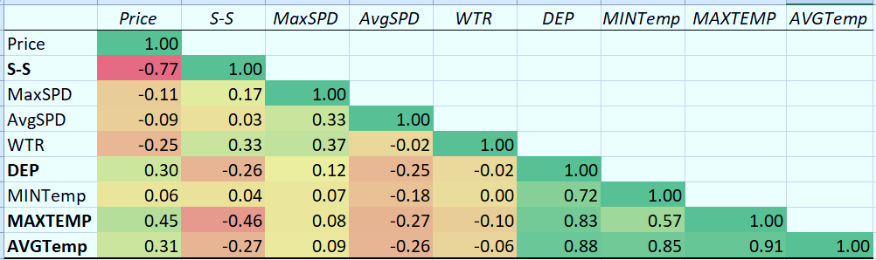
^{5 –}Effect of Weather on the Business
What could we do?
If a hotter day is forecasted:
Stock up more
Could increase the prices of the more popular products by a very meagre amount
Effect of S-S
Effect of Temperature
(The average sky cover between sunrise and sunset in tenths of sky covered)
MAXIMUM INVERSE RELATION
WITH SALES
S-S SALES
(The highest temperature for the day)
MAXIMUM DIRECT RELATION WITH SALES
MAXTEMP SALES
If a cloudier day is forecasted:
Could try to provide more attractive discounts
Notes:
Now we try to analyse the effect of weather on our sales. The correlation analysis we did was able to tell us that S-S, that is basically the cloud cover in the sky has the most inverse proportionality on the sale, meaning an increase in that, which probably makes the day cooler, drives down our sales. On the contrary, an increase in the Maximum temperature, which obviously makes the day hotter, will drive up our sales.
Since people don’t need to purchase lemonade on the cooler days due to dehydration, attractive discounts, instead, could incentivize the sales on such days.
For the days when it is hot, and people find lemonade as a necessity, we could stock up more if we know a hotter weather is forecasted, and also, increase the prices of the more popular products by a very, very meagre ratio, which will all add up to a more significant amount solely based on the tremendous volume of sales we’re able to make.

Slide 13
^{6 –}Customer Analysis
Best Customers
Worst Customers
Rick Gossen (Member ID 16)
Pat Lawrie (Member ID 38)
Jean Leonard (Member ID 36)
- Provide them with discounts and perks so that they may spread a good word about us
108 customers with no purchases
Product samples
We could also try to provide them with the product at discounted rates
Payment defaulters
Penalize them in some way (maybe a small fine for the late payment)
Notes:
These are three of our best customers,
The worst customers have to be the ones who have never purchased anything from us, ever.
Another aspect of the “worst customers” could be our payment defaulters.
We have made a report for the same as part of this project, let’s quickly take a look at that as well.
(Wait for it to open)
Here we see that all these customers that have non-zero accounts receivable balance towards the end of 2015 are the defaulters.
The defaulters could be fined, if the need arises, and the members who haven’t purchased anything from us could be provided with free samples, and discounted rates for the products, whereas the best customers should definitely be provided with perks and discounts that they can spread a good word for us around.

Slide 14
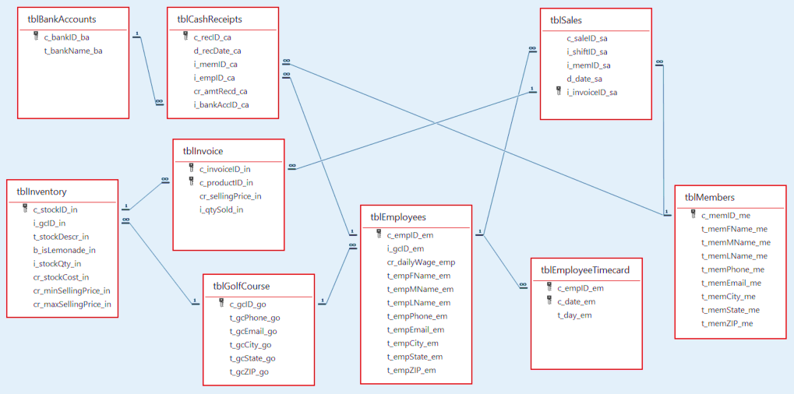
^{7 –} Security/Control Risks
Employees’ Wage Computation
Employee Access to Members’ Personal Details
No ‘Golf Course’ Specified in tables other than Cash Receipts
Employees’ Access to the Inventory
Notes:
Employees selling lemonade at the golf course have absolutely no utility of the members’ personal details such as address and ZIP codes. These details shouldn’t be openly accessible to all employees, and must be hidden away. They needn’t be included in the lemonade stand database in the first place.
Another problem that could arise is from not having specified which golf course an employee is working on… a customer is a member of…or even where the sales are being made. This could not only also cause a lot of disruptions in the computation of the balances of the members if incorrectly entered, (by mistake or on purpose), but will also make the creation of reports and queries for data analysis much more harder.
(click)
If we did include a golf course ID as foreign key for every employee in the employee details table, it will, by extension, take care of the problems.
(click)
Next,
All employees having open access to the inventory may be causative of a manipulation of the quantity in stock numbers, as well as the selling_price values, and although the price manipulation can be tracked using the bill invoices, the quantity in stock numbers’ manipulation can allow a theft of the inventory.
There’s also no perfect way to track which employee worked on which day, since this is being computed by the days on which the employee’s ID is said to be making sales. Suppose an employee was not able to sell any product for a day, their coming into work will not be recorded, which will in turn, affect their salary, which is computed on a daily wage basis.
Then we have weekdays where only one employee is scheduled to work on a particular day, if I accidentally or again, on purpose, show that two employees worked the same day, I’ll have to pay double the wage for a day that did not require so. This could be taken care of by having a timecard table store the dates and days every employee works on.

Slide 15
Thanks!
Questions?
Please keep this slide for attribution

