Slide 1
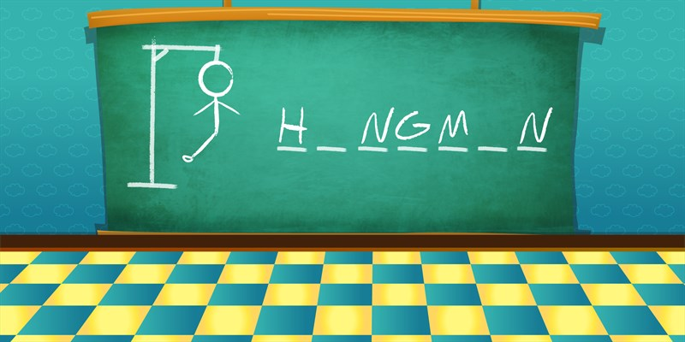
A
A
Made By:Ashvani Patel
UID:21MCA3105

Slide 2

Contents
Introduction
Introduction to language
Scope
Tools used in project
Advantages
Disadvantages
Modules of project

Slide 3
Introduction to Project
It is simple Hangman which you can play easily and the player has to guess that word.
The word to guess is represented by a row of dashes representing each letter of the word.
If the word is correct in limited chances, the game is over and the wins. Otherwise, an element get added to the diagram.
On the other hand, if the guesser makes enough incorrect guesses to complete the diagram, the guesser loses.
completing the word, before the diagram is completed.

Slide 4
Introduction to Language
Python is a high-level, interpreted, general-purpose programming language. Its design philosophy emphasizes code readability with the use of significant indentation.
Python is dynamically-typed and garbage-collected. It supports multiple programming paradigms, including structured (particularly procedural), object-oriented and functional programming. It is often described as a "batteries included" language due to its comprehensive standard library.
Guido van Rossum began working on Python in the late 1980s as a successor to the ABC programming language and first released it in 1991 as Python 0.9.0. Python 2.0 was released in 2000 and introduced new features such as list comprehensions, cycle-detecting garbage collection, reference counting, and Unicode support. Python 3.0, released in 2008, was a major revision that is not completely backward-compatible with earlier versions. Python 2 was discontinued with version 2.7.18 in 2020.

Slide 5
Scope
My project will be able to implement in future after making some changes and modifications as we make our project at a very low level.
So modifications that can be done inour project are:
It can be made with good graphics.
We can add more options like Top score player profile.
We can add multiplayer option.

Slide 6
Tools used in project
Pycharm IDE:
Pycharm is an integrated development environment (IDE) used in computer programming, specifically for the Python programming language. It is developed by the Czech company JetBrains (formerly known as IntelliJ). It provides code analysis, a graphical debugger, an integrated unit tester, integration with version control systems (VCSes), and supports web development with Django as well as data science with Anaconda.
PyCharm is cross-platform, with Windows , macOS and Linux versions.There is also an educational version, as well as a Professional Edition with extra features

Slide 7
Tools used in project
Python Turtle Module:
Turtle is a pre-installed library in Python that is similar to the virtual canvas that we can draw pictures and attractive shapes. It provides the onscreen pen that we can use for drawing.
The turtle Library is primarily designed to introduce children to the world of programming. With the help of Turtle's library, new programmers can get an idea of how we can do programming with Python in a fun and interactive way.
It is beneficial to the children and for the experienced programmer because it allows designing unique shapes, attractive pictures, and various games. We can also design the mini games and animation..

Slide 8
Tools used in project
Python random module:
Python Random module is an in-built module of Python which is used to generate random numbers. These are pseudo-random numbers means these are not truly random. This module can be used to perform random actions such as generating random numbers, print random a value for a list or string, etc.

Slide 9
Advantages
Easy to play so that even children can play
Grphical interface to look more attractive
Help children to remember country names
Help increasing long term memory

Slide 10
Disadvantages
Limited number of words.
Only country names are available.
Scoreboard currently not available.

Slide 11
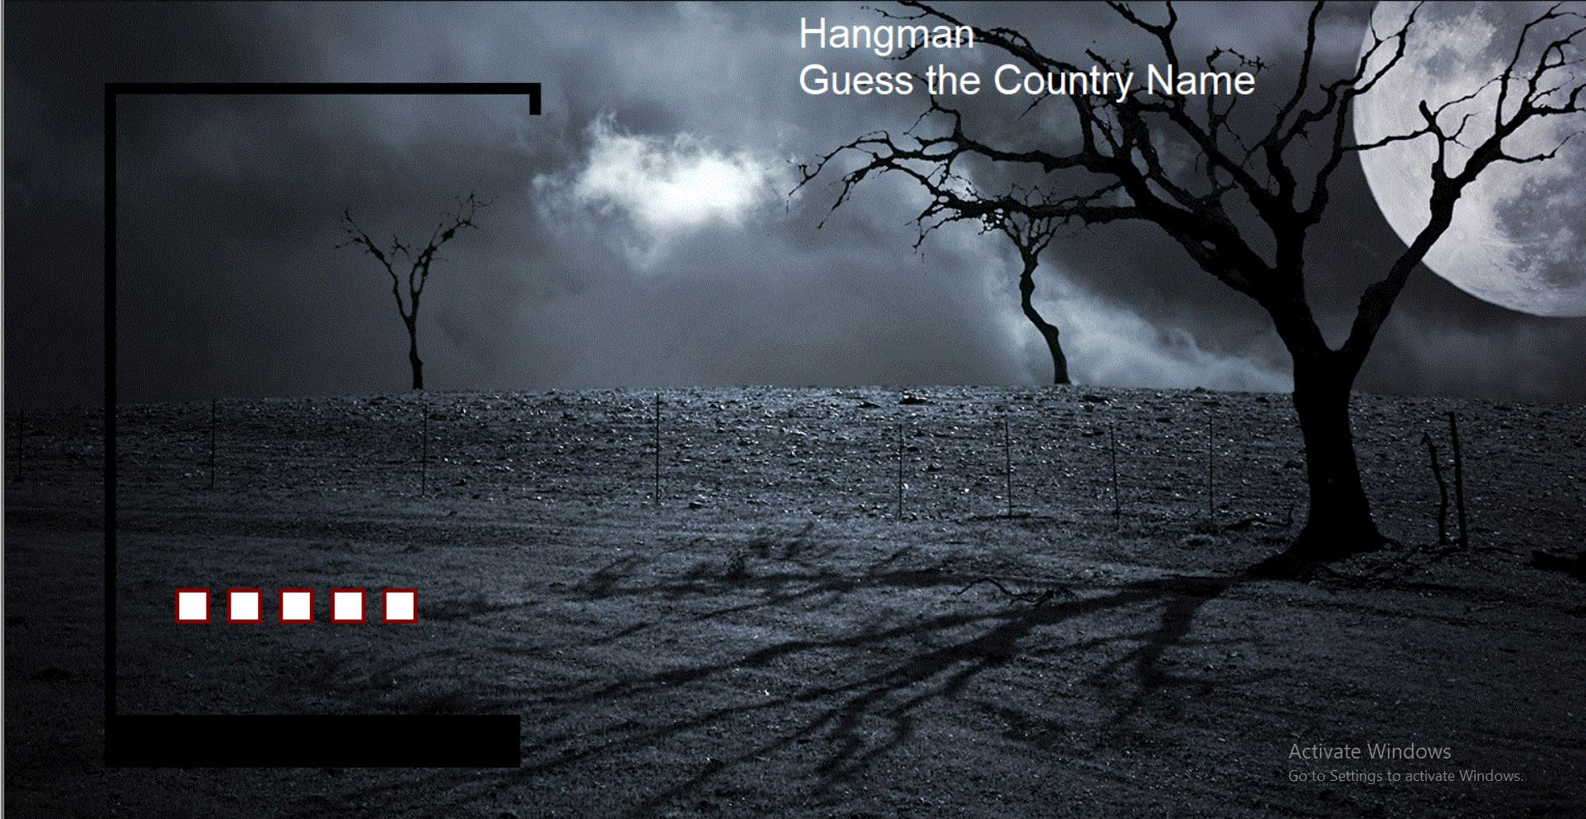
Modules of projects

Slide 12
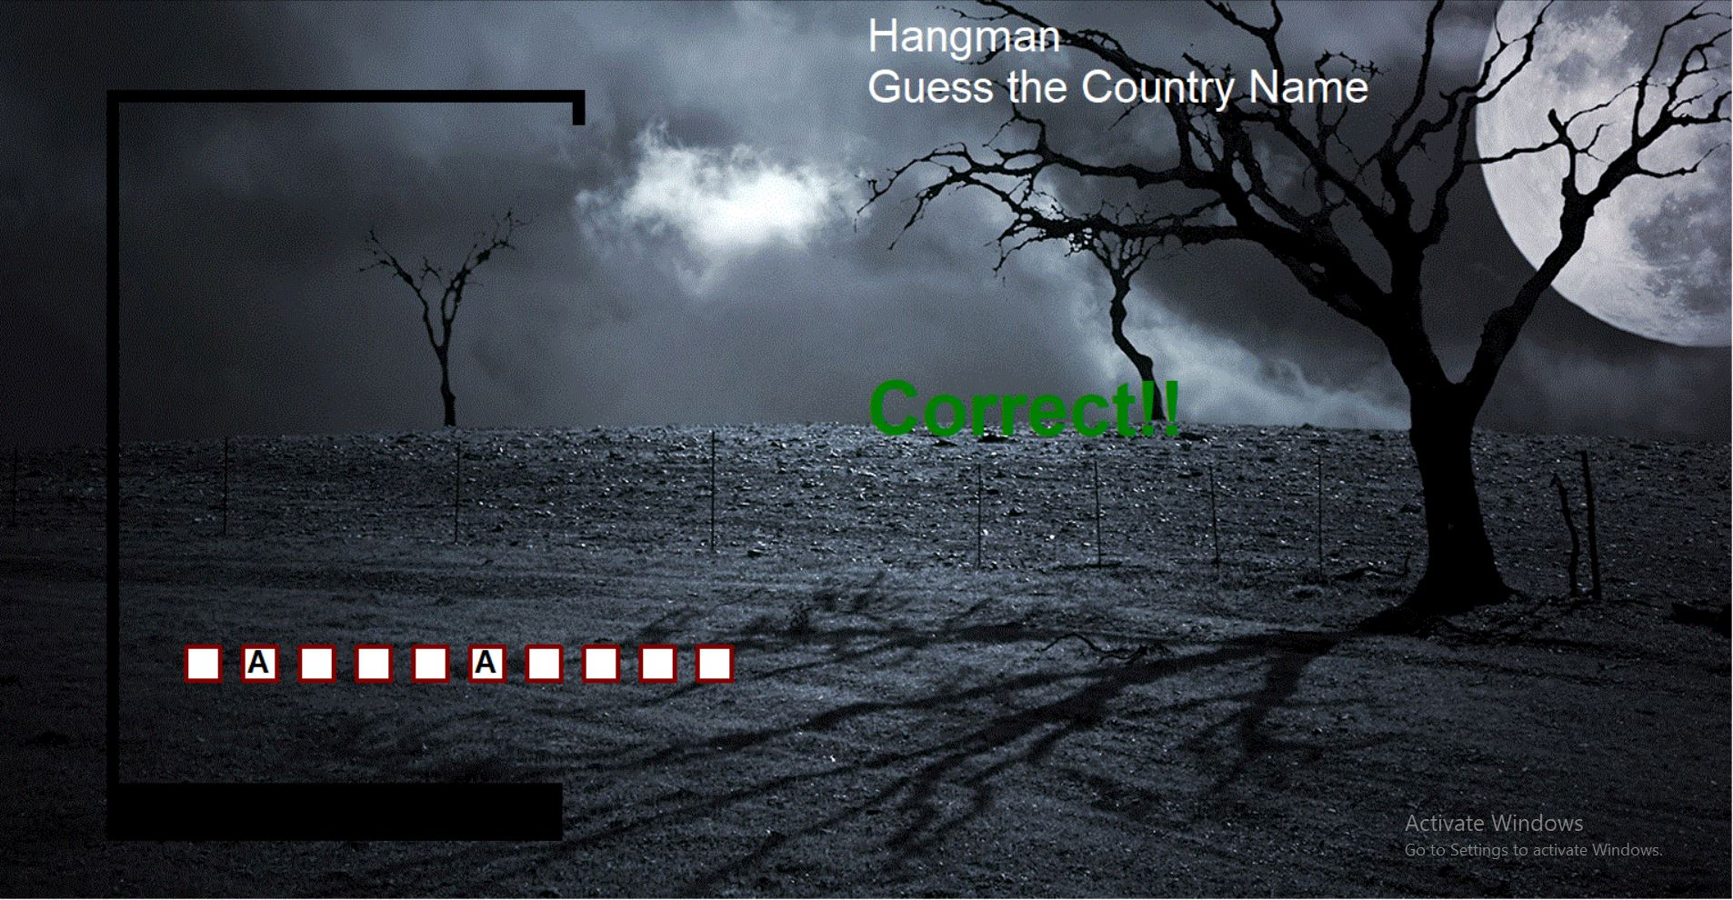
Modules of projects

Slide 13
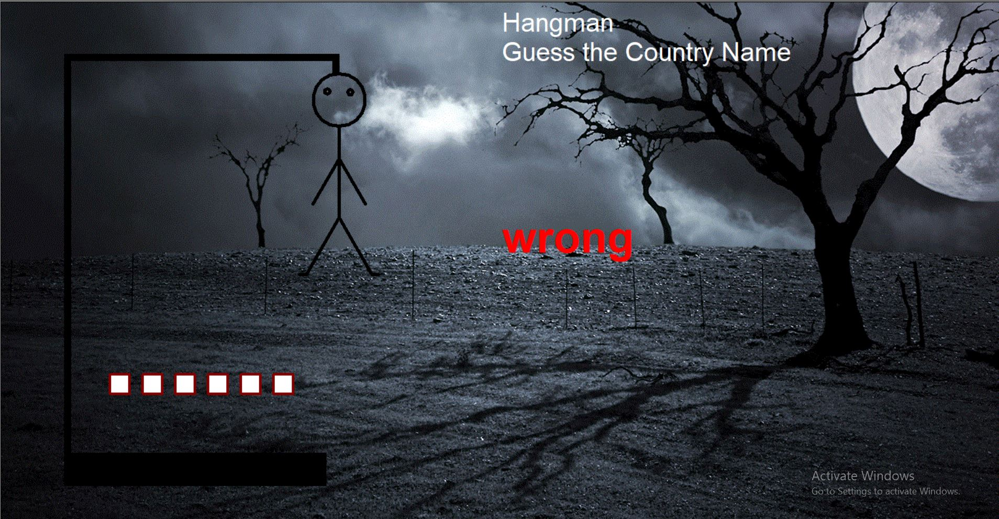
Modules of projects

Slide 14

Modules of projects

Slide 15

Modules of projects

Slide 16
THANK YOU
https://github.com/ashvanip002/Hangman_game/

