Slide 1
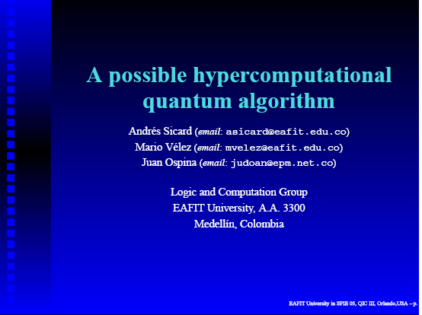

Slide 2
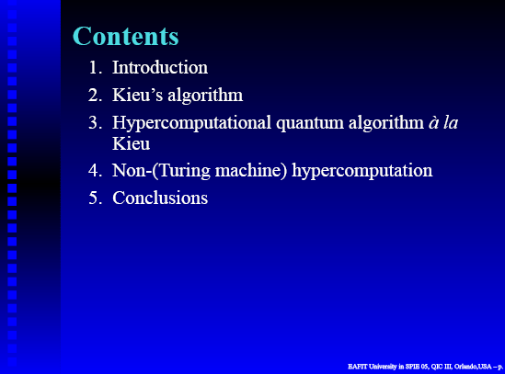

Slide 3
KINDS OF COMPUTERS
Computable Tractable Problem
Classical
Computer
Efficient
solution
Standard
Computable Intractable Problem
Quantum
Computer
Hybrid
Adiabatic
Non computable Problem
Hyper-
computer
Infinite

Slide 4
Kieu's Algorithm
Diophantine
Equation
Coherent state
Quantum
System
Solution state

Slide 5
Two sources of Kieu's Algorithms
Quantum
System
Dynamical
Algebra
Coherent
States
Ortho-
normalized
Polynomials
Generalized
Oscillator

Slide 6
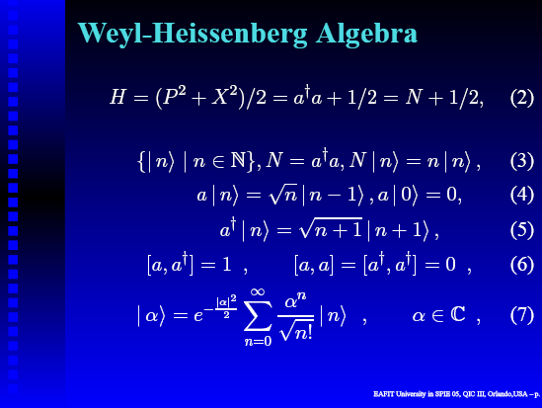

Slide 7
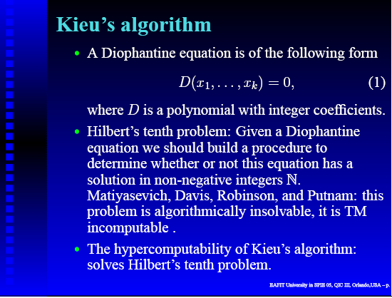

Slide 8
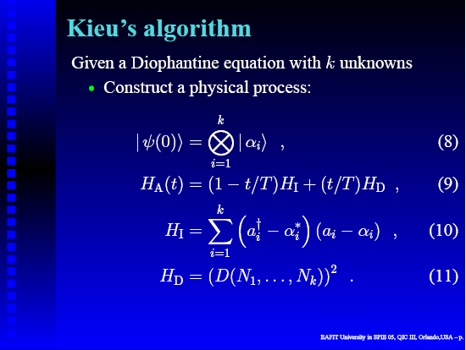

Slide 9
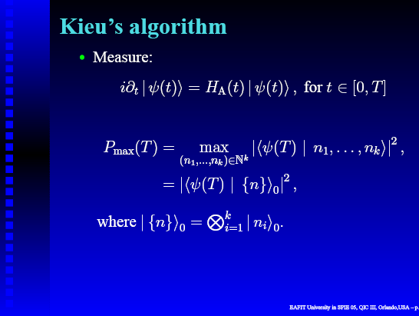

Slide 10
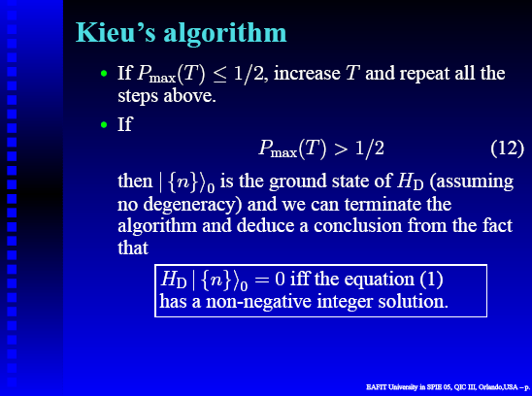

Slide 11
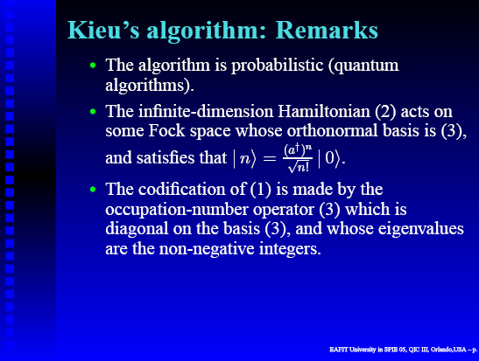

Slide 12
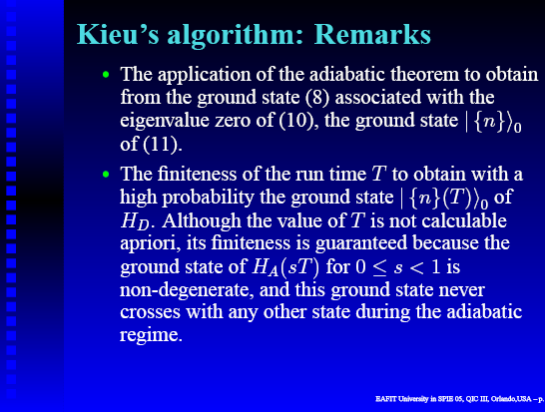

Slide 13
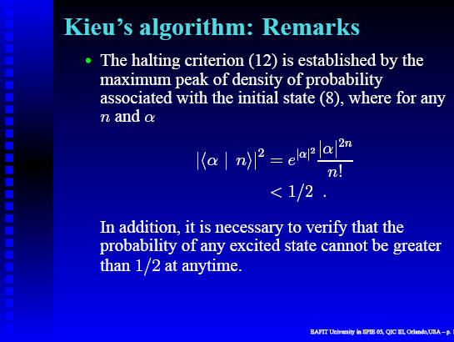

Slide 14
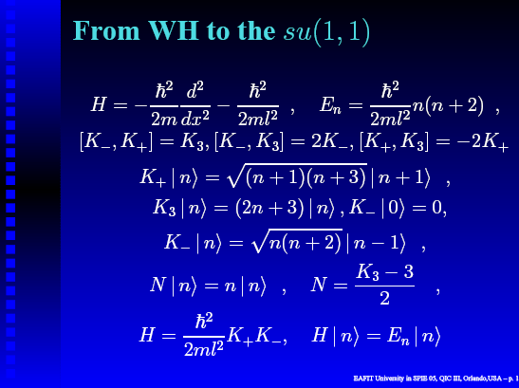

Slide 15
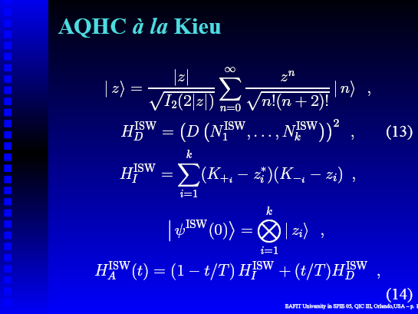

Slide 16
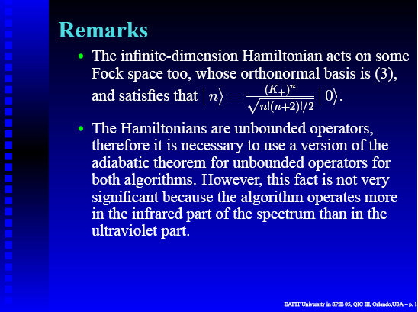

Slide 17
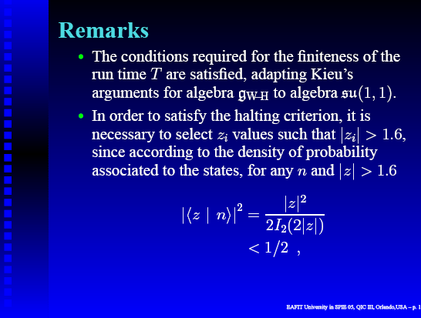

Slide 18
REFERENCES
T. D. Kieu, “Computing the non-computable,” Contemporary Physics 44(1), pp. 51–71, 2003.
T. D. Kieu, “Quantum algorithm for the Hilbert’s tenth problem,” Int. J. Theor. Phys. 42(7), pp. 1461–1478, 2003.
T. D. Kieu, “Quantum hypercomputation,” Minds and Machines 12, pp. 541–561, 2002.
T. D. Kieu, “Numerical simulations of a quantum algorithm for Hilbert’s tenth problem,” in Quantum Information and Computation, E. Donkor, A. R. Pirich, and H. E. Brandt, eds., Proc. of SPIE 5105, pp. 89–95, SPIE, Bellingham, WA, 2003.
T. D. Kieu, “Hypercomputation with quantum adiabatic processes,” Theoretical Computer Science 317, pp. 93–104, 2004.
T. D. Kieu, “A reformulation of Hilbert’s tenth problem through quantum mechanics,” Proc. R. Soc. Lond. A 460, pp. 1535–1545, 2004.
J. P. Antoine et al., “Temporally stable coherent states for infinite well and P¨oschl-Teller potentials,” Math. Phys. 42(6), pp. 2349–2387, 2001.
A. Sicard, J. Ospina, and M. Velez, “Numerical simulations of a possible hypercomputational quantum algorithm,” in Proceedings 7th International Conference on Adaptative and Natural Computing Algorithms - ICANNGA 2005, B. Ribeiro, ed., Springer-Verlag, (University of Coimbra, Portugal), 21st - 23rd March 2005.

Slide 19
