Slide 1
Hypercomputation
Andrés Sicard
Logic and Computation Group
EAFIT University, Medellín, Colombia
Centre for Atom Optics and Ultrafast Spectroscopy (CAOUS)
Swinburne University of Technology,Melbourne, Australia
19/11/2004

Slide 2
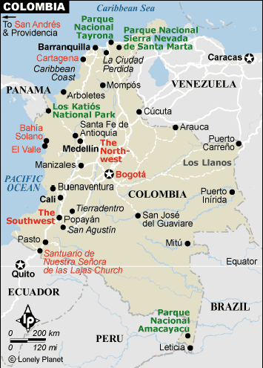
Colombia
Area: 1.14 m. sq km
Pop: 45 million
Capital City: Bogotá (pop: 6 million)
Language: Spanish
Religion: Catholic (95%)

Slide 3
Medellín
Second largest and biggest industrial and commercial city in the country.
Also called the “City of Eternal Spring” due to its fantastic weather all year long (between 20 C and 30 C).

Slide 4

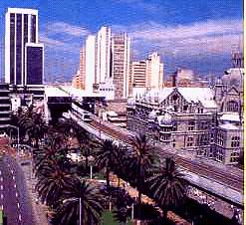
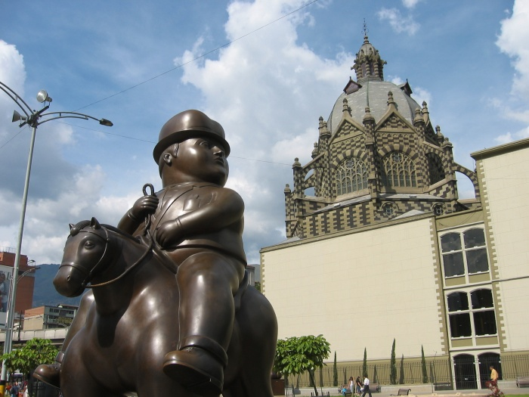
Medellín

Slide 5
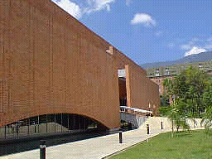
Universidad EAFIT
EAFIT stands for “Escuela de Administración y Finanzas”.
7.100 Undergraduate and 1.200 graduate students.
15 undergraduate fields, 22 graduate programs and a dynamic extension center
One of the leading Management Universities in South America.

Slide 6
Universidad EAFIT
(Undergraduate programs)
Accountancy
Business Management
Civil Engineering
Computer Science
Design Engineering Economics
Geology
International Business
Mathematics Engineering
Mechanical Engineering
Law
Music
Physics Engineering
Process Engineering
Production Engineering

Slide 7
Research Funding
ARC | COLCIENCIAS
381 millon (five year) | 39 millon (estimated five years)
1,387 new research projects from 2005 | 950 projects (estimated)

Slide 8
Research Funding
Swinburne University | Universidad EAFIT
7.4 millon (2002) (The Research and Research Training Management Report 2003 ) | 0.66 millon (2002)

Slide 9
COLCIENCIAS’ TOP 10
 | Institution | Research Groups | Public/Private
1 | Universidad Nacional De Colombia | 211 | Public
2 | Universidad De Antioquia | 140 | Public
3 | Universidad Del Valle | 81 | Public
4 | Universidad De Los Andes | 74 | Private
5 | Pontificia Universidad Javeriana - Bogotá | 52 | Private
6 | Universidad Del Cauca | 39 | Public
7 | Universidad Industrial De Santander | 35 | Public
8 | Universidad Pontificia Bolivariana | 29 | Private
9 | Fundación Universidad Del Norte | 29 | Public
9 | Universidad Del Atlántico | 28 | Public
10 | Universidad Del Magdalena | 28 | Public
10 | Universidad EAFIT | 28 | Private
10 | Universidad Externado De Colombia | 28 | Private
10 | Universidad Tecnológica De Pereira | 28 | Public

Slide 10
Administrative structure
School of Sciences and Humanities
Dept. of Humanities
Dept. of Basics Sciences
Dept. of Music
Mathematics
Physics

Slide 11
Research Groups in Dept. Basics Sciences
Functional analysis
Differential equations
Mathematics education and history
Applied electromagnetism
Logic and Computation
Applied optics
Stochastic process
Control system
Topology and Geometry

Slide 12
Logic and Computation Group
Professors
  Andrés Sicard (Computer Sciences)
  Francisco Correa (Math., Comp. Sciences)
  Juan Fernando Ospina (Physics)
  Manuel Sierra (Logic)
  Mario Vélez (Physics)
  Raúl Gómez (Philosophy)
Students: 4

Slide 13
Research areas
Computability
Quantum computation
Non-classical logics
Logical-functional programming

Slide 14

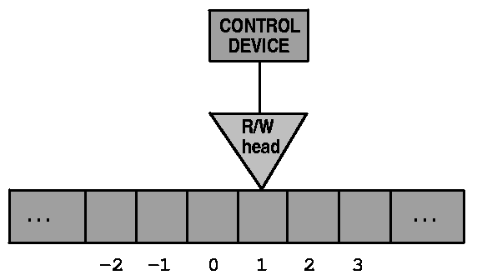
Research project: Hypercomputation
Standard computation model:
Turing machine (1936)

Slide 15
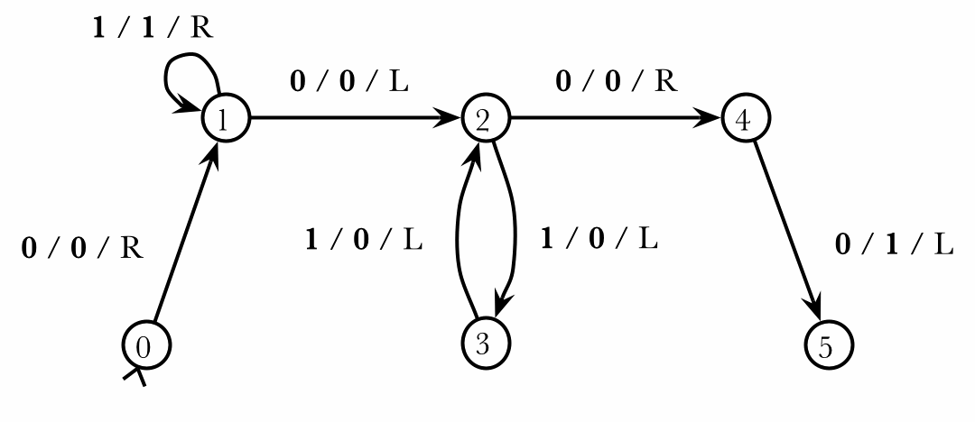
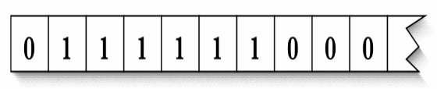
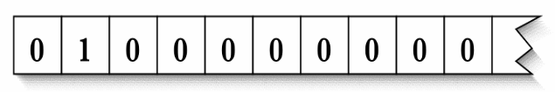
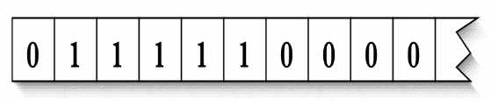
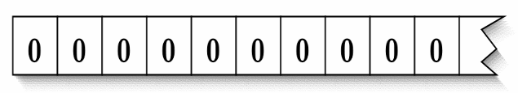
Turing machine example
state 0: ( 0, 0, right, 1 )
state 1: ( 1, 1, right, 1)
( 0, 0, left, 2)
state 2: ( 1, 0, left, 3)
( 0, 0, right, 4)
state 3: ( 1, 0, left, 2)
state 4: ( 0, 1, left, 6 )
state 5: [no instructions]
⇒
⇒

Slide 16
Church-Turing Thesis
Effectively computable ≡ Turing machine computable (accepted version)
⇒ The ‘computation’ is an absolute concept

Slide 17
Hypercomputation
Hypercomputer: A information-processing device system that can compute anything that a Turing machine can compute, and more.
f:ℕ→ℕ
Hypercomputers
Turing machines

Slide 18
A hypercomputer is any information-processing device able to carry out tasks that cannot be carried out by a Turing machine
f:ℕ→ℕ
Hypercomputers
Turing machines

Slide 19
Hypercomputation possibilities
Hypercomputation
Mathematics
Computability
Logic
Biology
???
Physics

Slide 20
Oracle Turing machines
It is a Turing machine equipped with an oracle that is capable of answering questions about the membership of a specific set of natural numbers
Oracle ≡ Recursive set ⇒ Turing machine
Oracle ≡ non recursive set ⇒ Hypercomputation model

Slide 21

Accelerated Turing machines
This is a Turing machines that performs its first step in one unit of time and each subsequent step in half the time of the step before.
Since 1 + 1/2 + 1/4 + 1/8 + … = 2 such Turing machine could complete an infinity of steps in two time units.

Slide 22
Analog recurrent neural networks
nets with integer weights ≡ finite automata
nets with rational weights ≡ Turing machines
nets with real weights ≡ hypercomputation model

Slide 23
Quantum computation
Algorithm complexity: Peter Shor’s algorithm for prime factorization
Digits | Classical | Shor
129 | 1.85 years | 45.9 minutes
250 | 2.1 x 10^6 years | 3.4 hours
1000 | 4.5 x 10^25 years | 3.07 days

Slide 24
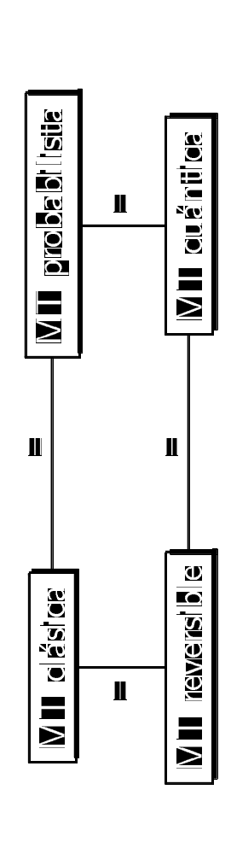
Computability and standard quantum computation

Slide 25
Hypercomputation and quantum computation
QTM ≡ TM exception (David Deutsch, Tien D. Kieu): Real random numbers. How can we use them for computation?
Quantum (finite) adiabatic computation (Edward Farhi et al.) ≡ QTM
Quantum (infinite) adiabatic computation (Tien D. Kieu) ≡ Hypercomputation model

Slide 26
Open problem: real hypercomputation
Theoretical models:
30 approximately
Implemented models:
0
Is it possible?

