Slide 1
Some basics of Machine Learning
With a Focus on the importance of Hyperparameters

Slide 2


Slide 3
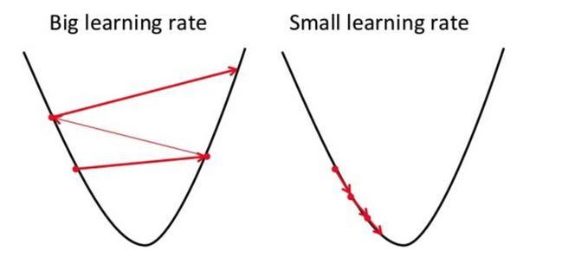

Slide 4
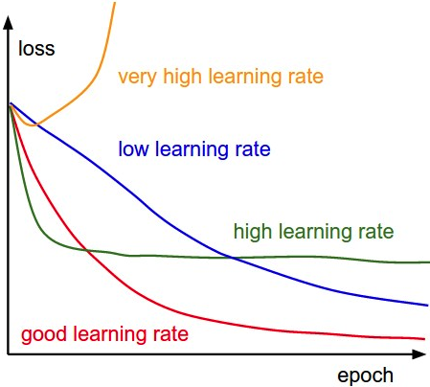

Slide 5
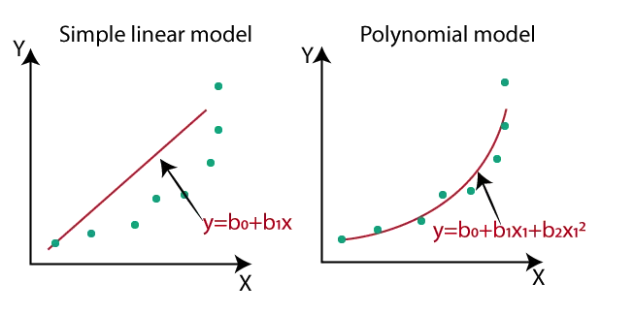

Slide 6
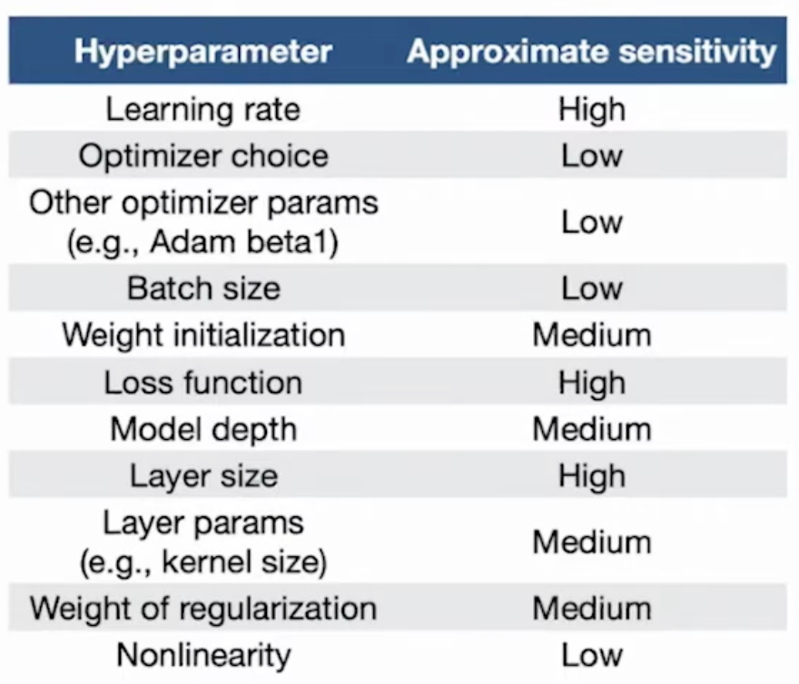

Slide 7
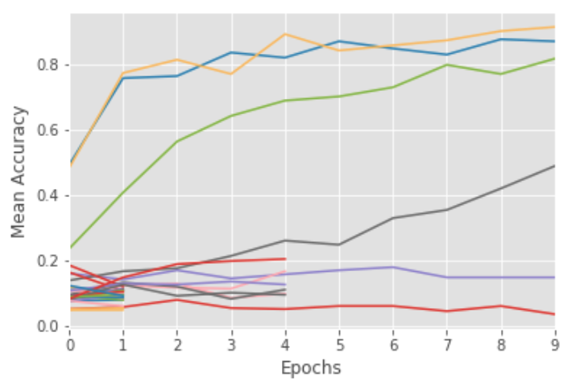

Slide 8
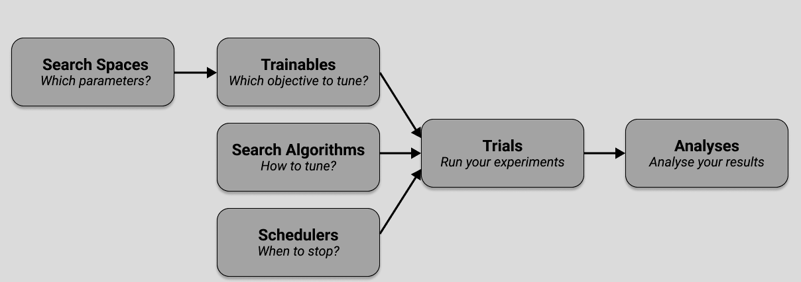
Key Concepts of Ray Tune

Slide 9
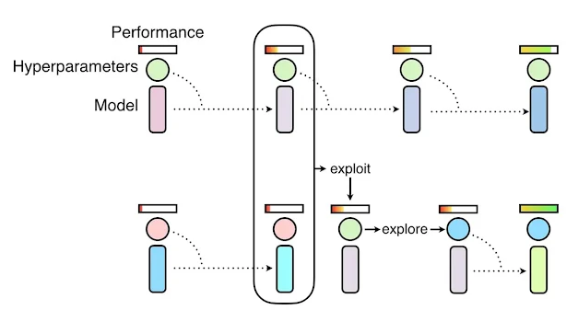
Example: Population Based Trainer

Slide 10
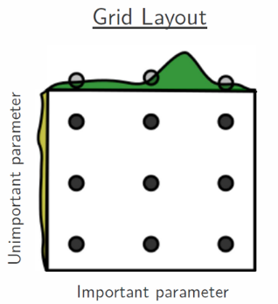
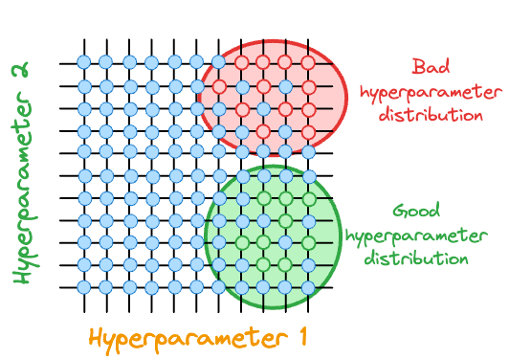
Example: Bayesian Optimization

Slide 11
Example: ASHA

Slide 12
Code base overview
/asr-christian
├── /output # output folder of training results
├── /main_ray_for_HF.py # main train function
├── /utils.py # Reusable utility functions
├── /configs # config files for different settings
├── /fine_tune.sh # bash script for cluster

Slide 13
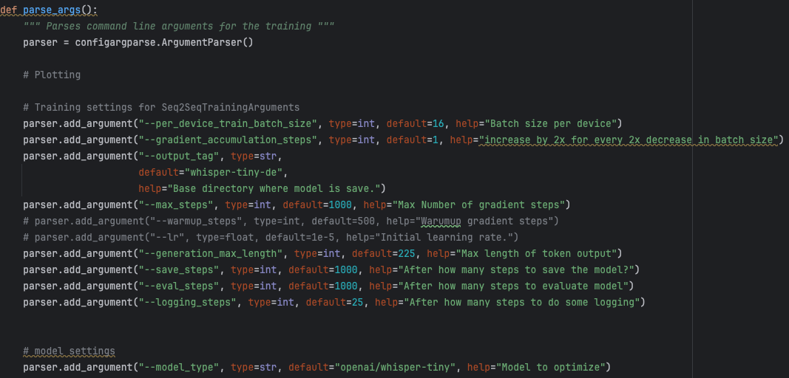
main_ray_for_HF.py

Slide 14


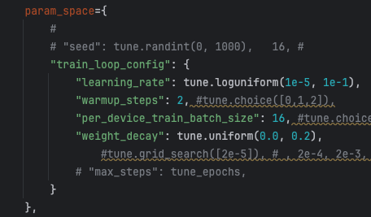

main_ray_for_HF.py

Slide 15
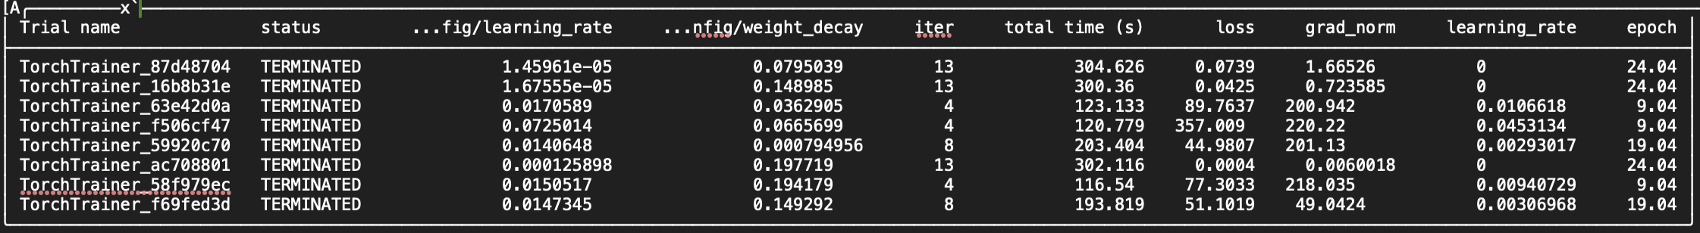
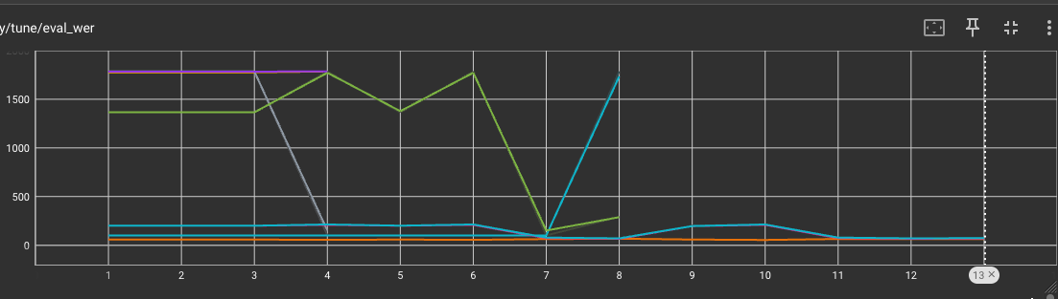

Slide 16
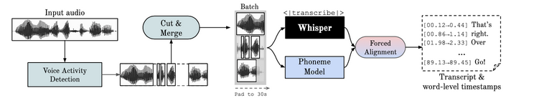
Challenges:
Find the right resource allocations for cluster computing
Multi nodes, efficient GPU utilization => might depend on choosen search algorithm
whisper v3 could not be trained on gtx 1080 with BS 1
Different partitions, e.g. scanvenger which have better GPUs
Which model to fine-tune? v2, v3, v3-german, medium, all?
Faster Whisper conversion
Conditional vs. non-conditional training?

