Slide 1

CricketVerse(Scores, Insights and many more)
UQ23CA741A - Capstone Project – Phase2 FSA Exam
Student Details
Guide Details
Name : Md Asraf Ali
SRN : PES1PG23CA080
Tamal Dey
Assistant Professor

Slide 2
Index
Abstract
Problem scenario
Domain
Functionalities
Tools and Technologies
Application in the real world
Notes:
https://undergradresearch.missouri.edu/how-to-write-an-abstract/

Slide 3
Abstract
This project focuses on enhancing the analytical insights for T20 cricket matches
Display real-time scores of all ongoing matches, dynamic statistics, and analytical insights to enhance the viewing experience for fans and analysts.
Provide pre-match insights to recommend whether to bat or bowl first based on venue-specific trends, and environmental factors.
Develop a machine learning model to predict the probability of a team chasing the target in real-time during the second inning of T20 matches, updated dynamically ball-by-ball.
Notes:
Refer: https://undergradresearch.missouri.edu/how-to-write-an-abstract/

Slide 4
Problem Scenario
Toss Decision Dilemma: Cricket teams often face challenges in deciding whether to bat or field after winning the toss, as the decision depends on multiple factors such as ground conditions, weather, and historical performance.
Inadequate Match Victory Predictions: Fans and teams lack accurate, real-time predictions of match outcomes based on evolving game scenarios and player/team performance metrics.
Notes:
Refer: https://www.betterup.com/blog/problem-statement

Slide 5
Purposed Solution
Toss Decision Support Tool: To assist cricket teams with toss decisions, develop a tool that analyzes factors like weather and past performance to recommend batting or bowling first. For example, overcast conditions may favor bowling due to increased swing.
Real-Time Match Outcome Predictor: For real-time match outcome predictions, implement a machine learning model that considers current game state, player performance, and historical data. Studies have shown that models like Random Forest Classifier can achieve high accuracy in predicting match results.
Notes:
Refer: https://www.betterup.com/blog/problem-statement

Slide 6
Project Scope
The project aims to provide a comprehensive solution for predicting and analyzing T20 cricket matches.
Using historical data to recommend optimal decisions after winning the toss, helping teams determine whether batting or bowling first would be more advantageous.
Delivering real-time predictions during the second inning, assessing the chasing team's probability of successfully reaching the target score based on factors such as required run rate, wickets in hand, and current game dynamics.

Slide 7
Domain
Application Domain
Sports Analytics and Management: The project focuses on cricket match data, including live scores, win prediction, and decision making on toss. It falls under the broader sports category, specifically for cricket enthusiasts and organizers.
Technical Domain
Artificial Intelligence and Data Science: With the integration of AI to predict match outcomes and analyze toss data, this project also operates in the AI/ML domain. It uses algorithms and models for real-time analytics and probabilistic predictions.
`
Notes:
Refer: http://projectcentersinchennai.co.in/Domains/Final-Year-Project-Domains-for-IT

Slide 8
Project Objectives
This system provides a platform to analyze and predict the outcomes of T20 cricket matches with a focus on live match scenarios.
It allows users to evaluate toss decisions based on venue-specific data and pre-match whether conditions, which helps in deciding whether to bat or bowl first.
The platform also offers real-time ball-by-ball predictions for the chasing team's success probability in the second inning of live matches.

Slide 9
Domain Survey
Technologies Considered
Programming Language: Use Python for machine learning development, and JavaScript for frontend and backend development, ensuring a comprehensive and versatile development stack
Web Development: Employ ReactJS for building user-friendly web interfaces, ensuring a responsive and interactive user experience.
Web Scraping: Implemented Beautiful soup and requests for data integration, enabling the gathering of information from external sources like ESPNcricInfo using web scraping.
Backend Development: Node.js is used for storing the data into the MongoDB, facilitating seamless communication between the API and frontend components.

Slide 10
Literature Survey
Existing Systems
Winner Prediction in One-Day International Cricket Matches Using Machine Learning Framework: An Ensemble Approach
Manoj Ishi, Dr. Jayantrao Patil et al. Year: 2022, ISSN: 0976-5166, Indian Journal of Computer Science and Engineering
Paper Overview: This research uses machine learning models to predict the winner of ODI cricket matches by analyzing batting-bowling strength, run-scoring patterns, and overall team metrics. Data from 1693 matches (2006–2019) is used, with ensemble techniques like voting and stacking classifiers applied for optimal predictions.
Main Findings/Results:
Logistic Regression and SVM achieved 96.30% accuracy for batting-bowling and run-scoring models.
Ensemble classifiers and artificial neural networks slightly better accuracy to 96.31%.
Impact and Relevance: The study advances sports analytics by providing predictive models like logistic regression and neural networks for ODI matches, focuses on batting balling strength and overall team metrics.

Slide 11
Literature Survey
Existing Systems
Prediction of IPL Match Outcome Using Machine Learning Techniques
Srikantaiah K C, Aryan Khetan et al. Year: 2021, 3rd International Conference on Integrated Intelligent Computing, Communication & Security (ICIIC 2021)
Paper Overview: This study uses machine learning algorithms to predict IPL match outcomes by analyzing features such as toss decisions, venue, player performance, and historical data. Algorithms like Random Forest, SVM, Logistic Regression, and K-Nearest Neighbor were tested using IPL datasets spanning nine years (2008–2019).
Main Findings/Results:
The Random Forest Classifier achieved the highest accuracy of 88.10%, outperforming other models.
Factors such as toss decisions, venue conditions, and team composition significantly influenced predictions.
Impact and Relevance: This research provides a systematic approach to analyzing IPL matches using machine learning, benefiting sports analysts and team strategists. Future enhancements include focusing on player-specific performance and predicting awards like "Man of the Match."

Slide 12
Literature Survey
Existing Systems
Cricket Match Analytics and Prediction Using Machine Learning
Param Dalal, Hirak Shah, Tej Kanjariya, Dhananjay Joshi Year: 2024, ISSN: 0975-8887, International Journal of Computer Applications
Paper Overview: This research focuses on predicting cricket match outcomes during the second innings by analyzing factors such as target, runs left, wickets fallen, and player-specific performance metrics. The study introduces a novel "Player Consistency" formula that integrates traditional cricket statistics with dynamic ratings to improve prediction accuracy. Models such as Random Forest, SVM, Logistic Regression, and Naive Bayes were tested, with Random Forest achieving the highest accuracy of 89.82%.
Main Findings/Results:
Random Forest delivered the best testing accuracy at 89.82%, demonstrating the effectiveness of tree-based models for cricket analytics.
A custom Player Consistency metric significantly improved model performance by capturing nuanced player contributions.
Impact and Relevance:
It focuses on machine learning for match prediction, particularly using player performance metrics. The Player Consistency formula and the success of the Random Forest model could enhance my project, improving prediction accuracy with similar innovative features.

Slide 13
Literature Survey
Existing Systems
Predicting IPL Victories: An Ensemble Modeling Approach Using Comprehensive Dataset Analysis
Pritpal Singh, Dr. Jatinder Kaur et al Year: 2024, International Conference on Artificial Intelligence and Machine Learning Applications
Paper Overview: This study explores using machine learning (ML) algorithms to predict IPL match outcomes by analyzing factors like player statistics, match venue, team performance, and weather. Decision Trees and Random Forest algorithms were applied, with the ensemble model showing superior predictive accuracy. The research aims to improve match outcome predictions in the dynamic IPL context using these techniques.
Main Findings/Results:
The ensemble model achieved a 99% accuracy, outperforming individual models like KNN, Random Forest, and Logistic Regression.
Factors such as team performance, player stats, and environmental conditions were critical in enhancing prediction accuracy.
Impact and Relevance: This research complements your project by using machine learning for IPL match predictions. The ensemble model's success in integrating multiple algorithms could be applied to your project to further enhance the accuracy of your win prediction system. Integrating contextual features like weather and player statistics could also improve your AI-based models.

Slide 14
Literature Survey
Comparison
Features | CricViz | ESPNcricInfo | Smartcric | CricketVerse
Live Score and Match Details | Y | Y | Y | Y
Toss Decision Prediction | N | N | N | Y
Second Innings Ball-by-Ball Victor Prediction | Y | Y | N | Y
Venue-Specific Insights | N | Y | N | Y
Prediction for all formats | Y | N | N | N

Slide 15
Tools & Technologies
Hardware Specifications
Processor: 11th Gen Intel(R) Core(TM) i3-1135G7 @ 2.40GHz 2.42 GHz Hard disk: 40 GB or higher RAM: 8.00 GB
Software Specifications
Operating System: Linux, Mac OS and Windows 8 and above Language: Python 3.7, JavaScript Library: NumPy 1.14.3, Matplotlib 2.1.2 Scikit-learn, Pandas, Seaborn, requests, BeautifulSoup Front End: ReactJS 18.0.0 Back End: NodeJS 21.5.0, Express.js 4.20.0, MongoDB Compass 1.45.0

Slide 16
Requirements Analysis
Users of the System
User(Fans/Cricket Analyst) : Accesses live match updates, toss decision, prediction insights, player statistics and match result statistics.

Slide 17
Requirements Analysis
Functional Requirements
Live Score and Statistics Display:
Provide real-time updates of the ongoing match scores, ball-by-ball details, and key statistics.
Showcase performance metrics like run rates, required run rates, and projected scores.
Second Inning Win Prediction:
Predict the likelihood of the chasing team achieving the target score based on real-time match data.
Consider factors such as wickets in hand, required run rate, and individual player performances.
Toss Decision Recommendation:
Analyze historical data and weather conditions to suggest the optimal toss decision (batting or bowling first).
Generate Match Result Statistics:
Generate and display results for completed matches.

Slide 18
Requirements Analysis
Non-Functional Requirements
Scalability: Support multiple concurrent users accessing live match updates and predictions.
Reliability: Ensure high system uptime, especially during matches, with minimal interruptions.
Accuracy:
Deliver highly accurate predictions using well-trained machine learning models.
Continuously improve accuracy based on real-time data feedback.
Usability:
Provide a user-friendly interface with clear visualizations for predictions and live scores.
Ensure the system is accessible to users with minimal technical expertise.

Slide 19
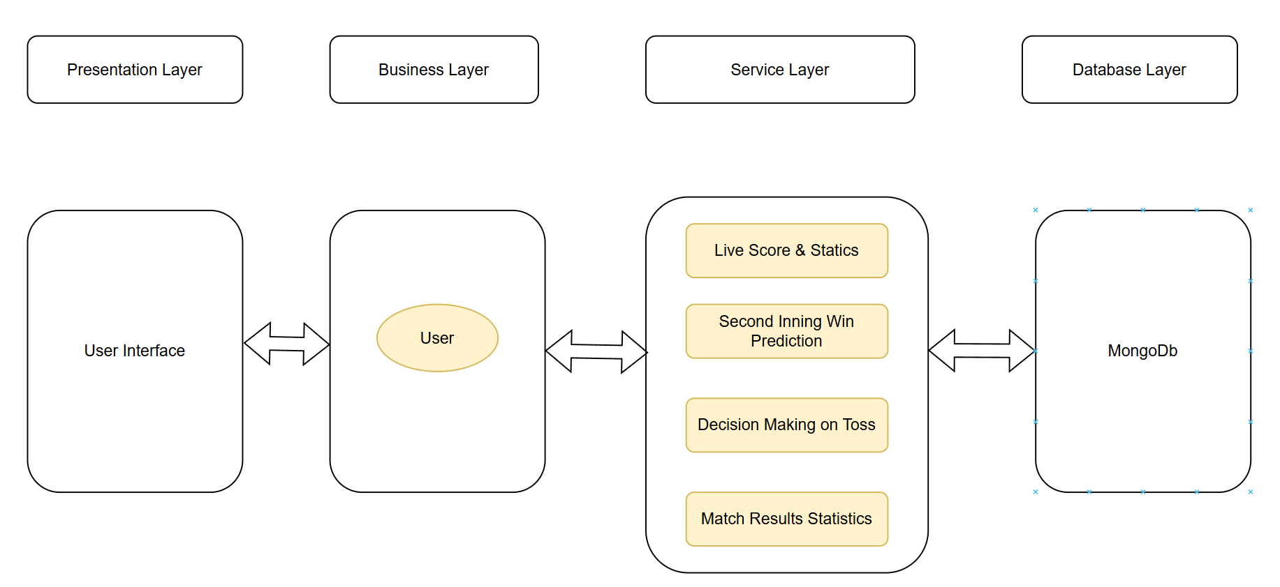
System Design
Architecture diagram

Slide 20
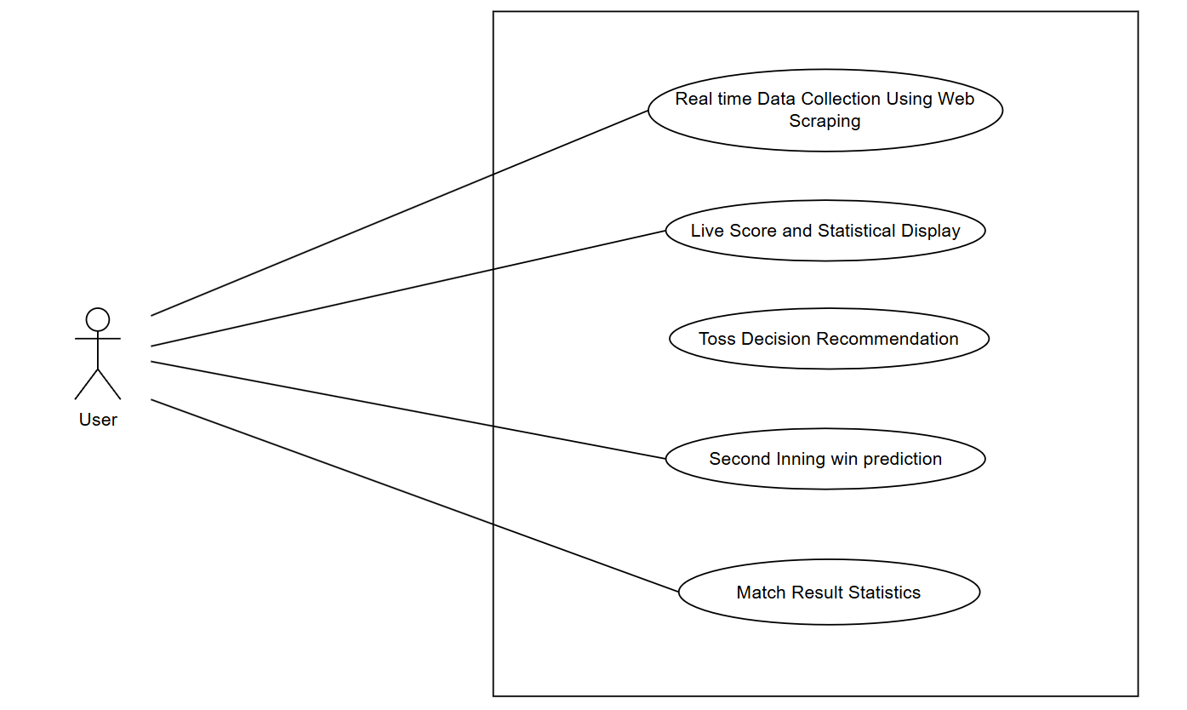
System Design
Use Case Diagram

Slide 21
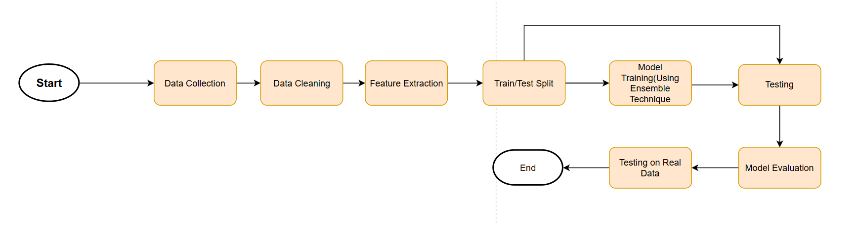
System Design
Process Flow Diagram

Slide 22
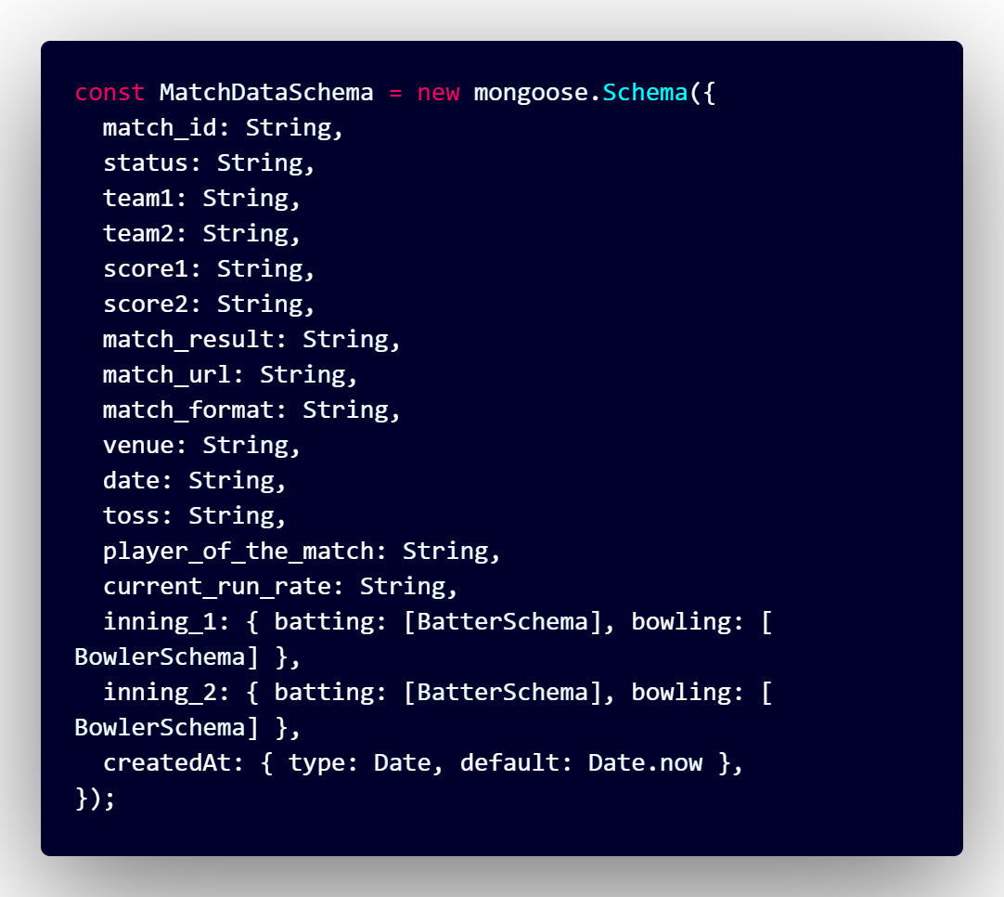
Database
Document Structure

Slide 23
Requirements Analysis
Pseudo Code
Pseudo code for 2nd Inning Prediction
START
1. Load the trained regression model
MODEL = load_model("path_to_saved_model")
2. Collect input data (minimal + optional fields)
INPUT_1 = get_user_input("Field 1") // e.g., Target Score
INPUT_2 = get_user_input("Field 2") // e.g., Current Score
...
INPUT_N = get_user_input("Field N")

Slide 24
Database
Pseudo Code
3. Calculate derived features if needed
DERIVED_1 = compute_derived_feature(INPUT_1, INPUT_2)
...
DERIVED_M = compute_derived_feature(...)
4. Create the final feature vector
FEATURES = [INPUT_1, INPUT_2, ..., DERIVED_1, ..., DERIVED_M]
5. Pass features to model for prediction
PREDICTION = MODEL.predict(FEATURES)
6. Display or return prediction result
print("Predicted Output:", PREDICTION)
END

Slide 25
Requirements Analysis
Pseudo Code
Pseudo code for Toss Decision Recommendation
START
1. Load match data from CSV
IF file not found THEN show error and exit
2. Define list of top international teams
3. Compute team and venue statistics:
FOR each match in dataset:
Determine toss winner and their decision
Identify which team batted first
Record match outcome for batted-first team
Update stats:
- team_stats[team]: bat_first_wins, bat_first_matches
- venue_stats[venue]: bat_first_wins, bat_first_matches, scores

Slide 26
Database
Pseudo Code
4. Define helper functions:
get_team_bat_win_rate(team)
get_venue_bat_win_rate(venue)
get_venue_avg_score(venue)
5. Define toss decision logic:
Input: team1, team2, venue, weather (temp, humidity, wind, cloud, conditions)
Initialize decision_score = 0
IF team1 bat-first win rate > 0.5 THEN score += 1
IF team2 bat-first win rate < 0.5 THEN score += 1
IF venue bat-first win rate > 0.5 THEN score += 1
IF venue average score > 160 THEN score += 1
IF humidity > 70 OR "Rain" in conditions THEN score -= 1
IF wind > 20 THEN score += 0.5
IF cloud cover > 60 THEN score -= 0.5
RETURN "BAT" if score ≥ 2 ELSE "BOWL“
END

Slide 27
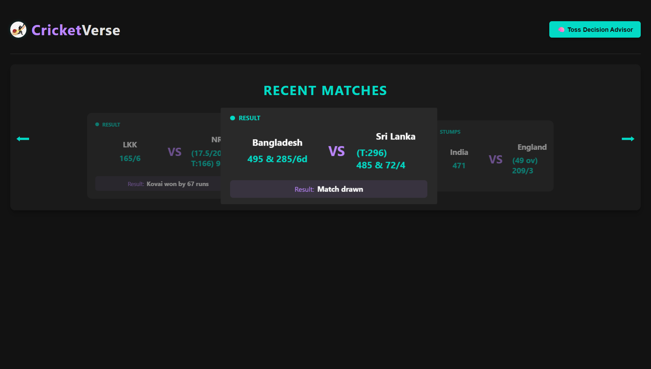
Implementation
Dashboard

Slide 28
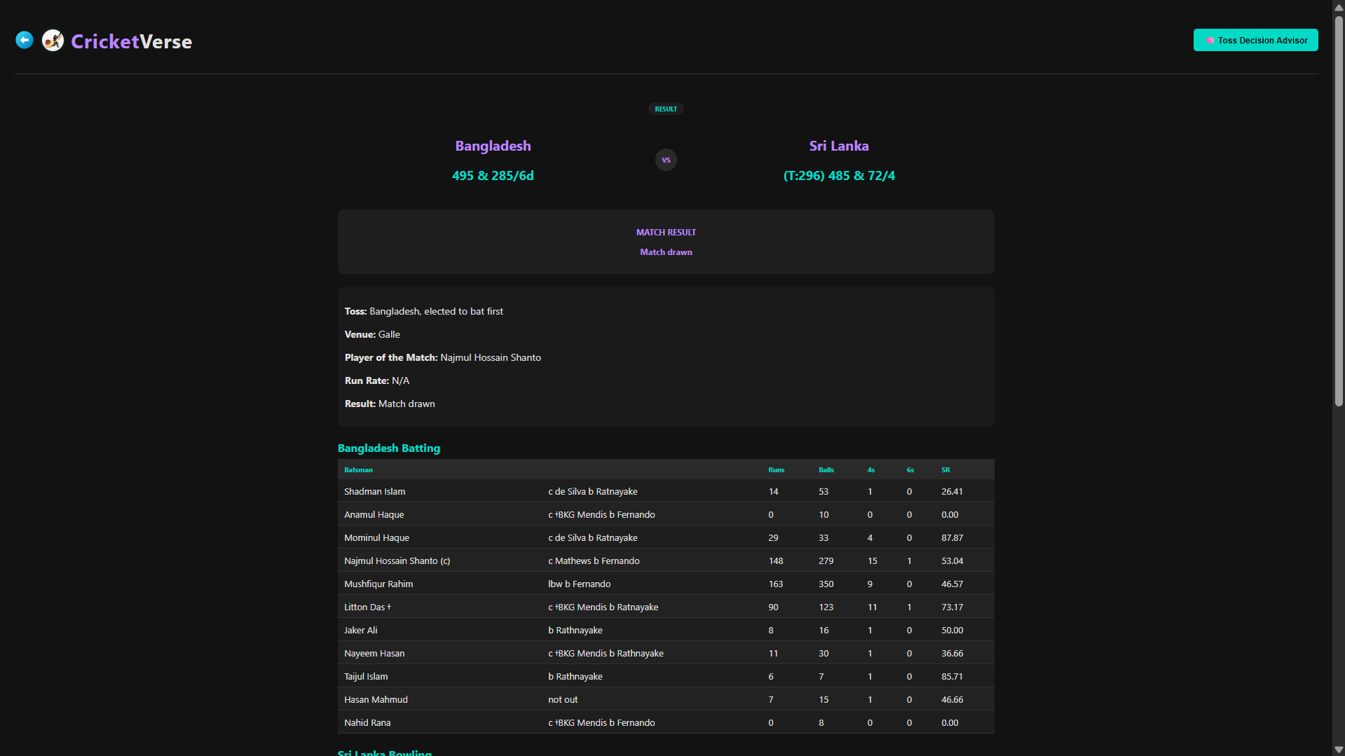
Implementation
Match Details

Slide 29
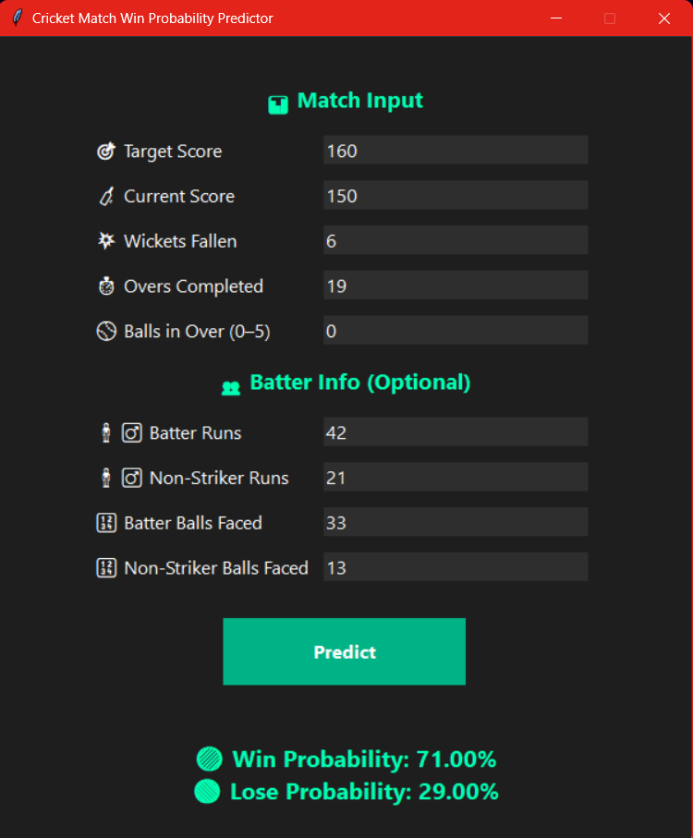
Implementation
Second Inning Prediction

Slide 30
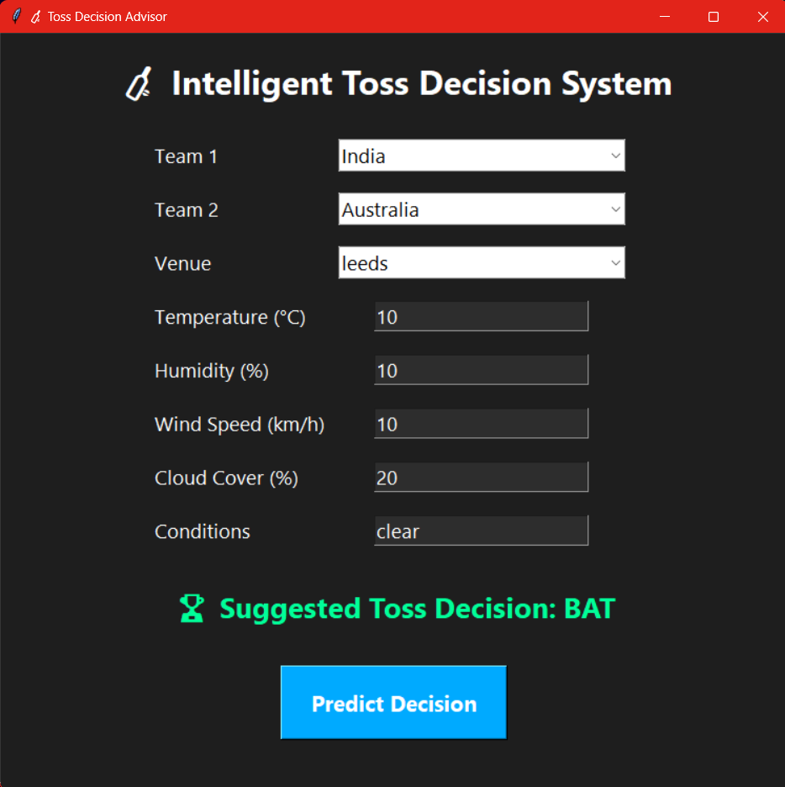
Implementation
Toss Decision Recommendation

Slide 31
Software Testing
Manual Testing
Test Scenario | Second Inning Prediction
Test Case ID | Step Details | Expected Result | Actual Result | Pass/Fail/ Non Executed/ Suspended
REG_01 | First innings | Prediction not available | As expected | Pass
REG_02 | Invalid over (greater than 20) | Error or validation message shown | As expected | Pass
REG_03 | All out before full overs | Wickets remaining = 0, model predict 0% win | As expected | Pass

Slide 32
Software Testing
Manual Testing
Test Scenario | Live Match Scores
Test Case ID | Step Details | Expected Result | Actual Result | Pass/Fail/ Non Executed/ Suspended
REG_01 | Open the dashboard in browser | Verify dashboard loads properly | dashboard loads properly | Pass
REG_02 | Layout on different screen sizes | Responsive layout, fields don't break | Responsive layout, fields don't break | Pass
REG_03 | UI consistency | All UI elements follow consistent style guide | All UI elements following consistent style guide | Pass

Slide 33
Software Testing
Manual Testing
Test Scenario | Match Details Page
Test Case ID | Step Details | Expected Result | Actual Result | Pass/Fail/ Non Executed/ Suspended
REG_01 | Click on Specific Match Card for Detail Information | Verify match details page loads properly | Match details page loads properly | Pass
REG_02 | Layout on different screen sizes | Responsive layout, fields don't break | Responsive layout, fields don't break | Pass
REG_03 | UI consistency | All UI elements follow consistent style guide | All UI elements following consistent style guide | Pass

Slide 34
Software Testing
Manual Testing
Test Scenario | Toss Decision Recommendation
Test Case ID | Step Details | Expected Result | Actual Result | Pass/Fail/ Non Executed/ Suspended
REG_01 | Load page with database containing mixed-format matches | Only T20 matches with top 8 ICC teams are displayed in dropdown | As expected | Pass
REG_02 | Load page with no valid T20 matches with top ICC teams | Show “No valid matches found” message instead of dropdown | As expected | Pass
REG_03 | Check that matches in dropdown are not repeated | Dropdown shows unique matches only | As expected | Pass

Slide 35
Conclusions
The Second Innings Prediction project successfully demonstrates the use of machine learning techniques to estimate the winning probability of a T20 cricket team during the second innings. By using historical ball-by-ball data and engineering key match-specific features such as current score, target score, balls remaining, wickets lost, and run rates, we developed a predictive model capable of providing real-time probabilistic insights.
A Random Forest Classifier was employed to generate win/lose probabilities with accuracy of 92%, offering interpretable and reliable outputs. The project was further enhanced with an intuitive CLI and GUI interface to reduce input overhead by auto-calculating derived features, making the tool user-friendly for analysts, commentators, and cricket enthusiasts.

Slide 36
Future Enhancements
First Innings Prediction Integration The current model focuses solely on second innings outcome prediction. A key enhancement will be to develop a regression-based model to predict the final score in the first innings using real-time match features such as run rate, wickets in hand, recent performance, and player-specific form.
Support for All Cricket Formats The existing model is tailored for T20 format. Future versions will extend support for ODIs (50 overs) and Test matches, taking into account the unique pacing, strategic depth, and variable match lengths of each format.
Contextual Feature Expansion New features like pitch condition, team strengths, and head-to-head records will be integrated to make the model more context-aware and accurate.

Slide 37
Future Enhancements
Mobile and Web Deployment The system will be deployed as a responsive web app and mobile application, enabling users to interact with predictions on the go, during live matches.
Admin Dashboard & Data Management A robust admin interface will be added to manage match data, update models, and monitor prediction performance. This will streamline model maintenance and scalability.

Slide 38
Application in the Real World
Enhanced Fan Engagement: By providing real-time scores, win probabilities, and player stats, the project creates an engaging experience for cricket fans. It enhances viewership by giving insights into match dynamics, thus building a more informed audience base.
Easy Decision Making on Toss: By providing the decision what to choose after winning the toss will help cricket analyst not to choose wrong decision on whether to bat first or ball first.
Sports Business and Marketing Opportunities: By integrating predictive analytics and real-time updates, sports businesses can attract sponsorships, provide targeted advertisements, and promotions to cricket fans.

Slide 39
Plan Of Action
Modules | Completed | Need to be done
Live Score and Statistics Display | 100% | --
Second Inning Win Prediction | 100% | --
Toss Decision Recommendation | 100% | --
Generate Match Result Statistics | 100% | --

Slide 40
References
[1] Manoj Ishi, Dr. Jayantrao Patil et al.” Winner Prediction in One-Day International Cricket Matches Using Machine Learning Framework: An Ensemble Approach” | Indian Journal of Computer Science and Engineering (2022)
https://www.ijcse.com/abstract.html?file=22-13-03-043
[2] Srikantaiah K C, Aryan Khetan et al. “Prediction of IPL Match Outcome Using Machine Learning Techniques” | 3rd International Conference on Integrated Intelligent Computing, Communication & Security (2019)
https://www.researchgate.net/publication/355061139_Prediction_of_IPL_Match_Outcome_Using_Machine_Learning_Techniques
[3] Param Dalal, Hirak Shah, Tej Kanjariya, Dhananjay Joshi. “Cricket Match Analytics and Prediction Using Machine Learning” | International Journal of Computer Applications (2024)
https://www.ijcaonline.org/archives/volume186/number26/dalal-2024-ijca-923744.pdf

Slide 41
References
[4] Pritpal Singh, Dr. Jatinder Kaur, Lovedeep Singh “Predicting IPL Victories: An Ensemble Modelling Approach Using Comprehensive Dataset Analysis” | 2nd International Conference on Artificial Intelligence and Machine Learning Applications Theme: Healthcare and Internet of Things (2024)
https://ieeexplore.ieee.org/document/10531489
[5] Jalaz Kumar, Rajeev Kumar, Pushpender Kumar “Outcome Prediction of ODI Cricket Matches Using Decision Trees and MLP Networks” | First International Conference on Secure Cyber Computing and Communication (2018)
https://ieeexplore.ieee.org/document/8703301
Web Application: https://www.kaggle.com/datasets/pardeep19singh/icc-mens-world-cup-2023

Slide 42
Thank You !!

