Slide 1

Chapter 3
RDF Schema

Slide 2
Introduction
RDF has a very simple data model
RDF Schema (RDFS) enriches the data model, adding vocabulary and associated semantics for
  Classes and subclasses
  Properties and sub-properties
  Typing of properties
Support for describing simple ontologies
Adds an object-oriented flavor
But with a logic-oriented approach and using “open world” semantics

Slide 3
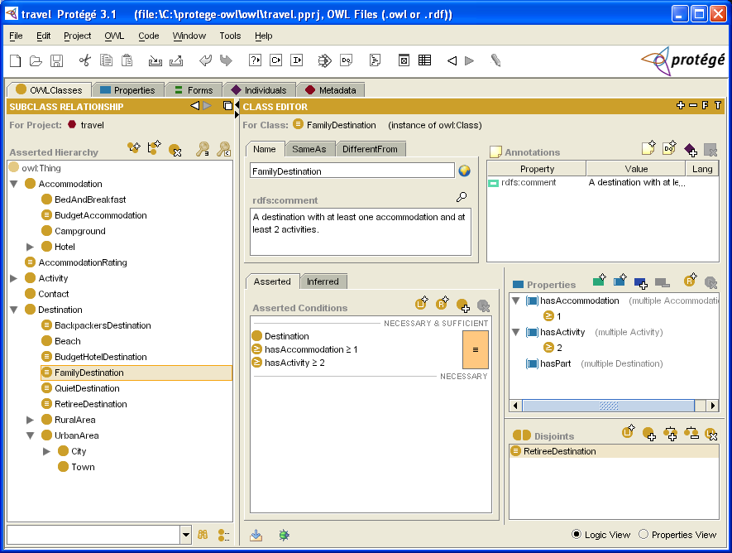
RDFS is a simple KB Language
Several widely used Knowledge-Base tools can import and export in RDFS, including Stanford’s Protégé KB editor

Slide 4
RDFS Vocabulary
RDFS introduces the following terms, giving each a meaning w.r.t. the rdf data model
Terms for classes
  rdfs:Class
  rdfs:subClassOf
Terms for properties
  rdfs:domain
  rdfs:range
  rdfs:subPropertyOf
Special classes
  rdfs:Resource
  rdfs:Literal
  rdfs:Datatype
Terms for collections
  rdfs:member
  rdfs:Container
  rdfs:ContainerMem-bershipProperty
Special properties
  rdfs:comment
  rdfs:seeAlso
  rdfs:isDefinedBy
  rdfs:label

Slide 5
Modeling the semantics in logic
We could represent any triple with a binary predicate, e.g.
  type(john, human)
  age(john, 32)
  subclass(human, animal)
But traditionally we model a classes as a unary predicate
  human(john)
  age(john, 32)
  subclass(human, animal)

Slide 6
Classes and Instances
We must distinguish between
  Concrete “things” (individual objects) in the domain: Discrete Math, Richard Chang, etc.
  Sets of individuals sharing properties called classes: lecturers, students, courses etc.
Individual objects that belong to a class are referred to as instances of that class
The relationship between instances and classes in RDF is through rdf:type

Slide 7
Classes are Useful
Classes let us impose restrictions on what can be stated in an RDF document using the schema
  As in programming languages
    E.g. A+1, where A is an array
  Disallow nonsense from being stated

Slide 8
Preventing nonsensical Statements
Discrete Math is taught by Calculus
  We want courses to be taught by lecturers only
  Restriction on values of the property “is taught by” (range restriction)
Room ITE228 is taught by Richard Chang
  Only courses can be taught
  This imposes a restriction on the objects to which the property can be applied (domain restriction)

Slide 9
Class Hierarchies
Classes can be organized in hierarchies
  A is a subclass of B if every instance of A is also an instance of B
  We also say that B is a superclass of A
A subclass graph needn’t be a tree
  A class may have multiple superclasses
In logic:
  subclass(p, q) ⬄ p(x) => q(x)
  subclass(p, q) ∧ p(x) => q(x)

Slide 10
Domain and Range
The domain and range properties let us associate classes with a property’s subject and object, e.g.
Only a course can be taught
  domain(isTaughtBy, course)
Only an academic staff member can teach
  range(isTaughtBy, academicStaffMember)
Semantics in logic:
  domain(pred, aclass) ∧ pred(subj, obj) => aclass(subj)
  range(pred, aclass) ∧ pred(subj, obj) => aclass(obj)

Slide 11
Property Hierarchies
Hierarchical relationships for properties
  E.g., “is taught by” is a subproperty of “involves”
  If a course C is taught by an academic staff member A, then C also involves Α
The converse is not necessarily true
  E.g., A may be the teacher of the course C, or a TA who grades student homework but doesn’t teach
Semantics in logic
  subproperty(p, q) ∧ p(subj, obj) => q(sub,obj)
  e.g, subproperty(mother,parent), mother(p1, p2) => parent(p1, p2)

Slide 12
RDF Layer vs RDF Schema Layer
Discrete Math is taught by Richard Chang
The schema is itself written in a formal language, RDF Schema, that can express its ingredients:
  subClassOf, Class, Property, subPropertyOf, Resource, etc.

Slide 13
RDF Schema in RDF
RDFS’s modeling primitives are defined using resources and properties (RDF itself is used!)
To declare that “lecturer” is a subclass of “academic staff member”
  Define resources lecturer, academicStaffMember, and subClassOf
  define property subClassOf
  Write triple (subClassOf, lecturer, academicStaffMember)
We use the XML-based syntax of RDF

Slide 14
Core Classes
rdfs:Resource: class of all resources
rdfs:Class: class of all classes
rdfs:Literal: class of all literals (strings)
rdf:Property: class of all properties.
rdf:Statement: class of all reified statements

Slide 15
Core Properties
rdf:type: relates a resource to its class
  The resource is declared to be an instance of that class
rdfs:subClassOf: relates a class to one of its superclasses
  All instances of a class are instances of its superclass
rdfs:subPropertyOf: relates a property to one of its superproperties

Slide 16
Core Properties
rdfs:domain: specifies the domain of a property P
  The class of those resources that may appear as subjects in a triple with predicate P
  If the domain is not specified, then any resource can be the subject
rdfs:range: specifies the range of a property P
  The class of those resources that may appear as values in a triple with predicate P

Slide 17
Examples
<rdfs:Class rdf:about="#lecturer">
<rdfs:subClassOf rdf:resource="#staffMember"/>
</rdfs:Class>
<rdf:Property rdf:ID="phone">
<rdfs:domain rdf:resource="#staffMember"/>
<rdfs:range rdf:resource="http://www.w3.org/
2000/01/rdf-schema#Literal"/>
</rdf:Property>

Slide 18
Relationships: Core Classes & Properties
rdfs:subClassOf and rdfs:subPropertyOf are transitive, by definition
rdfs:Class is a subclass of rdfs:Resource
  Because every class is a resource
rdfs:Resource is an instance of rdfs:Class
  rdfs:Resource is the class of all resources, so it is a class
Every class is an instance of rdfs:Class
  For the same reason

Slide 19
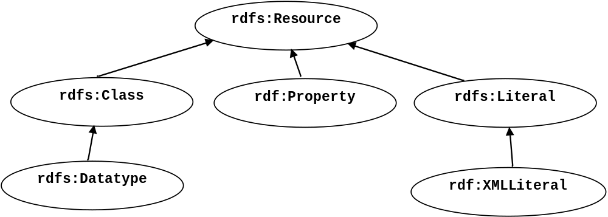
Subclass Hierarchy of RDFS Primitives

Slide 20
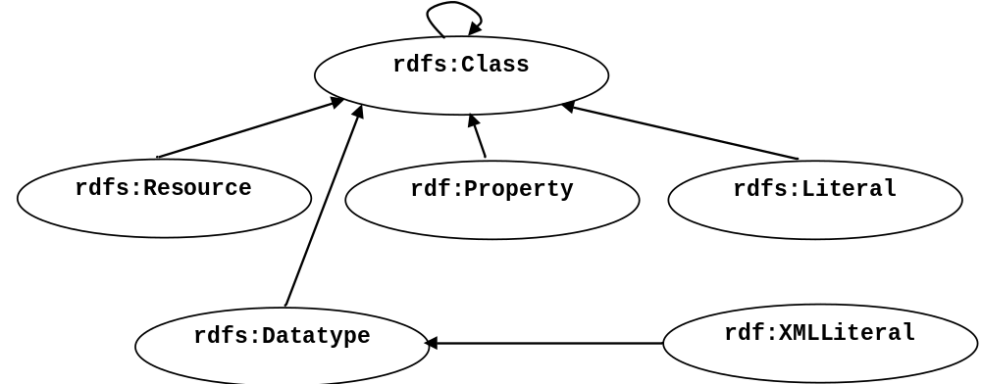
Instance Relationships of RDFS Primitives

Slide 21
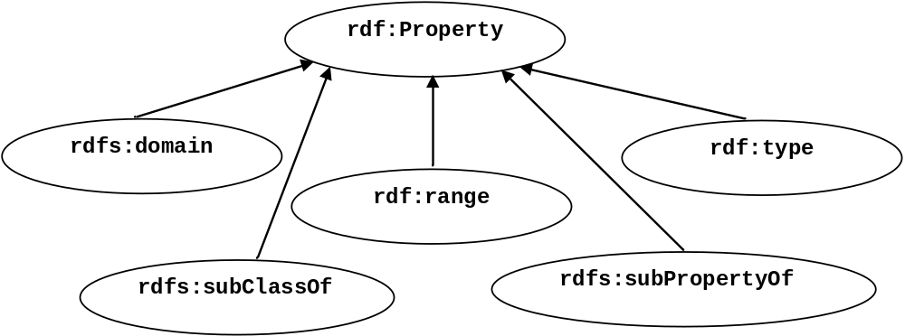
RDF and RDFS Property Instances

Slide 22
Reification and Containers
rdf:subject: relates a reified statement to its subject
rdf:predicate: relates a reified statement to its predicate
rdf:object: relates a reified statement to its object
rdf:Bag: the class of bags
rdf:Seq: the class of sequences
rdf:Alt: the class of alternatives
rdfs:Container: a superclass of all container classes, including the three above

Slide 23
Utility Properties
rdfs:seeAlso relates a resource to another resource that explains it
rdfs:isDefinedBy: a subproperty of rdfs:seeAlso that relates a resource to the place where its definition, typically an RDF schema, is found
rfds:comment. Comments, typically longer text, can be associated with a resource
rdfs:label. A human-friendly label (name) is associated with a resource

Slide 24
Ex: University Lecturers – Prefix
<rdf:RDF
xmlns:rdf="http://www.w3.org/1999/02/22-rdf-syntax-ns#" xmlns:rdfs=http://www.w3.org/2000/01/rdf-schema#
>

Slide 25
Ex: University Lecturers -- Classes
<rdfs:Class rdf:ID="staffMember">
<rdfs:comment>The class of staff members </rdfs:comment>
</rdfs:Class>
<rdfs:Class rdf:ID="academicStaffMember">
<rdfs:comment>The class of academic staff members </rdfs:comment>
<rdfs:subClassOf rdf:resource="#staffMember"/>
</rdfs:Class>
<rdfs:Class rdf:ID="lecturer">
<rdfs:comment> The class of lecturers. All lecturers are academic staff members.
</rdfs:comment>
<rdfs:subClassOf rdf:resource="#academicStaffMember"/>
</rdfs:Class>
<rdfs:Class rdf:ID="course">
<rdfs:comment>The class of courses</rdfs:comment>
</rdfs:Class>

Slide 26
Ex: University Lecturers -- Properties
<rdf:Property rdf:ID="isTaughtBy">
<rdfs:comment>Assigns lecturers to courses. </rdfs:comment>
<rdfs:domain rdf:resource="#course"/>
<rdfs:range rdf:resource="#lecturer"/>
</rdf:Property>
<rdf:Property rdf:ID="teaches">
<rdfs:comment>Assigns courses to lecturers. </rdfs:comment>
<rdfs:domain rdf:resource="#lecturer"/>
<rdfs:range rdf:resource="#course"/>
</rdf:Property>

Slide 27
Ex: University Lecturers -- Instances
<uni:lecturer rdf:ID="949318"
uni:name="Richard Chang"
uni:title="Associate Professor">
<uni:teaches rdf:resource="#CIT1111"/>
<uni:teaches rdf:resource="#CIT3112"/>
</uni:lecturer>
<uni:lecturer rdf:ID="949352"
uni:name="Grigoris Antoniou"
uni:title="Professor">
<uni:teaches rdf:resource="#CIT1112"/>
<uni:teaches rdf:resource="#CIT1113"/>
</uni:lecturer>
<uni:course rdf:ID="CIT1111"
uni:courseName="Discrete Mathematics">
<uni:isTaughtBy rdf:resource="#949318"/>
</uni:course>
<uni:course rdf:ID="CIT1112"
uni:courseName="Concrete Mathematics">
<uni:isTaughtBy rdf:resource="#949352"/>
</uni:course>

Slide 28
Example: A University
<rdfs:Class rdf:ID="lecturer">
<rdfs:comment>
The class of lecturers. All lecturers are academic staff members.
</rdfs:comment>
<rdfs:subClassOf rdf:resource="#academicStaffMember"/>
</rdfs:Class>

Slide 29
Example: A University
<rdfs:Class rdf:ID="course">
<rdfs:comment>The class of courses</rdfs:comment>
</rdfs:Class>
<rdf:Property rdf:ID="isTaughtBy">
<rdfs:comment>
Inherits its domain ("course") and range ("lecturer")
from its superproperty "involves”
</rdfs:comment>
<rdfs:subPropertyOf rdf:resource="#involves"/>
</rdf:Property>

Slide 30
Example: A University
<rdf:Property rdf:ID="phone">
<rdfs:comment>
It is a property of staff members
and takes literals as values.
</rdfs:comment>
<rdfs:domain rdf:resource="#staffMember"/>
<rdfs:range rdf:resource="http://www.w3.org/2000/01/rdf-schema#Literal"/>
</rdf:Property>

Slide 31
RDF and RDFS Namespaces
The RDF, RDFS and OWL namespaces specify some constraints on the ‘languages’
  http://www.w3.org/1999/02/22-rdf-syntax-ns#
  http://www.w3.org/2000/01/rdf-schema#
  http://www.w3.org/2002/07/owl#
Strangely, each uses terms from all three to define its own terms
Don’t be confused: the real semantics of the terms isn’t specified in the namespace files

Slide 32
RDF Namespace
<rdf:RDF
xmlns:rdf="http://www.w3.org/1999/02/22-rdf-syntax-ns#"
xmlns:rdfs="http://www.w3.org/2000/01/rdf-schema#"
xmlns:owl="http://www.w3.org/2002/07/owl#"
xmlns:dc="http://purl.org/dc/elements/1.1/">
<owl:Ontology
rdf:about="http://www.w3.org/2000/01/rdf-schema#"
dc:title="The RDF Schema vocabulary (RDFS)"/>
<rdfs:Class rdf:about="http://www.w3.org/2000/01/rdf-schema#Resource">
<rdfs:isDefinedBy rdf:resource="http://www.w3.org/2000/01/rdf-schema#"/>
<rdfs:label>Resource</rdfs:label>
<rdfs:comment>The class resource, everything.</rdfs:comment>
</rdfs:Class>
…

Slide 33
RDF Namespace example
This example shows how RDFS terms are used to say something important about the RDF predicate property
    <rdf:Property
    rdf:ID="predicate"
    rdfs:comment="Identifies the property of a statement in reified form"/>
    <rdfs:domain rdf:resource="#Statement"/>
    <rdfs:range rdf:resource="#Property"/>
    </rdf:Property>

Slide 34
RDF Namespace
Define rdf:Resource and rdf:Class as instances of rdfs:Class & rdf:Class as a subclass of rdf:Resource
  <rdfs:Class rdf:ID="Resource"
  rdfs:comment="The most general class"/>
  <rdfs:Class rdf:ID="Class"
  rdfs:comment="The concept of classes.
  All classes are resources"/>
  <rdfs:subClassOf rdf:resource="#Resource"/>
  </rdfs:Class>

Slide 35
RDF Namespace
Define rdf:Resource and rdf:Class as instances of rdfs:Class & rdf:Class as a subclass of rdf:Resource
  <rdfs:Class rdf:ID="Resource"
  rdfs:comment="The most general class"/>
  <rdfs:Class rdf:ID="Class"
  rdfs:comment="The concept of classes.
  All classes are resources"/>
  <rdfs:subClassOf rdf:resource="#Resource"/>
  </rdfs:Class>
rdfs:
Class
rdf:type
rdf:
Resource
rdf:type
rdfs:subclass
rdf:
Class

Slide 36
RDFS Namespace
<rdf:RDF … xmlns:dc="http://purl.org/dc/elements/1.1/">
…
<rdfs:Class rdf:about="http://www.w3.org/2000/01/rdf-schema#Class">
<rdfs:isDefinedBy rdf:resource="http://www.w3.org/2000/01/rdf-schema#"/>
<rdfs:label>Class</rdfs:label>
<rdfs:comment>The class of classes.</rdfs:comment>
<rdfs:subClassOf rdf:resource="http://www.w3.org/2000/01/rdf-schema#Resource"/>
</rdfs:Class>
<rdf:Property rdf:about="http://www.w3.org/2000/01/rdf-schema#subClassOf">
<rdfs:isDefinedBy rdf:resource="http://www.w3.org/2000/01/rdf-schema#"/>
<rdfs:label>subClassOf</rdfs:label>
<rdfs:comment>The subject is a subclass of a class.</rdfs:comment>
<rdfs:range rdf:resource="http://www.w3.org/2000/01/rdf-schema#Class"/>
<rdfs:domain rdf:resource="http://www.w3.org/2000/01/rdf-schema#Class"/>
</rdf:Property>
…

Slide 37
Namespaces vs. Semantics
Consider rdfs:subClassOf
  The namespace specifies only that it applies to classes and has a class as a value
  The meaning of being a subclass not specified
The meaning cannot be expressed in RDF
  If it could RDF Schema would be unnecessary
External definition of semantics required
  Respected by RDF/RDFS processing software

Slide 38
RDFS vs. OO Models
In OO models, an object class defines the properties that apply to it
  Adding a new property means modifying the class
In RDF, properties are defined globally and aren’t encapsulated as attributes in the class definition
  One can define new properties without changing the class
  Properties can have properties
    :mother rdfs:subPropertyOf :parent; rdf:type :FamilyRelation.
  You can’t narrow the domain and range of properties in a subclass

Slide 39
Example
@prefix rdf: <http://www.w3.org/1999/02/22-rdf-syntax-ns#> .
@prefix rdfs: <http://www.w3.org/2000/01/rdf-schema#> .
@prefix bio: <http://example.com/biology#> .
bio:Animal a rdfs:Class.
Bio:offspring a rdfs:Property;
rdfs:domain bio:Animal;
rdfs:range bio:Animal.
bio:Human rdfs:subClassOf bio:Animal.
bio:Dog rdfs:subClassOf bio:Animal.
:fido a bio:Dog.
:john a bio:Human;
bio:offspring :fido.
There is no way to say that the offspring of humans are humans and the offspring of dogs are dogs.

Slide 40
Example
Bio:child rdfs:subPropertyOf bio:offspring;
rdfs:domain bio:Human;
rdfs:range bio:Human.
Bio:puppy rdfs:subPropertyOf bio:offspring;
rdfs:domain bio:Dog;
rdfs:range bio:Dog.
:john bio:child :mary.
:fido bio:puppy :rover.
What do we know after each of the last two triples are asserted?
Suppose we also assert:
:john bio:puppy :rover
:john bio:child :fido

Slide 41
Not like types in OO systems
Classes differ from types in OO systems in how they are used.
  They are not constraints on well-formedness
The lack of negation and the open world assumption make it impossible to detect contradictions
  Can’t say that Dog and Human are disjoint classes
  Not knowing that there are individuals who are both doesn’t mean it’s not true

Slide 42
No disjunctions or union types
What does this mean?
  Bio:Human rdfs:subClassOf bio:Animal.
  bio:Cat rdfs:subClassOf bio:Animal.
  Bio:Dog rdfs:subClassOf bio:Animal.
  bio:hasPet a rdfs:Property;
  rdfs:domain bio:Human;
  rdfs:range bio:Dog;
  rdfs:range bio:Cat.

Slide 43
What do we want to say?
Only a dog or a cat can be the object of a hasPet property.
Dogs and cats and maybe other animals are possible as pets.
Dogs and cats and maybe other things, not necessarily animals, are possible as pets.
All dogs and all cats are pets.
It is possible for some dogs and for some cats to be pets.

Slide 44
What do we want to say?
property
animal
subclass
pet
subclass
hasPet
subclass
subclass
subclass
subclass
subclass
range
human
dog
cat
domain

Slide 45
Classes and individuals are not disjoint
In OO systems a thing is either a class or object
  Many KR systems are like this: you are either an instance or a class, not both.
Not so in RDFS
  bio:Species rdf:type rdfs:Class.
  bio:Dog rdf:type rdfs:Species; rdfs:subClassOf bio:Animal.
  :fido rdf:type bio:Dog.
Adds richness to the language but causes problems, too
  In OWL lite and OWL DL you can’t do this.
  OWL has it’s own notion of a Class, owl:Class

Slide 46
Inheritance is simple
No defaults, overriding, shadowing
What you say about a class is necessarily true of all sub-classes
A class’ properties are not inherited by its members.
  Can’t say “Dog’s are normally friendly” or even “All dogs are friendly”
  The meaning of the Dog class is a set of individuals

Slide 47
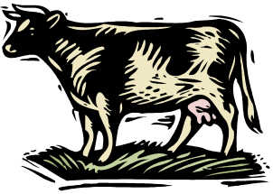



Set Based Model Theory Example
World
Model
Interpretation
Δ
Daisy isA Cow
Cow kindOf Animal
Mary isA Person
Person kindOf Animal
a
Z123ABC isA Car
b
T-box
Mary drives Z123ABC
{... list of facts
about individuals ...}
A-box

Slide 48
Set Based Model Theory Example
World
Model
Interpretation
Δ
Daisy isA Cow
Cow kindOf Animal
Mary isA Person
Person kindOf Animal
a
Z123ABC isA Car
b
Mary drives Z123ABC
{... list of facts
about individuals ...}

Slide 49
Is RDF(S) better than XML?
Q: For a specific application, should I use XML or RDF?
A: It depends…
XML's model is
  a tree, i.e., a strong hierarchy
  applications may rely on hierarchy position
  relatively simple syntax and structure
  not easy to combine trees
RDF's model is
  a loose collections of relations
  applications may do “database”-like search
  not easy to recover hierarchy
  easy to combine relations in one big collection
  great for the integration of heterogeneous information

Slide 50
Problems with RDFS
RDFS too weak to describe resources in sufficient detail, e.g.:
  No localised range and domain constraints
    Can’t say that the range of hasChild is person when applied to persons and elephant when applied to elephants
  No existence/cardinality constraints
    Can’t say that all instances of person have a mother that is also a person, or that persons have exactly 2 parents
  No transitive, inverse or symmetrical properties
    Can’t say that isPartOf is a transitive property, that hasPart is the inverse of isPartOf or that touches is symmetrical
We need RDF terms providing these and other features.

Slide 51
Conclusions
RDF is a simple data model based on a graph
  Independent on any serialization (e.g., XML or N3)
RDF has a formal semantics providing a dependable basis for reasoning about the meaning of RDF expressions
RDF has an extensible URI-based vocabulary
RDF has an XML serialization and can use values represented as XML schema datatypes
Anyone can make statements about any resource (open world assumption)
RDFS builds on RDF’s foundation by adding vocabulary with well defined semantics (e.g., Class, subClassOf, etc.)
OWL addresses some of RDFS’s limitations adding richness (and complexity).

