Slide 1
INFRAFRONTIER / IMPC Machine Learning "Hackathon" (Helmholtz Centre Munich, 23rd -24th January 2019) Some ideas / thoughts / potential projects from the GMC

Slide 2
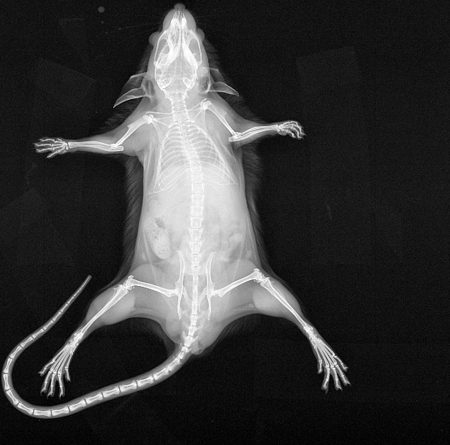
1) large-scale classification / morphometry on histopathological images
2) predict early death / welfare issues based on early-pipeline data
3) predict weight outcome/curve based on early-pipeline data
4) use high-dimensional phenotype profiles to generate "phenotype families/clusters" (low-dim), look into associated gene sets
5) deep learning on X-Ray images
GMC project for building deep learning expertise
start with "easy" labels: sex, body weight/composition
classify normal vs. not normal
prepared data set available:
3636 IMPC mice with both dorso-ventral and lateral X-Ray
273 genes, 1813/1825 males/females
csv file with ID, sex, genes, body weight, equipment ID

