Slide 1
Network analysis for identification of pleiotropy
Hackathon January 2019

Slide 2
Pleiotropy networks
Identify pleiotropy – particularly co-phenotypes that are unexpected
Search based on phenotypes/parameters of interest
Identify what other phenotypes are found in lines along with those of interest
Form networks where phenotypes are connected if they are both found in multiple lines
Edges are weighted based on the number of lines that have the connected phenotypes
Followed by cluster analysis to view subsets of the networks formed
Could use the same method on whole IMPC data not just those phenotypes of interest

Slide 3
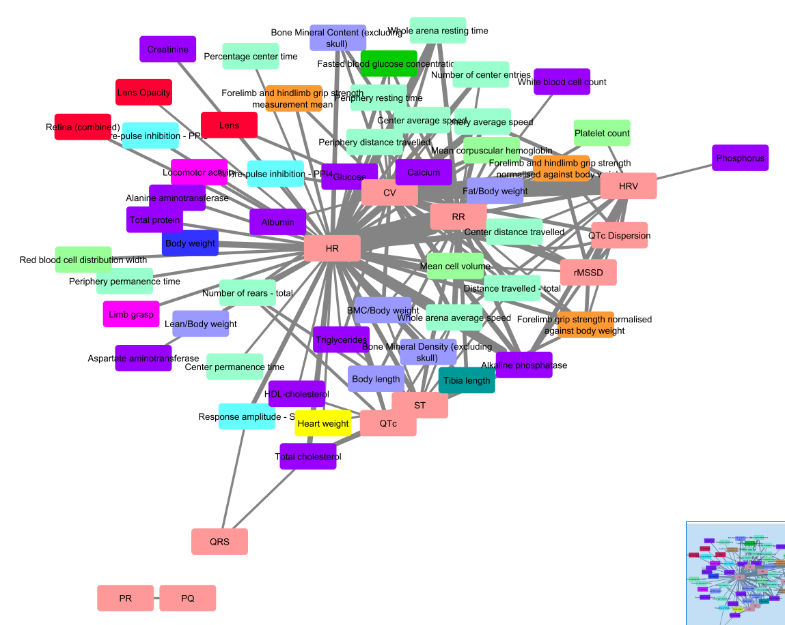
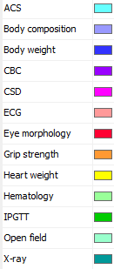
Networks produced
using Cytoscape

Slide 4
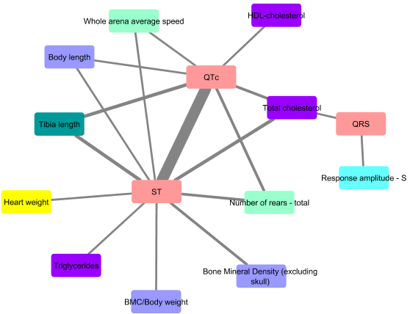
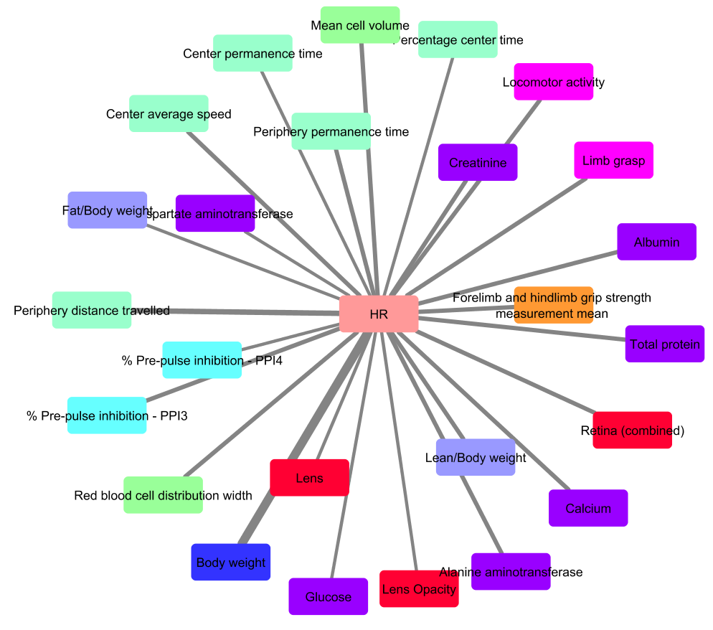
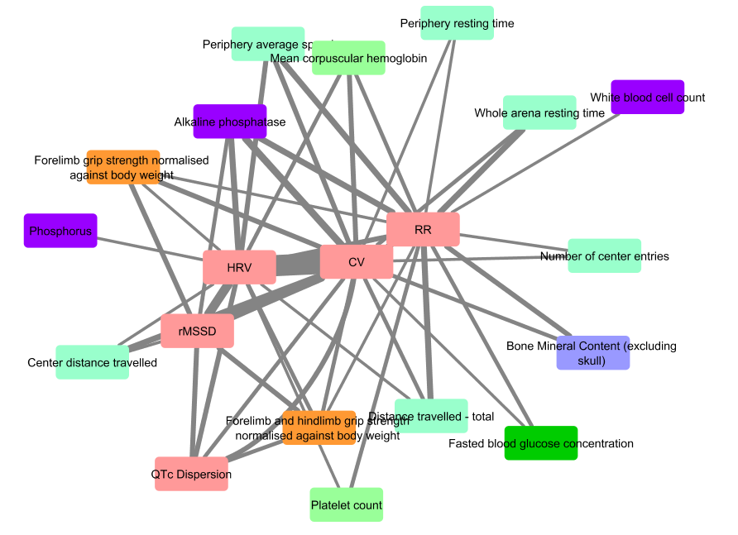
Cluster analysis
Using ClusterViz in Cytoscape

Slide 5
Questions
Is there enough information in the network to make clustering worthwhile?
Could p-value be included to be used when clustering?
Alternative clustering methods?
Usefulness of applying such a method to all data vs a subset of phenotypes of interest?

