Slide 1
Machine Learning Lifecycle Management with MLflow
Predicting E-Commerce Customer Churn — an end-to-end MLOps system
Asra Sarı · Student No. 2101640
AIN-3009 Delivering AI Applications with MLOps · Bahçeşehir University
github.com/asrasari/ecommerce-churn-mlops

Slide 2
The Problem & The Data
Why churn?
Retaining a customer is far cheaper than acquiring a new one — predicting who will leave lets a business act early.
But the real focus: managing the ML lifecycle with MLflow
Track experiments · tune · register · deploy · monitor
Dataset
• E-Commerce Customer Churn — 3,941 customers, 10 features
• Target: Churn (yes/no), ~17% churn — a class imbalance
• 8 numeric + 2 categorical features; 576 missing values handled
Example features
• Tenure
• Satisfaction score
• Complaint filed?
• Days since last order
• Cashback amount
• Preferred order category
• Marital status

Slide 3
System Architecture — the MLflow Lifecycle
1 Track
Log every model run: params, metrics, plots, model
2 Tune
Optuna search, each trial a nested run
3 Register
Best model → Staging → Production
4 Serve
Load Production model, predict via REST
5 Monitor
Live metrics + PSI drift over incoming batches
→
→
→
→
A local MLflow tracking server (port 8080) with a SQLite metadata database and a local artifact store ties it together. An Airflow DAG orchestrates the pipeline on a schedule.
Code: focused Python modules — data_prep · train · tune · register · serve · monitor

Slide 4
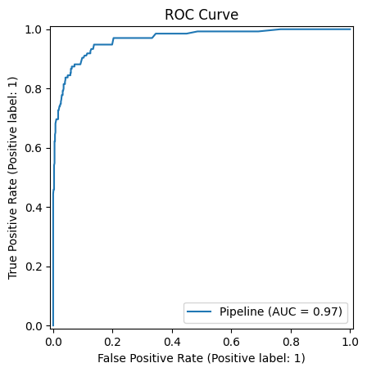
Experiment Tracking — Results
Three models trained, each logged as an MLflow run and compared in the UI.
Model | F1 | ROC-AUC
Logistic Regression | 0.544 | 0.879
Gradient Boosting | 0.675 | 0.927
Random Forest ★ | 0.783 | 0.966
Random Forest wins — ROC-AUC 0.966. AUC is the key metric because the classes are imbalanced.

Slide 5
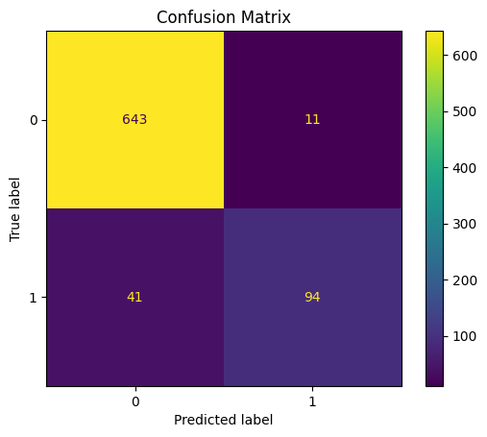
Tuning & the Model Registry
Hyperparameter tuning — Optuna
• 20 automated trials searching n_estimators, learning rate, depth
• Every trial logged as a nested MLflow run — full audit trail
• Best tuned model: ROC-AUC ≈ 0.958
Model Registry — lifecycle control
• Best run registered as ecommerce-churn-model
• Promoted: new version → Staging
• Quality gate: ROC-AUC ≥ 0.85 → promoted to Production
The gate stops a bad model from ever going live

Slide 6
Deployment, Monitoring & Orchestration
Deployment — real-time serving
• Production model served over HTTP; send a customer record → get a churn prediction back
Demo: a short-tenure customer who filed a complaint → predicted to churn (1)
Monitoring — drift detection
• Simulated incoming batches; live metrics logged to MLflow
• Population Stability Index (PSI) per feature; PSI > 0.2 = drift → would trigger a retrain
Orchestration — Apache Airflow
• A DAG runs ingest → train → tune → register on a schedule, calling the same code

Slide 7
Key Takeaways
MLflow let me manage the complete ML lifecycle in one reproducible system.
• Tracking made every experiment comparable and reproducible.
• The registry gave a controlled Staging → Production path with a quality gate.
• The same logged model served both batch and real-time predictions.
• Monitoring closes the loop — drift detection signals when to retrain.
• Best model: Random Forest, ROC-AUC 0.966, live in Production.
Thank you! — Demo: http://127.0.0.1:8080

