Slide 1
Improved TCP congestion control algorithms for HTTP/2.0
Prof. Aruna Balasubramanian
Praveen Kumar Saminathan ( 110739913 )
Vinothkumar Raja ( 110422174 )
Aathira Prabhakar ( 110749512 )

Slide 2
Problem Statement
Performance of HTTP/2.0 (SPDY) degrades under high packet loss.
Need for an improved congestion control algorithm
Window back off technique

Slide 3
Approach
Study and evaluate existing TCP Congestion control algorithm for various network conditions( packet loss, delay, initial congestion window)
Identify key parameters and modify TCP congestion control algorithms
TCP CUBIC
TCP RENO

Slide 4
Setup
Server
Apache Server 2.4 with protocol HTTP2.0 enabled
Ubuntu machine with Linux kernel 4.2.0
Hosts HTML webpages of different object size ( <1KB, <10KB, <100KB, >1 MB)
Client
Ubuntu machine with Linux kernel 4.2.0
Firefox browser
Connected to server via Ethernet cable
Tools
Netem - emulating poor network conditions
Wireshark - to analyze packet trace
Tcpdump - to capture packets

Slide 5
Improvements to CUBIC
Modifying window decrease constant, β on packet loss.
Modifying recovery time, K based on varying RTT.

Slide 6
Improving window reduction
A new parameter, β’ is introduced which is calculated as follows :
β’=1-(1-β)/n , where n=6.
The above improvement is based on the study from How Speedy is SPDY research paper.

Slide 7
Modified Cubic Algorithm Evaluation under packet loss
Fig1
Fig 2
Fig 3
The modified algorithm performs well for large sized objects under high packet loss.

Slide 8
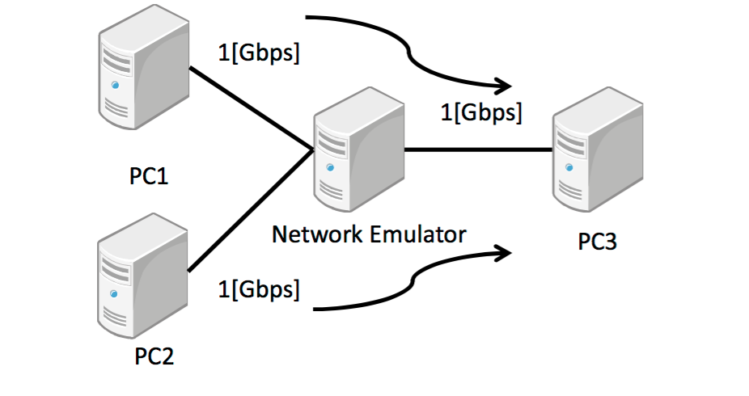
RTT fairness evaluation
Current Recovery time, K calculation does not consider RTT :
W(t)=C(t−K)³ +W_{max}
K = (W_{max}β)^{1/3}
Improved Recovery time, K calculation involves a factor func(RTT) , where it monotonically decreases as RTT increases:
K = (W_{max}β)^{1/3} * func(RTT)

Slide 9
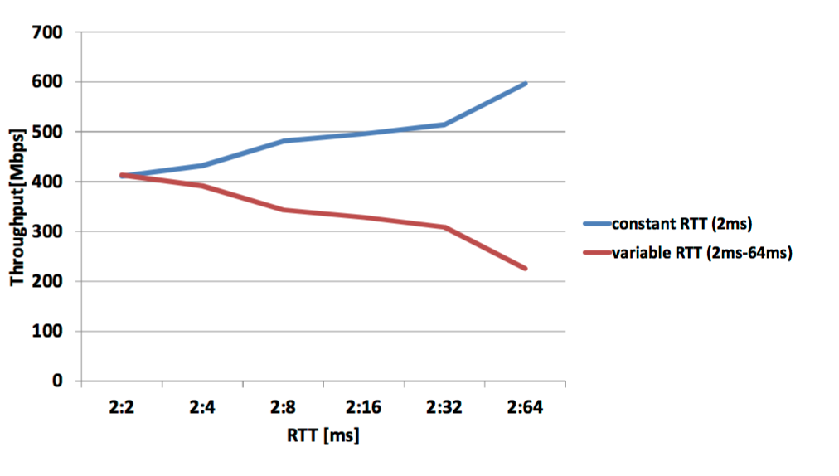
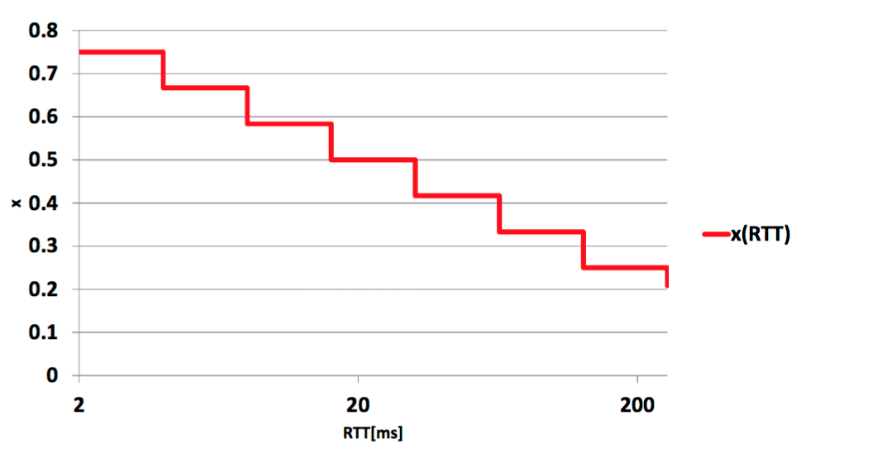
RTT fairness evaluation

Slide 10
Modified Cubic Algorithm Evaluation under delay
Fig 4
Fig 5
The performance of modified algorithms is similar to the original version under induced delay.

Slide 11
Modified Cubic Algorithm Evaluation under delay
Fig 6
Fig 7
The performance of modified algorithms is similar to the original version under induced delay.

Slide 12
Sensitivity Analysis - RENO
We analyzed the congestion window reduction factor for RENO. By default, the window gets reduced by half :
cwnd = cwnd/2
We performed a sensitivity analyses of the algorithm by reducing cwnd through a range of factors from 0.5 through 0.9.

Slide 13
Evaluation
With varying cwnd factors, we see the performance of algorithm with cwnd factor = 0.9 performing better under high loss.

Slide 14
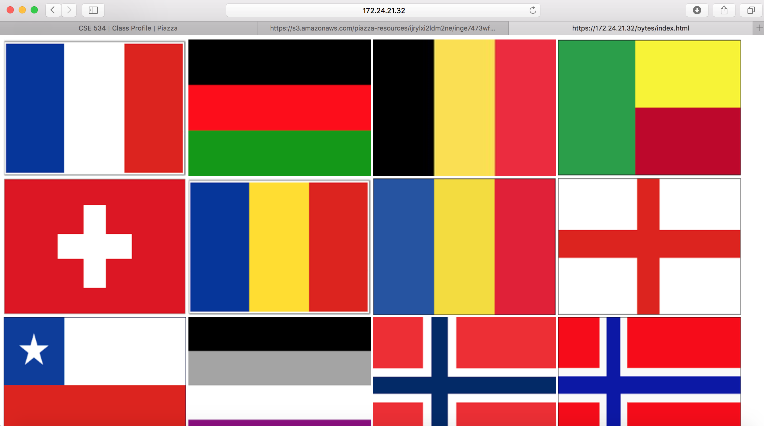

Other works
Experiments were performed with different initial congestion window size. However, the performance of the modified algorithms were similar to that of original version.
Technical studies on other improved versions of TCP CUBIC algorithms such as different initial ssthresh value, for wireless networks, etc. However, only important factors like packet loss and recovery time were evaluated
We also computed the page load time for our experiments. However, average Mbps was taken into consideration to evaluate the performance.
HTML pages loaded with flags of various object sizes are as shown in the figure below :

Slide 15
References
[1] How speedy is SPDY
https://www.usenix.org/system/files/conference/nsdi14/nsdi14-paper-wang_xiao_sophia.pdf
[2] Improving RTT fairness on CUBIC TCP
http://ieeexplore.ieee.org/stamp/stamp.jsp?tp=&arnumber=6726892
[3] CUBIC: A New TCP-Friendly High-Speed TCP Variant
http://netsrv.csc.ncsu.edu/export/cubic_a_new_tcp_2008.pdf
[4] Linux Cross Reference
http://lxr.free-electrons.com/source/net/ipv4/tcp_cubic.c

Slide 16
Thank You

