Slide 1


Agile Behavioural Testing (in Java)
Generic Guidance for efficiently creating tests during an agile project

Slide 2
Motivation

Slide 3
Commonly ask questions
Why even test in Agile (and other methodologies)?
Why expend the effort, the code will change.
Why expend the effort when the Product Owner may not accept the story?
How do you know what to test?
What is too much testing?
What is too little testing?

Slide 4
First some benefits
1) Developer efficiency
Tests can be used to allow developers to prove features work in isolation;
Test cases can be used to speed up repetitive processes that would have to be performed manually;
2) Proving nothing has been broken
As the code base is built the existing tests can be run to prove new code has not had an adverse effect;
3) Test can be used to demonstrate features
If the test is written well it can be used in a demo to the Product Owner to prove functionality is delivered.

Slide 5
Some challenges
1) Tests are not reproducible
With out test data it is not possible to run a test more than once;
2) Tests can be fragile
When code libraries are changed or refactored the tests may break/not compile;
3) Tests can become redundant/irrelevant
Without a sensible context how do developers know that a test must be maintained sooner than removed;

Slide 6
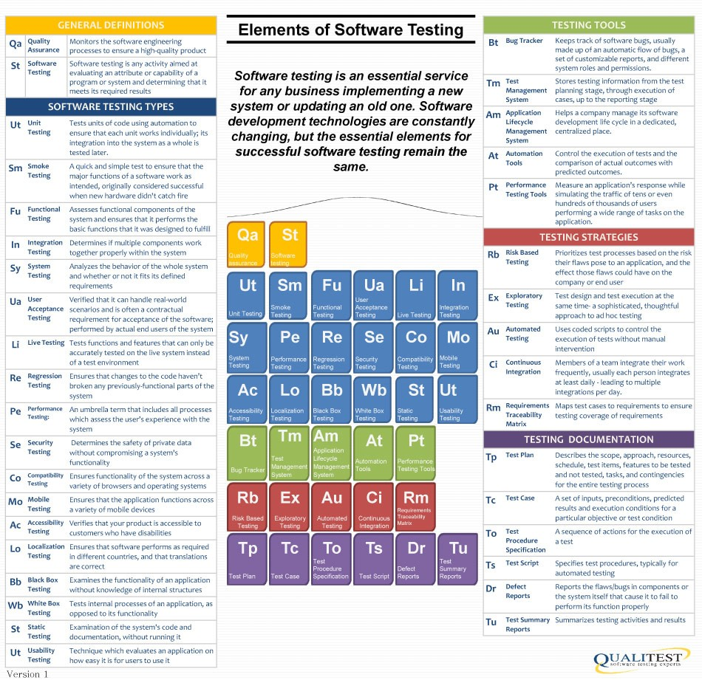
This is nothing new
There are plenty of different types of testing:
https://www.qualitestgroup.com/blog/testing-tools/elements-software-testing/

Slide 7
So what are you on about?
1) Test Driven Development (TDD)
xxcxcxcx
2) Tests can be fragile
When code libraries are changed or refactored the tests may break/not compile;
3) Tests can become redundant/irrelevant
Without a sensible context how do developers know that a test must be maintained sooner than removed;

Slide 8
Tests that are always relevant

Slide 9
The Source
1) Start from the User Stories
Each user story MUST have acceptance criteria;
The criteria must be testable (a basic tenet of Agile).
2) Create a minimum of one test per criteria
When code libraries are changed or refactored the tests may break/not compile;
3) Tests can become redundant/irrelevant
Without a sensible context how do developers know that a test must be maintained sooner than removed;

Slide 10
And that's it!

