Slide 1
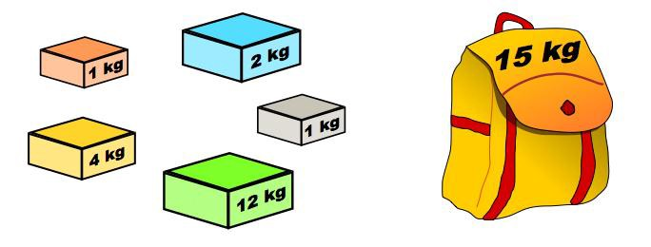
FRACTIONAL KNAPSACK PROBLEM USING GREEDY METHOD
Presented by:
A. Sree Roja Rani(No:11),
M. Sravani(No:29).

Slide 2
CONTENTS
PROBLEM STATEMENT
TYPES OF KNAPSACK PROBLEM
ALGORITHM
EXAMPLE
TIME COMPLEXITY
APPLICATIONS

Slide 3
Problem Statement of Knapsack Problem
Let us consider a Store with 'n' items as i₁,i₂,i₃,…...i_{n}. Let, the profits and weights of those items be p₁,p₂,p₃,….,p_{n} and w₁,w₂,w₃,….,w_{n}.
A Thief want to rob that store with his empty knapsack whose maximal capacity is 'W'.
The items should be selected in such a way that the thief will carry those items for which he can gain maximum profit.
Hence, the Objective of this problem is to maximize the profit.

Slide 4
TYPES OF KNAPSACK PROBLEM:
Fractional Knapsack – using Greedy Programming :
Here, the items can be broken into smaller pieces, hence the thief can select fractions of items.
0|1 Knapsack – using Dynamic Programming, Backtracking and Branch & Bound :
Here, the items cannot be broken which means the thief should take the item as a whole or should leave it.

Slide 5
ALGORITHM: (FOR GREEDY METHOD): Let W-Capacity, n- no of items, w-weights, p-profits, x-solution set.
#Calculate p_{i}/w_{i}
for i=1 to n
Do p_{i}/w_{i}
#Sort p_{i}/w_{i} in decreasing order
#Initialize solution set to 0.
for i = 1 to n do x[i] = 0
total,profit= 0

Slide 6
ALGORITHM: Let W-Capacity, n- no of items, w-weights, p-profits,x-solution set.
for i = 1 to n if total+w[i] ≤ W then x[i] = 1 total = total + w[i] else x[i] = (W - total) / w[i] total = W break return x
#Maximum profit
for i=1 to n
profit=profit+(p[i]*x[i])

Slide 7
EXAMPLE: Find the solution for the given knapsack problem. W=20,n=4, p=[30,50,24,15], w=[6,5,12,15].
Step-1: Calculate p/w.
p/w=[5,10,2,1]
Step-2: Sort p/w in decreasing order.
p/w=[10,5,2,1].
Corresponding
profits(p)=[50,30,24,15], weights(w)=[5,6,12,15].
Step-3: x=[0,0,0,0], total=0.
Iteration-1: (0+w[1])<=W
=> 5<=20(True)
=>x[1]=1 , total=5

Slide 8
EXAMPLE:
Iteration-2: (5+w[2])<=W
=> (5+6)<=20(True)
=>x[2]=1 , total=5+6=11
Iteration-3: (11+w[3])<=W
=> (11+12)<=20 (False)
x[3]=(W-total)/w[3]
=> x[3]=(20-11)/12 => x[3]=9/12=¾
x[4]=0. Therefore, x=[1,1,¾,0]
Maximum Profit=Sum of p*x=50*1+30*1+24*(¾)+15*0=98

Slide 9

TIME COMPLEXITY:
If the items are already arranged in the sorted order, then for loop takes O(n).
If the items are not in sorted order (The time complexity of sort is O(nlogn)).
Then, The total time complexity with sorting is O(nlogn).

Slide 10
APPLICATIONS
Dynamic Resource Allocation.
Selection of assets.
Waste Management.
Power Allocation.

Slide 11

THANK YOU

