Slide 1
MUSA650 Spring 2020, Week13
Case Study:
Azavea-RasterVision,
An Open Source Framework
for
Deep Learning in Remote Sensing

Slide 2

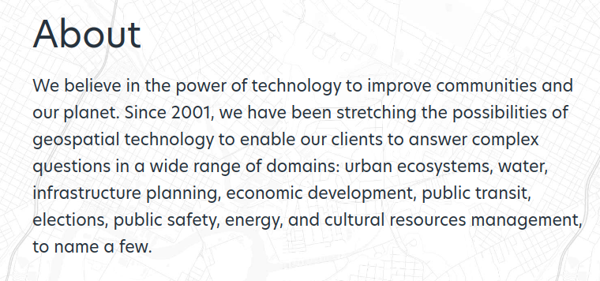
https://www.azavea.com/

Slide 3
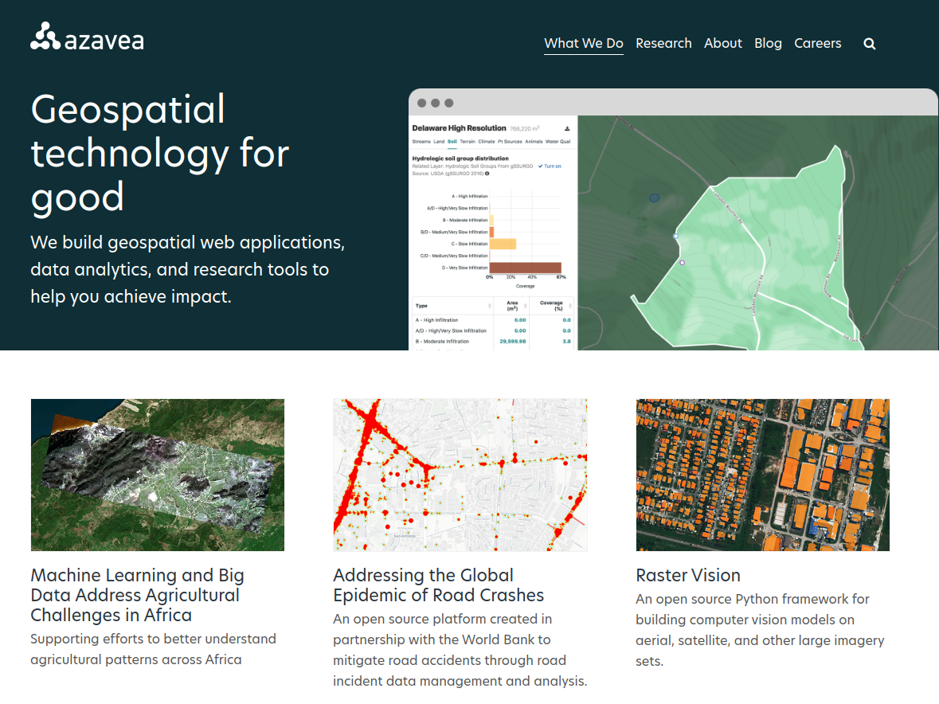

Slide 4
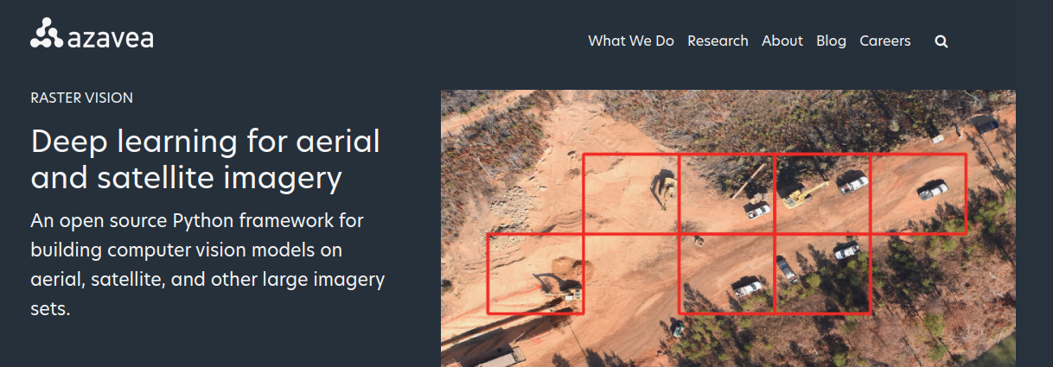
https://rastervision.io/

Slide 5
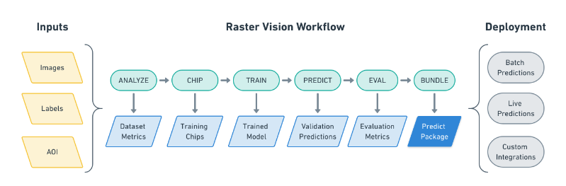

Slide 6
DEMO:
A practical Example; running Rastervision for Semantic Segmentation
Steps for running the experiment:
https://docs.rastervision.io/en/0.10/quickstart.html

Slide 7
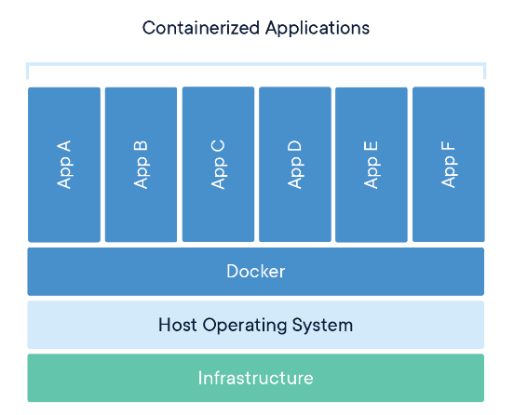

Docker
An open-source project that automates the deployment of software applications inside “containers”
https://docker-curriculum.com/
https://nickjanetakis.com/blog/comparing-virtual-machines-vs-docker-containers

Slide 8
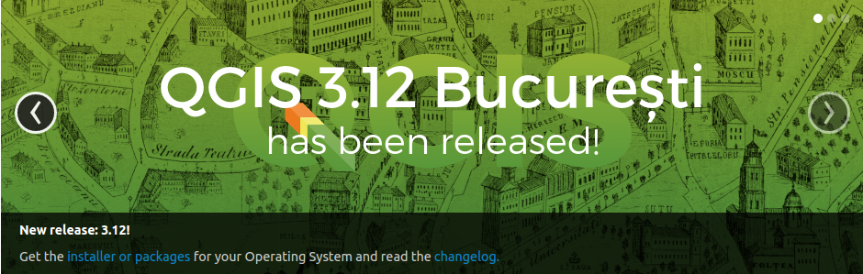
QGIS:
A Free and Open Source Geographic Information System
https://qgis.org/en/site/
https://docs.qgis.org/3.10/en/docs/user_manual/

