Slide 1

RTL-DESIGN-OF FB-CPU

Slide 2
Designing a Processor Capable of Executing Ten Different Machine Language Operation Codes
Introduction: The FB-CPU processor will be created within the scope of this project utilizing the Verilog language for Register-Transfer Level (RTL) design.
For the designed CPU, various code fragments will be written in machine language. At the end of the project, the collaboration of RAM, Control Unit, and Registers in a simple processor will be witnessed to execute machine language code snippets.
The FB-CPU will be demonstrated on the Basys3 FPGA development board.

Slide 3
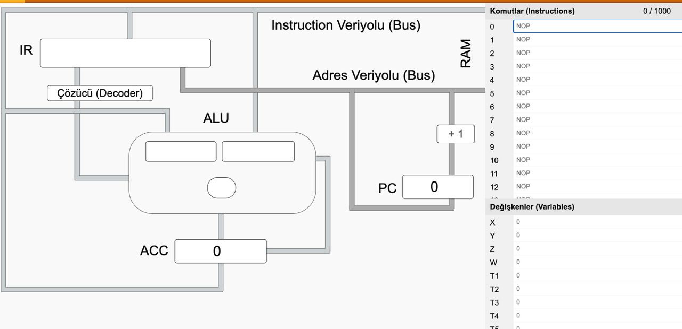
tools Used:
Von Neumann Simulator: A simulator used to visualize the architecture of FBU-CPU and observe the data flow.
Xilinx Vivado Design Suite: Utilized for creating the necessary designs to work on FPGA development boards.

Slide 4
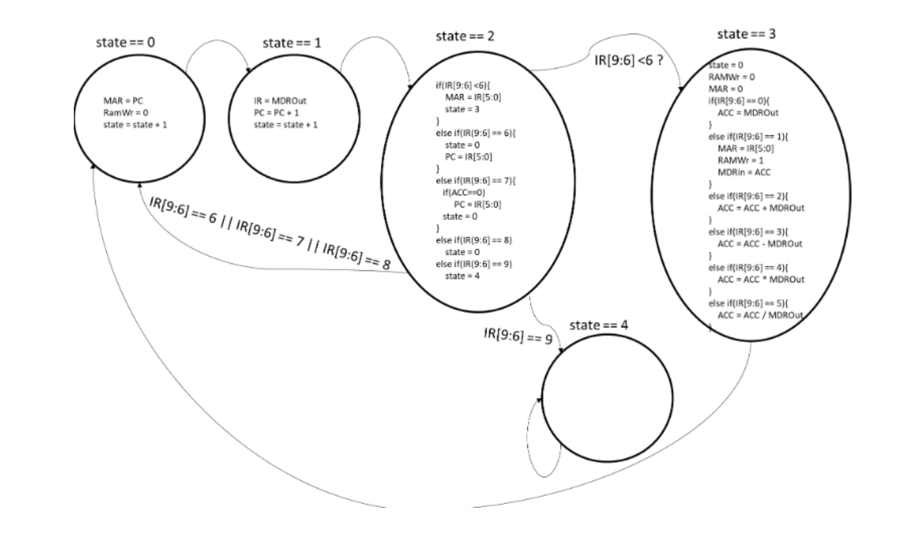
The design of the project named FFB-CPU is depicted as shown. The objective is to execute commands as per the specified conditions.
The FB-CPU design is intended to accommodate 10 commands. To execute the specified commands, the necessary condition values must be provided. Given conditions such as condition=0, condition==1, and condition==4, we are required to perform operations for condition=2 and condition==3.

Slide 5
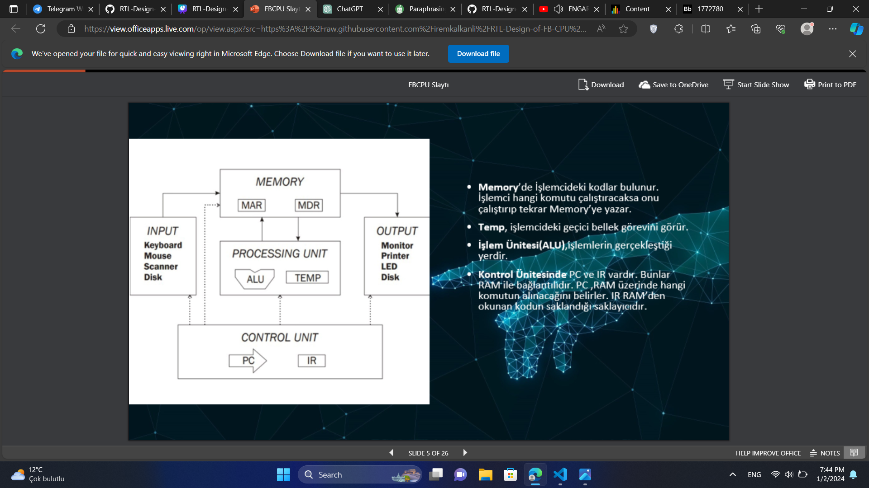
In the processor's memory, codes are stored. The processor executes the command it needs and then writes it back to the memory.
The 'Temp' functions as the temporary memory within the processor.
The Arithmetic Logic Unit (ALU) is where the actual computations take place.
Within the Control Unit, there are the Program Counter (PC) and Instruction Register (IR). These are connected to the RAM. The PC determines which command is fetched from the RAM, while the IR is the storage unit for the code read from the RAM.

Slide 6
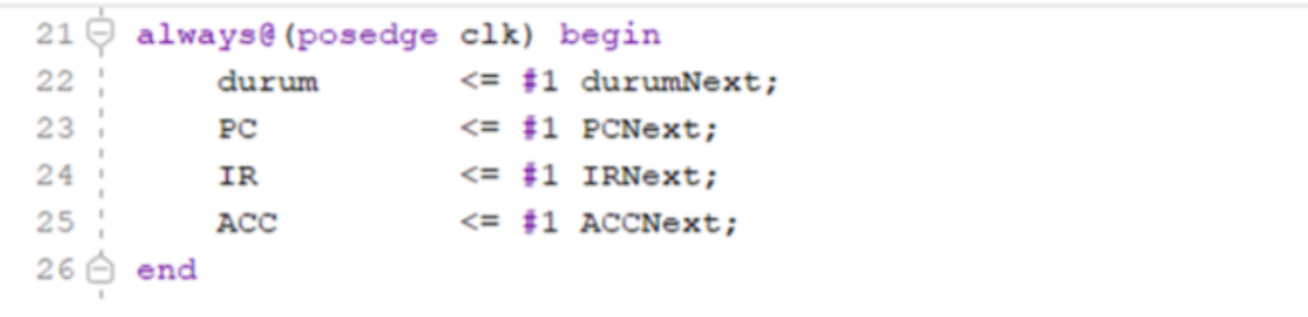
The design comprises four storage units:
Status Register: Holds information about the current state of the state machine.
PC (6 Bits): Determines which command from the RAM will be fetched. Its 6-bit size corresponds to the 2^6 locations in RAM, allowing the PC value to address every location in the RAM.
IR (10 Bits): Instruction Register, storing the instruction read from the RAM.
ACC (10 Bits): Accumulator, a storage unit for holding arithmetic operation results.
All other storage units will operate based on changes in the state register. In other words, the input signals for all storage units change according to the value of the state register.

Slide 7
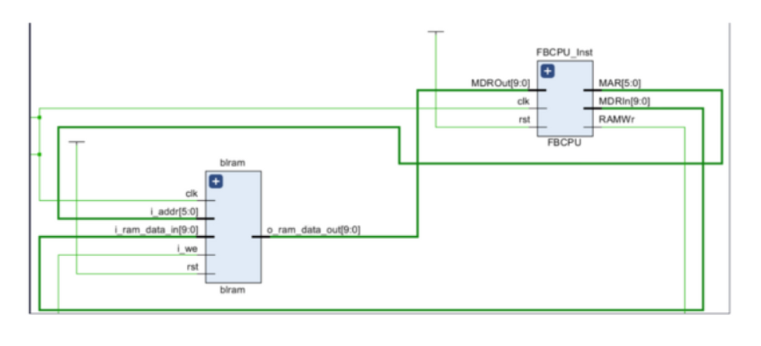
The memory signals connected to the input-output ports in the diagram are as follows:
1. MAR (6 Bits): Memory Address Register is a storage unit linked to the address input of RAM. It is 6 bits since RAM has 2^6 locations.
2. MDRIn (10 Bits): Memory Data Register In is a storage unit used when writing data to RAM. It's 10 bits to match the size of RAM's location. This register is within the RAM.
3. RAMWr (1 Bit): Controls the writing of data to RAM. It activates when set to 1. When not active, data is not written to RAM. This control is within the RAM.
4. MDROut (10 Bits): Memory Data Register Out is a storage unit used when reading data from RAM. It's 10 bits to match the size of RAM's location. This register is within the RAM.

Slide 8
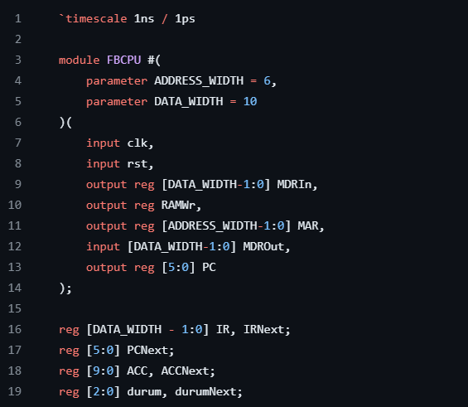
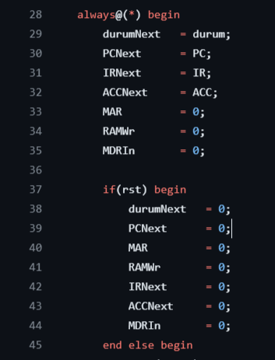
The codes here contain the operation itself. In the design, the necessary storage units connected to the input-output ports have been defined.

Slide 9
RAM , random access memory
• FB-CPU has storage units and a clock signal connected to the RAM where it reads commands, performs calculations, and writes back the computed value.
•
Arithmetic Logic Unit (ALU): This is the section where arithmetic operations are carried out.
•
Control Unit: Responsible for the transfer of data between storage units, Arithmetic Logic Unit, and RAM. It manages the data flow within the processor.

Slide 10
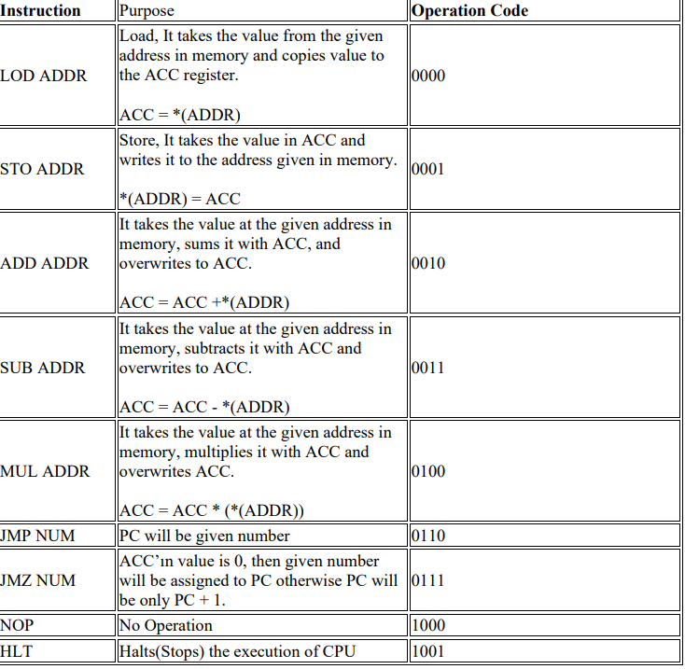
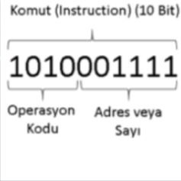
Each processor has its own instruction set. To read and decode commands in memory, the state machine uses a 10-bit command where the first 4 bits [9:6] specify the operation code, while the last 6 bits [5:0] represent the address or number. The number to be processed can be obtained from a memory address, within the command itself, or from a storage unit.

Slide 11
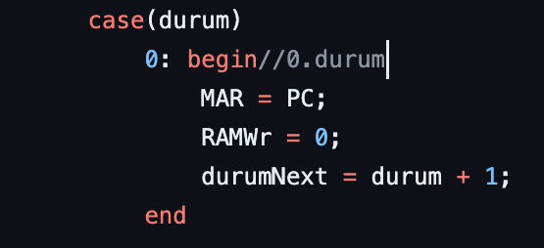
Durum==0, durumu Ram'den komutun istenildigi yerdir.

Slide 12
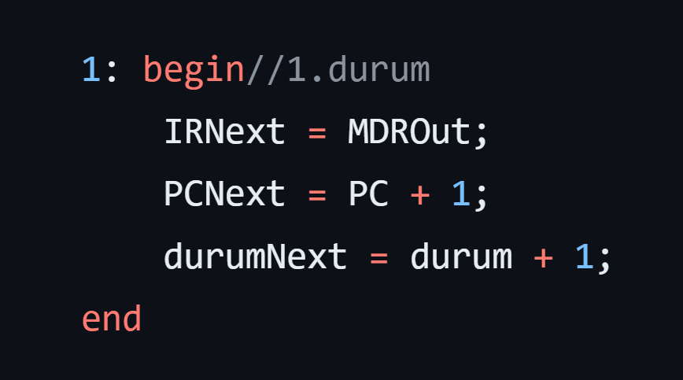
"durum == 1" is represented in Verilog language like this.

Slide 13
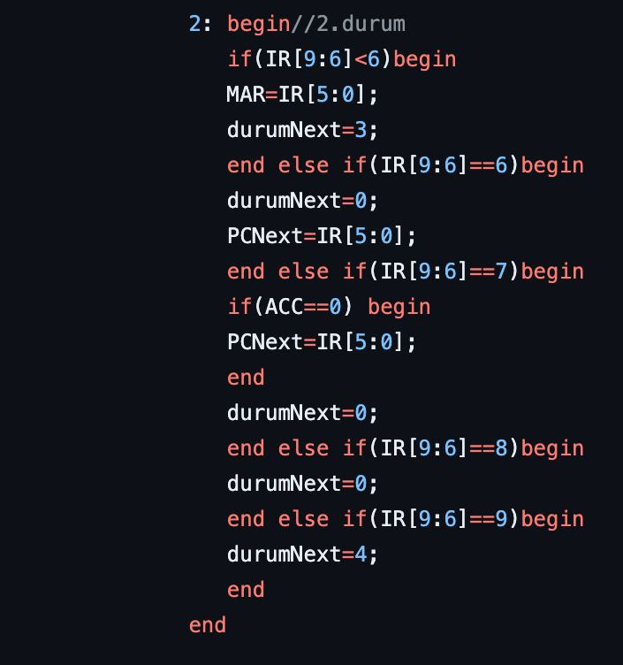
state == 2

Slide 14
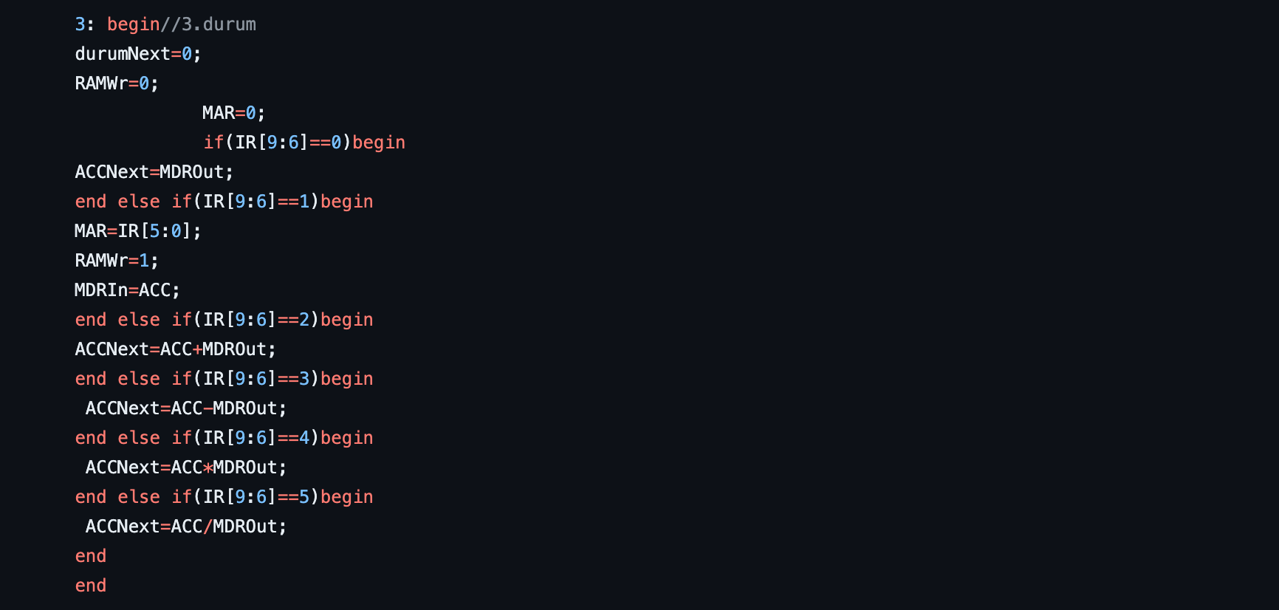
state == 3

Slide 15
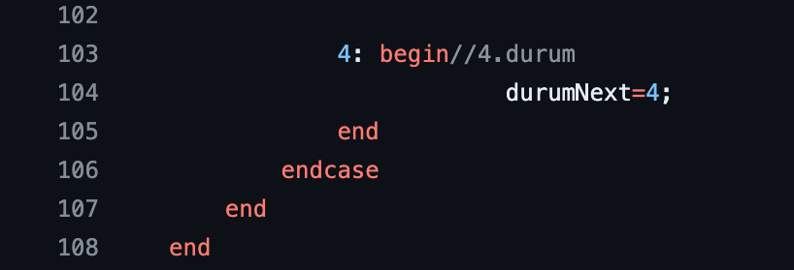
state == 4

Slide 16
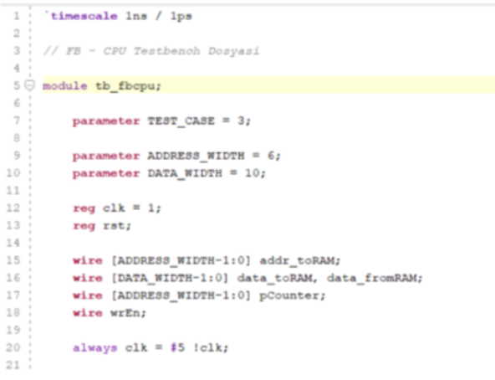
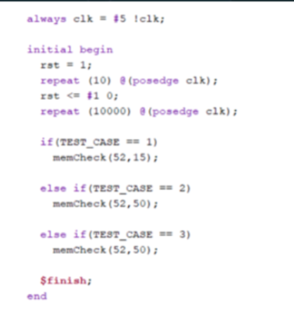

Slide 17
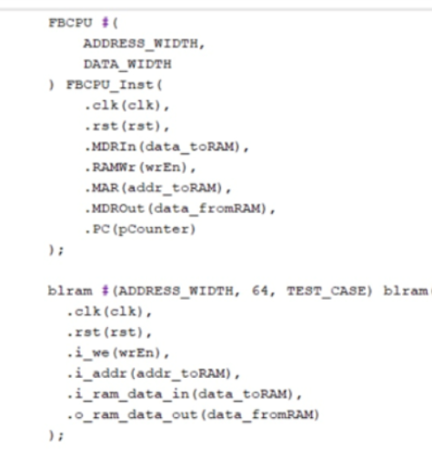
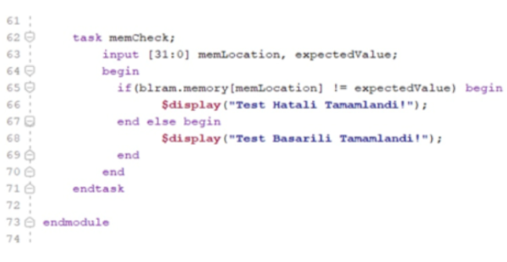
The codes in the FBCPU and Memory files have been defined as shown above. The signals of both are interconnected.

