Slide 1

OpenFlow Controller
http://floodlight.openflowhub.org

Slide 2
About Us
Big Switch Networks
Big Switch Networks builds and promotes Open Software Defined Networking Solutions
We use and help support Floodlight and a number of other OpenFlow tools
Yes, you can contact us about jobs and internships at careers@bigswitch.com
©2012 – Big Switch Networks Inc.

Slide 3
Introduction
Floodlight overview
Floodlight architecture
Demo!
©2012 – Big Switch Networks Inc.

Slide 4
Floodlight Overview
Floodlight is a completely open, free, Apache-licensed Java-based OpenFlow controller.
©2012 – Big Switch Networks Inc.

Slide 5






Floodlight Controller
A great platform for OpenFlow
Research and commercial friendly ☺
Easy to build, run, and develop
Toolchain
Rich set of build and debugging tools
Community of OpenFlow experts, access to commercial upgrades, and frequent testing
©2012 – Big Switch Networks Inc.
Notes:
Tools – packetstreamer ,static flow pusher, mininet. All the tools we use here at big switch.
Finally, Floodlight is something we use at big switch in the core of our commercial controller. Its an extremely important part of our business. This means

Slide 6
Building Floodlight
Fast…an easy…
Download from Github
$ git clone git://github.com/floodlight/floodlight.git
$ sudo apt-get install build-essential default-jdk ant python-dev
$ cd floodlight; ant
$ java –jar target/floodlight.jar
Get the VM (including mininet)
$ wget http://floodlight.openflowhub.org/files/floodlight-vm.zip
(login as “floodlight” user, no password)
©2012 – Big Switch Networks Inc.

Slide 7











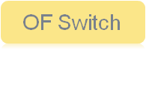
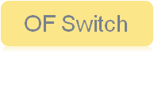
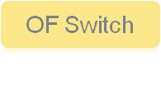

Other Floodlight Highlights
REST-based App
Static Flow Pusher
2
1
Java event APIs
REST-based APIs
Ability to push flows
Active work in defining standard “Northbound” APIs
3
Support for integrating with non-OpenFlow networks
©2012 – Big Switch Networks Inc.
Notes:
Our topology, device manager know about host attachment points and make it possible to deal with integrating openflow and non openflow networks.

Slide 8





OpenFlowHub
A community of open source OpenFlow developers
What it is:
Get involved:
A community of open source OpenFlow developers
An OpenFlow Blog (available for guest authors)
Free hosting, tools, and marketing for open source projects
  Wiki, forums, bug tracking tools, logos, etc.
Submit a project
Write a blog post
http://www.openflowhub.org
Contact: mike.cohen@openflowhub.org
Projects:
©2012 – Big Switch Networks Inc.

Slide 9
Internals

Slide 10
Architecture Overview
Everything is a module: modules export services
  Synchronous service calls
  Asynchronous publish/subscribe events
  Automatic dependency resolution
Programming environment
  Core and all current modules written in Java
  Rich, extensible REST API
  Recently added Jython: could dev in Python
Main Module: Floodlight “Provider”
  Manages OpenFlow switch I/O with Netty
  Translates OpenFlow messages to Floodlight Events
©2012 – Big Switch Networks Inc.

Slide 11
IFloodlightModule Interface
getModuleDependencies()
  What services does this module require?
getModuleServices(), getServiceImpls()
  Services does this module provide and how?
init(FloodlightModuleContext context)
  Internal, before dependencies have init()’d
startup(FloodlightModuleContext context)
  External, with dependencies initialization
Function | Description
getModuleDependencies() | What services does this module require?
getModuleServices() | Services does this module provide and how?
init(FloodlightModuleContext context) | Internal, before dependencies have init()’ed
startup(FloodlightModuleContext context) | External, with dependencies initialization

Slide 12
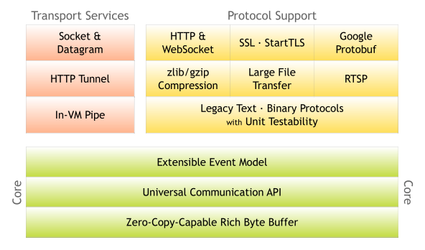
Netty
An asynchronous event-driven network application framework
©2012 – Big Switch Networks Inc.
Notes:
Say “high performance I/O is a PITA to get right. Best practice is to use an off-the-shelf already optimized library, so we’re using Netty. Only affects floodlight provider module, so could easily move to something else”

Slide 13
Threading Model
All inter-module communication is through services
  Inter-service calls need to be thread safe
Event handling happens in publisher’s thread context
  Don’t block, use a bottom half handler
Thread pool executer service exists
  Allows modules to share threads
Number of shared data structures protected by locks
  Any Java object can be an event
  Standard locks apply : synchronized
©2012 – Big Switch Networks Inc.

Slide 14
Floodlight Provider Module
Manages I/O from OF Switches
  Tracks switch add/removes
  Translates OF messages to Floodlight events
IFloodlightProvider Service
  addOFMessageListener(OFType type)
    Ordering defined by caller with OFMessageListener iface
  Map<dpid,Switches> getSwitches();
  addOFSwitchListener();
  injectOfMessage(IOFSwitch sw, OFMessage msg);
    Used for recirculation-style hacks
©2012 – Big Switch Networks Inc.

Slide 15
Topology Module
Floodlight Automatically discover topologies
OpenFlow and non-OF networks
  SwitchClusters – managing OF-islands
Controller sends active probes via packet out/in
  Probes are formatted to look like LLDPs
ITopologyService interface
  getLinks()
  addListeners()
  inSameCluster(switch1, switch2)
  Set<Switches> getSwitchesInCluster(switch1)
©2012 – Big Switch Networks Inc.

Slide 16
Device Manager Module
Host location tracking
Tracks End-Host Locations in the network
  Mac to ( Switch, Port) mapping
  Mac to IP
  IP to Mac
IDeviceManager Service
  List<Device> getDevices()
  addListener()
  Device getDeviceByIPv4Address(ip)
  Device getDeviceByDataLayerAddress(mac)
TODO: Extend Device definition, include Vlan?
©2012 – Big Switch Networks Inc.

Slide 17
REST API Module
Any module can export via REST
Implementation uses Restlets internally
  www.restlets.org
IRestAPI Service
  addRestletRoutable(RestletRoutable rr)
Your module implements RestletRoutable
  String basePath()
    “/rest/version1/myMod”
  Restlet getRestlet(Context)
    New Router(context).attach(“/switch/all/{statType}/json”, MyStatClass.class}
MyStatClass extends org.restlet.resources.ServerResource
©2012 – Big Switch Networks Inc.

Slide 18
Demo

Slide 19
Demo
Problem:
Track the last N Packet-Ins seen by the controller and expose it via a REST API
What you will see:
Adding a new module
Creating a REST API
Running Floodlight
©2012 – Big Switch Networks Inc.

Slide 20
Interested in Learning More?
Check out the website
  http://floodlight.openflowhub.org
Join the mailing list:
  http://groups.google.com/a/openflowhub.org/group/floodlight-dev/topics
  Or just email floodlight-dev@openflowhub.org
Get the code:
  http://floodlight.openflowhub.org/download
©2012 – Big Switch Networks Inc.

