Slide 1

INTRODUCTION TO PENFLOW

Slide 2
STATEMENT OF PRODUCT DIRECTION
This statement of product direction sets forth Juniper Networks’ current intention and is subject to change at any time without notice. No purchases are contingent upon Juniper Networks delivering any feature or functionality depicted in this presentation.

Slide 3




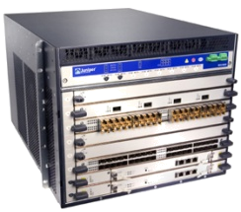







OPENFLOW – WHAT IS IT?
Openflow compromises an architecture and a protocol
In a traditional networking device, the control processes and forwarding functionality reside on the network device
In the Openflow architecture, an interface is created on the network device through which an external control process known as a ‘controller’, is able the program the packet matching and forwarding operations of the networking device
penflow
Control
Control
penflow
Controller
Forwarding
Forwarding
Traditional
Openflow-enabled

Slide 4
OPENFLOW – WHAT IS IT?
The Openflow protocol defines
  A standardized API and communication method between the external controller and Openflow process on the networking device
  The use of ‘Flow-tables’ held on the networking device which are populated by the external controller which are used for matching and forwarding packets
Openflow Flow-tables contain
  Header Fields – fields against which a packet can be matched
  Counters – statistics reporting capabilities
  Actions – defining how the packet should be treated (forward, drop, modify)
There is no use of static configuration or cli/xml-based programming via Openflow, nor does Openflow provide functionality to boot or maintain the networking device

Slide 5
OPENFLOW 1.0 FLOW TABLE & FIELDS
Header Fields
Ingress
Port
Ethernet
VLAN
IP
TCP/UDP
SA
DA
Type
ID
Priority
SA
DA
Proto
TOS
Src
Dst
Classifier
Action
Statistics
Flow Table
OF1.0 style
Classifier
Action
Statistics
Classifier
Action
Statistics
…
Classifier
Action
Statistics
Forward
Physical Port
Virtual Port
ALL
Actions
CONTROLLER
LOCAL
TABLE
IN_PORT
Drop
Mandatory Action
Forward
Virtual Port
NORMAL
Optional Action
FLOOD
Enqueue
Modify Field
Actions

Slide 6
OPENFLOW – WHAT IS IT?
Two components
  Openflow controller
    Controls one or more switches
    Computes paths, maintains state, formulates flows and programs Openflow Switches
  Openflow Switch
    Receives commands (flow entries, queries) from the Openflow controller in order to populate entries in the flow-table
    Holds the flow-table in volatile memory
Flow-table population can occur in two modes
  Reactive – Flow-table programmed in response to received packet
  Proactive – Flow-table is populated with pre-provisioned entries

Slide 7
MODES OF OPERATION
Reactive – Data plane driven
Base principle of flow caching
Pro-active – Configuration driven
Like Static routes & LSPs
Not stored in configuration file
Controller
Controller
FIB
FIB
C
4
Switch
Switch
FIB
FIB
1
2
3
1
2
3
Receive packet
Perform lookup in local FIB
Hit: forward to port
Miss: forward to controller
  Controller inspects packet
  Performs route computation
  C: Inserts new flow entry
Receive packet
Perform lookup in local FIB
Hit: forward to port
Miss: DROP

Slide 8
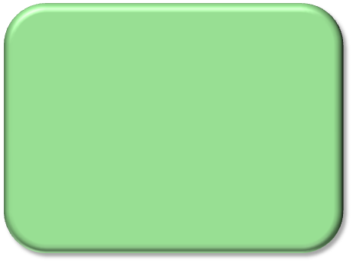







OPENFLOW SWITCH / NETWORK DESIGN
Switch Control Plane
Applications
Switch Control Plane:
Logically centralized
Physically distributed in one or more compute devices
Embedded OF Controller to communicate with switches
OpenFlow Controller
OpenFlow
Protocol
penflow switch
penflow switch
penflow switch
penflow switch
penflow switch
penflow switch
Source: OpenFlow.org
Notes:
OpenFlow Switch (Figure shows dedicated OF switch)
Flow table
Secure channel
OpenFlow protocol as interface to OpenFlow controller

Slide 9



THE ISSUE:
APPLICATIONS DON’T COMMUNICATE WITH THE NETWORK
THE HUMAN WORLD
THE NETWORK WORLD
Network Aware Applications:
Applications blindly probe the network to understand what it can deliver
Application Aware Networking:
Networks spy on traffic to try to understand applications
Game ping-stats, Doppler, Geo-location, whois, proprietary codecs, proprietary control channels in VBRB
Approximate topology/location thru:
Active/game-based broadcast, passive derivation
Deep Packet Inspection, Deep Flow Inspection
Approximate application by fingerprinting
Service specific overlay topologies
Application-based Quality of Service profiles
Current approximation techniques are barely sufficient and inefficient

Slide 10


OPENFLOW HELPS BY ENABLING NETWORK PROGRAMMABILITY FOR COMMUNICATION
APPLICATION
NETWORK
NETWORK
APPLICATION
Applications made better by information from network
Understanding of end-device capabilities
Real location / topology
Adjust behavior to real-time usage
Billing granularity
Networks made better by information from application
Bandwidth and resource optimization
New service topologies
Security identification
Service-specific packet treatment
Flexibility of service placement
Control of resources from applications
Notes:
This is just an examples discussion. Imagine what you could do… what if…
Bring in architectural changes over last few years … IGP Generic application information can be carried. Separate from routing. You don’t have to break everything. You can target specific devices in the network (ak flooding) …
Key is “Network, User and Session Telemetry” for apps and being able to program the network beyond session logon and working within the constraints of IF-Map, Radius/Diameter, COPs, PCMM. Now it’s possible for multiple sources to create a service profile and update it in real time

Slide 11


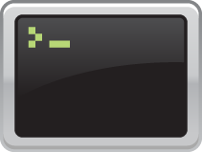
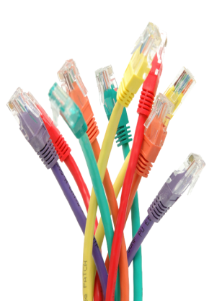

HOW DO YOU MAKE THIS HAPPEN?
THE APPLICATION WORLD
THE APPLICATION WORLD
Real-time topology understanding
(ALTO, BGP-TE)
SI
Partner
ISV
Partner
Service
Provider
Research
Institution
Enterprise
Customer
Steering traffic through optimal paths
(PCE)
Web Services API
Network
Programmability
Orchestration Across Networks
Selecting specific traffic
(OpenFlow)
Network APIs
ALTO
BGP-TE
PCE
Mgmt
OpenFlow
…
Opening more touchpoints to control: Gateways, billing collectors, service appliances, CDN, DPI/IDP
THE NETWORK WORLD
THE NETWORK WORLD
Programmable Networking is SFW

Slide 12









AN EXAMPLE: BE “IN THE NETWORK”
Weak architecture = one-legged tap dancing
Continuous, real-time streaming of surrounding content, resources, places, people
Where am I?
I am here!
You’re here!
<access>
<capability>
<BW>
<profile>
And this is around you:
<content>
<resources>
<places>
<people>
…
Active broadcast
Game broadcast
Passive derivation
!
“Above the topology”
“Visualize the topology”
“Below the topology”
“In the topology”
Low value in navigational coordinates
APPLICATION
NETWORK
Notes:
This is an easy one. Foursquare on steroids.
Current, weak architecture:
“ above the topology" - user-interactive layer - (Loopt, burbn, BooYay, Gowalla, micello, foursquare)
"on the topology" - visual representation of topo - (SimpleGeo, motricity, tele atlas, navteq, geo api)
"below the topology" - HW/SW layer - (android, IOS - Apple, Skyhook, SiRF).
These categories are to describe functionality that is beyond tweeting your location, checking-in and geo marking in social media map-ups.
As an analogy to the current fubared'ness of the situation ... using straight mobile phone GSM coordinates for marking your location in a social media interface is merely noting the navigational coordinates that has little to do with the interaction/exchange/communication of information of a social network on the internet. It's less useful that what a dog leaves on a fire hydrant.
Advert: Socialbomb
Commerce:
Comm: Blockchalk
Content: Navx
Analytics:
Social:Gowalla, Loopt
his means that the quality of interaction can abandon the three common modes of topologic interaction listed above and enter continuous real time updates and streaming. Really the point in the non-exhaustive list of topo-interested APIs/platforms above is that they are in fact the *orchestration* platforms that "app developers" that go to J1 know about.

Slide 13
WANT MORE ON OPENFLOW?
Useful URLs:
Open Networking Foundation https://www.opennetworking.org/
Openflow Whitepaper http://www.openflow.org//documents/openflow-wp-latest.pdf
Openflow protocol
https://www.opennetworking.org/standards/open-flow/50-openflow

