Slide 1
OpenFlow Overview
Edited by:
Michael Cohen
mike.cohen@bigswitch.com
Big Switch Networks
(authored by A LOT of folks listed at the end of this preso)

Slide 2
Agenda
Why OpenFlow?
How does OpenFlow work?

Slide 3
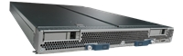




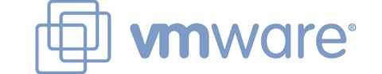






The evolution of infrastructure
Servers
Storage
Networking
5400 RFCs
Mainframe-style hardware + software integration
Expensive
Long protocol design + adoption cycles
Cheap x86, Linux, hypervisors, cloud
Scale out, flash, thin provisioning, object storage, etc
Ethernet, IP, Lots of new protocols…
While servers and storage have evolved in cost, flexibility, speed of development, and performance, networking has not kept pace.

Slide 4
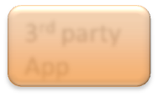
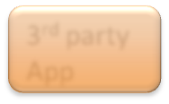





Closed vs. Open platforms
Closed Platform
Open Platform
3rd party App
3rd party App
Feature
Feature
Public APIs
Proprietary interface
OS / Controller
Kernel OS
+
Specialized Packet Forwarding Hardware
vs.
Standard hardware
Specialized hardware
Closed proprietary stack
Slow innovation
Standard, well understood hw
Open standards – vibrant 3rd party ecosystem
Very fast innovation
The world today

Slide 5



Control / Data plane separation
Unified Data and Control
Control + Data Separation
Add feature here?!?!
Controller
vs.
The world today
Control
Data
Today, new features are implemented as fully distributed algorithms at a protocol level rather than centralized applications. Spanning tree is a great example…

Slide 6
OpenFlow: a pragmatic compromise
Separate the control plane and the data plane
  No need for spanning tree
Develop an open ecosystem for networking with clean abstractions and an easy programming model
Result: Faster innovation, lower costs, more flexibility!

Slide 7
How does OpenFlow work?

Slide 8
OpenFlow Controller
OpenFlow Protocol (SSL/TCP)
Control Path
OpenFlow
Data Path (Hardware)

Slide 9


OpenFlow Example
Controller
OpenFlow Client
PC
Software
Layer
Flow Table
MAC
src
MAC
dst
IP
Src
IP
Dst
TCP
sport
TCP
dport
Action
Hardware
Layer
*
*
*
5.6.7.8
*
*
port 1
port 1
port 2
port 3
port 4
5.6.7.8
1.2.3.4

Slide 10
OpenFlow Basics
Flow Table Entries
Rule
Action
Stats
Packet + byte counters
Forward packet to zero or more ports
Encapsulate and forward to controller
Send to normal processing pipeline
Modify Fields
Any extensions you add!
Switch
Port
Eth
type
VLAN
ID
VLAN
pcp
MAC
src
MAC
dst
IP
Src
IP
Dst
IP
ToS
IP
Prot
L4
sport
L4
dport
+ mask what fields to match
Notes:
Now I’ll describe the API that tries to meet these goals.

Slide 11
Examples
 | Switch port | MAC src | MAC dst | Eth type | VLAN ID | IP Src | IP Prot | TCP sport | TCP dport | Action
Switching | * | * | 00:1f:.. | * | * | * | * | * | * | Port6
Flow switching | Port3 | 00:20.. | 00:1f.. | 0800 | Vlan1 | 1.2.3.4 | 5.6.7.8 | 4 | 17264 | Port6
Firewall | * | * | * | * | * | * | * | * | 22 | Drop
Routing | * | * | * | * | * | * | 5.6.7.8 | * | * | Port6
VLAN switching | * | * | 00:1f.. | * | Vlan1 | * | * | * | * | Port6,port7, port8

Slide 12

Centralized vs Distributed Control
Anything in this spectrum is possible with OpenFlow
Centralized Control
Distributed Control
Controller
Controller
OpenFlow
Switch
OpenFlow
Switch
Controller
OpenFlow
Switch
OpenFlow
Switch
Controller
OpenFlow
Switch
OpenFlow
Switch

Slide 13
Flow Routing vs. Aggregation
Anything in this spectrum is possible with OpenFlow
Flow-Based
Every flow is individually set up by controller
Exact-match flow entries
Flow table contains one entry per flow
Good for fine grain control, e.g. campus networks
Aggregated
One flow entry covers large groups of flows
Wildcard flow entries
Flow table contains one entry per category of flows
Good for large number of flows, e.g. backbone

Slide 14
Reactive vs. Proactive (pre-populated)
Anything in this spectrum is possible with OpenFlow
Reactive
First packet of flow triggers controller to insert flow entries
Efficient use of flow table
Every flow incurs small additional flow setup time
If control connection lost, switch has limited utility
Proactive
Controller pre-populates flow table in switch
Zero additional flow setup time
Loss of control connection does not disrupt traffic
Essentially requires aggregated (wildcard) rules

Slide 15
What you cannot do with OpenFlow v1.0
Non-flow-based (per-packet) networking
  ex. Per-packet next-hop selection (in wireless mesh)
  yes, this is a fundamental limitation
  BUT OpenFlow can provide the plumbing to connect these systems
Use all tables on switch chips
  yes, a major limitation (cross-product issue)
  BUT OF version 1.1 exposes these, providing a way around the cross-product state explosion

Slide 16
What you cannot do with OpenFlow v1.0
New forwarding primitives
  BUT provides a nice way to integrate them through extensions
New packet formats/field definitions
  BUT a generalized OpenFlow (2.0) is on the horizon
Optical Circuits
  BUT efforts underway to apply OpenFlow model to circuits
Low-setup-time individual flows
  BUT can push down flows proactively to avoid delays

Slide 17
Where it’s going
OF v1.1: released March 1
  multiple tables: leverage additional tables
  tags and tunnels
  multipath forwarding
OF v1.2+
  extensible match
  generalized matching and actions: an “instruction set” for networking

Slide 18
OpenFlow Building Blocks

Slide 19
OpenFlow building blocks
oftrace
oflops
openseer
Monitoring/
debugging tools
Stanford Provided
ENVI (GUI)
LAVI
n-Casting
Expedient
Applications
Floodlight
NOX
Beacon
Trema
Maestro
Controller
Slicing
Software
FlowVisor
Console
FlowVisor
Commercial Switches
Stanford Provided
Software
Ref. Switch
NetFPGA
Broadcom
Ref. Switch
HP, NEC, Pronto, Juniper.. and many more
OpenFlow
Switches
OpenWRT
PCEngine
WiFi AP
Open vSwitch
Notes:
There are components at different levels that work together in making it work
The commercial switch details will follow in next slide
There are a plethora of applications possible. I only list those available at Stanford

Slide 20
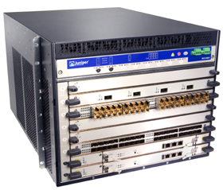
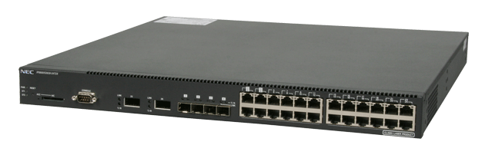
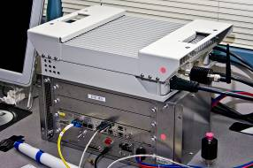
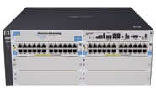
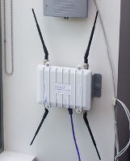

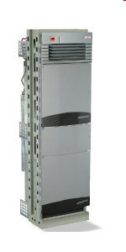

Current SDN hardware
Juniper MX-series
NEC IP8800
WiMax (NEC)
HP Procurve 5400
Netgear 7324
PC Engines
Pronto 3240/3290
Ciena Coredirector
Ask your vendors

Slide 21
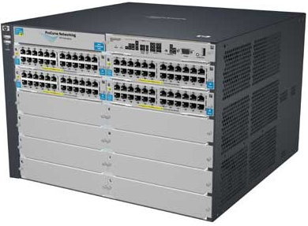

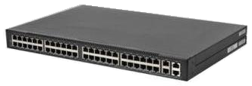
Commercial Switch Vendors
Model | Virtualize | Notes
HP Procurve 5400zl or 6600 | 1 OF instance per VLAN | LACP, VLAN and STP processing before OpenFlow Wildcard rules or non-IP pkts processed in s/w Header rewriting in s/w CPU protects mgmt during loop
NEC IP8800 | 1 OF instance per VLAN | OpenFlow takes precedence Most actions processed in hardware MAC header rewriting in h/w
Pronto 3240 or 3290 with Pica8 or Indigo firmware | 1 OF instance per switch | No legacy protocols (like VLAN and STP) Most actions processed in hardware MAC header rewriting in h/w
Notes:
All support ver 1.0
All have approx 1500 flow table entry limit

Slide 22
Open Controllers
Name | Lang | Platform(s) | License | Original Author | Notes
OpenFlow Reference | C | Linux | OpenFlow License | Stanford/Nicira | not designed for extensibility
NOX | Python, C++ | Linux | GPL | Nicira | actively developed
Beacon | Java | Win, Mac, Linux, Android | GPL (core), FOSS Licenses for your code | David Erickson (Stanford) | runtime modular, web UI framework, regression test framework
Maestro | Java | Win, Mac, Linux | LGPL | Zheng Cai (Rice)
Trema | Ruby, C | Linux | GPL | NEC | includes emulator, regression test framework
Floodlight | Java | Win, Mac, Linux | Apache | Big Switch | Apache licensed, actively developed
Notes:
Language open-source Performance cross-platform runtime modular

Slide 23
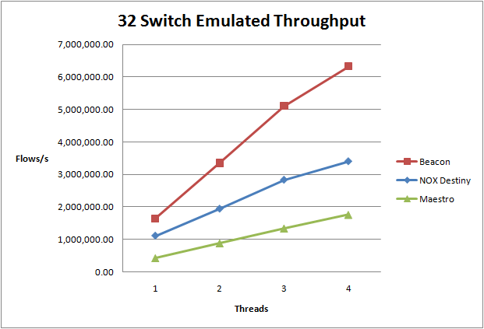
all 1M plus flows in one box!
  CPU: 1 x Intel Core i7 930 @ 3.33ghz, 9GB RAM, Ubuntu 10.04.1 x64
For more testing details, see:
http://www.openflow.org/wk/index.php/Controller_Performance_Comparisons
Notes:
Cbench Test, part of Oflops suite
PacketIn to PacketOut/FlowMod throughput test, fills controller input buffers
10 loops, 32 switches, 10s per loop
Test Machine
CPU: 1 x Intel Core i7 930 @ 3.33ghz, 9GB RAM, Ubuntu 10.04.1 x64
Controllers
Beacon, NOX (Destiny branch), Maestro

Slide 24
Closed-source Controller Vendors
Ask these vendors for more info
  BigSwitch
  Nicira
  NEC

Slide 25














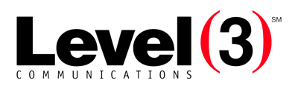










Growing Community
Vendors and start-ups
Providers and business-unit
More...
More...
Note: Level of interest varies

Slide 26
This tutorial was adapted from
OpenFlow Experts
  Brandon Heller
  Glen Gibb
  Nicholas Bastin
  Ali Al-Shabibi
  Tatsuya Yabe
  Masayoshi Kobayashi
  Yiannis Yiakoumis
  Ali Yahya
  Te-Yuan Huang
  Bob Lantz
  David Erickson

Slide 27
This tutorial wouldn’t be possible without:
Deployment Forum Speakers
  Subhasree Mandal (Google)
  Johan van Reijendam (Stanford)
  David Erickson (Stanford)
Videographer:
  Yiannis Yiakoumis

Slide 28
This tutorial wouldn’t be possible without:
Past slides from:
  Nick McKeown
  Rob Sherwood
  Guru Parulkar
  Srini Seetharaman
  Yiannis Yiakoumis
  Guido Appenzeller
  Masa Kobayashi, + others

Slide 29

Questions / Comments?

