Slide 1
SIGNAL PROCESSING PROJECT
Adaptive Irrigation
Management
Through Environmental Condition-Based Water Requirement Estimation
A software-based study of 24-hour-ahead soil-moisture prediction
TEAM MEMBERS
GUIDE
Monica Raghini Chelle • 2520040093 (Team Lead)
Swarna Asritha • 2520040114
Dhanush Karthikeya • 2520040032
Dr. V. Sahiti
Assistant Professor
Department of ECE
KL University, Hyderabad
SOIL SIGNALS → FORECASTS → DECISION SUPPORT
ADAPTIVE IRRIGATION MANAGEMENT
01

Slide 2
01 • CONTEXT
02 / 15
Introduction & Practical Motivation
WHY SOIL MOISTURE?
PROJECT IDEA
• Soil moisture changes as weather, evaporation, rainfall and watering change.
• A forecast 24 hours ahead can help plan irrigation instead of reacting only to current readings.
• Weather-station signals may contain spikes, missing values and rapid changes.
• Signal processing prepares the series; machine learning estimates future moisture.
Observe
01
Weather + soil data
02
Clean
Hampel filter
03
Predict
LightGBM, +24 h
04
Explain
SHAP + advisory
TAKEAWAY
This project tests whether a signal-processing and ML pipeline improves 24-hour soil-moisture forecasts.
SIGNAL PROCESSING • FINAL PROJECT
02

Slide 3
02 • PROJECT GOALS
03 / 15
Problem Statement & Objectives
PROBLEM STATEMENT
PROJECT OBJECTIVES
Noisy and irregular environmental time series can make future soil-moisture prediction difficult. A complex model also needs to be compared fairly with simple baselines.
01
Prepare
Clean, sort and resample station data hourly.
02
Process
Detect spikes with Hampel and analyse components with CEEMDAN.
03
Forecast
Train LightGBM for soil moisture 24 hours ahead.
Research question
Does Hampel cleaning + CEEMDAN analysis + LightGBM improve 24-hour-ahead prediction, and which stages actually help?
04
Evaluate
Compare MAE/RMSE with persistence and ridge baselines.
05
Explain
Use SHAP and produce decision-support advice.
TAKEAWAY
The contribution is a tested implementation and honest comparison—not a claim of a new algorithm.
SIGNAL PROCESSING • FINAL PROJECT
03

Slide 4
03 • RELATED WORK
04 / 15
Literature Review & Research Gap
Ullah et al. (2020)
Singh et al. (2019)
ANN + Kalman filtering
ML for smart irrigation
Sensor-noise reduction in greenhouse environments.
Shows soil moisture can be modelled from IoT data.
Gap: Different target; no CEEMDAN/SHAP pipeline.
Gap: Limited robust filtering and interpretability.
Mabunga & Dela Cruz (2022)
Afzal et al. (2025)
Optimised Gaussian Process
ARIMA-based watering
Predicts moisture from environmental variables.
Connects time-series prediction to watering.
Gap: No multiscale decomposition or SHAP.
Gap: Linear/stationary assumptions; different pipeline.
RESEARCH GAP
We evaluate Hampel + CEEMDAN + LightGBM + SHAP on one real station record and test whether each stage beats simple baselines.
References are listed on the final slide.
SIGNAL PROCESSING • FINAL PROJECT
04

Slide 5
04 • METHOD
05 / 15
Proposed System: Overview of Our Approach
A software-only pipeline from real station measurements to an interpretable forecast.
01
02
03
04
05
06
DATA
CLEAN
FILTER
ANALYSE
MODEL
INTERPRET
Weather-station
records
Sort + hourly
resampling
Hampel spike
replacement
CEEMDAN + IMF
selection
Features +
LightGBM
Metrics + SHAP
advisory
TARGET
Predict soil moisture (%) 24 hours ahead from current soil and environmental time-series features.
TAKEAWAY
Each stage is evaluated; a more complex pipeline is useful only if the evidence supports it.
SIGNAL PROCESSING • FINAL PROJECT
05

Slide 6

05 • SYSTEM DESIGN
06 / 15
System Block Diagram
Raw station data
Preprocessing
Hampel filter
CEEMDAN
Weather + soil
Timestamp, gaps,
hourly grid
Spike detection
and replacement
8 IMFs + trend
IMF selection
Feature building
LightGBM
Evaluation + SHAP
Retain IMF 7, 8
and trend
Lagged + weather
features
Predict moisture
after 24 hours
MAE / RMSE / R²
feature explanation
Evaluation is chronological (70% train / 15% validation / 15% test); full-series CEEMDAN has a future-information leakage caveat.
SIGNAL PROCESSING • FINAL PROJECT
06

Slide 7
06 • DATA
07 / 15
Dataset & Experimental Setup
22,112
13,567
1,496
90%
raw rows
hourly values
Hampel flags
median moisture
DATA SOURCE & TARGET
CHRONOLOGICAL SPLIT
• P18 BIORO weather-station records (real data).
• Period: 7 Mar 2024 – 13 Oct 2025.
• Target: soil moisture (%) 24 hours ahead.
• Hourly variables include soil moisture, temperature, humidity and rainfall.
70%
15%
15%
Train
Validation
Test
Time order is preserved; the last 15% represents about 11 weeks at one station.
TAKEAWAY
The series is often near saturation, so a simple persistence forecast is a strong baseline.
SIGNAL PROCESSING • FINAL PROJECT
07

Slide 8
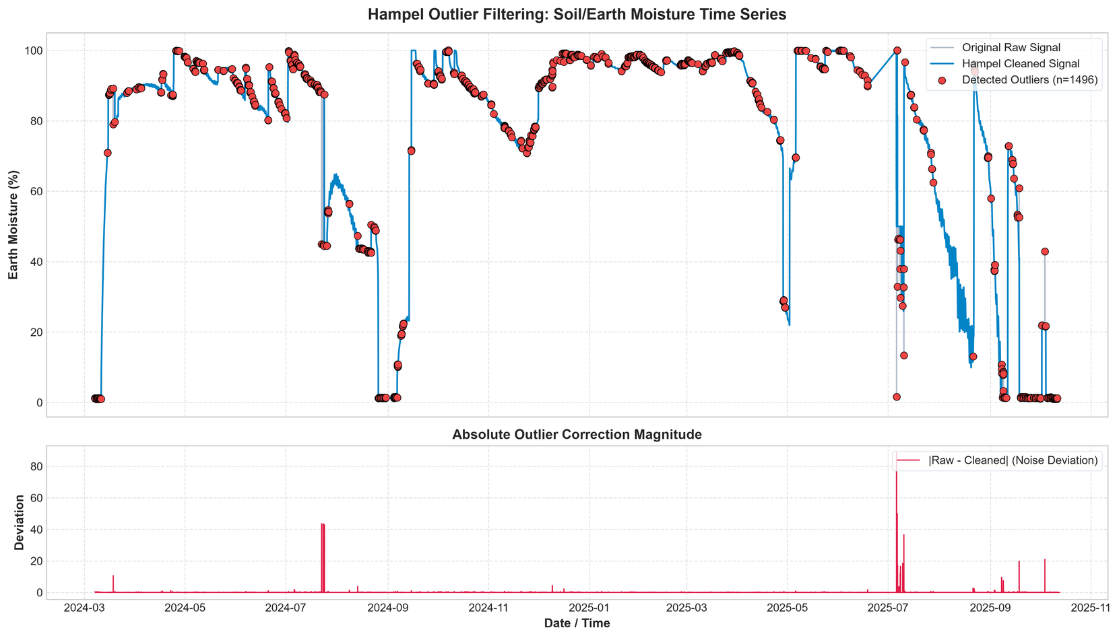
07 • SIGNAL CLEANING
08 / 15
Preprocessing: Hampel Filter & Results
WHAT IT DOES
• Compares each sample with a local median.
• Uses median absolute deviation (MAD) as a robust spread estimate.
• Flags points beyond a 3-sigma robust threshold and replaces them with the local median.
• Goal: reduce isolated spikes without heavily smoothing the whole signal.
1,496 points flagged • ~11%
This is relatively high; some real rapid changes may also be removed.
TAKEAWAY
Hampel reduces isolated spikes, but its threshold needs tuning because it flags about 11% of samples.
SIGNAL PROCESSING • FINAL PROJECT
08

Slide 9
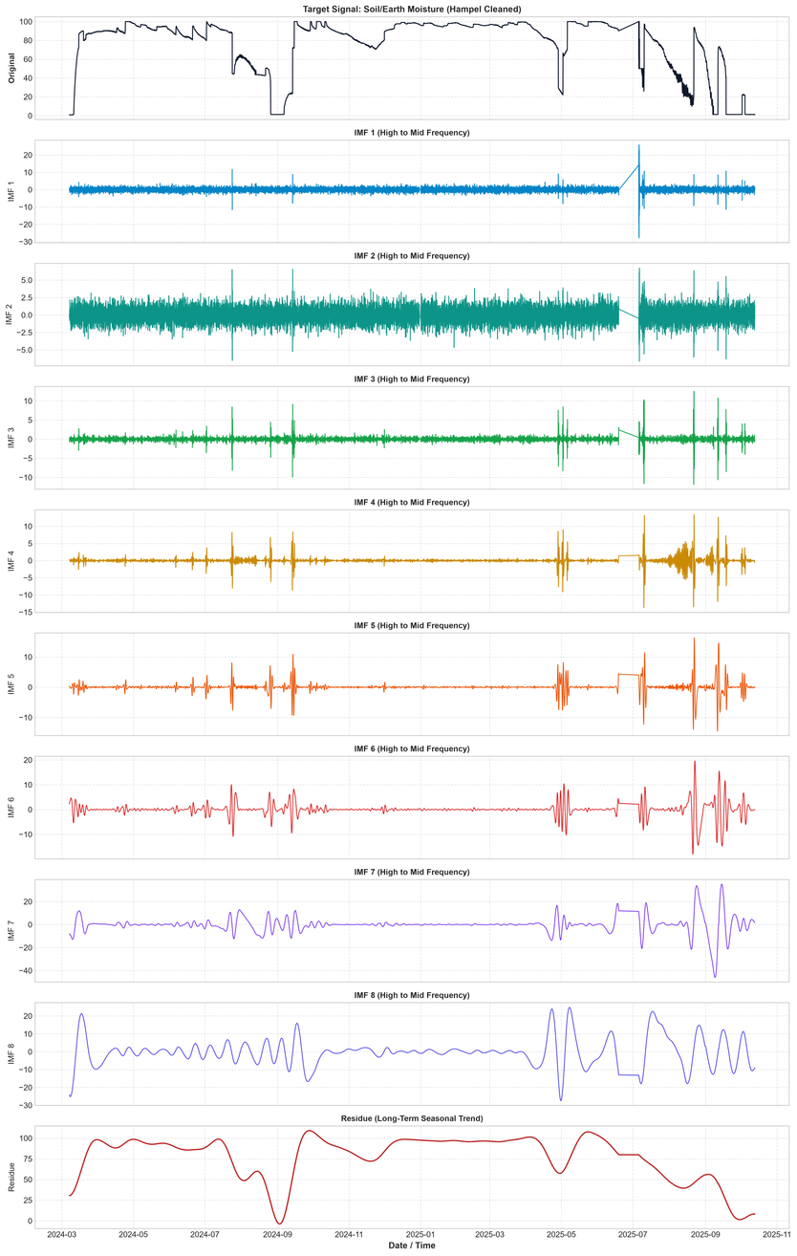
08 • MULTISCALE ANALYSIS
09 / 15
CEEMDAN Decomposition & IMF Selection
WHY CEEMDAN?
• Decomposes a non-stationary signal into oscillatory components (IMFs) plus a residual trend.
• IMFs 1–6 were treated as small, high-frequency components and dropped.
• IMF 7, IMF 8 and the trend were retained for reconstruction/features.
• The residual trend contains about 98% of signal energy.
Important caveat
Full-series decomposition uses future samples; past-only CEEMDAN is the fairer variant.
TAKEAWAY
The trend dominates the signal, and CEEMDAN did not improve the reported baseline metrics.
SIGNAL PROCESSING • FINAL PROJECT
09

Slide 10
09 • FORECASTING
10 / 15
Feature Engineering & LightGBM Model
INPUT FEATURES
LIGHTGBM REGRESSION
1
Recent history
Lagged soil-moisture observations
Feature matrix
Past observations
2
Signal features
Selected/reconstructed CEEMDAN components and lags
Boosted trees
Learn non-linear patterns
3
Weather context
Temperature, humidity and rainfall-related variables
Hourly time-series alignment
Forecast
Soil moisture at t + 24 h
4
Time context
Training / validation / test split: 70% / 15% / 15% in chronological order.
TAKEAWAY
LightGBM predicts the next-day moisture level from lagged signal and environmental features.
SIGNAL PROCESSING • FINAL PROJECT
10

Slide 11
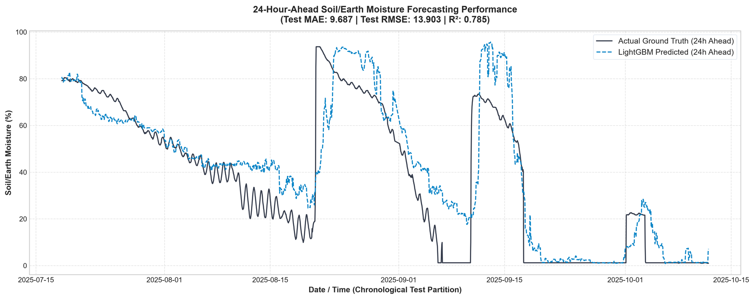
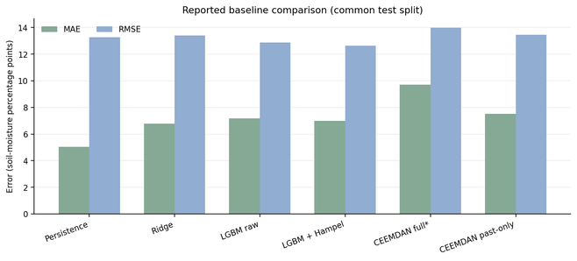
10 • RESULTS
11 / 15
Prediction Performance & Baseline Comparison
TEST PERFORMANCE SUMMARY
Test MAE
9.69
Test RMSE
13.90
Test R²
0.785
Train MAE
0.24
Large train–test gap indicates overfitting.
KEY COMPARISON
Best MAE: persistence (5.03)
Best RMSE: LightGBM + Hampel (12.65)
*Full-series CEEMDAN uses future data; its score is not a clean estimate. The report contains slightly different model-summary values across outputs—use the common-split table for baseline comparison.
SIGNAL PROCESSING • FINAL PROJECT
11

Slide 12
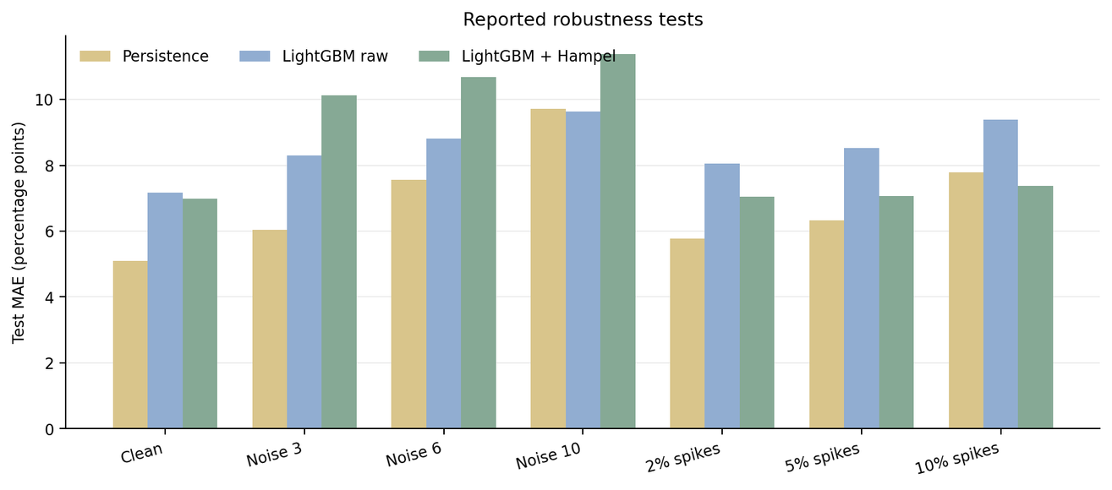
11 • FAILURE MODES
12 / 15
Robustness Testing & Error Analysis
WHAT THE TESTS SHOW
• Injected spikes: Hampel improves LightGBM MAE (9.39 → 7.37 at 10% spikes).
• Random noise: Hampel worsens the reported MAE.
• Large moisture jumps are difficult for both models.
ERROR BY CONDITION
For large jumps (>20 points), model MAE = 36.77 vs persistence = 46.43; on normal hours, persistence is better (2.40 vs 5.10).
TAKEAWAY
Hampel helps with spikes, not all noise; sudden rain/watering changes remain a major error source.
SIGNAL PROCESSING • FINAL PROJECT
12

Slide 13
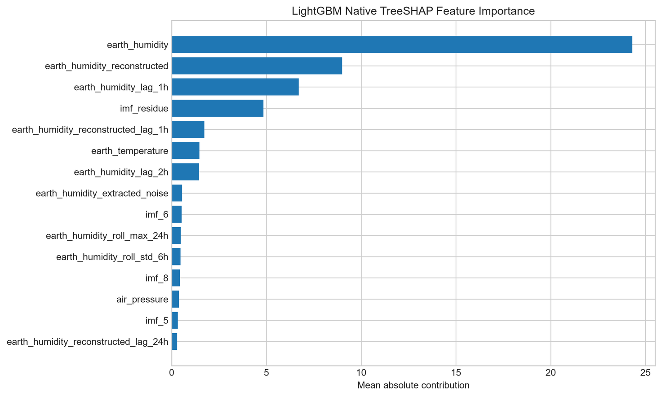
12 • INTERPRETABILITY
13 / 15
SHAP Explainability & Irrigation Decision Support
WHAT SHAP ADDS
• SHAP attributes a prediction to contributions from individual features.
• Mean absolute SHAP values rank global feature importance.
• Current soil moisture is the strongest feature in the submitted output.
• The forecast can be passed to configurable rules for an irrigation advisory.
Decision support — not field validated
Rainfall forecasts are not included, limiting anticipation of sudden wetting events.
TAKEAWAY
Explainability highlights current moisture as the dominant driver; recommendations need agronomic validation.
SIGNAL PROCESSING • FINAL PROJECT
13

Slide 14
13 • WRAP-UP
14 / 15
Conclusion, Limitations & Future Scope
CONCLUSIONS
LIMITATIONS
FUTURE SCOPE
• Built an end-to-end software pipeline on real station data.
• Hampel reduced spike impact but flagged ~11% of samples.
• Persistence had best MAE; LightGBM + Hampel had best RMSE in the reported common-split comparison.
• CEEMDAN did not improve reported accuracy.
• One station; test period is about 11 weeks.
• Clear train–test performance gap (overfitting).
• No rainfall forecast input.
• Full-series CEEMDAN leaks future information; walk-forward validation remains incomplete.
• Use causal/past-only processing and rerun all metrics.
• Tune Hampel threshold and improve IMF selection.
• Add rainfall forecasts and validate across more stations/seasons.
• Reduce overfitting and test with walk-forward validation.
TAKEAWAY
The pipeline is a useful prototype, but current evidence does not show consistent improvement over persistence.
SIGNAL PROCESSING • FINAL PROJECT
14

Slide 15
14 • ACKNOWLEDGEMENTS
15 / 15
Team Contributions, References & Q&A
TEAM CONTRIBUTIONS
SELECTED REFERENCES
Monica Raghini Chelle
• [1] Ullah et al., “ANN Based Learning to Kalman Filter Algorithm for Indoor Environment Prediction in Smart Greenhouse,” IEEE Access, 2020.
• [2] Singh et al., “Machine Learning Based Soil Moisture Prediction for IoT Based Smart Irrigation System,” IEEE SPCC, 2019.
• [3] Mabunga & Dela Cruz, “An Optimized Soil Moisture Prediction Model for Smart Agriculture Using Gaussian Process Regression,” IEEE CSPA, 2022.
• [4] Afzal et al., “IoT-Enabled Adaptive Watering System With ARIMA-Based Soil Moisture Prediction,” IEEE Access, 2025.
• [5] Torres et al., “A Complete Ensemble Empirical Mode Decomposition with Adaptive Noise,” IEEE ICASSP, 2011.
• [6] Ke et al., “LightGBM: A Highly Efficient Gradient Boosting Decision Tree,” NeurIPS, 2017.
• [7] Lundberg & Lee, “A Unified Approach to Interpreting Model Predictions,” NeurIPS, 2017.
CEEMDAN, IMF selection, past-only variant
Swarna Asritha
Data preparation, Hampel filtering, robustness tests
Dhanush Karthikeya
LightGBM modelling, evaluation, SHAP
THANK YOU
Questions & Discussion
KEY MESSAGE
Evaluate the full pipeline honestly: filtering helps against spikes, but simpler baselines remain highly competitive.
Dataset: P18 BIORO weather-station record, 7 Mar 2024 – 13 Oct 2025. Metrics are from submitted report/output files.
SIGNAL PROCESSING • FINAL PROJECT
15

