Slide 1

GNN-BASED DYNAMIC USER PAIRING AND SLOT ASSIGNMENT FOR HYBRID NOMA NETWORKS
Final Project Review
Team Members :
Monica Raghini Chelle (2520040093)
S. Asritha (2520040114)
Bagili Akshaya (2520040084)
Guide Name : N. L. Lava Prasad
Department : Electronics and Communication Engineering Academic year : 2026-27

Slide 2
Introduction to the Project
OMA
One user per slot; simple but limits spectral efficiency
PD-NOMA
Users share a slot by power levels; SIC separates them
SCMA
Sparse codebooks; MPA detector recovers users
  Hybrid NOMA combines PD-NOMA and SCMA across slots
  Which users to pair, and in which slot, drives the sum rate
  This project uses a graph neural network to learn pairing and slot preferences from user and channel data

Slide 3
Problem Statement
  Choosing user pairs and slots for hybrid NOMA is a combinatorial problem
  Pairing the wrong users raises interference and lowers the sum rate
  Channel gains differ widely between users, so good pairs are not obvious
  Slots are limited: one allocation per slot, spare slots stay idle
  Fixed heuristics do not adapt to changing channels
Interference
between paired users
Channel-gain gap
near-far differences
Slot limits
one allocation per slot

Slide 4
Objectives of the Project
1
Represent users and channel relations as a graph for a hybrid NOMA cell
2
Learn user pairing and slot assignment with an edge-aware GNN
3
Compare against OMA, Random, Near-Far, Greedy and Optimization Reference
4
Report sum rate, fairness and outage from seeded, reproducible runs

Slide 5
Literature Survey
Work | Contribution
Ding et al., 2017 | Surveyed NOMA fundamentals, research challenges, and future trends for 5G networks.
Ding, Fan & Poor, 2016 | Studied how user-pairing strategies affect downlink NOMA performance.
Shen et al., 2021 | Investigated GNN architectures for scalable wireless radio resource management.
IEEE Access, 2020 | Examined user selection and resource allocation in multicarrier NOMA systems.
IEEE Transactions on Vehicular Technology, 2020 | Studied pairing distance and power control for improving NOMA connectivity.
This project | GNN-learned pairing and slot assignment for hybrid PD-NOMA / SCMA
Details are in the references slide. Add any further papers you used.

Slide 6
Proposed System and Architecture
Network parameters
Graph construction
GNN processing
User pairing
Slot assignment
Rate evaluation
➜
➜
➜
➜
➜
Graph model and GNN
PD-NOMA and SCMA
  Nodes: users with x, y, distance, channel gain (linear, dB), SNR, minimum rate
  Edge features feed an edge-aware GNN (HybridNOMAGNN)
  Outputs: pair affinities and slot-preference logits
  PD-NOMA: paired users share a slot with SIC
  SCMA: MPA detector, BER and SER vs. SNR
  Hybrid scheduler picks a feasible mode per slot
  Layer sizes and edge definition: [from gnn_model]

Slide 7
Methodology and Workflow
1
Generate scenarios (synthetic or CSV); split train / val / test
Objective and rules
  Objective: sum rate; fairness and outage reported
  One allocation per slot; spare slots idle
  Final slots: rule-based conflict resolution
  Baselines: OMA, Random, Near-Far, Greedy, Optimization Reference
2
Extract per-user features; build user graph
3
Label scenarios with a combinatorial oracle
4
Train GNN; keep best validation checkpoint
5
Pairing from affinities; slots from logits
6
Hybrid schedule: PD-NOMA, SCMA or OMA single
7
Evaluate rate, fairness, outage vs. baselines

Slide 8
Dataset and Simulation Setup
Parameter | Value (CLI default)
Number of users | 10
Number of slots | 5
Training epochs | 50
Random seed | 42
Data source | synthetic (or CSV)
Train / val / test sizes | [from config.yaml]
Channel model | [from channel_model]
Data and splits
  Synthetic topologies with oracle labels, or per-user CSV scenarios
  Separate seeds for train, validation and test sets
  Same test topologies for all methods
Defaults are from main.py; confirm they match the recorded run.

Slide 9
Tools and Technologies Used
Python
Core language
PyTorch
GNN model and training
pandas, NumPy
Data and metrics tables
scikit-learn
Scaling, regression, clustering
Matplotlib
Figures and plots
argparse, YAML
CLI and config.yaml

Slide 10
Implementation of the Project
Input data
Graph builder
GNN model
Training
Pair + slot
Evaluation
➜
➜
➜
➜
➜
Module | Purpose
main.py | CLI entry point, six run modes
channel_model, data_pipeline | Network, scenarios, graphs
gnn_model | HybridNOMAGNN, edge-aware
training | DatasetGenerator, GNNTrainer
pairing, evaluation | Pairing, schedule, benchmarks
classical_models | Rate regression, clustering
Run modes
  train, evaluate, inference
  clustering, compare, retrain
  Config: config.yaml with CLI overrides
  Outputs: results/metrics, results/figures

Slide 11
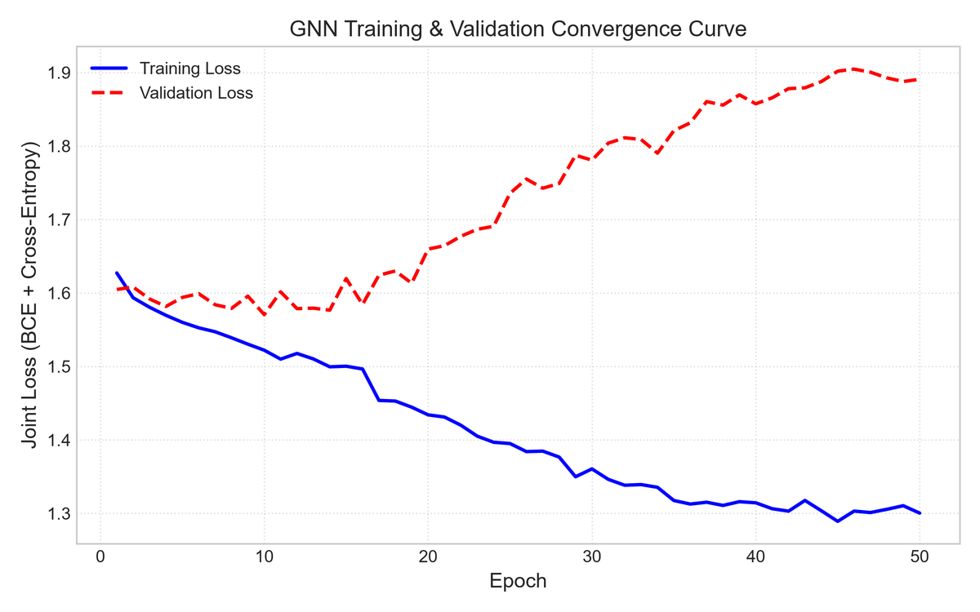
GNN Training Results
Insert training_loss_curves.png
from results/figures
Item | Value
Epochs | 50
Best validation loss | 1.5596
Best validation epoch | 10
Stopping | Epoch limit, no early stopping
Checkpoint | best_gnn_model.pt

Slide 12
User Pairing and Slot Assignment Results
Pair | Users | Slot | Method
1 | U3, U6 | S5 | SCMA
2 | U1, U2 | S4 | PD-NOMA
3 | U0, U8 | S3 | PD-NOMA
  User pairing: The GNN selects suitable pairs of users.
  Slot assignment: The system chooses a time slot for each pair.
  Slot rule: Only one allocation is allowed per slot. Unused slots remain empty.
  Unpaired users: Users without a pair are served individually using OMA.

Slide 13
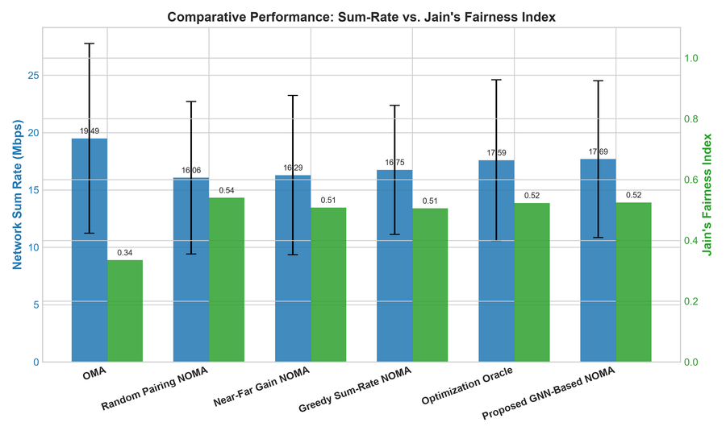
Performance Comparison with Existing Methods
Method | Sum rate (Mbps) | Fairness | Outage (%)
GNN pairing | 17.69 | 0.529 | 10.00
OMA | 19.49 | 0.335 | 50.40
Random pairing | 16.04 | 0.526 | 1.60
Near-far pairing | 16.29 | 0.508 | 2.20
Greedy pairing | 16.75 | 0.505 | 11.00
Optimization reference | 16.59 | 0.523 | 6.40
Insert sum_rate_benchmark.png
from results/figures
  Source: results/metrics/benchmark_results.csv (mean over test topologies)
  Classical regressors (Linear, Ridge, Lasso, Tree, Random Forest) predict rate only; they are not pairing methods

Slide 14
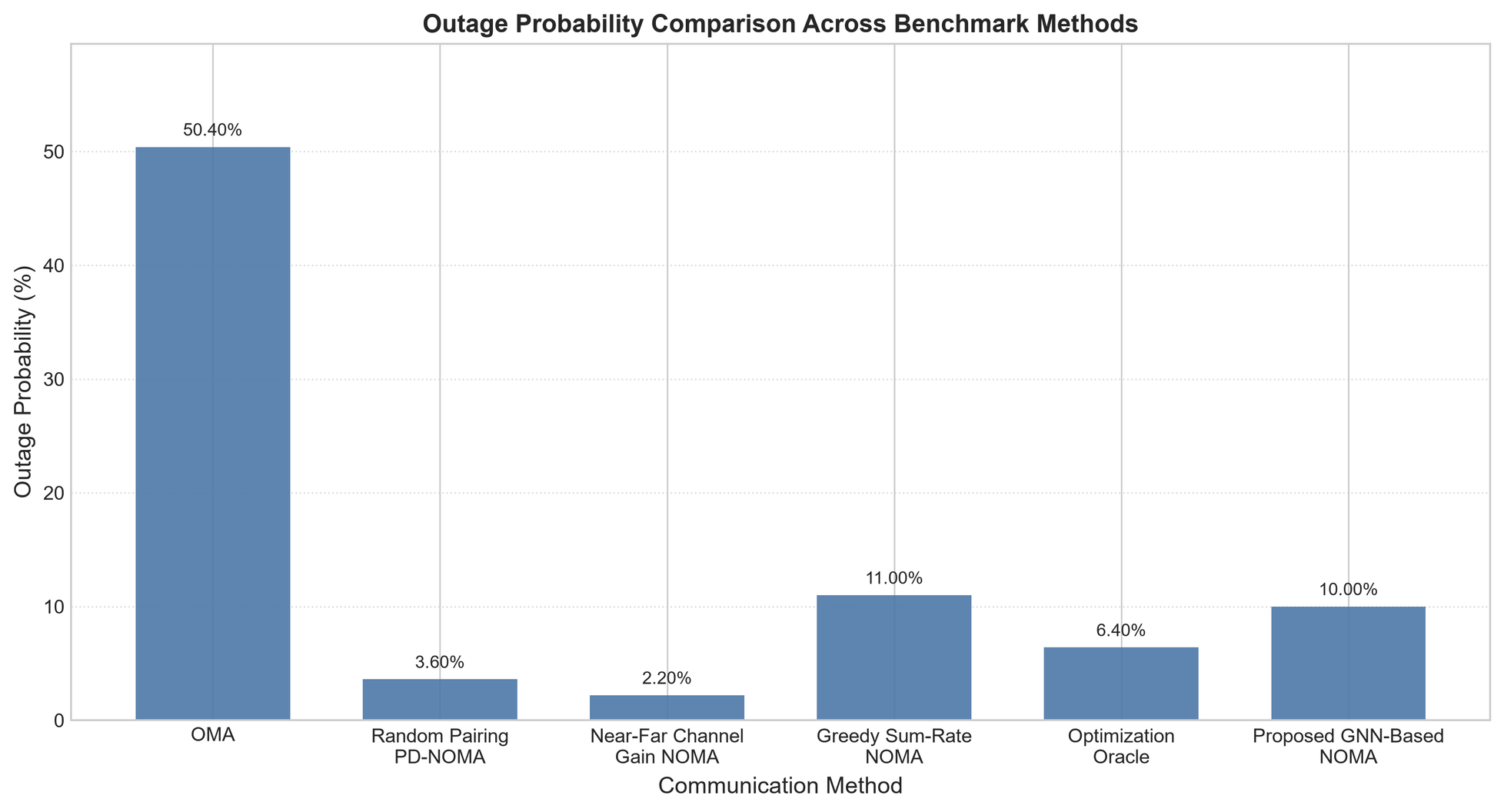

Slide 15
Results and Discussion
SNR (dB) | BER | SER | Rate (Mbps)
-5 | 0.4342 | 0.6400 | 3.95
0 | 0.3717 | 0.5433 | 9.56
5 | 0.2942 | 0.4200 | 18.06
10 | 0.1625 | 0.2450 | 26.24
15 | 0.0417 | 0.0600 | 31.39
20 | 0.0033 | 0.0050 | 33.75
Discussion
  Best method per metric: state after the run
  Whether GNN approaches the optimization reference: [run]
  SCMA BER and SER trend with SNR: [run]
  Results are simulated, not field data
SCMA table: standalone MPA sweep, 100 blocks per SNR.

Slide 16
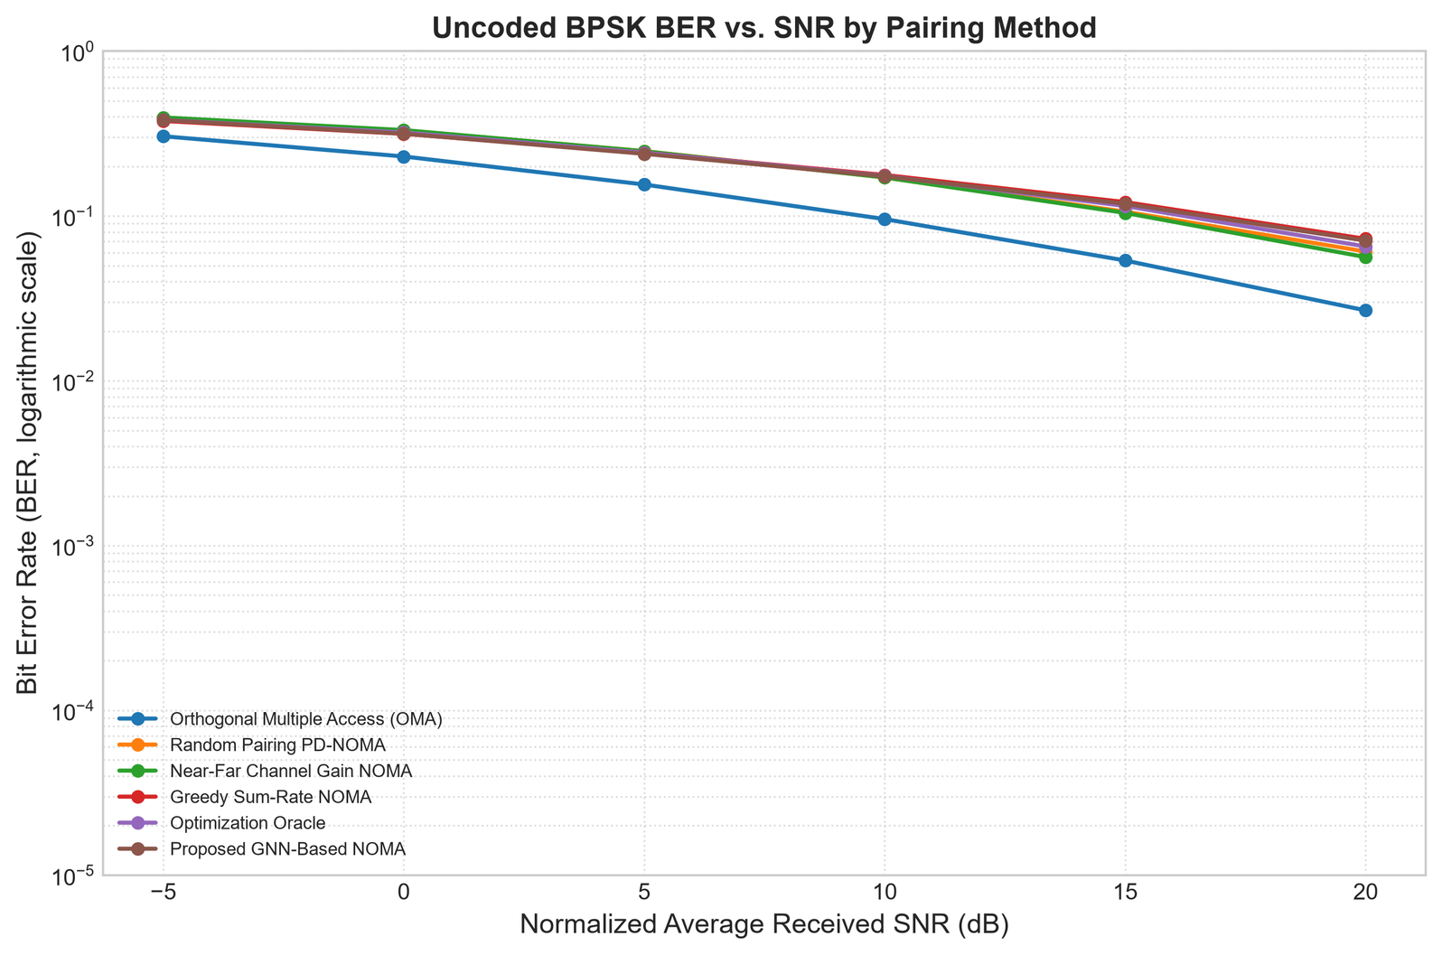

Slide 17
Conclusion and Future Scope
Summary
Future scope
  Implemented: edge-aware GNN pairing and slot preference, hybrid PD-NOMA / SCMA scheduling, five baselines, SCMA sweep
  Data is synthetic unless a CSV is supplied
  Larger networks
  Real channel datasets
  Stronger baselines
  Real-time scheduling

Slide 18
References and Thank You
[1] Y. Saito et al., “Non-orthogonal multiple access (NOMA) for cellular future radio access,” IEEE VTC Spring, 2013.
[2] H. Nikopour and H. Baligh, “Sparse code multiple access,” IEEE PIMRC, 2013.
[3] L. Dai et al., “Non-orthogonal multiple access for 5G: Solutions, challenges, opportunities, and future research trends,” IEEE Communications Magazine, 2015.
[4] Z. Ding et al., “A survey on non-orthogonal multiple access for 5G networks: Research challenges and future trends,” IEEE Journal on Selected Areas in Communications, 2017.
[5] T. N. Kipf and M. Welling, “Semi-supervised classification with graph convolutional networks,” International Conference on Learning Representations (ICLR), 2017.
Thank You

