Slide 1
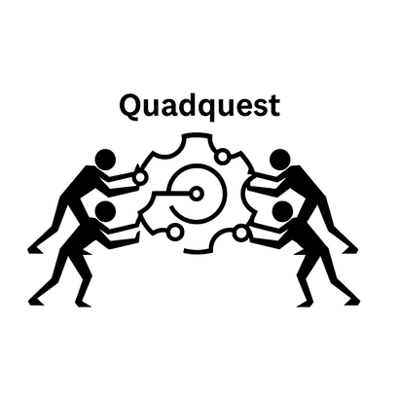
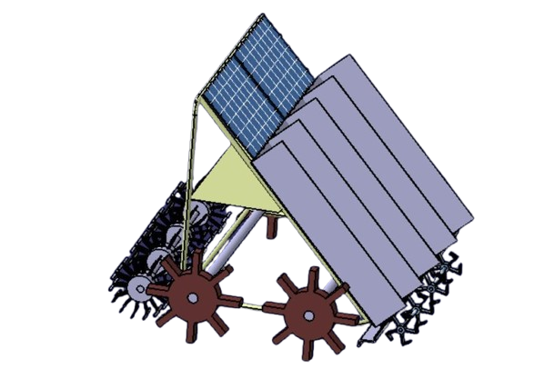
Autonomous Small Precision Machine
for Planting/Weeding

Slide 2
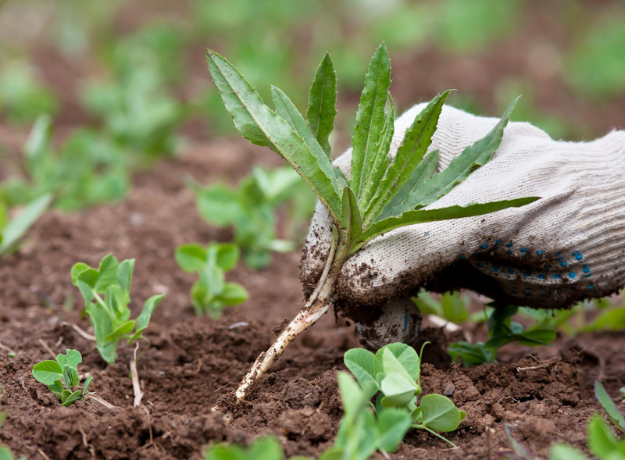

Problem Statement
Small and medium-scale farmers face labor shortages, increasing operational costs, and up to 30–40% yield loss due to inefficient and manual planting and weeding practices.
Current farming methods lack precision, efficiency, and automation, leading to lower productivity and higher labor costs.

Slide 3
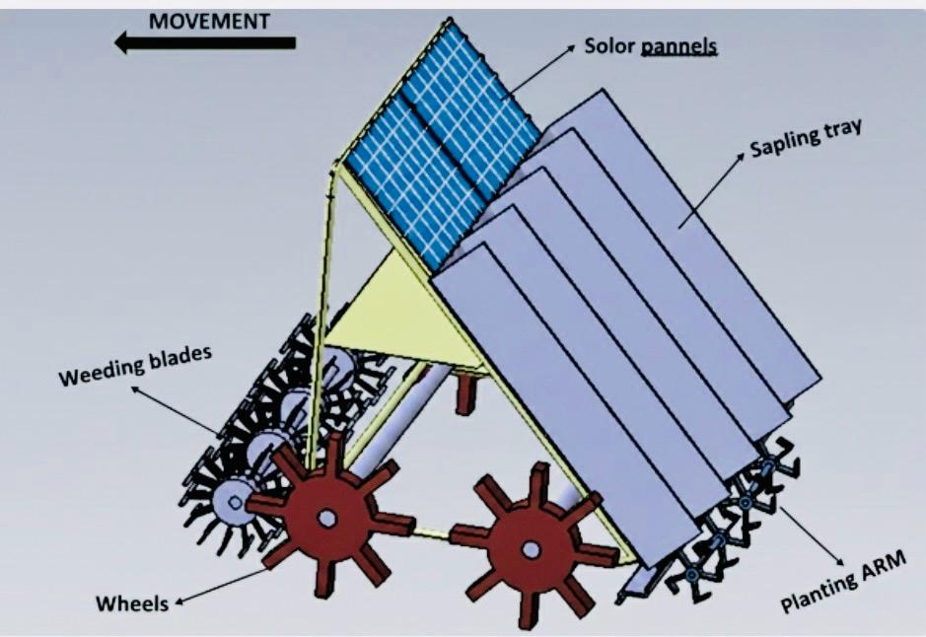
Our Approach
  Designed a lightweight, compact machine for precision planting and weeding.
  Built as per specifications (1000 × 800 × 700 mm, 120 kg).
  Autonomous and remotely operable using IoT and AI.
  Integrated solar backup for improved energy efficiency.

Slide 4
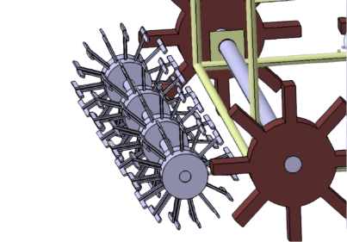
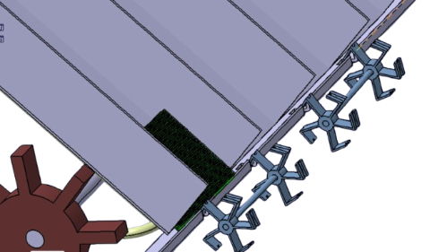
Technical Approach
Operation Concept:
Human loads seedlings → machine plants automatically, row by row.
Hardware:
Compact chassis with seedling hopper, planting arm, motor-driven wheels/tracks, and linear actuators.
Sensors:
Ultrasonic/IR for obstacle detection, GPS for navigation, Encoders for depth and spacing control.
Software :
Designed and simulated using CATIA V5 and ANSYS.

Slide 5
PROCESS FLOW
Boundary Set
Seedlings Loaded
Start
Planting Continues
Stops when Area Completes

Slide 6


Competitors
  Competitors include small-scale agricultural robotics startups and semi-automated planting equipment manufacturers.

Slide 7
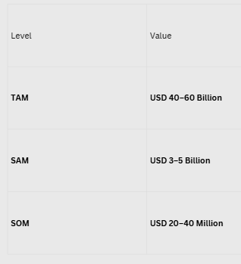
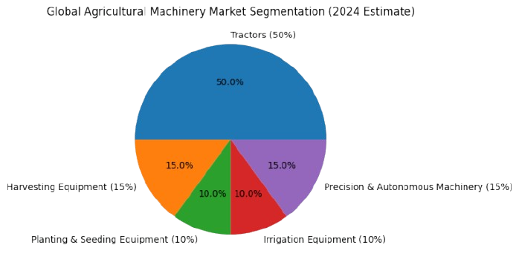
Marketing
The global agriculture machinery market, valued at approx USD 170–238 billion in 2024, is projected to grow to over USD 250–400 billion by 2032–2034.
The industry is experiencing a CAGR of 4% to 8.6%.

Slide 8

Business Model
Hybird Business Model(B2C and B2B)
Our Target Customers are
  Small and medium-scale farmers (B2C)
  Agricultural cooperatives
  Government farming schemes
  Precision agriculture startups
  Rural development programs

Slide 9
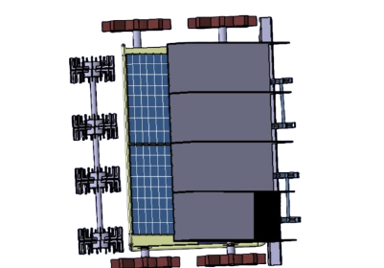
Uniqueness
Designed to enhance planting precision by up to 30% (estimated based on controlled spacing and depth monitoring)., reduces labor costs by ~40%, and lowers carbon footprint by ~20% through a solar-hybrid system. Integrates IoT, AI, and smart automation, with a scalable design adaptable for multiple crops.
Future Vision
We aim to enhance AI-driven decision-making, improve energy efficiency, and make smart farming accessible and affordable for farmers worldwide.

Slide 10
OUR TEAM
Shaik Zainab
Team Leader
P.Hemanth Siva Reddy
Simulation & Analysis
Katakamasetty Vinay
Simulation & Analysis
Modepalli Hareesh
Design Engineer
V.J.Phaneendra Kumar
Electronics & Sensors Engineer
Sai Pranith Varma Pothuri
Electronics & Sensors Engineer
R.Anand Narayana
AI and IoT Developer

