Slide 1
EMPLOYEE
MANAGEMENT SYSTEM
Presented by:
Name: A.Srividya
Std_ID: AF05217381
01

Slide 2
ABSTRACT
The Employee Management System is a software application developed to manage employee information efficiently and systematically. It helps store and maintain employee details such as employee ID, name, department, designation, and salary.
The system provides basic operations such as adding, viewing, searching, updating, and deleting employee records.
In this project, Python is used as the programming language, MySQL is used to store and manage employee data, and Visual Studio Code (VS Code) is used as the development environment. The application connects to the MySQL database using MySQL Connector.
The main aim of this project is to reduce manual paperwork, save time, improve data accuracy, and make employee record management easier. This system can be further enhanced by adding features such as attendance management, payroll processing, and leave management.

Slide 3
Introduction
An Employee Management System is a software application used to store and manage employee information in an organized way.
It helps an organization maintain employee details such as employee ID, name, department, designation, and salary. This system allows users to add, view, update, search, and delete employee records easily.
In this project, Python is used to develop the application, and MySQL is used to store employee information in a database. The main purpose of this system is to reduce manual work, save time, improve accuracy, and manage employee records efficiently.
02

Slide 4
Objectives
The main objective of the Employee Management System is to manage employee information efficiently and systematically.
Add new employee records.
View and search employee details.
Update employee information.
Delete records when an employee leaves.
Store data securely and consistently in a database.
03

Slide 5
Technologies Used
1. Python: Used to develop the application and implement employee management operations.
2. MySQL: Used to store and manage employee details in a database.
3. MySQL Connector: Used to connect Python with the MySQL database.
4. SQL: Used to insert, retrieve, update, and delete employee records.
5. Visual Studio Code (VS Code): Used as a code editor to write, edit, and run Python code.
04

Slide 6
Advantages
Easy to use and maintain.
Reduces repetitive manual work.
Enables faster searching and updating.
Keeps employee records in one place.
Can be expanded with login, attendance, leave, and reports.
10

Slide 7
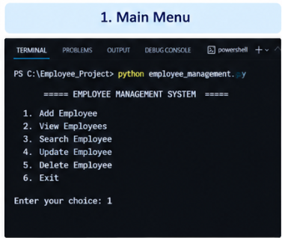
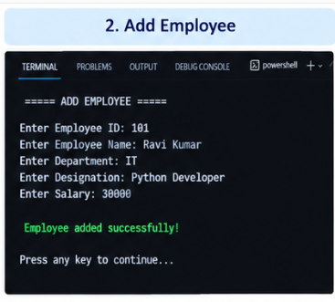
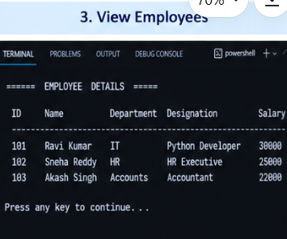
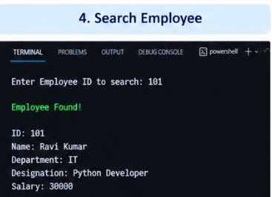
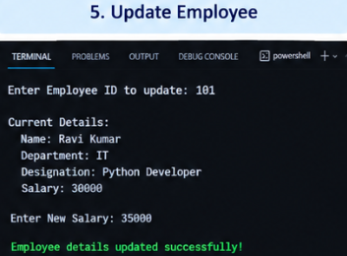
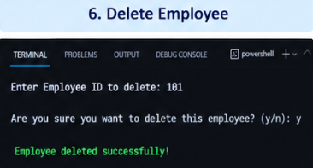
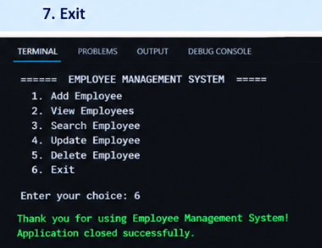
SCREENSHORTS

Slide 8
Conclusion
The Employee Management System organizes employee records efficiently.
Python handles the application logic while MySQL stores the data.
The project demonstrates database connectivity and CRUD operations.
It can be improved with more modules as future work.
12

Slide 9

13

