Slide 1
FRONT-END PROJECT
ON
STUDENT REGISTRATION SYSTEM
PRESENTED BY:
A.SRIVIDYA 3572 BATCH

Slide 2
ABSTRACT
The Student Registration System is a front-end web application developed to simplify the process of registering student information. It allows users to enter student details such as name, roll number, email, phone number, course, and address through an easy-to-use online form. The application is built using HTML, CSS, and JavaScript.
The system validates the entered information to ensure that all required fields are completed correctly before submission. It helps reduce manual paperwork, minimizes data entry errors, and saves time by providing a faster and more organized registration process.
This project demonstrates the basic concepts of front-end web development and can serve as a foundation for more advanced systems.
In the future, it can be enhanced by integrating a database, user login, an admin dashboard, and search and reporting features to create a complete student management solution.

Slide 3
INTRODUCTION
A Student Registration System is a web-based application designed to collect, manage, and organize student information in a simple and efficient way. It allows students to enter their personal and academic details through an online registration form.
The system checks whether the entered information is valid before accepting the registration, ensuring accurate data entry.
This project provides an easy-to-use interface where users can register student details, and view the registered information.
It can be further enhanced by connecting it to a database and adding login and authentication features for secure data management.

Slide 4
OBJECTIVE
To provide an easy and efficient way to register student information online.
To reduce manual paperwork and simplify the registration process.
To collect student details.
To validate user input and prevent incorrect or incomplete data entry.
To save time for both students and administators.
To improve accuracy and organization of student data.

Slide 5
SAMPLE CODE
<!DOCTYPE html>
<html>
<head>
<title>Student Registration</title>
<style>
body{ font-family:Arial;text-align:center;background:#f2f2f2;}
input, button{padding:8px;margin:5px;}
table{ margin:auto;border-collapse:collapse;}
table,th,td{border:1px solid black;padding:8px;}
</style>
</head>
<body>
<h2>Student Registration System</h2>
<input type="text" id="name" placeholder="Name">
<input type="text" id="roll" placeholder="Roll No">
<button onclick=“ addStudent()">Register</button>
<table>
<tr>
<th>Name</th>

Slide 6
<th>Roll No</th>
</tr>
<tbody id="list"></tbody>
</table>
<script>
function addStudent(){
let name=document.getElementById("name").value;
let roll=document.getElementById("roll").value;
if(name==""||roll==""){
alert("Enter all details");
return;
}
document.getElementById("list").innerHTML +=
"<tr><td>"+name+"</td><td>"+roll+"</td></tr>";
document.getElementById("name").value="";
document.getElementById("roll").value="";
}
</script>
</body>
</html>

Slide 7
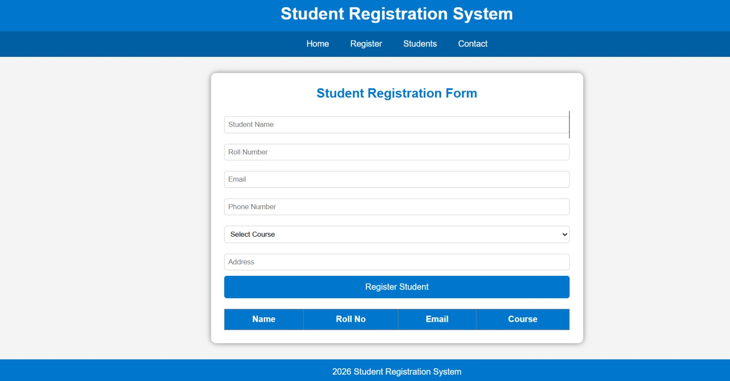
OUTPUT

Slide 8
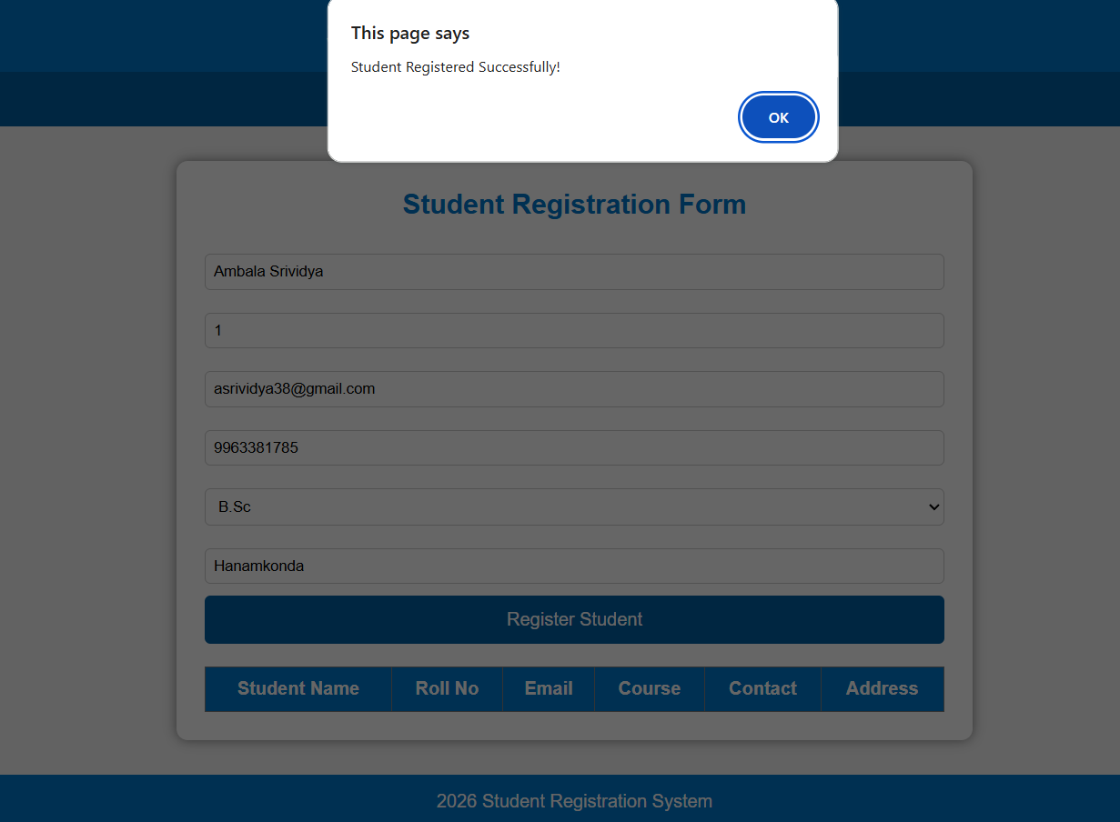

Slide 9
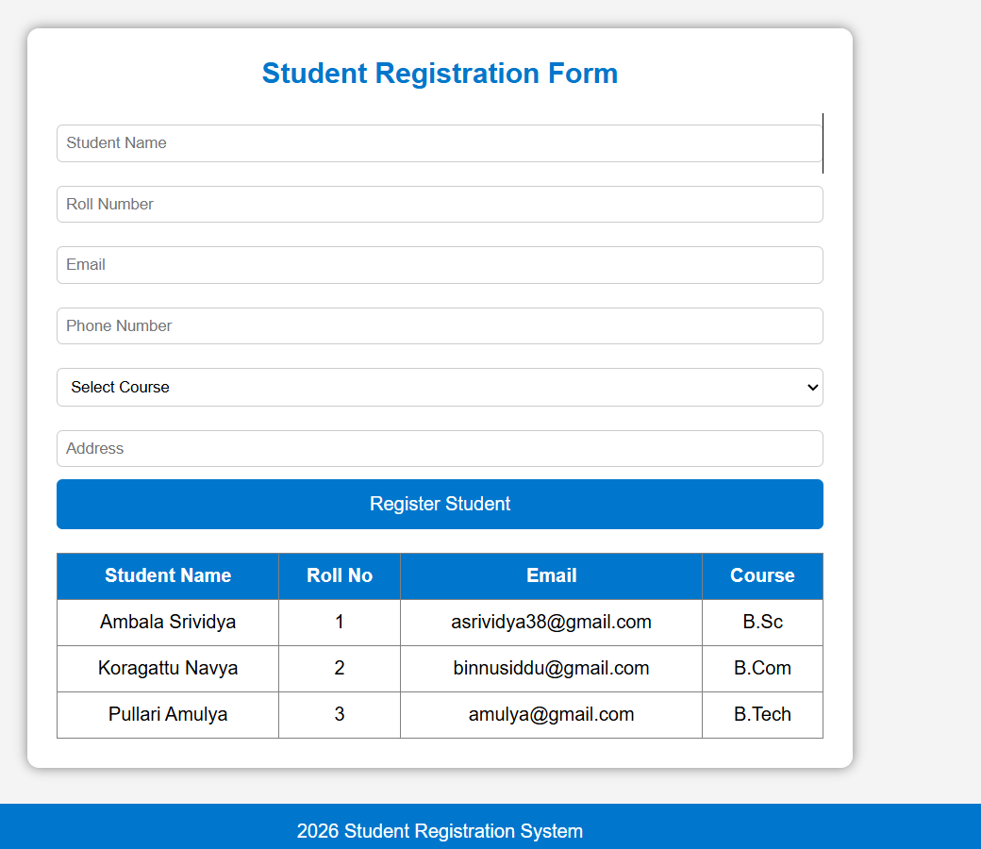

Slide 10


