Slide 1

Welcome to:

Slide 2
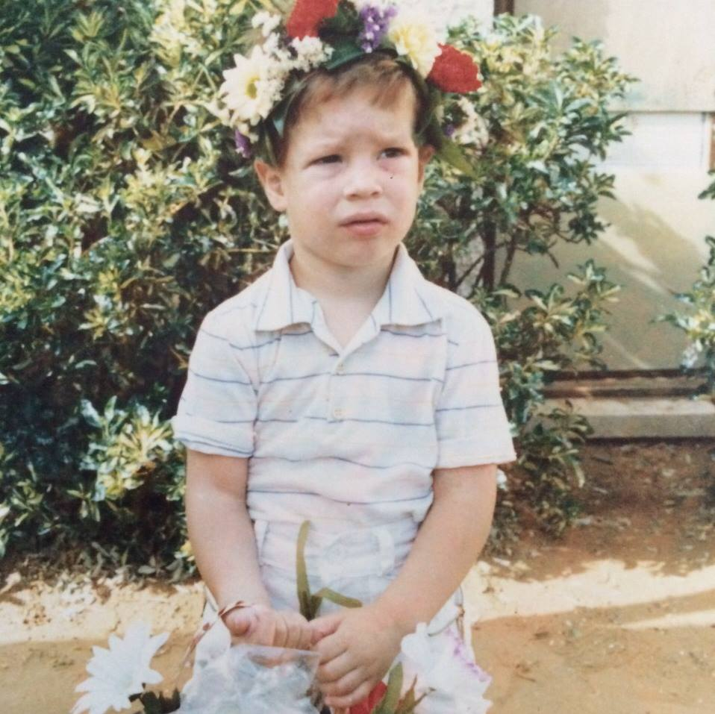
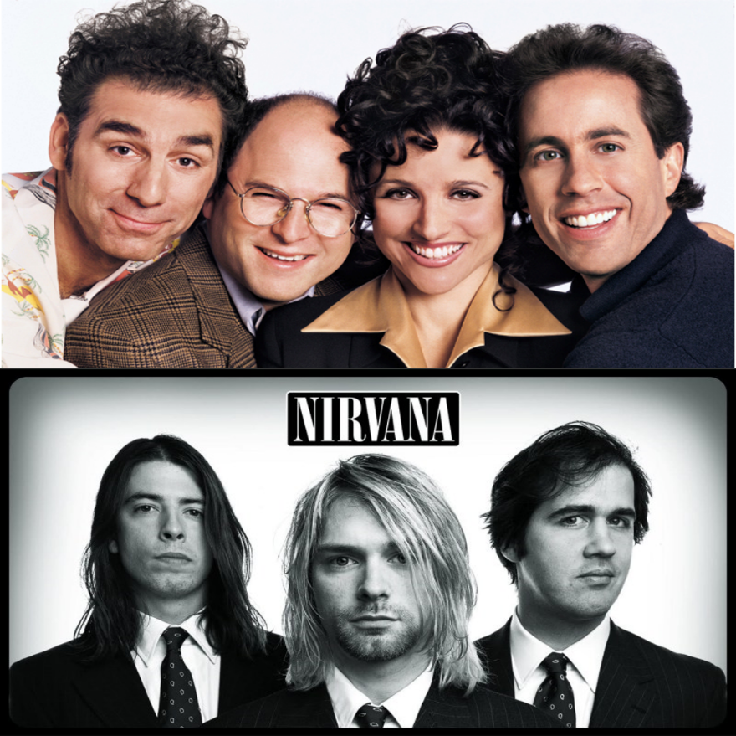
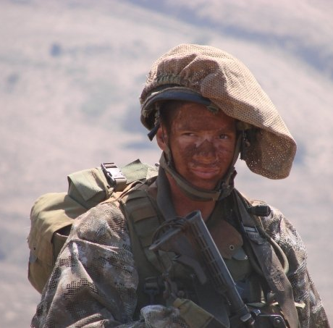
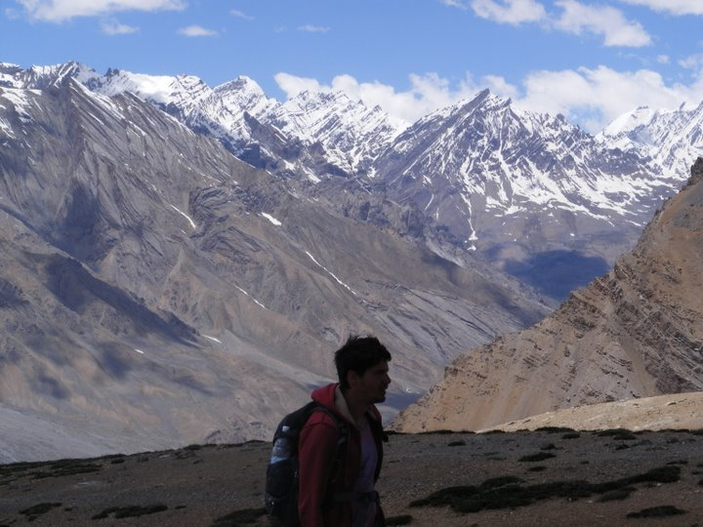
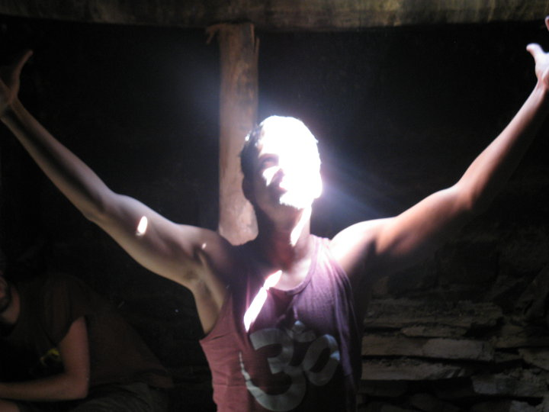
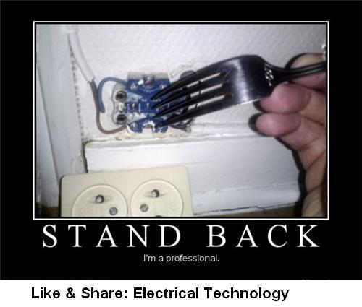
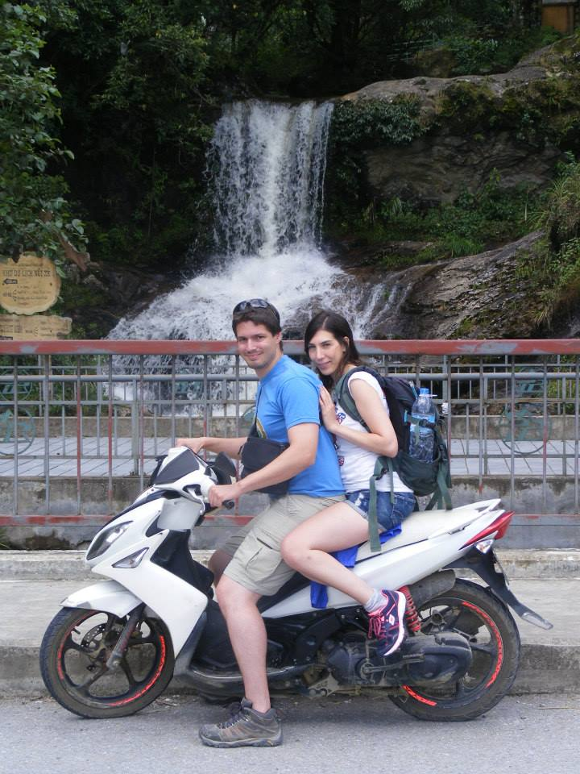
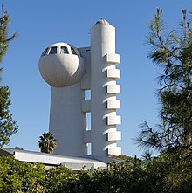
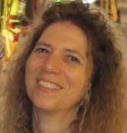
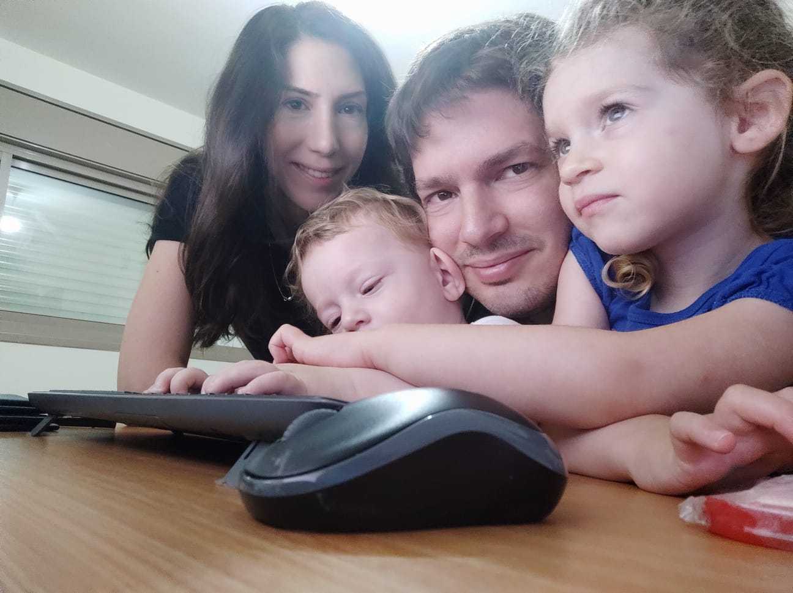
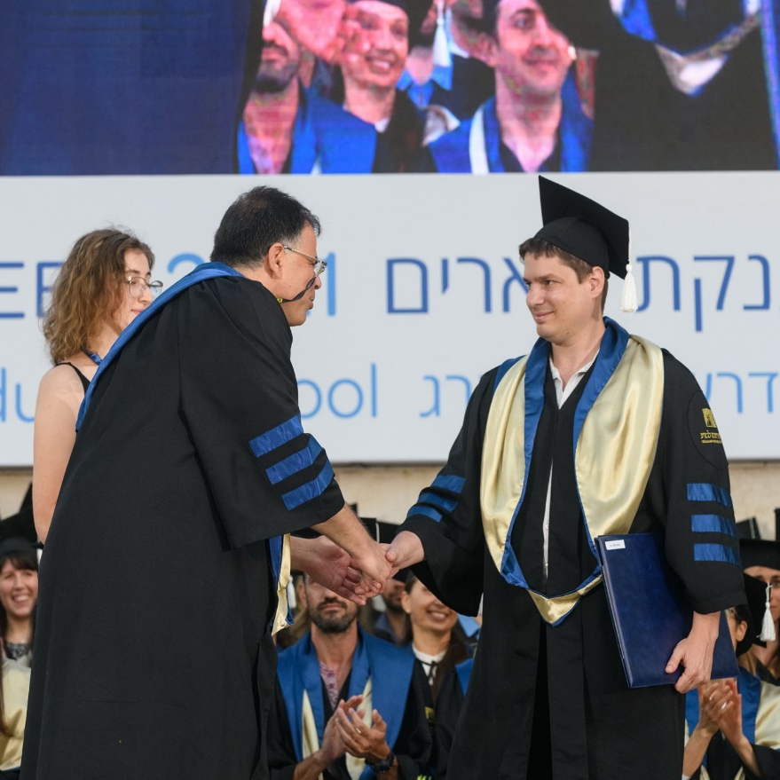
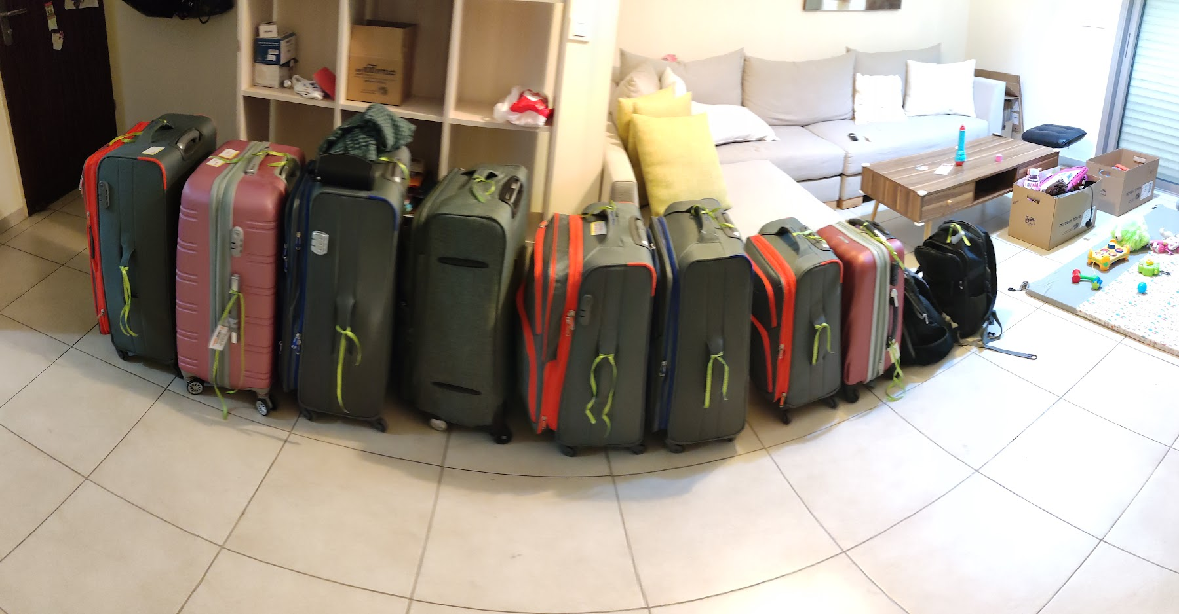

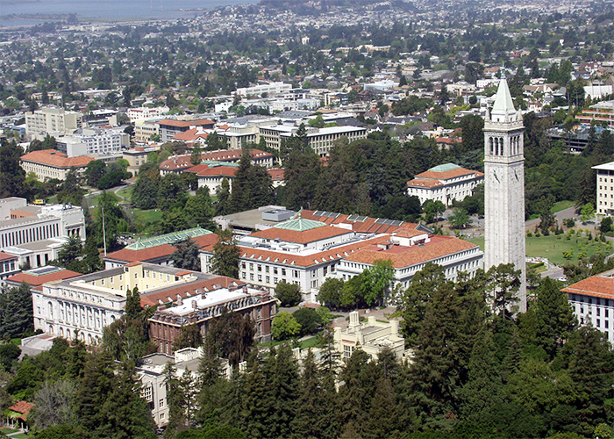
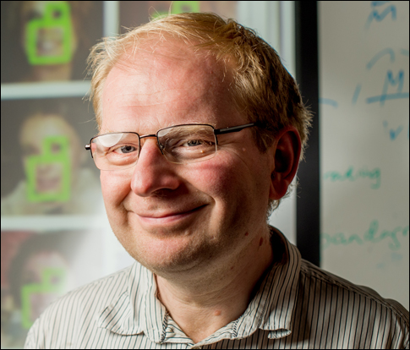



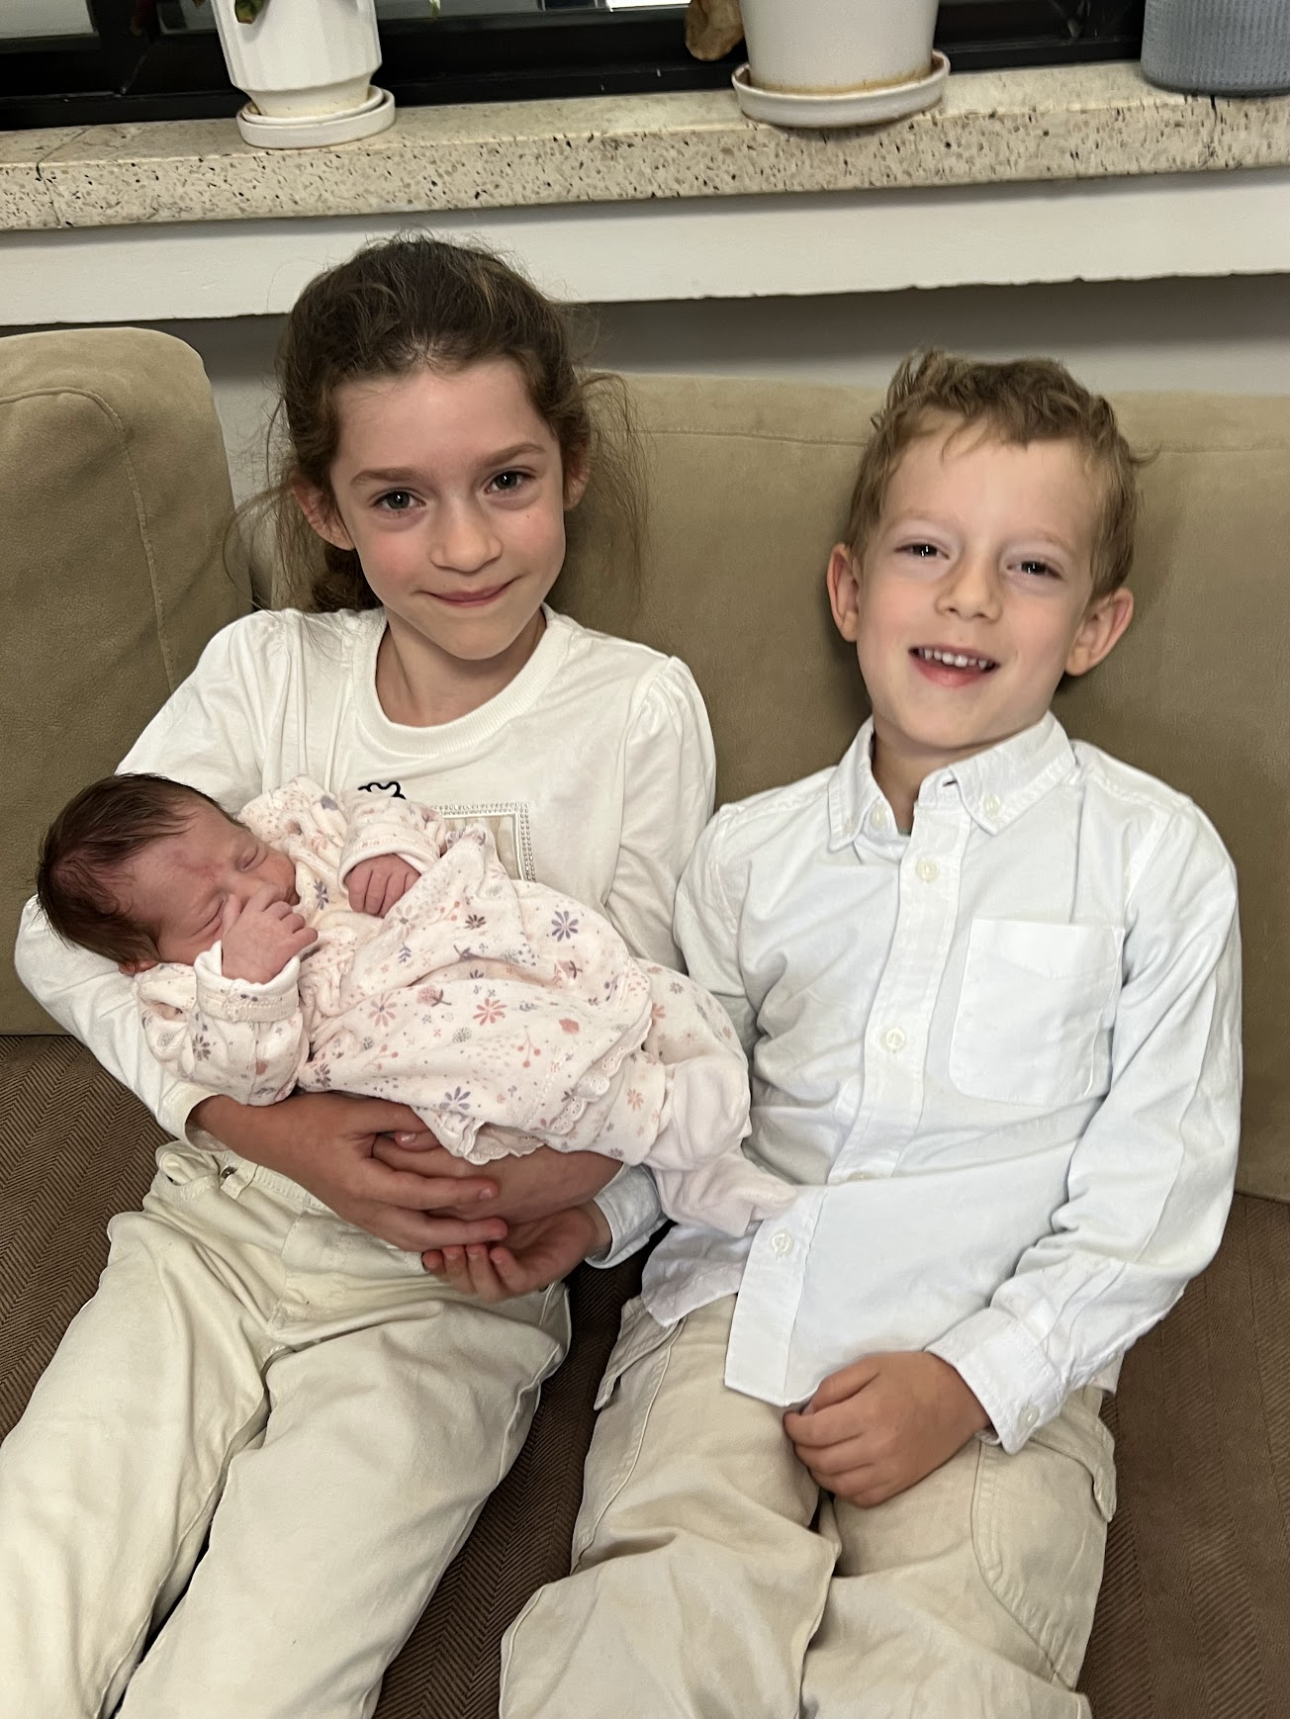

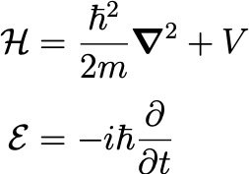
I’m Assaf, nice to meet you ☺
t

Slide 3
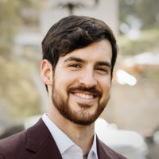
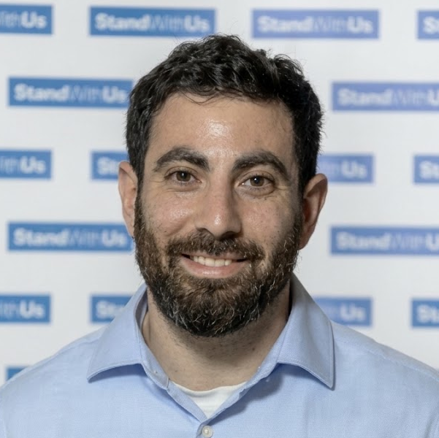

TAs:
Amit Shmidov
Roi Ben-Gigi
Tal Aloni

Slide 4
Today:
00:00) Course administration and context
00:10) History and motivation
00:20) The physics of light
00:30) Image formation and basic optics
01:00) ---- Break ----
01:15) Convolution
02:00) ---- Break ----
02:15) The digital image pipeline
02:45) ---- Break ----
03:00) Tutorial (Amit): Basic PyTorch and point ops

Slide 5

Administration
Everything is on the course website.
In-person (when no war is going on).
3.5 credit points.
3 hrs. Lecture + 1 hr. tutorial
(Tutorial covers new material).
5 homework assignments + Final Project.
Homework is demanding, but worth it.
Accumulated 7 days late HW submission for the semester.

Slide 6

”If we have seen further, it is by
standing on the shoulders of Giants"
From basics to most recent SotA
Intuition
Hands-on
We get to the bottom of things
Research oriented
Openness
MCV
DL4CV
Weizmann
CS231n
Stanford

Slide 7
We Assume you…
Know Basic Calculus (e.g. know what a Gradient is).
Know Basic Algebra (e.g. Vector spaces, Matrix multiplication, Eigen decomposition).
Know Basic probability (e.g. Cov matrix, Conditional expectation)
Written code before (preferably Python).
Bumped into Machine Learning (e.g. heard the term “Overfitting”).
Homework
Theory
From Scratch
Applied
HW1 is online!
Please don’t use AI

Slide 8
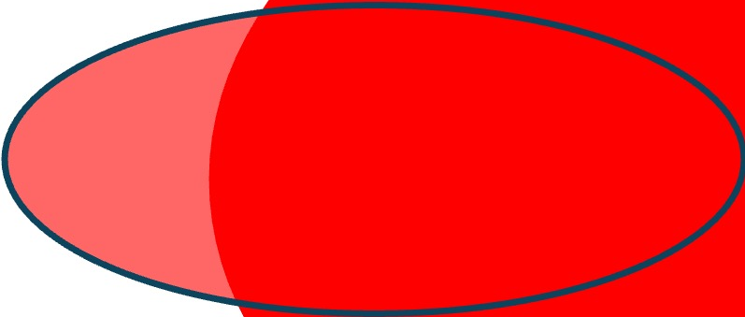
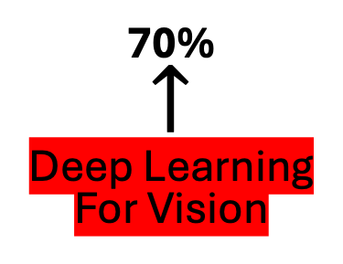
Road map
AI
Computer Vision
Machine Learning
MCV
Deep
Learning
30%
Classic
Relevant
CV
70%
$$↑$$
Deep Learning
For Vision
Slide idea: Justin Johnson

Slide 9
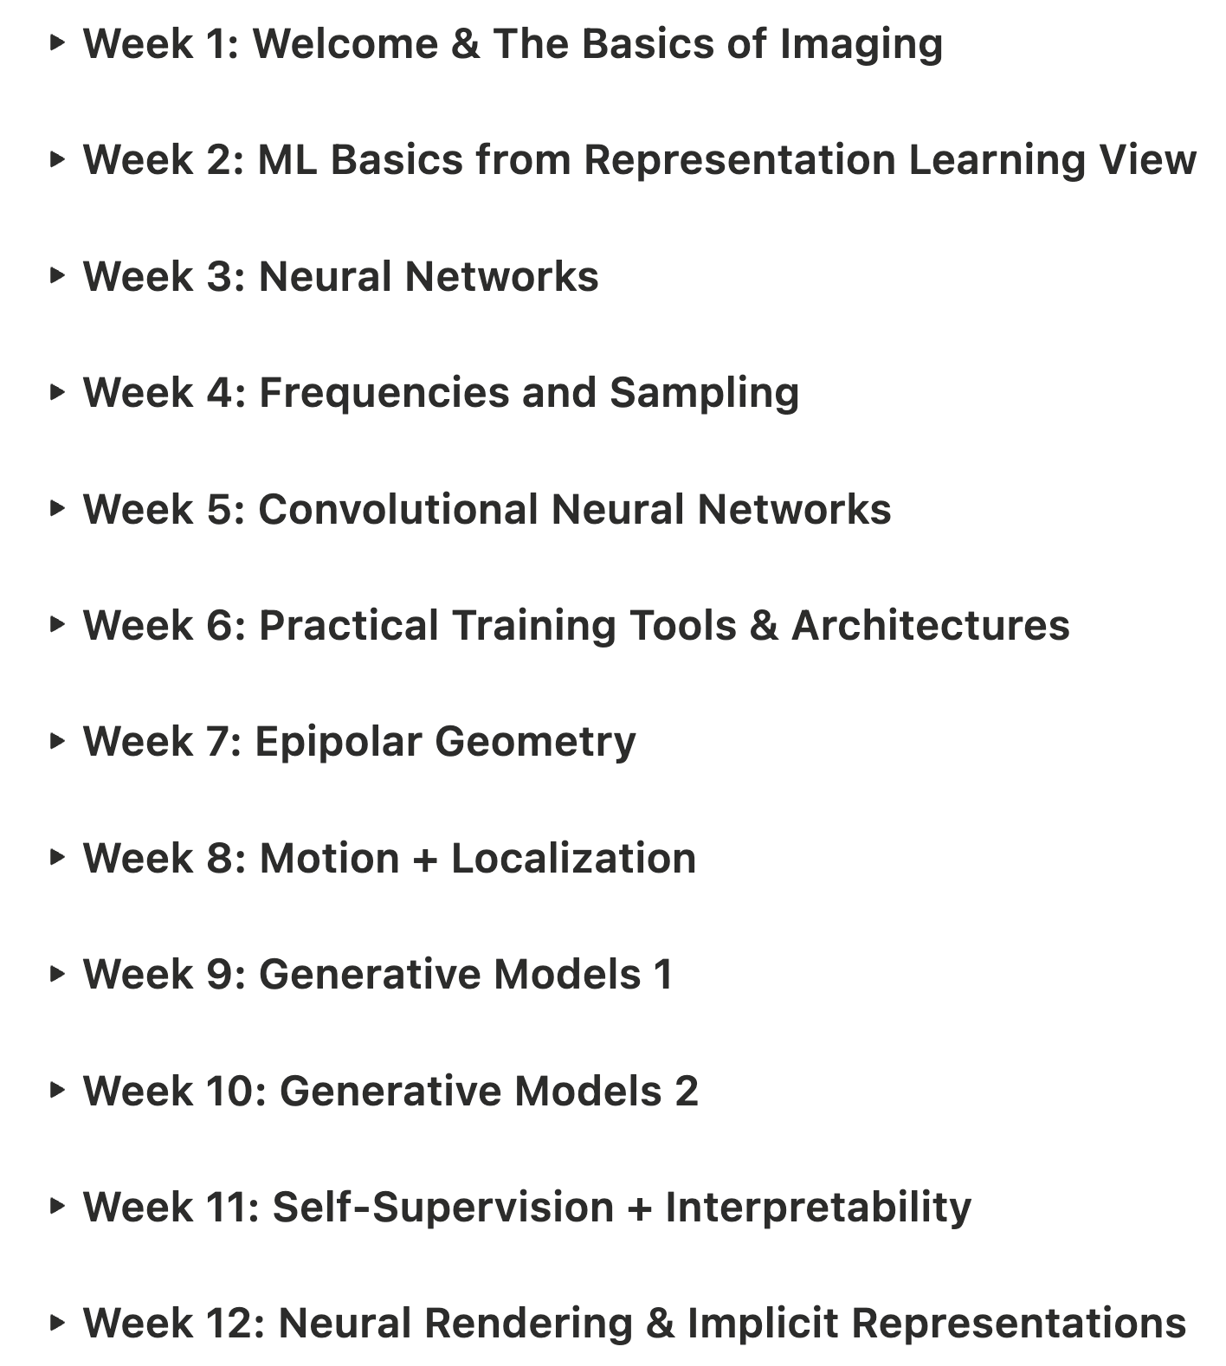
Syllabus
Classic Vision
Deep Learning

Slide 10
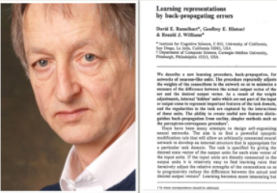
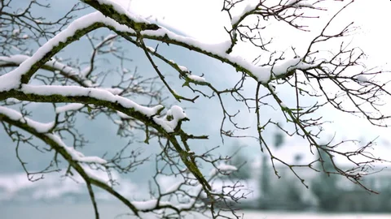
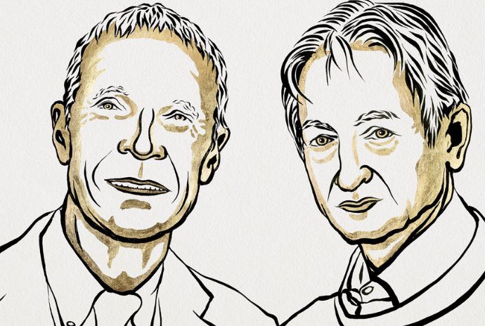
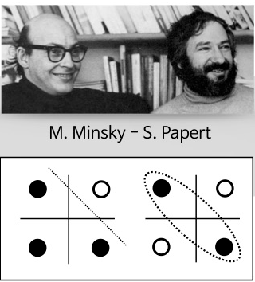
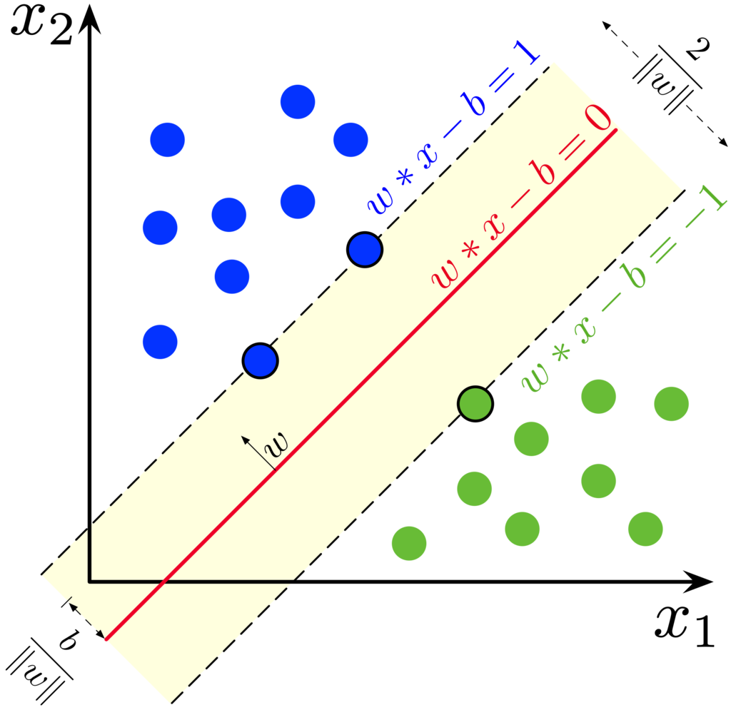
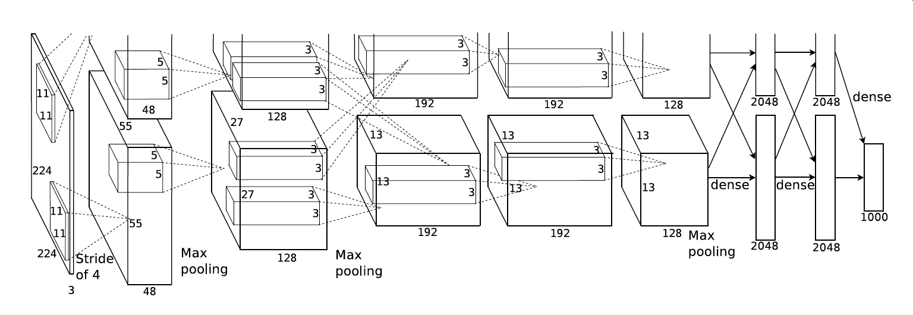
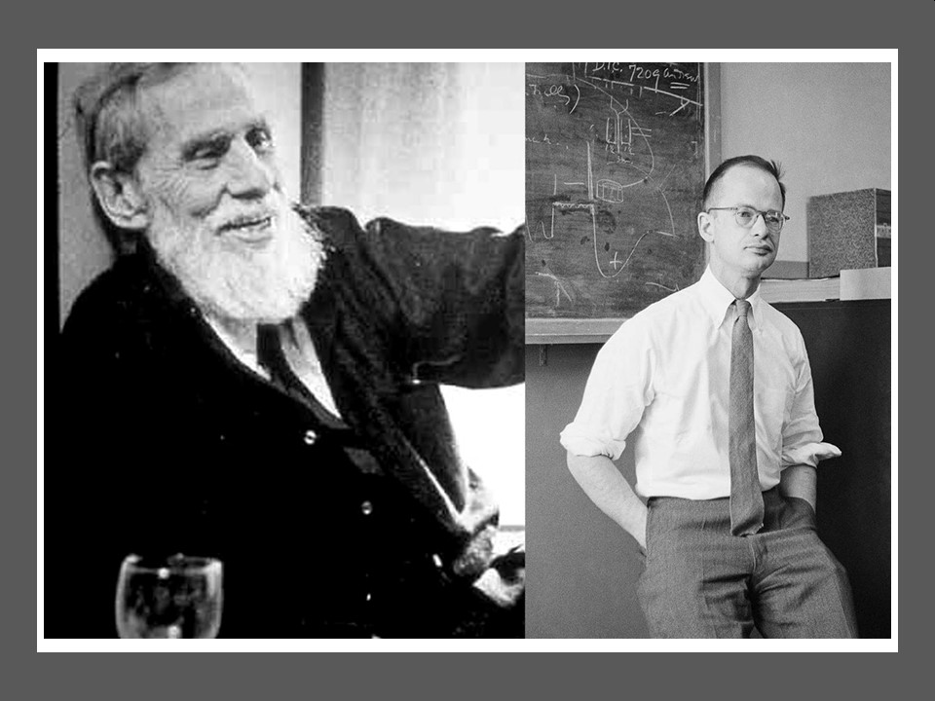
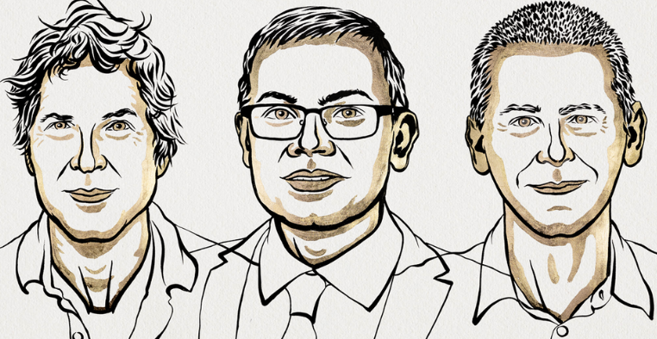
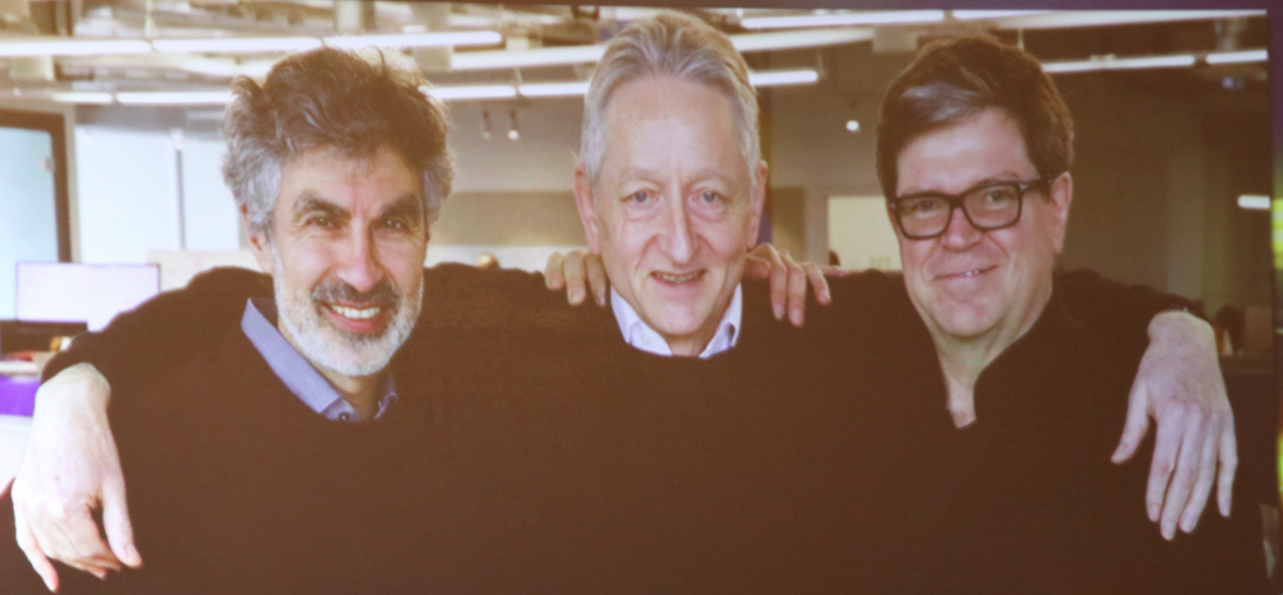
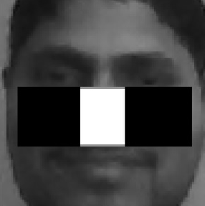
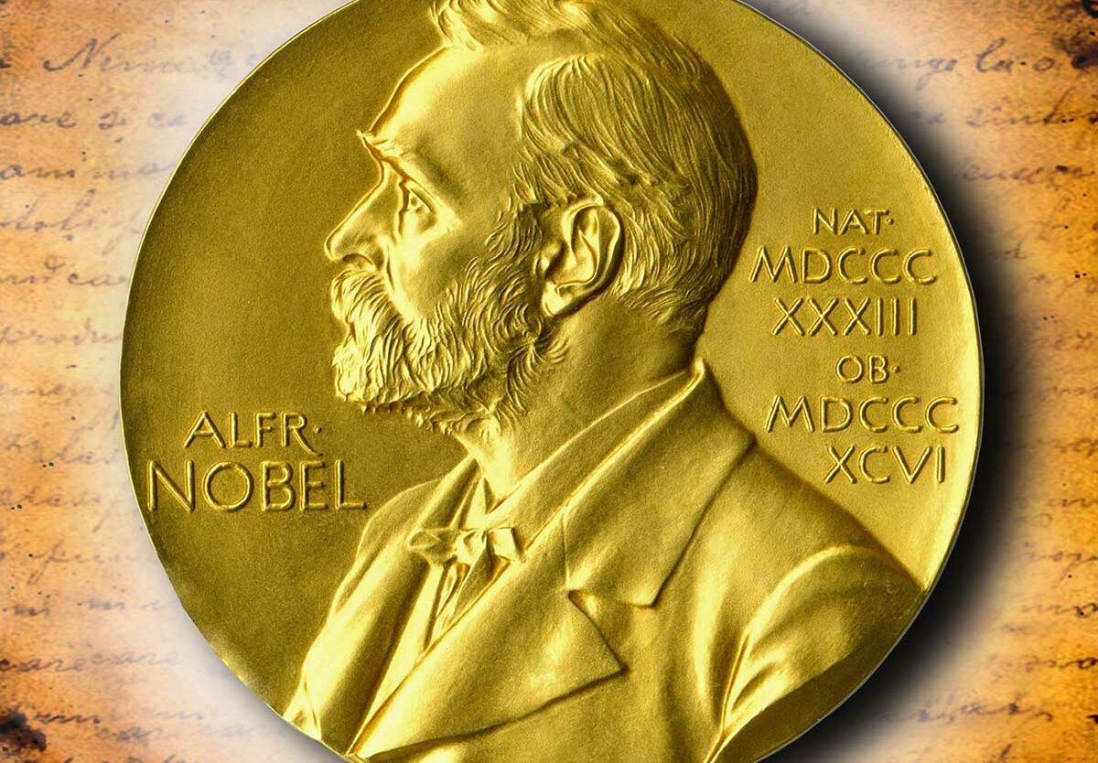

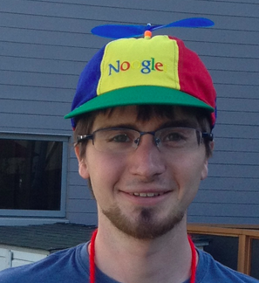
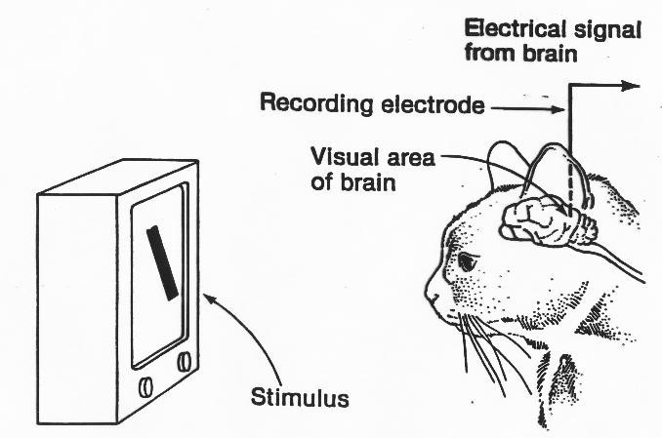
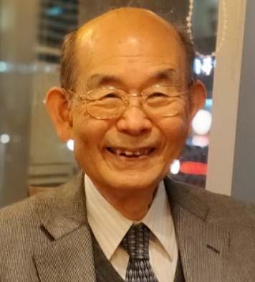
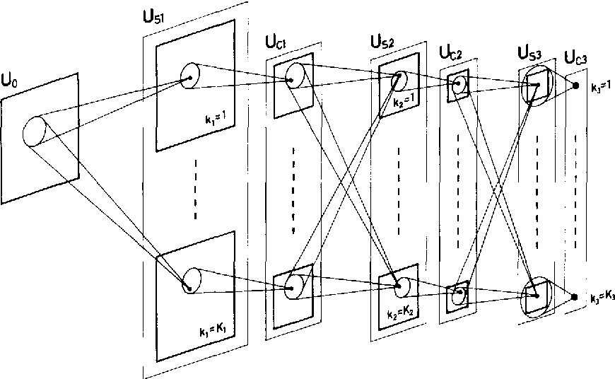
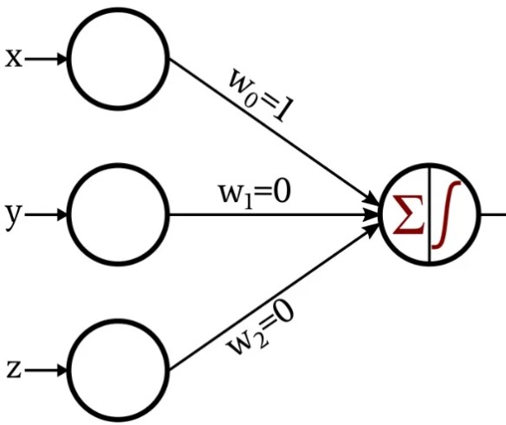
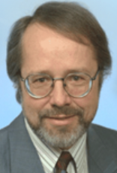
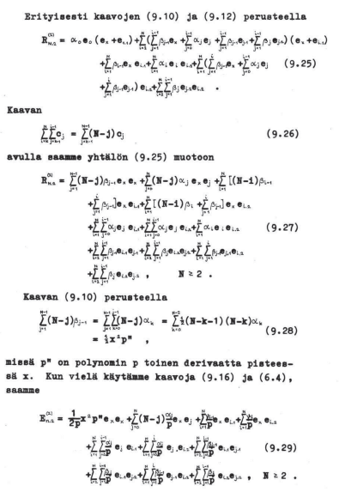

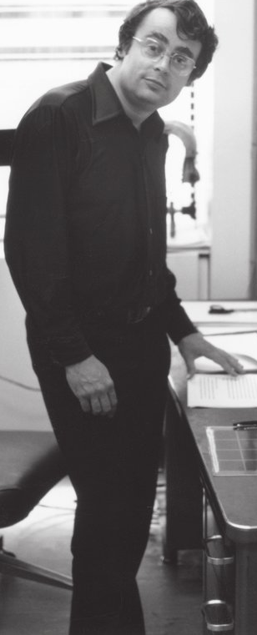


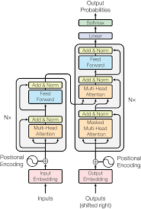

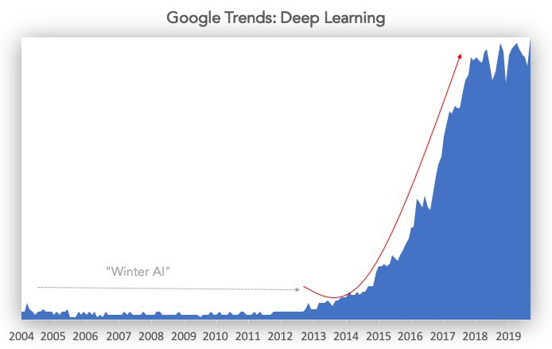
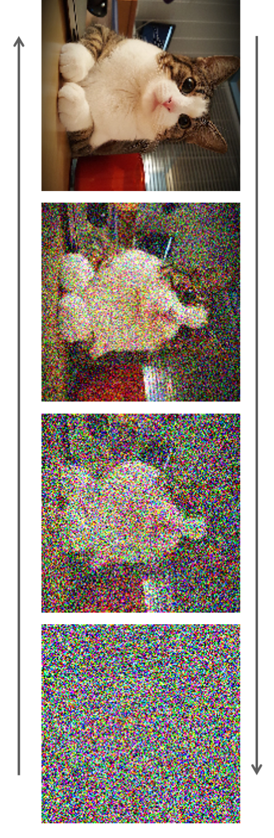
McCulloch Pitts
Non learned
Neuron
XOR kills
perceptron
Kernel-SVM
Vapnik&Cortes
AlexNet- Revolution begins!
Krizhevsky, Sutskever, Hinton
Neural
Winter?
Backprop in Neural Nets
(Hinton et al.)
Neocognitron
(Fukushima)
First CNN?
Hubel & Wiesel
Rand. Forest
2nd AI
Winter
Viola&
Jones
Bengio, Hinton, LeCunn:
Turing Award
GANs
(Good
fellow)
1957
1970
1979
1989
2017
2020
2022
1943
1959
1969
1980
1986
1995
2001
2012
2014
2018
2024
1st AI Winter
Back
Propagation
(Linnainmaa)
Perceptron
(Rosenblatt)
learned weights
SotA Diffusion models
ChatGPT
CNN + Backprop
(LeCunn)
Deep Learning revolution
Transformer
(Vaswani)

Slide 11
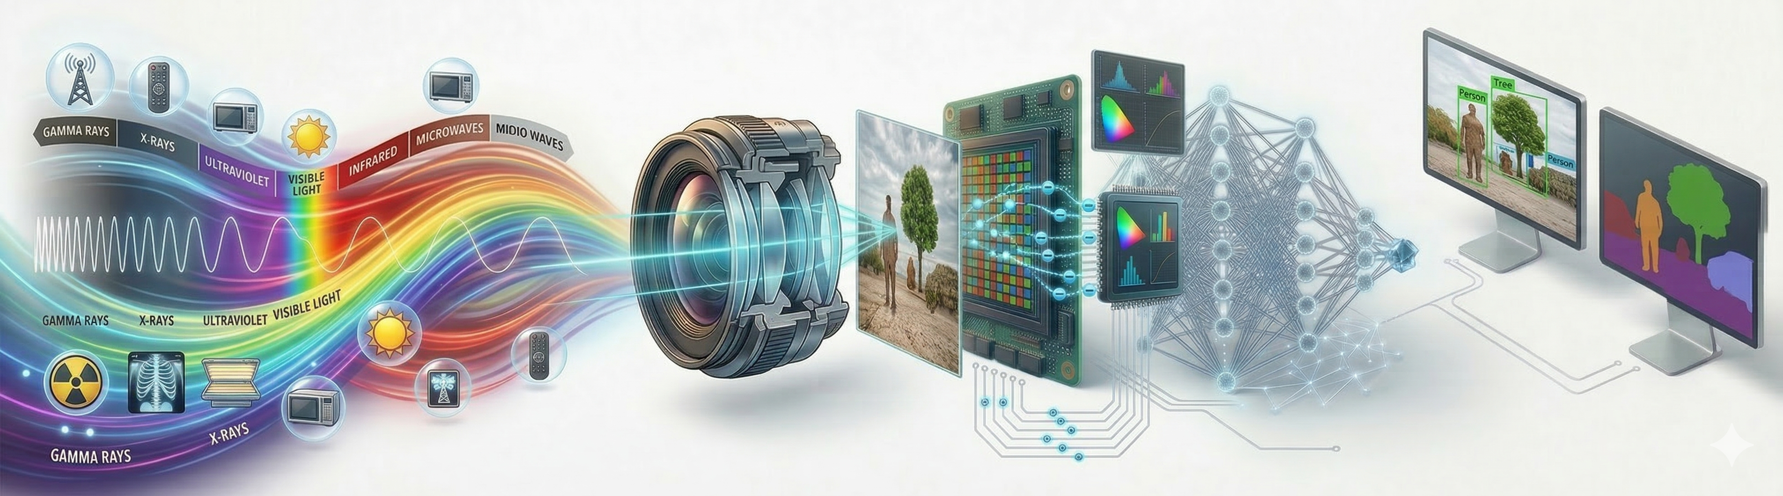
From light to insight
Physics of light
Optics of image formation
Digital image pipeline
Algorithms of computer vision
Today
Rest of the course

Slide 12
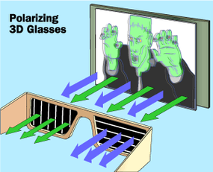
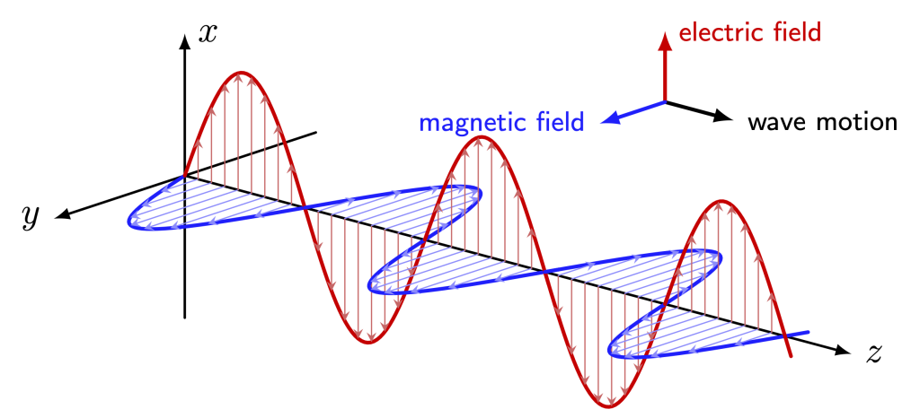
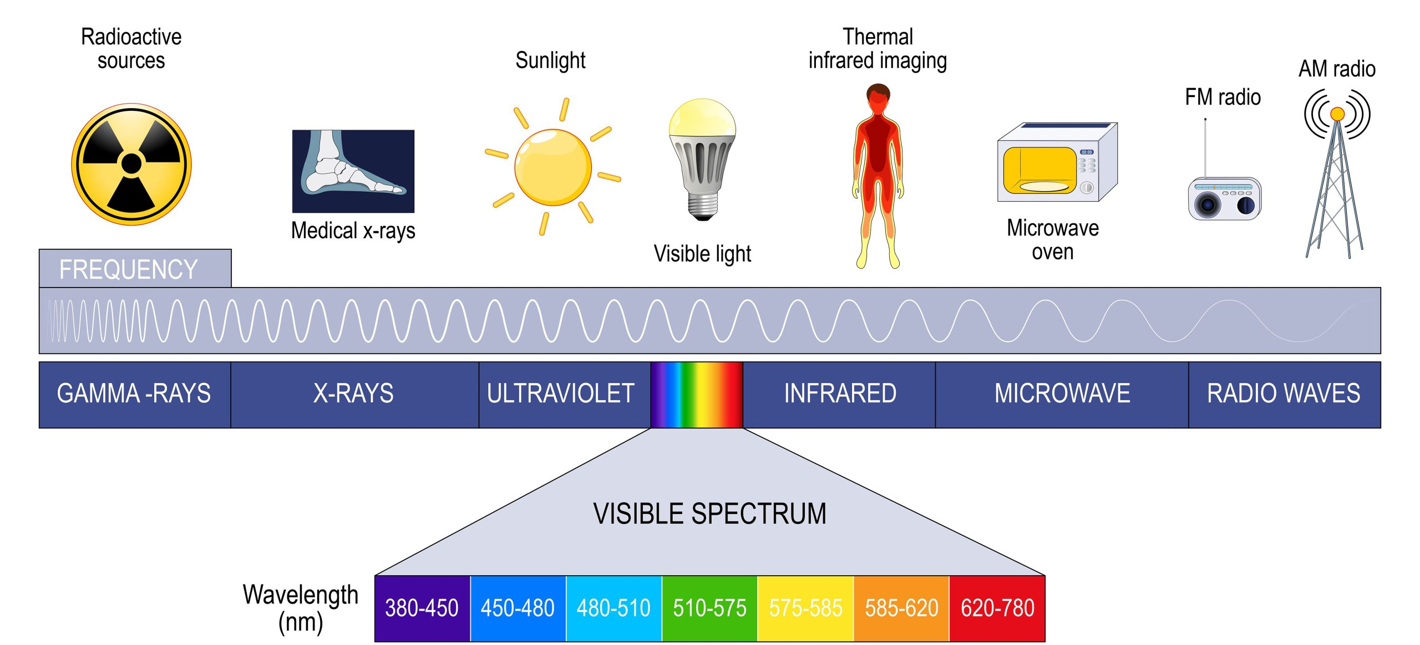
What is Light?
Polarization

Slide 13
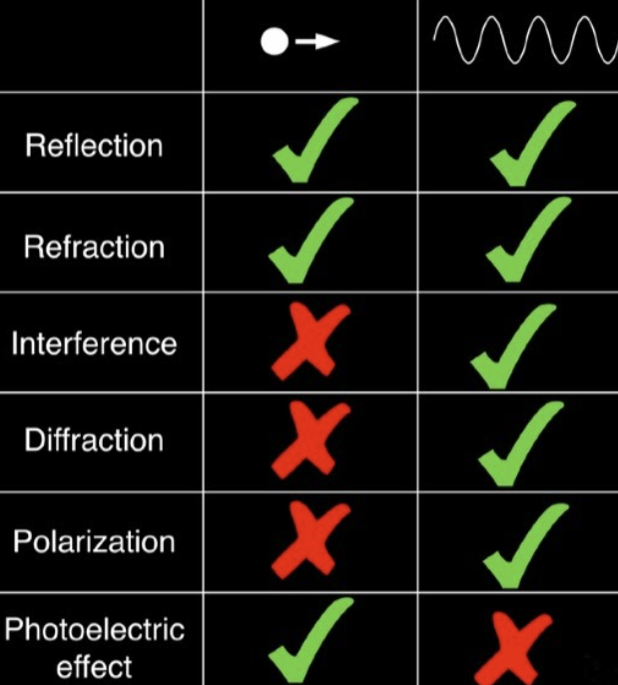
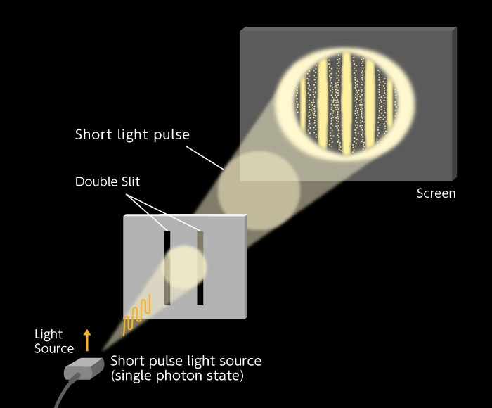
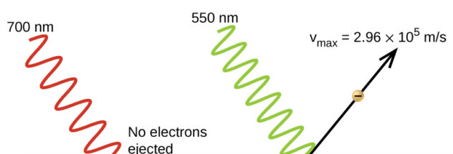
So light is a wave, Einstein?
So light is particles?
-
Rays?
stationary phase approximation

Slide 14


Human optical system

Slide 15


“View from the Window at Le Gras”; 1826
Pinhole Camera Model
Trade-off
Time ←→ Intensity ←→ Resolution

Slide 16

“You press the button, we do the rest”; Kodak 1888

Slide 17












$$\frac{x⋅{sin⁡(θ}_{1})}{x⋅{sin⁡(θ}_{2})}=\frac{v_{1} }{v_{2}}=\frac{n_{2}}{n_{1}}$$
Refraction
${n_{1}sin⁡(θ}_{1})=$ ${n_{2}sin⁡(θ}_{2})$
$$x⋅{sin⁡(θ}_{1})$$
$$x$$
$$θ_{1}$$
$$θ_{2}$$
Velocity 1
$$x⋅{sin⁡(θ}_{2})$$
Velocity 2
For small angles:
${n_{1}θ}_{1}=$ ${n_{2}θ}_{2}$
Willebrord Snellius

Slide 18
Demo:

Slide 19





















Thin lens
$${θ_{2}=\left(θ_{1}−\frac{y}{R_{1}}\right)}/n+\frac{y}{R_{1}}$$
$$R_{2}$$
$$R_{1}$$
$${θ_{3}=\left(θ_{2}+\frac{y}{R_{2}}\right)}/n+\frac{y}{R_{2}}$$
${ =θ}_{1}+y\left(1−n\right)\left(\frac{1}{R_{1}}+\frac{1}{R_{2}}\right)$
$${\text{θ}}_{\text{1}}\text{−}{\text{y}}/{R_{1}}$$
$$y/R_{1}$$
$$θ_{1}$$
$$y$$
$$R_{1}$$
$$≈0$$
$$1/f$$
$$x_{1}=f$$
$${\text{y}}/{R_{1}}$$
$$O_{2}$$
$$y_{1}+ \\ y$$
$$O_{1}$$
$$\frac{{y+y}_{1}}{x_{1}}=θ_{3}=θ_{1}+y/f$$
$${≈x}_{1}$$
$$f$$
$$y_{1}+y=fθ_{1}+y$$
$$y_{1}=fθ_{1}$$

Slide 20
Demo:

Slide 21





















Convolution (starting with discrete 🤯)
$$a$$
$$b$$
What if we want the same function to be applied at all times/places?
$$c$$
$$Y_{t}={T(x)}_{t}$$
$$x_{0}^{}$$
$${T(x_{t−τ})}_{t}={T(x_{t})}_{t−τ}$$
$$x_{1}^{}$$
$$y_{0}^{}$$
$$x_{2}^{}$$
$$y_{1}^{}$$
Convolution:
$$\{f∗g\}[t]=\sum_{τ=−∞}^{∞}{f[τ]g[t−τ]}$$
$$x_{3}^{}$$
$$y_{2}^{}$$
$$x_{4}^{}$$
$$y_{3}^{}$$
$$x_{5}^{}$$
$$y_{4}^{}$$
$$g=[c, b, a]$$
$$x_{6}^{}$$
$$y_{5}^{}$$
$$x_{7}^{}$$

Slide 22




















Convolution Filter
$$g=[c, b, a]$$
$$a$$
$$b$$
$$x_{0}^{}$$
$$c$$
Standard
inner
product
$$y_{0}= \begin{matrix}\left[\begin{matrix}x_{0} & x_{1} & x_{2}\end{matrix}\right] \\ \\ \end{matrix}\left[\begin{matrix}c \\ b \\ a\end{matrix}\right]=\left\langle x_{0:3} , g\right\rangle$$
$$x_{1}^{}$$
$$y_{0}^{}$$
$$x_{2}^{}$$
$$y_{1}^{}$$
$$x_{3}^{}$$
$$y_{2}^{}$$
$$x_{4}^{}$$
$$y_{3}^{}$$
Linear Time Invariant
$$x_{5}^{}$$
$$y_{4}^{}$$
LTI is always a convolution!
Proof: HW
$$x_{6}^{}$$
$$y_{5}^{}$$
$$x_{7}^{}$$

Slide 23




















Is it even linear?
$$a$$
$$b$$
$$c$$
$$x_{0}^{}$$
$$Y_{t}=\{f∗g\}[t]$$
$$g=[c, b, a]$$
$$x_{1}^{}$$
$$y_{0}^{}$$
$$\left[\begin{matrix}a & b & c & 0 & 0 & 0 & 0 & 0 \\ 0 & a & b & c & 0 & 0 & 0 & 0 \\ 0 & 0 & a & b & c & 0 & 0 & 0 \\ 0 & 0 & 0 & a & b & c & 0 & 0 \\ 0 & 0 & 0 & 0 & a & b & c & 0 \\ 0 & 0 & 0 & 0 & 0 & a & b & c\end{matrix}\right]$$
$$x_{2}^{}$$
$$y_{1}^{}$$
$$x_{3}^{}$$
$$y_{2}^{}$$
$$x_{4}^{}$$
$$y_{3}^{}$$
$$x_{5}^{}$$
$$y_{4}^{}$$
$$x_{6}^{}$$
$$y_{5}^{}$$
Toeplitz matrix
$$x_{7}^{}$$
Common: cyclic conv. Not covering it at this point

Slide 24
Demo:

Slide 25


Continuous Convolution
$$\{f∗g\}(t)=\int_{−∞}^{∞}{f(t)g(t−τ)dτ}$$

Slide 26









Impulse Response
Q: $\{f∗δ\}=?$
Dirac Delta
$$δ\left(x\right)=\left\{\begin{matrix}∞ ; 0 \\ 0 ; else\end{matrix}\right.$$
A: $f$
Proof: HW
Called Impulse Response
$$\int_{−∞}^{∞}{δ\left(x\right)dx}=1 \text{🤯}$$
$$δ\left(x\right)=\lim_{ε→0}{\frac{1}{ε}⊓\left(\frac{x}{ε}\right)}$$
Is it a function?
Distribution / Generalized function
Don’t hate me, I’m not that Schwartz!
Laurent-Moïse Schwartz

Slide 27

Properties
Proof: HW

Slide 28


2D

Slide 29




Q: What is $x∗x∗x∗x∗x∗x…$
$$∗x$$
$$∗x$$
$$∗x$$
$$∗x$$
Proof : HW (Think CLT)

Slide 30

Q: Given that all patches have the same norm (not realistic), where will convolution get the highest value?
A: Now it’s that Schwartz! (and Cauchy): ${\left|\left\langle f,g\right\rangle \right|}^{2}≤\left\|f\right\|∙\left\|g\right\|$, max: $f=g$
Idea taken from https://compneuro.neuromatch.io/tutorials/W1D5_DeepLearning/student/W1D5_Tutorial2.html

Slide 31
Common Convolution Filters
Smoothing
Basic Derivative
Smoothed Derivative
Box Blur (3×3)
∂/∂x (horizontal)
Sobel X
1
1
1
-1
1
-1
0
1
1
1
1
× ¹⁄₉
-2
0
2
1
1
1
-1
0
1
∂/∂y (vertical)
Gaussian Blur (3×3)
Sobel Y
-1
1
2
1
-1
-2
-1
2
4
2
× ¹⁄₁₆
1
0
0
0
1
2
1
1
2
1
Reduces noise
Averages neighbors
Simplest finite difference
Sensitive to noise
More robust gradient
Smoothing + derivative in one kernel
Basic derivative is noisy → Sobel adds Gaussian smoothing for a more stable gradient
red = negative gray = zero green = weighted

Slide 32
More Filters
Laplacian
Sharpening
Gaussian 5×5
∂²/∂x² + ∂²/∂y²
identity − Laplacian
larger kernel = more blur
0
1
0
0
-1
0
1
4
6
4
1
1
-4
1
-1
5
-1
4
16
24
16
4
6
24
36
24
6
0
1
0
0
-1
0
4
16
24
16
4
1
4
6
4
1
center = 1 + 4 = 5
× ¹⁄₂₅₆
2nd derivative → edges at zero-crossings
Isotropic: same in all directions
Boosts edges in the original image
"Unsharp mask" idea
Kernel size controls blur scale
Foundation of scale-space theory
Sharpening = original + edges → I − α∇²I (Laplacian sharpening)

Slide 33
Demo:

Slide 34


Point Spread Function
Func that describes the pattern of zero sized point of light on the optical system.
Q: But didn’t we see that a point maps to a point?
A: Small angle approximation!
Q: What does it do to the entire picture?
A: What the hell were we discussing during the last 30 mins?!?!
This is exactly the impulse response, so, convolution with the
image
Q: Implications?
A: These are called “Geometric Aberrations” and they induce a blur effect.
Q: Is this the only reason for the blur?
A: No. Also diffraction. Light is a wave, remember?

Slide 35
Demo:

Slide 36

Pope Benedict announcement
Pope Francis announcement
Slide credit:
Peyman Milanfar

Slide 37

Digital Image Pipeline
* Credit: Some figures in this topic taken from Peyman Milanfar and from Michael S Brown.

Slide 38




The Bayer mosaic
How does light become voltage?
What about color?
-
Raw image
1976

Slide 39


Your eyes do it too!
Non-unique

Slide 40
Digital Image Pipeline

Slide 41


Demosaicing
Moiré pattern
Methods:
Bilinear
Edge-aware
Freq. domain
Deep learning

Slide 42
Digital Image Pipeline

Slide 43


Denoising
Where does noise come from?
Naïve solution- Gaussian blur

Slide 44




Bilateral filter
Why did we have this Gaussian trade-off?
A little less naïve
*
=
Blurry edge
Edge
Idea: weigh not only special dist, also value dist (color)!
.

Slide 45


Non-local means
Somewhat less naïve

Slide 46
Digital Image Pipeline

Slide 47




White balance
Same scene different lighting

Slide 48





White balance
Presets
Automatic
Basic: Gray world / White patch
Many fancy algos. Each cam has its own

Slide 49




Photo-finishing pipeline:
Photo-Finishing
Gamma / Tone curve
Contrast enhancement
Tutorial
Sharpening
JPEG compression → sRGB

Slide 50
Digital Image Pipeline
Modern systems have >50 stages with many “secret sauces”

Slide 51

Burst photography
All pipeline elements improve!
Denoising
Digital Zoom
Demosaicing

Slide 52


Burst photography. E.g., Demosaicing
How do we get the motion?
Hand tremor motion
Tripod? Google pixel uses lens stabilizer mechanism to induce shifts.
Our eyes shift too!

Slide 53
That’s a wrap!
Physics of light
Optics of image formation
Digital image pipeline
Algorithms of computer vision
Today
Rest of the course

Slide 54

Thank you!
A photon checks in to a hotel…
Conclusion from today:
Images are imagined!
Next week:
ML basics from representation learning view

