Slide 1
Software Modelling
VuFind
Design & Architecture

Slide 2
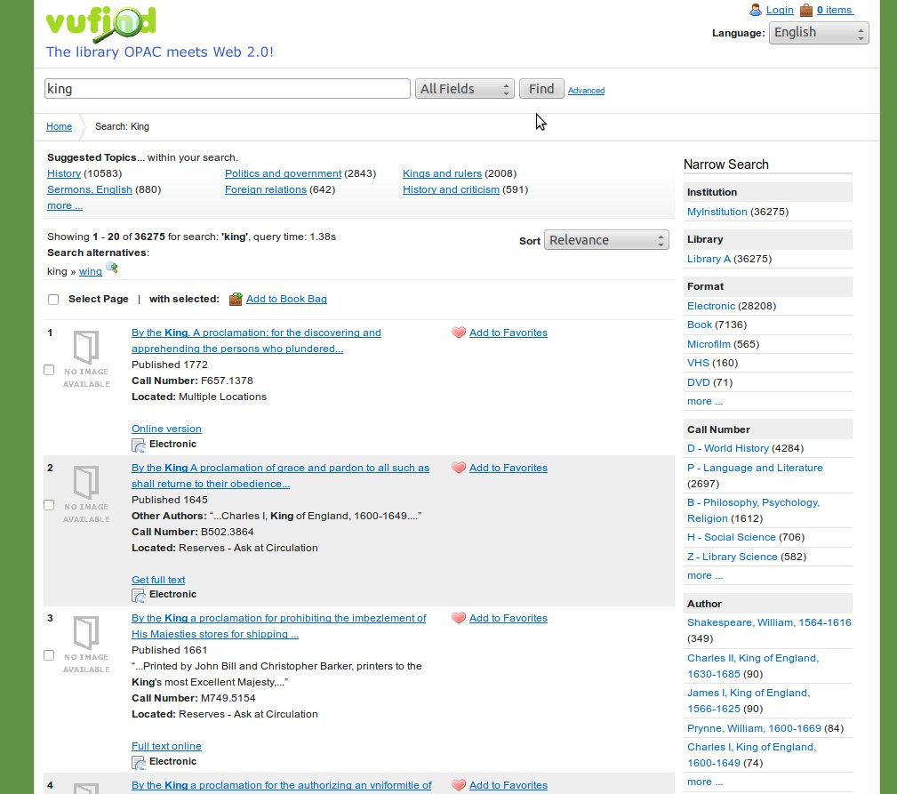
VuFind Introduction – GUI
Original VuFind UI:

Slide 3
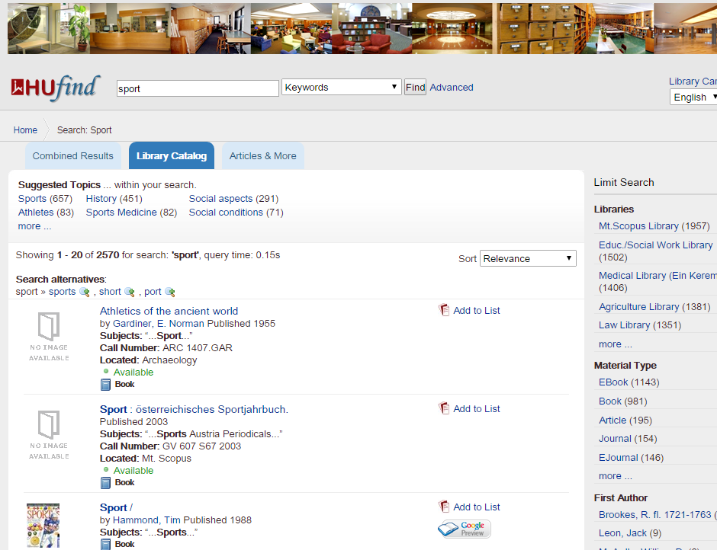
HU Customized VuFind

Slide 4
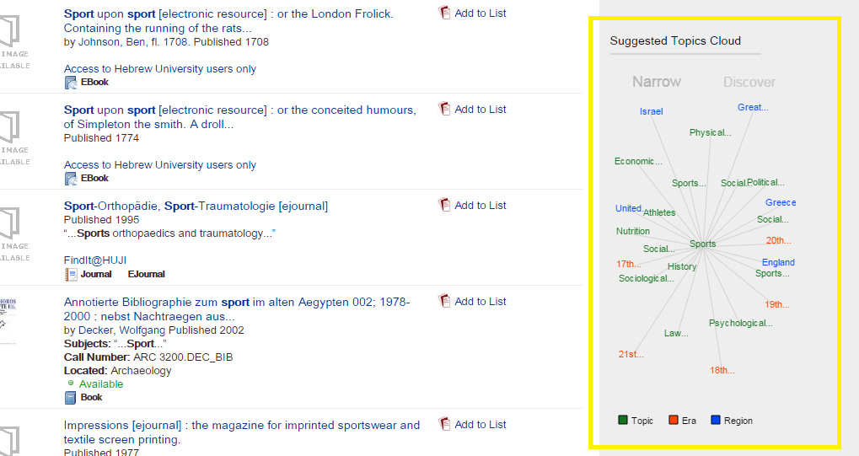
BTW
JCE (Azrielli) – is ‘On The map!’:

Slide 5
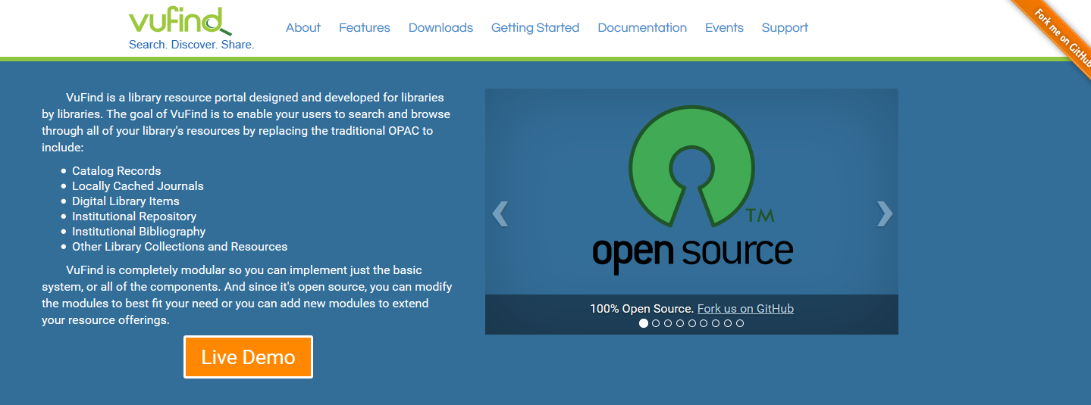
VuFind – Cont.
And in formal words:

Slide 6
VuFind Introduction
Quote:
VuFind is a resource portal designed and developed for libraries.
The goal of VuFind is to enable your users to search and browse through all of your library's resources.

Slide 7
VuFind Introduction - II
This, to include:
Catalog Records
Locally Cached Journals
Digital Library Items
Institutional Repository
Institutional Bibliography
Other Library Collections and Resources

Slide 8
VuFind Introduction - III
Now, let us please notice what they say, on their code:
1. Since it's open source, you can modify the modules to best fit your need or you can add new modules to extend your resource offerings.
2. VuFind is completely modular so you can implement just the basic system, or all of the components.

Slide 9
Outline
As the first step of this presentation, we shall go through the main stream design characteristics, as we well-learnt during this course.
Afterwards, we might have a turning point, and there might be a twist with the lecture’s topic.
Now, it seems that we are ready to begin, let’s get started with a high level architecture diagram:

Slide 10
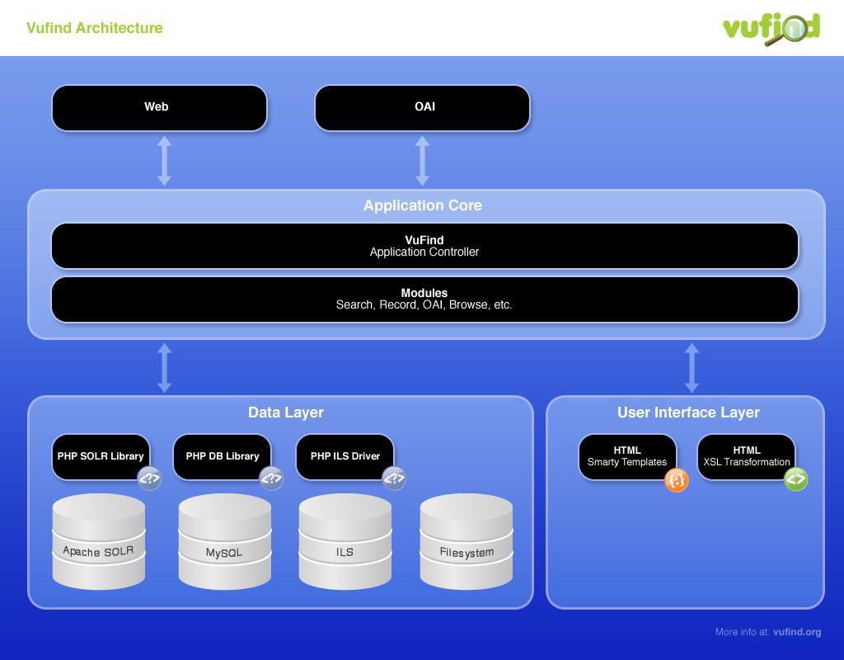
VuFind – General Architecture

Slide 11
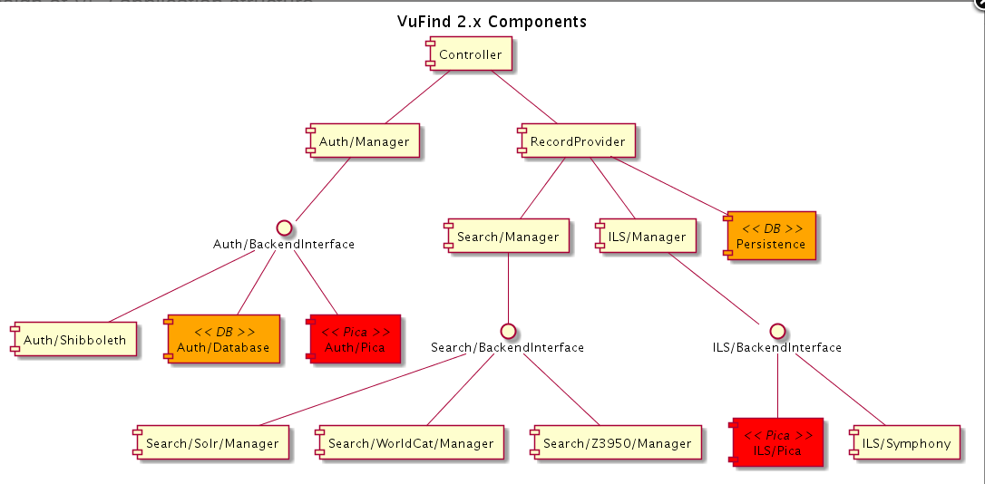
VuFind – Component Diagram

Slide 12
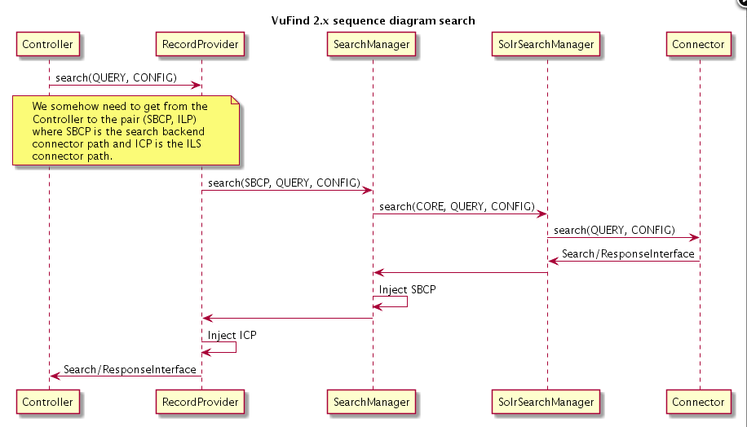
VuFind – Search – Basic Sequence Diagram

Slide 13
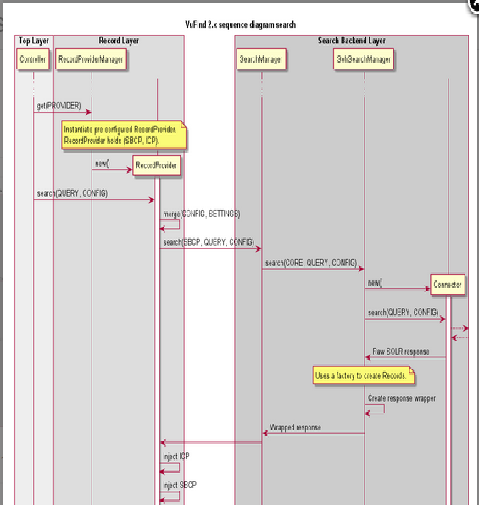
VuFind – Search - Sequence Diagram

Slide 14
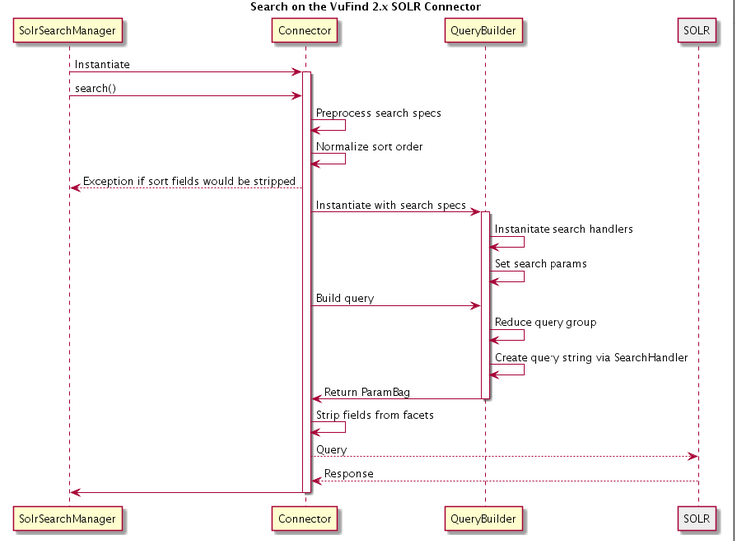
VuFind – SOLR Sequence Diagram

Slide 15
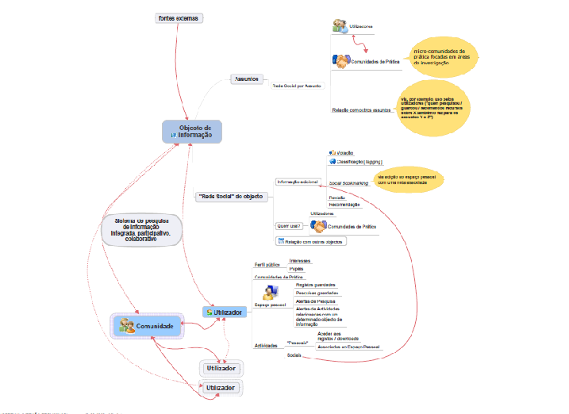
VuFind – Additional Diagrams

Slide 16
Vufind – Components List
VuFind list of components can be found at:
VuFind Components.
For a watcher from outside, but with some level of understanding the application requirements - it seems that it has a very hierarchical, ordered and well designed modularity.
VuFind tries, as much as possible, to use standard Zend Framework 2 conventions for model-view-controller (AKA MVC).
Notes:
Try to see live?

Slide 17
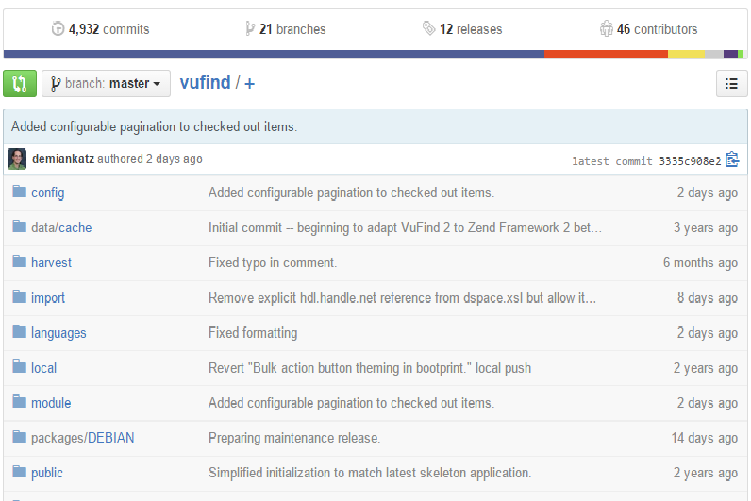
VuFind – Code Structure
Code on GitHub:
https://github.com/vufind-org/vufind

Slide 18
VuFind - Bugs Statistics
Count starts at 09/Oct/08 11:10 AM.
~7 Years.
Total Number of Bugs: 517.
Priority Distribution:
10 Blockers - None for Architecture.
12 Critical - None for Architecture.
217 Major - 1 for Architecture.
219 Minor - 3 for Architecture.
59 Trivial - None for Architecture.

Slide 19
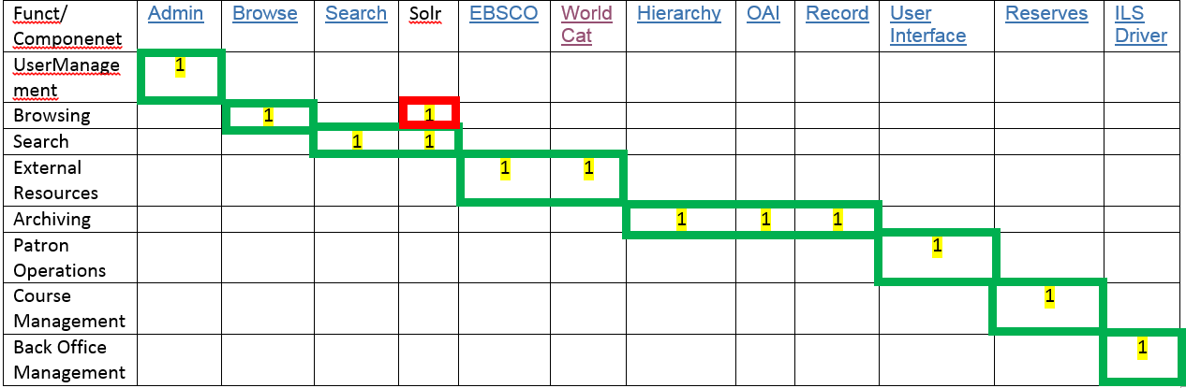
Basic Modularity Matrix calculation for VuFind
Notes:
Try to see live?

Slide 20
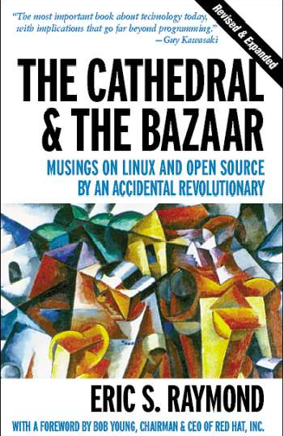
The Cathedral and the Bazaar
Notes:
Try to see live?

Slide 21
Design in Open-Source Applications
"Given enough eyeballs, all bugs are shallow“.
Freestyle Translation )Wikipedia):
"בעזרת מספיק עיניים, כל הבאגים שטחיים"
Do you agree?
OK, Great, but WHY?
Notes:
Try to see live?

Slide 22
Cathedral
"Cathedral" software is built by a group of developers based on a central plan. They code, find bugs, fix as much as they can and then after a year or so they eventually ship a product. Much like building a cathedral where everything is painstakingly crafted and installed before the doors open.
Think Microsoft Windows or Office -- monster projects with a new release every few years and point releases more than six months apart.
Notes:
Try to see live?

Slide 23
Bazaar
"Bazaar," or open-source software, is created more independently. Building upon a basic kernel, independent developers improve functionality or fix bugs as they see a need. It's basically crowdsourcing for software.
Well-known examples include Linux and Apache (But not Firefox or Eclipse).
Today, with the Internet and tremendous collaboration and social networking available, the Bazaar model exposes the code to thousands of developers, who can both find and fix the bugs.
Notes:
Try to see live?

Slide 24
Best Practice – Is there such thing?
Perhaps the best way to be successful is to start with an idea and create the first iteration as a Cathedral project.
That way developers can see the potential, and see how it can benefit them.
Then free the project and invite contributions in a manner that when you're using the software and see that bug, you can jump right in and fix it or add something else you need.
Notes:
Try to see live?

Slide 25
How can VuFind be Improved?
VuFind founder, Demian Katz:
1. ‘In the case of VuFind, I don’t think that a more detailed design phase would have yielded better results’.
2. ‘In some sense, the VuFind 1.x code served as a design document for the VuFind 2.x code: a working model and set of configurations that had to be re-implemented on a more robust architecture’.
3. ’in the early stages, leaving users free to experiment and branch in new directions was very helpful in figuring out the potential of the project’.
4. I don’t know whether any generalizations can be done from VuFind’s model that could be applied to other open source approaches
Notes:
Try to see live?

Slide 26
How to choose my open-source project level of design?
Which factors would you consider as relevant in order to decide which implementation method and design level will better suit your project?
1. Project scope (Bi-directional in fact…).
2. Project complexity (again…?).
3. Size of the development community.
4. Experience of the development community.
5. First time application VS. Well known one?
6. Just a question of time and resources?
7. More…?
Notes:
Try to see live?

Slide 27
Any suggestions for improving VuFind
It might not looks like, but in fact VuFind is a legacy system project.
Not only that, it deals with Big-Data, very Big-Data.
During my Engineering project, we have noticed handling Big-Data with relational data structures moves between ineffective to impossible.
Notes:
Try to see live?

Slide 28
VuFind Data Model
This issue has been raised by me, during current project to the VuFind community, and it turns that indeed this has been changed in the 2.x.
‘…it was discovered that it did not scale well – eventually, the write operations began to slow the whole system down, and the analysis was somewhat limited’
‘…Based on the way the architecture is designed, it would be relatively straightforward to write an additional driver for a different dedicated NoSQL system, and that might work better’
Notes:
Try to see live?

Slide 29
References & Bibliography - I
Official site documentation: https://vufind.org/wiki/.
2. Lots of information within the developers calls, with a very rich archive:
https://vufind.org/wiki/developers_call.
3. Issue & project tracking by Jira:
0https://vufind.org/jira/browse/VUFIND/?selectedTab=com.atlassian.jira.jira-projects-plugin:issues-panel.
4. Dr. Exman Iaakov, Linear-Software-Models,
http://www.researchgate.net/profile/Iaakov_Exman/publication/274309089_Linear_Software_Models_-_Extended_Abstract/links/551aa3d80cf26cbb81a31ecd.pdf.
http://www.worldscientific.com/doi/abs/10.1142/S0218194014500089.
Notes:
Try to see live?

Slide 30
References & Bibliography - II
5. The cathedral and the bazaar, by Eric S. Raymond.
6. The Architecture of Open Source Applications, (Volumes 1 & 2).
Edited by Ami Brown and Greg Wilson.
7. This course.
Notes:
Try to see live?

Slide 31

Questions…?
Notes:
Difference between human/computer communication protocols.

