Slide 1
Understanding LSTM Concept
Anuar Assamidanov

Slide 2
Overview
Review of Neural Networks
Recurrent Neural Network
The Problem of Long-Term Dependencies
The Core Idea Behind LSTMs
Step-by-Step LSTM Walk Through
Variants on Long Short Term Memory
Demo with TensorFlow

Slide 3
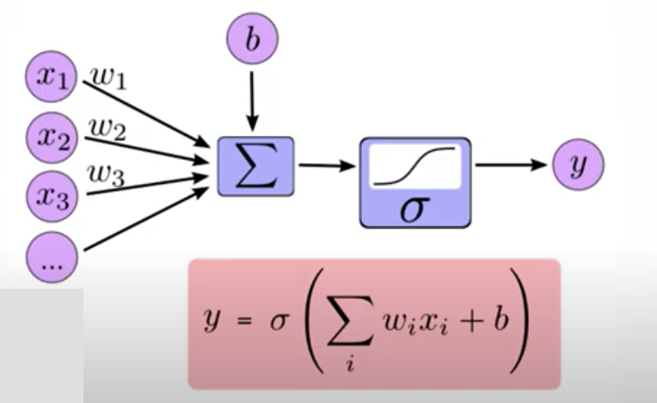

Review of Neural Networks

Slide 4
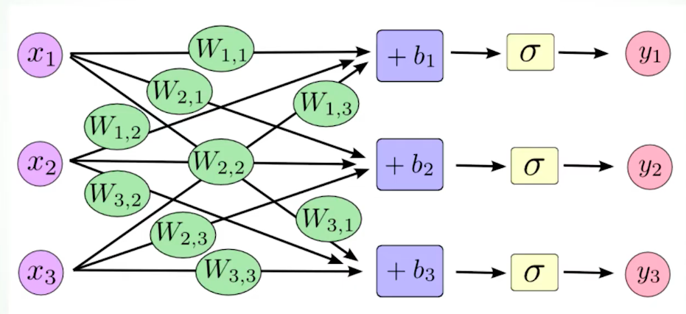
Layers

Slide 5
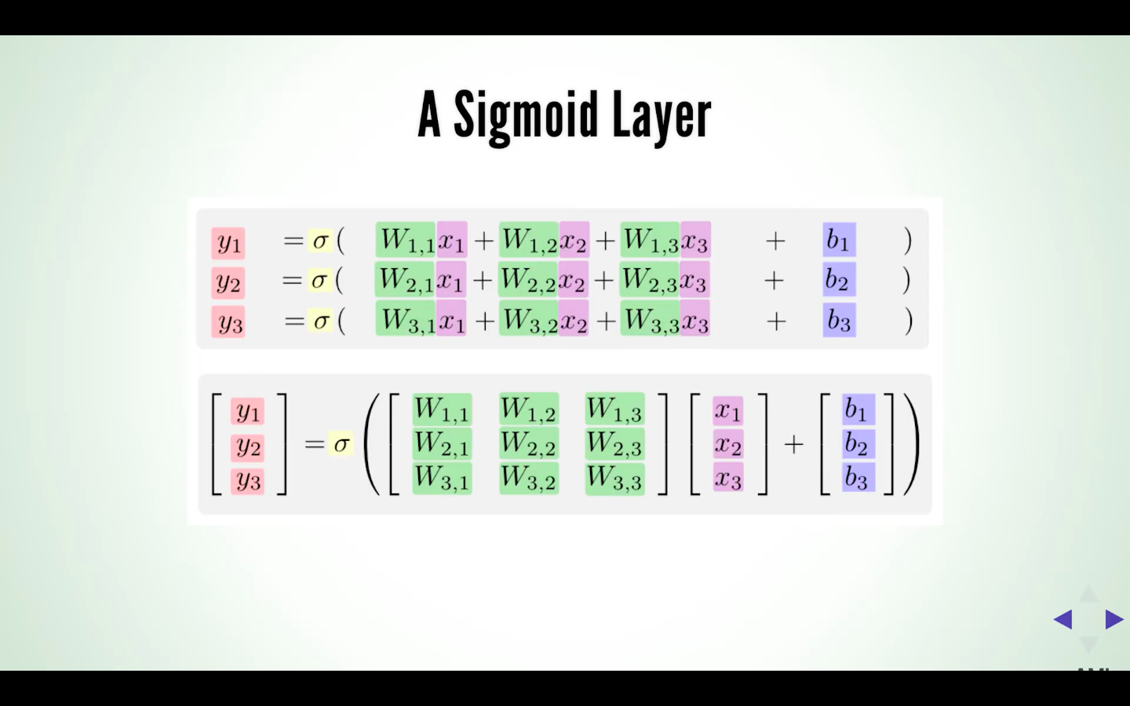
Neural Networks

Slide 6
Recurrent Neural Network(RNN)

Slide 7
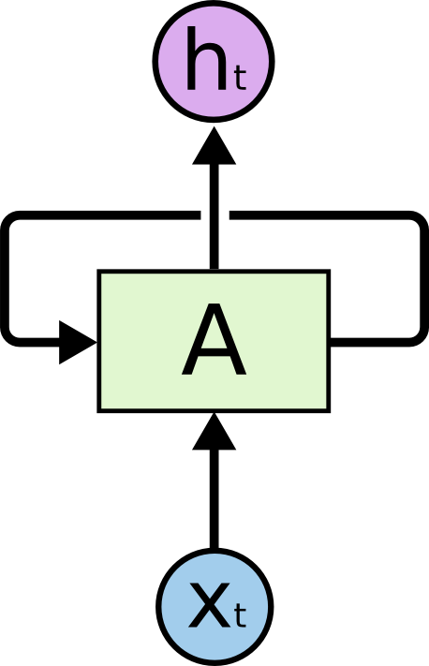
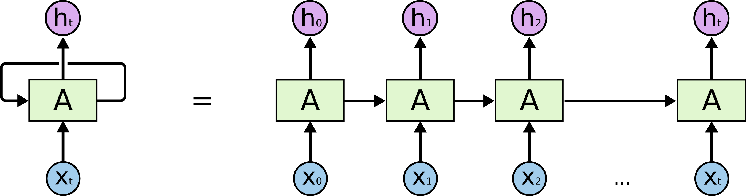
Recurrent Neural Networks (RNN)

Slide 8
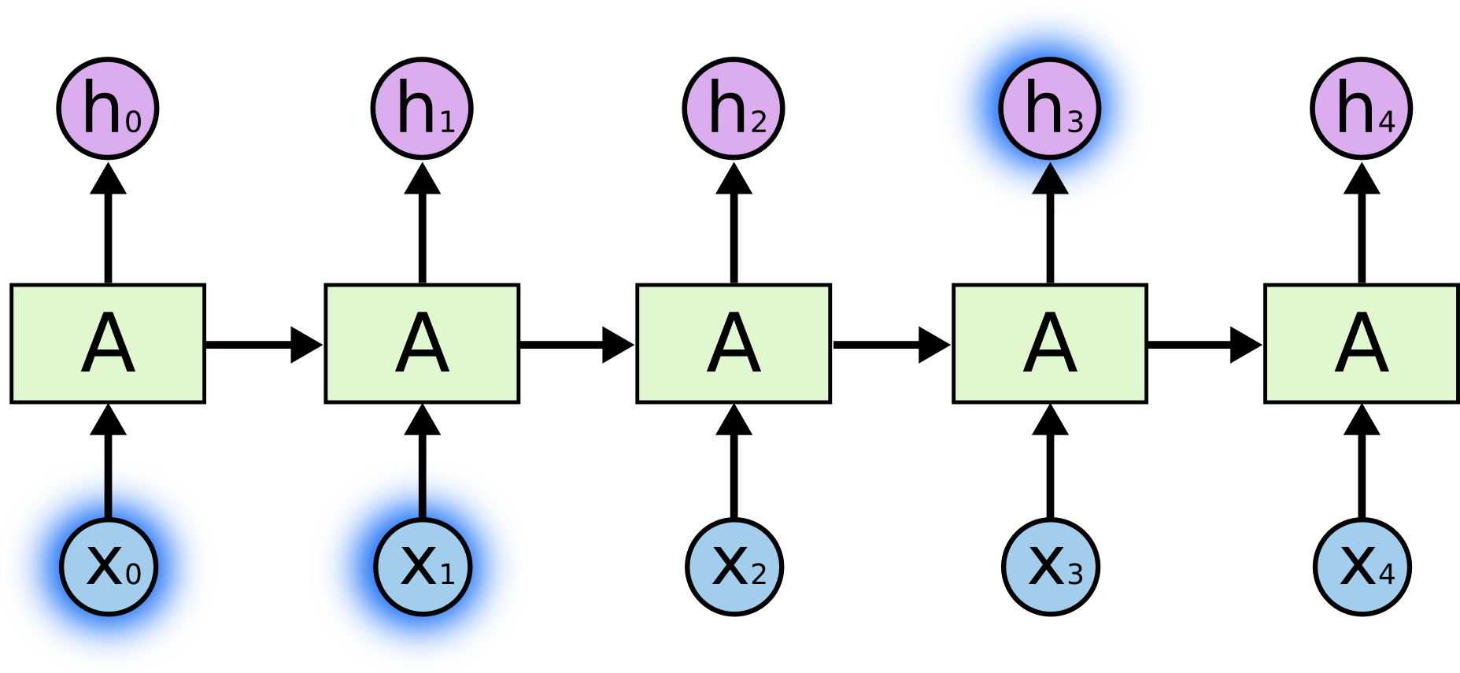
The Problem of Long-Term Dependencies
“We eat breakfast in the morning”

Slide 9
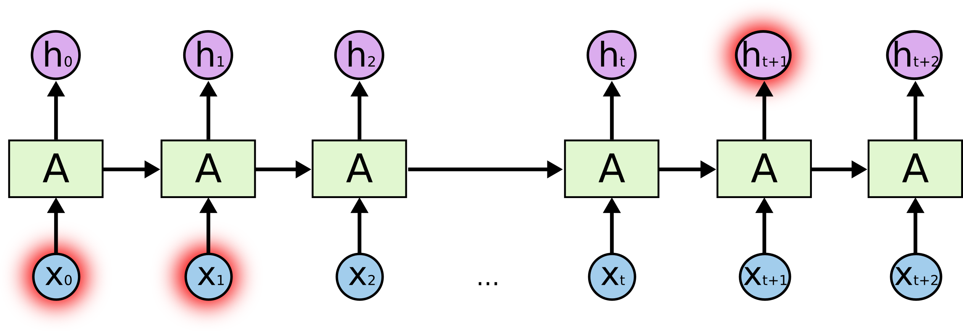
The Problem of Long-Term Dependencies
“I live in Europe…. I speak fluent Spanish”

Slide 10
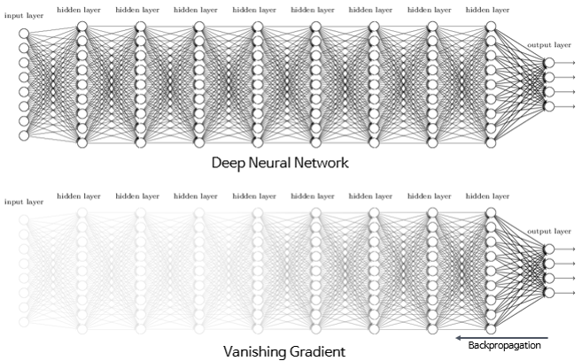
Vanishing Gradient Problem

Slide 11
Good news is LSTMs don’t have this problem

Slide 12
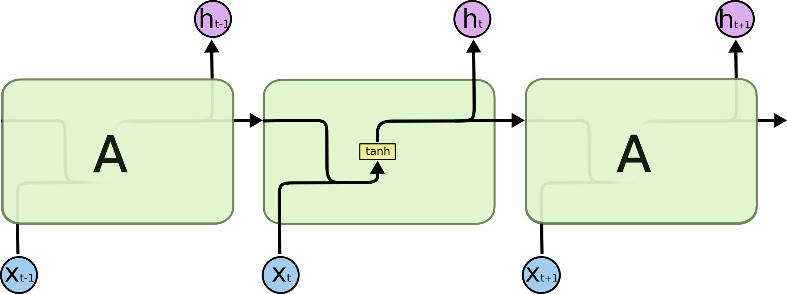
The repeating module in a standard RNN contains a single layer.

Slide 13

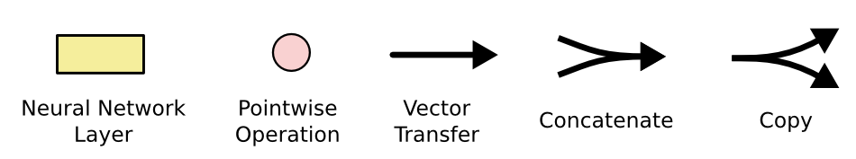
The repeating module in an LSTM contains four interacting layers.

Slide 14
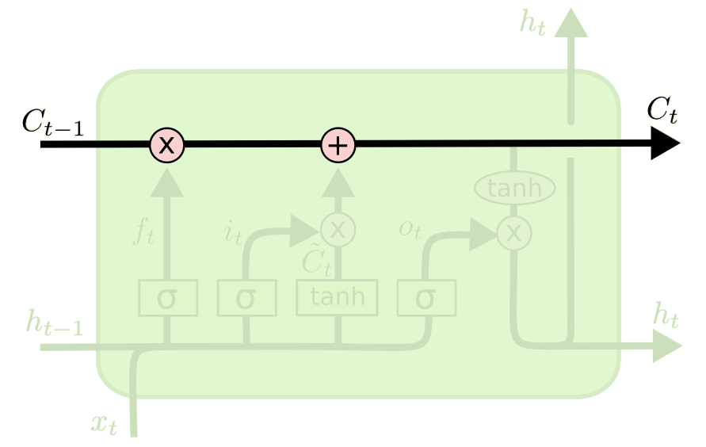
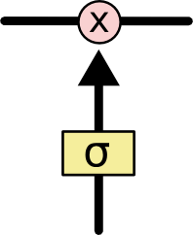
The Core Idea Behind LSTMs

Slide 15
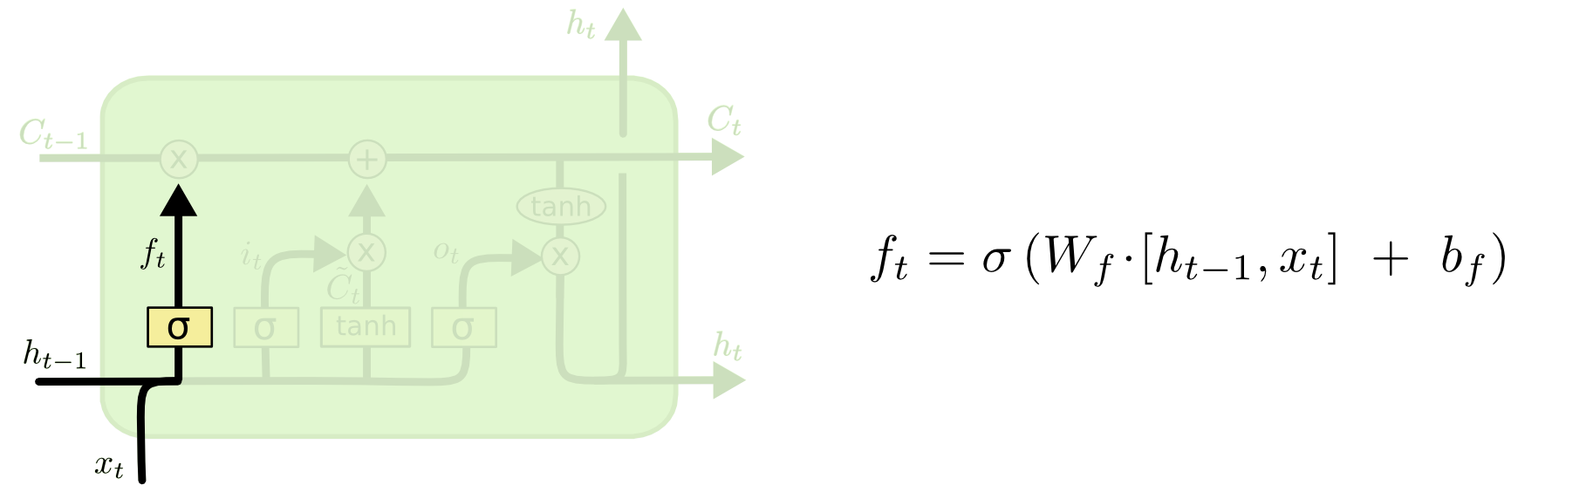
Forget Gate Layer

Slide 16
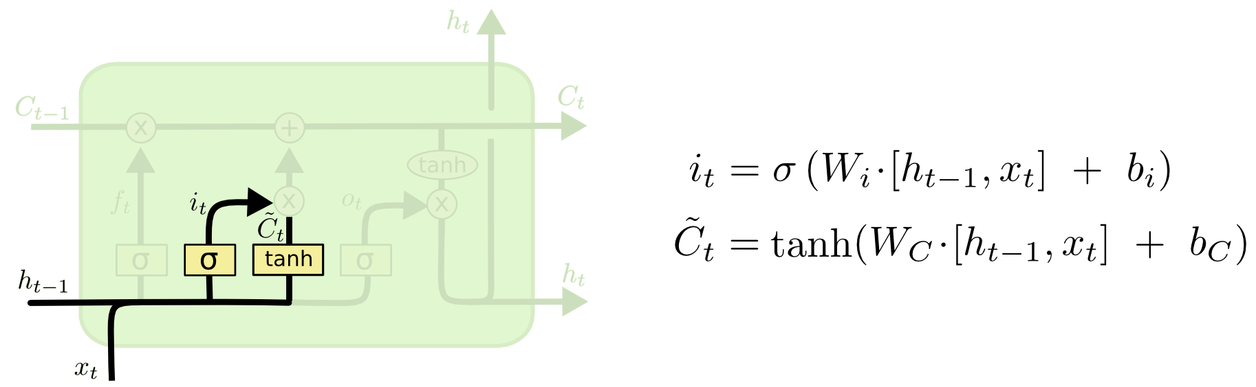
Input Gate Layer

Slide 17
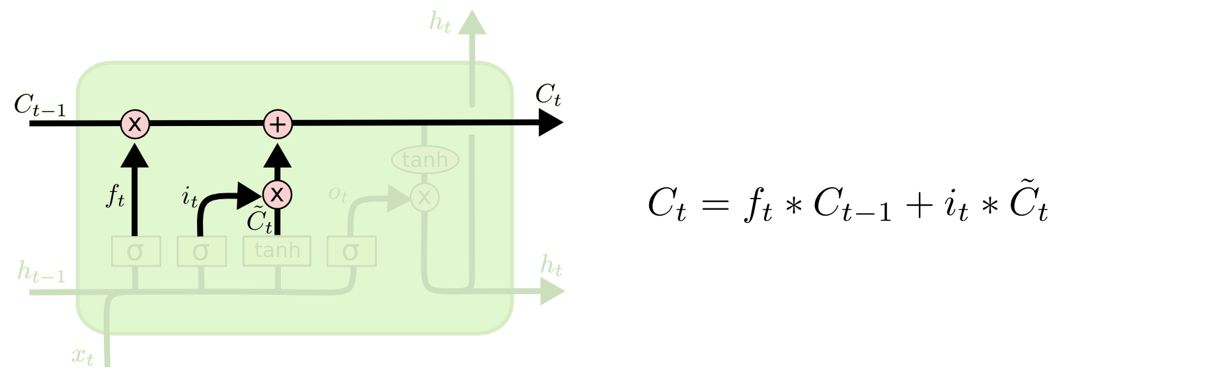
Update Cell State

Slide 18
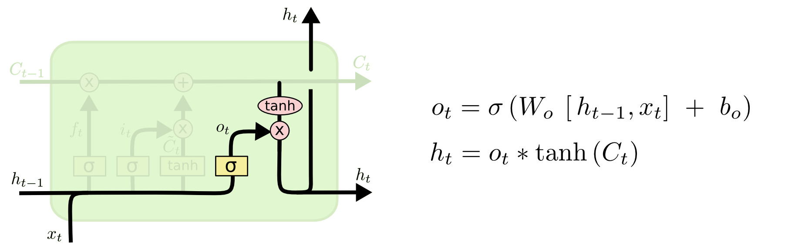
Output Gate Layer

Slide 19
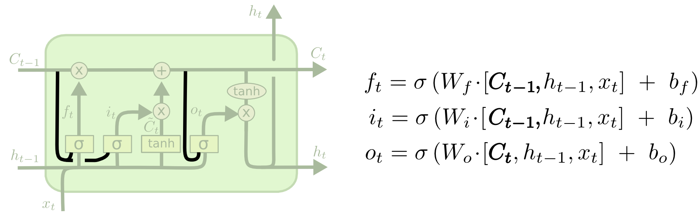
Variants on Long Short Term Memory

Slide 20
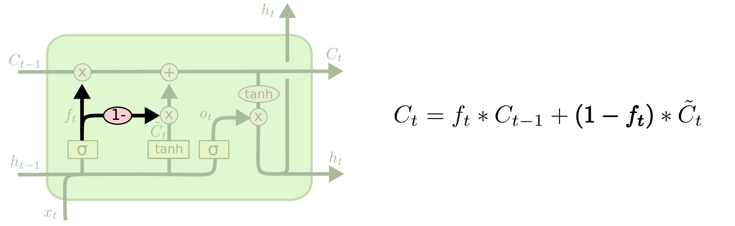
Variants on Long Short Term Memory

Slide 21
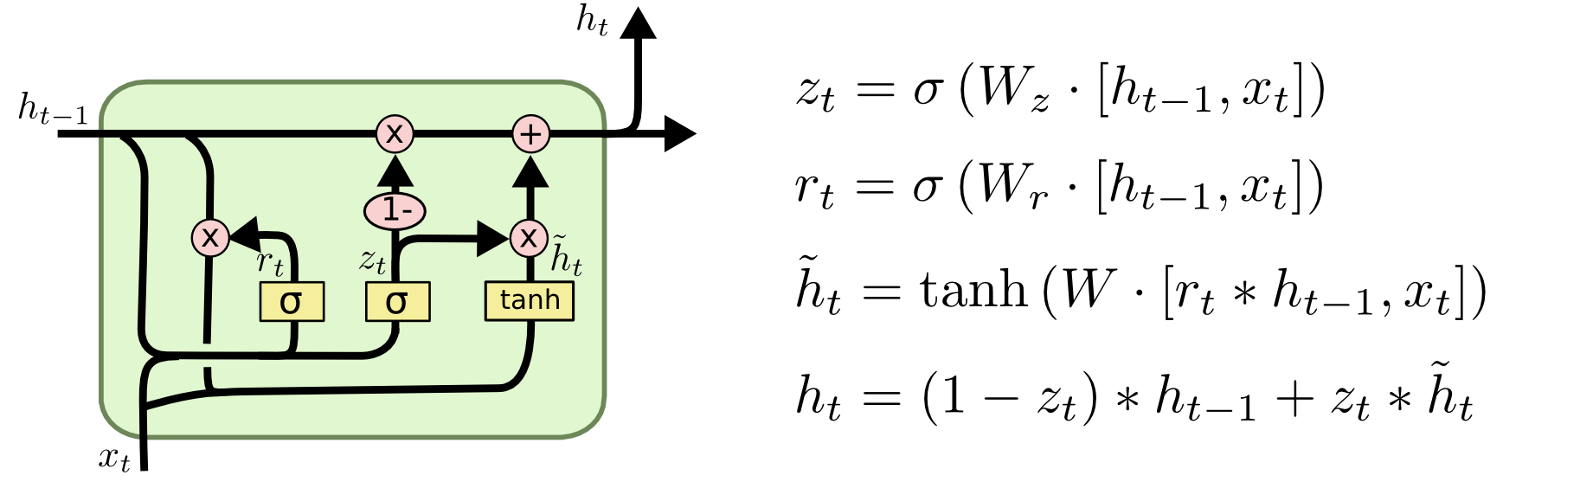
Variants on Long Short Term Memory

Slide 22
Demo of LSTM

