Slide 1
Sales Performance Analysis
& Management Dashboard
Turning transactional sales data into a validated, interactive management view.
BUSINESS PROBLEM
• Sales information needed to be organized across customers, products and transactions.
• Management needed a clear view of revenue, orders, customers, products, regions and salespeople.
• The objective was to support evidence-based decisions through SQL analysis and Power BI.
Sales Management Dashboard • Final Project Handover • 1/7

Slide 2
Data & Preparation
From source transactions to a validated relational model
DATA SOURCES
Customers
CustomerID, name, region, segment
Products
ProductID, product, category, reference price
Orders
OrderID, date, customer/product IDs, quantity, price, salesperson, payment
VALIDATION & CLEANING
• 1,000 order records and 1,000 unique OrderIDs; no duplicates.
• No null key fields, invalid quantities, or unmatched CustomerID/ProductID values.
• Revenue standardized as Quantity × UnitPrice and reconciled between SQL and Power BI.
• 375 price differences were retained as systematic transaction-level adjustments: 185 at −5% and 190 at +5%.
Sales Management Dashboard • Final Project Handover • 2/7

Slide 3
Key KPIs
Full dataset, Jan–Aug 2026; growth compares the latest full month (July) with June
TOTAL REVENUE
GH₵3,458,371.25
Revenue = Quantity × UnitPrice
TOTAL ORDERS
1,000
Transaction rows
AVERAGE ORDER VALUE
GH₵3,458.37
Revenue ÷ orders
TOTAL CUSTOMERS
120
Unique ordering customers
PREVIOUS MONTH REVENUE
GH₵349,313.00
June 2026, the month before July
MONTHLY REVENUE GROWTH
+48.86%
July vs June 2026
WHY THESE MATTER
• The KPI layer gives management a fast view of scale and recent movement.
• The DateTable supports contiguous time intelligence for previous-month and growth calculations.
Sales Management Dashboard • Final Project Handover • 3/7

Slide 4
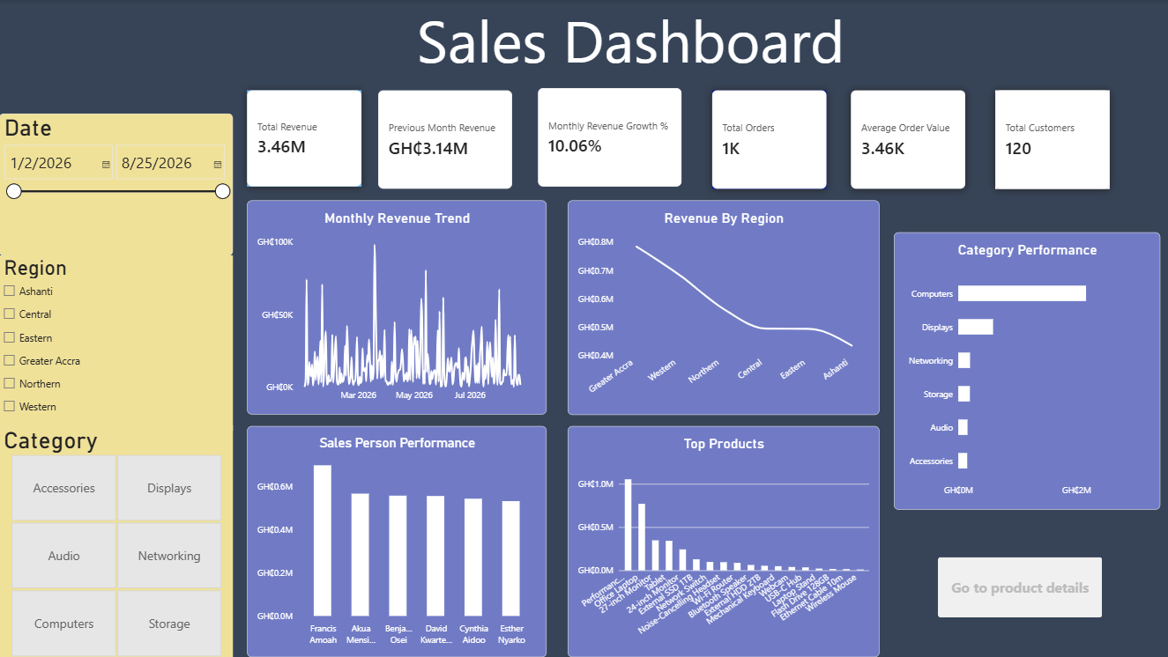
Dashboard
A management-level view with interactive exploration
INTERACTION
Date • Region • Category slicers | Product Details drill-through | Data Notes page
Sales Management Dashboard • Final Project Handover • 4/7

Slide 5
Key Insights
What the analysis says about performance
Revenue is volatile
May was strongest at GH₵602,685.75 (+65.03% vs April); June and August fell 42.04% and 39.22%.
Regional spread
Greater Accra and Western lead with 22.67% and 19.77% of revenue; no region contributes less than 12.58%.
High value ≠ high volume
Computers generated GH₵2.164M from 388 units, while Accessories sold 758 units but generated GH₵151,598.
Products are concentrated
Performance Laptop and Office Laptop lead at GH₵1.053M and GH₵769,860 respectively.
Order frequency ≠ customer value
Kojo Sarpong: GH₵62,199 from 12 orders; Priscilla Issah: GH₵22,943 from 15 orders.
Salesperson patterns differ
Francis Amoah led revenue/AOV; Benjamin Osei had the most orders but lower revenue.
Sales Management Dashboard • Final Project Handover • 5/7

Slide 6
Recommendations
Actions grounded in the observed sales patterns
1
Investigate monthly swings
Review the causes behind the June and August declines before using monthly results for forecasting.
2
Prioritize value, not just volume
Focus attention on high-value products and customers while reviewing weaker performers for pricing or positioning issues.
3
Use the dashboard routinely
Monitor KPIs, monthly growth, regions, categories and drill-through details to identify changes early.
DECISION PRINCIPLE
Use the dashboard to monitor evidence first, then investigate causes before acting.
Sales Management Dashboard • Final Project Handover • 6/7

Slide 7
Limitations & Next Steps
Important context for responsible interpretation
LIMITATIONS
NEXT STEPS
• Analysis covers January–August 2026; the dataset ends August 25, so August may be partial.
• Revenue is derived from quantity and transaction price; errors in source fields flow into revenue.
• Unit-price variation (approximately 95%, 100%, 105% of base price) is consistent but unexplained in the source.
• The analysis identifies patterns but does not establish causation without additional business context.
• No cost or profit data is available, so conclusions are about sales/revenue rather than profitability.
• Add cost/margin data to move from revenue performance to profitability analysis.
• Capture business context behind promotions, pricing changes and major monthly movements.
• Continue using the validated SQL + Power BI workflow as new transactions are added.
• Use the Product Details drill-through for deeper investigation of individual products.
End-to-end workflow: Clean → Validate → Analyze → Visualize → Decide
Sales Management Dashboard • Final Project Handover • 7/7

